Slide 1
Introduction
CS 765: Complex Networks
Slides are adapted from
Constantine Dovrolis, Eileen Kraemer, Peter Dodds, and Sergei Maslov
and
Network Science by Albert-László Barabási

Slide 2
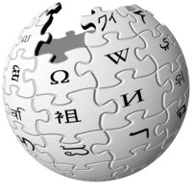
Basic definitions
Network (Noun):
Any interconnected group or system
Multiple computers and other devices connected together to share information
Network (Verb):
To interact socially for the purpose of getting connections or personal advancement
To connect two or more computers or other computerized devices

Slide 3
Basic definitions
Nodes (Vertices) = A collection of entities which have properties that are somehow related to each other
e.g., people, cities, organisms, computers, webpages, ...
Links (Edges) = Connections between nodes
may be real and fixed (roads),
real and dynamic (airline routes),
abstract with physical impact (hyperlinks),
purely abstract (semantic connections between concepts).
Links may be directed or undirected.
Links may be binary or weighted.

Slide 4
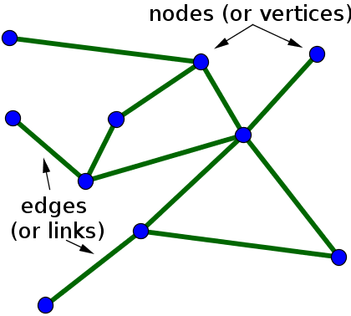
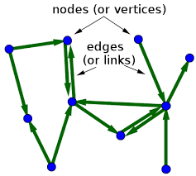
Basic definitions
Undirected Network
Directed Network
Weighted Directed Network
2
5
3
1
1
2
1
3
7
3
4
10
3

Slide 5
Basic definitions
Complex Systems
Made up of multiple parts; intricate or detailed
Not simple or straightforward
Relationships are nonlinear
Relationships contain feedback loops
Modular (nested)/multiscale structure
May result in emergent phenomena
Many complex systems can be regarded as complex networks of physical or abstract interactions
Opens door to mathematical and numerical analysis

Slide 6
Complex Network
Complex networks are large (in node number)
Complex networks are sparse (low edge to node ratio)
Complex networks are usually dynamic and evolving
Complex networks can be social, economic, natural, informational, abstract, ...
Isn’t this graph theory? (Yes, but)
Graph theory is concerned with proving theorems and developing algorithms for arbitrary graphs
Complex network study network representations of real-world systems to understand the universal properties of networks.
Notes:
edge/node is low
https://neo4j.com/news/graph-theory-and-network-science/
Graph theory is a branch of discrete mathematics concerned with proving theorems and developing algorithms for arbitrary graphs (e.g. random graphs, lattices, hierarchies). For example, can a graph with four vertices, seven edges, and structured according to the landmasses and bridges of Königsberg have its edges traversed once and only once? From such problems, the field of graph theory has developed numerous algorithms that can be applied to any graphical structure irrespective of the domain it represents (i.e. irrespective of what the graph models in the real-world).
In the domain of network science, researchers don’t study networks in the abstract, but instead, they study numerous real-world representations in order to understand the universal properties of networks. Examples of such networks include social networks, transportation networks, gene regulatory networks,knowledge networks, scholarly networks, etc.

Slide 7
Networks As Graphs
Networks can be undirected or directed, depending on whether the interaction between two neighboring nodes proceeds in both directions or in only one of them, respectively.
⇔
1
2
3
4
5
6
The specificity of network nodes and links can be quantitatively characterized by weights.
2.5
7.3
3.3
12.7
Vertex-Weighted
Edge-Weighted
5.4
8.1
2.5

Slide 8
Networks As Graphs
A network can be connected (presented by a single component) or disconnected (presented by several disjoint components).
connected
disconnected
Networks having no cycles are termed trees. The more cycles the network has, the more complex it is.
trees
cyclic graphs

Slide 9
Networks As Graphs
Some Basic Types of Graphs
Paths
Stars
Cycles
Complete Graphs
Bipartite Graphs

Slide 10
Historical perspective on Complex Networks
Systems approach: thinking about Networks
The focus moves from the elements (network nodes) to their interactions (network links)
To a certain degree, the structural details of each element become less important than the network of interactions
Some system properties, such as Robustness, Fragility, Modularity, Hierarchy, Evolvability, Redundancy (and others) can be better understood through the Networks approach
Some milestones:
1998: Small-World Networks (D.Watts and S.Strogatz)
1999: Scale-Free Networks (R.Albert & A.L.Barabasi)
2002: Network Motifs (U.Alon)

Slide 11
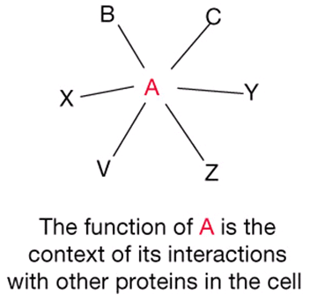
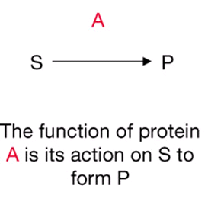
Historical perspective on Complex Networks
traditional view
post-genomic view
from Eisenberg et al. Nature 2000 405: 823-6

Slide 12
Historical perspective on Complex Networks
Complex Networks science is a framework to shed light on the link between the microscopic interaction of the many elements of the system and the emergence of macroscopic collective phenomena, patterns and dynamics.
How entities interact together and/or relate with each other at the smallest scale to organize themselves into non-trivial structures at larger scales.
These structures might lack central authorities/leaders and are responsible for the spontaneous appearance of functionalities and other phenomena that could not be either predicted or deduced from the full knowledge of its constituents alone.

Slide 13
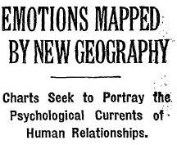
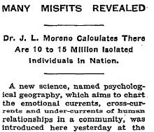
Historical perspective on Complex Networks
Early social network analysis
1933 Moreno displays first sociogram at meeting of the Medical Society of the state of New York
article in NYT
interests: effect of networks on e.g. disease propagation
Source: The New York Times (April 3, 1933, page 17).

Slide 14
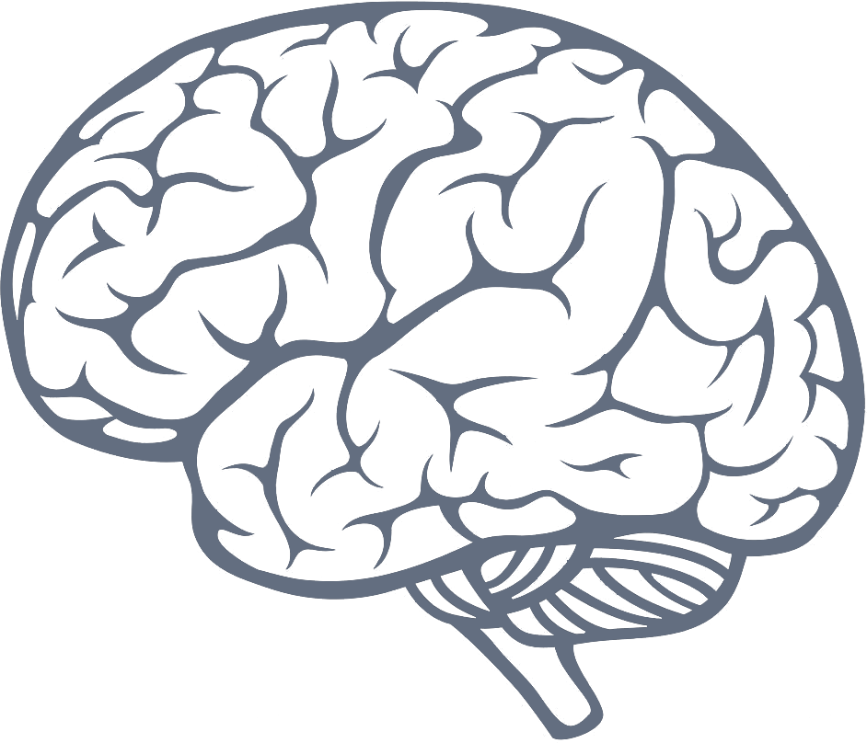
Examples of Complex Networks
Network | Nodes | Edges
Internet | routers | wires
Brain | neurons | synapses
WWW | pages | hyperlinks
Hollywood | actors | movies
Genes | proteins | binding sites
Ecology | species | competition

Slide 15
Examples of Complex Networks Node diversity and dynamics
Network | Node Diversity | Node State
Internet | Routers, PC, switches | Routing state, algorithm,
Brain | Sensory, inter, motor neuron | Electrical potential
WWW | Commercial, educational | Popularity, num of visits
Hollywood | Traits, talents | Celebrity level, contract
Genes | Protein type, DNA sites | Boundness, concentration
Ecology | Species traits (diet, reprod) | Fitness, density
Nodes can be of
different subtypes
Nodes can have
different states

Slide 16
Examples of Complex Networks Edge diversity and dynamics
Network | Node Diversity | Node State
Internet | Bandwidth (DSL, cable) | --
Brain | Excit., inhib synapsis | Weight learning
WWW | -- | --
Hollywood | Theater movie, TV series | partnership
Genes | Enhancing, blocking | Mutation, evolution
Ecology | Predation, cooperation | Evolution, selection
Edges can be of
different subtypes
Edges can have
different weights

Slide 17
Network Questions: Structural
How many connections does the average node have?
Are some nodes more connected than others?
Is the entire network connected?
On average, how many links are there between nodes?
Are there clusters or groupings within which the connections are particularly strong?
What is the best way to characterize a complex network?
How can we tell if two networks are “different”?
Are there useful ways of classifying or categorizing networks?

Slide 18
Network Questions: Communities
Are there clusters or groupings within which the connections are particularly strong?
What is the best way to discover communities, especially in large networks?
How can we tell if these communities are statistically significant?
What do these clusters tell us in specific applications?

Slide 19
Network Questions: Dynamics of
How can we model the growth of networks?
What are the important features of networks that our models should capture?
Are there “universal” models of network growth? What details matter and what details don’t?
What’s the deal with power laws, anyway?

Slide 20
Network Questions: Dynamics of
How do diseases/computer viruses/innovations/ rumors/revolutions propagate on networks?
What properties of networks are relevant to the answer of the above question?
If you wanted to prevent (or encourage) spread of something on a network, what should you do?
What types of networks are robust to random attack or failure?
What types of networks are robust to directed attack?

Slide 21
Network Questions: Algorithms
What types of networks are searchable or navigable?
What are good ways to visualize complex networks?
How does google page rank work?
If the Internet were to double in size, would it still work?

Slide 22
THE CHARACTERISTICS OF NETWORK SCIENCE
Interdisciplinary
Empirical
Quantitative and Mathematical
Computational
Network Science: Introduction
Notes:
Interdisciplinary nature: Network science offers a language through which different disciplines can seamlessly interact with each other. Indeed, cell biologists and computer scientists alike are faced with the task of characterizing the wiring diagram behind their system, extracting information from incomplete and noisy datasets, and the need to understand their systems’ robustness to failures or deliberate attacks.
To be sure, each discipline brings along a different set of technical details and challenges, which are important on their own. Yet, the common character of the many issues various fields struggle with have led to a cross-disciplinary fertilization of tools and ideas. For example, the concept of betweenness centrality that emerged in the social network literature in the 1970s, today plays a key role in identifying high traffic nodes on the Internet; algorithms developed by computer scientists for graph partitioning have found novel applications in cell biology.

Slide 23
THE CHARACTERISTICS OF NETWORK SCIENCE
Interdisciplinary
Empirical, data driven
Quantitative and Mathematical
Computational
Network Science: Introduction
Notes:
Empirical, data driven nature: The tools of network science have their roots in graph theory, a fertile field of mathematics. What distinguishes network science from graph theory is its empirical nature, i.e. its focus on data and utility. As we will see in the coming chapters, we will never be satisfied with developing the abstract mathematical tools to describe a certain network property. Each tool we develop will be tested on real data and its value will be judged by the insights it offers about a system’s structure or evolution.

Slide 24
THE CHARACTERISTICS OF NETWORK SCIENCE
Interdisciplinary
Empirical
Quantitative and Mathematical
Computational
Network Science: Introduction
Notes:
Quantitative and mathematical nature: To contribute to the development of network science, it is essential to master the mathematical tools behind it. The tools of network science borrowed the formalism to deal with graphs from graph theory and the conceptual framework to deal with randomness and seek universal organizing principles from statistical physics. Lately, the field is benefiting from concepts borrowed from engineering, control and information theory, statistics and data mining, helping us ex- tract information from incomplete and noisy datasets.

Slide 25
THE CHARACTERISTICS OF NETWORK SCIENCE
Interdisciplinary
Empirical
Quantitative and Mathematical
Computational
Network Science: Introduction
Notes:
Computational nature: Finally, given the size of many of the networks we explore, and the exceptional amount of data behind them, network science offers a series of formidable computational challenges. Hence, the field has a strong computational character, actively borrowing from algorithms, database management and data mining. A series of software tools help practitioners with diverse computational skills analyze networks.

Slide 26
Network Questions: Outlook
Advances in available data, computing speed, and algorithms have made it possible to apply network analysis to a vast and growing number of phenomena.
This means that there is lots of exciting, novel work being done
This work is a mixture of awesome, exploratory, misleading, irrelevant, relevant, fascinating, ground-breaking, important, and just plain wrong
It is relatively easy to fool oneself into seeing thing that aren’t there when analyzing networks.
This is the case with almost anything, not just networks

Slide 27
Empirical Study of Networks
CS 765: Complex Networks
Slides are adapted from
Constantine Dovrolis, Eileen Kraemer, Peter Dodds, and Sergei Maslov
and
Network Science by Albert-László Barabási
Notes:
Conferences
International Conference on Complex Networks and their Applications
International Conference on ​Complex Networks (Complnet)
The Network Science Society (NetSci)
Journal
Journal of Complex Networks
Applied Network Science Computational Social Networks

Slide 28
Conferences and Journals
Conferences
International Conference on Complex Networks & their Applications
International Conference on ​Complex Networks (CompleNet)
The Network Science Society (NetSci)
Journal
Journal of Complex Networks
Applied Network Science
Computational Social Networks
Notes:
I can share publications (books) of two conference over the years

Slide 29
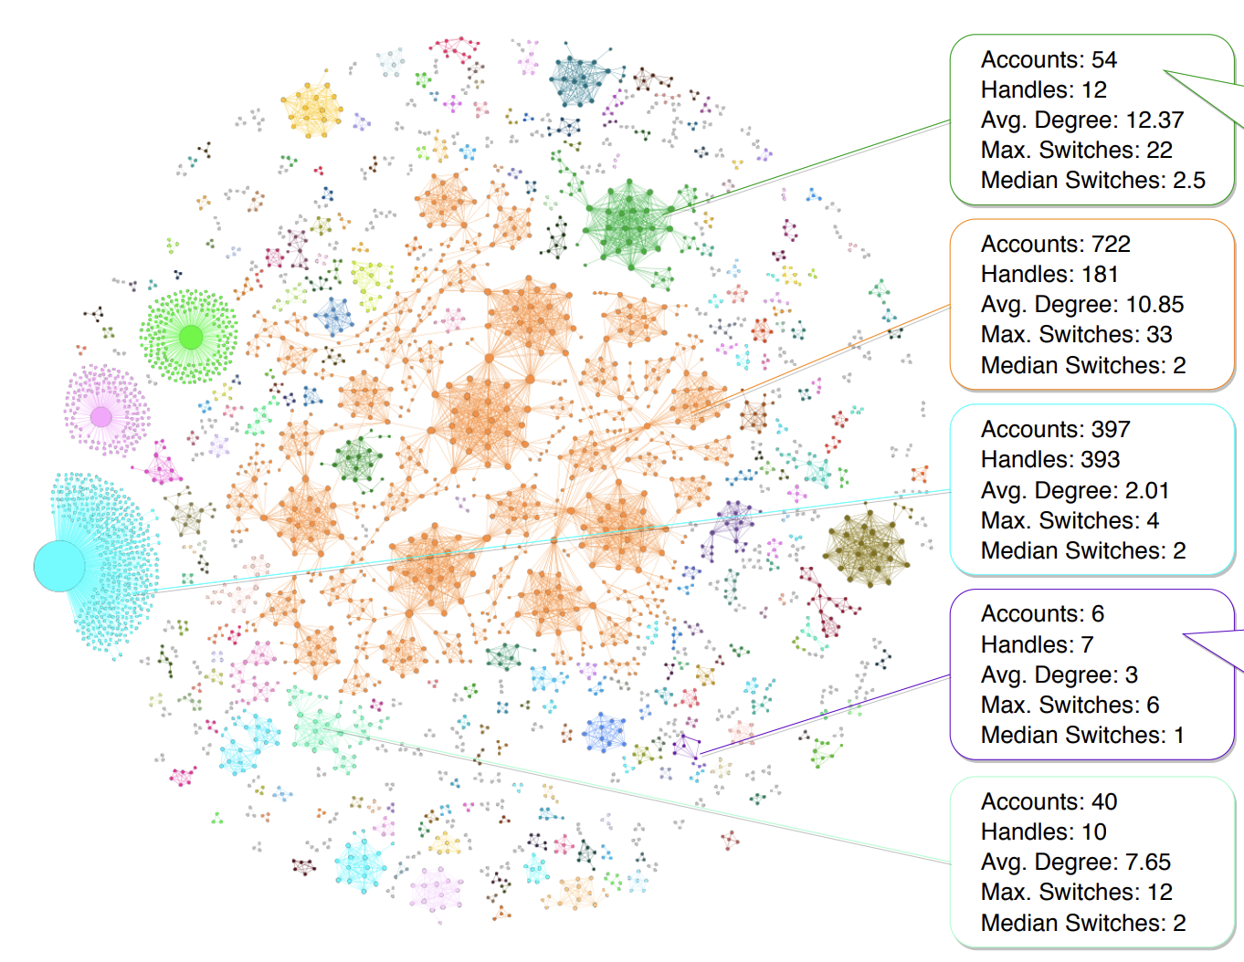
Social Networks
Links denote a social interaction
Facebook, Instagram, Snapchat
Handle: @GullyMN49
2015
Offensive tweets (Obama)
Evades suspension
23 accounts take
handle with 5-day interval
6 accounts share 7 handles
@ProTrumpMvmt
@AntiTrumpMvmt
Fundraising campaigns
Notes:
Twitter data
Node: Twitter account
Size: proportional to the number of accounts with which it shares handles
Edge weight is the number of unique handles shared by two accounts
https://www.researchgate.net/profile/Diogo-Pacheco-5/publication/338643671_Uncovering_Coordinated_Networks_on_Social_Media/links/5e31a056299bf1cdb9fc6f78/Uncovering-Coordinated-Networks-on-Social-Media.pdf
In June 2015, the handle @GullyMN49 was reported in the news due to an offensive tweet against President Obama.
More than one year later, the same handle was still posting similar content.
In March 2017, we observed 23 different accounts taking the handle in a 5-day interval. We conjecture that this may have been an attempt to keep the persona created back in 2015 alive and evade suspension by Twitter following reports of abuse to the platform. Currently, the @GullyMN49 handle is banned but 21 of the accounts are still active.
The second example in Fig. 2 shows a cluster of six accounts sharing seven handles.
They have all been suspended since. Interestingly, the cluster was sharing handles that appeared to belong to conflicting political groups, e.g., @ProTrumpMvmt and @AntiTrumpMvmt.
Some of the suspicious accounts kept changing sides over time. Further investigation revealed that these accounts were heavily active;
they created the appearance of political fundraising campaigns in an attempt to take money from both sides.

Slide 30
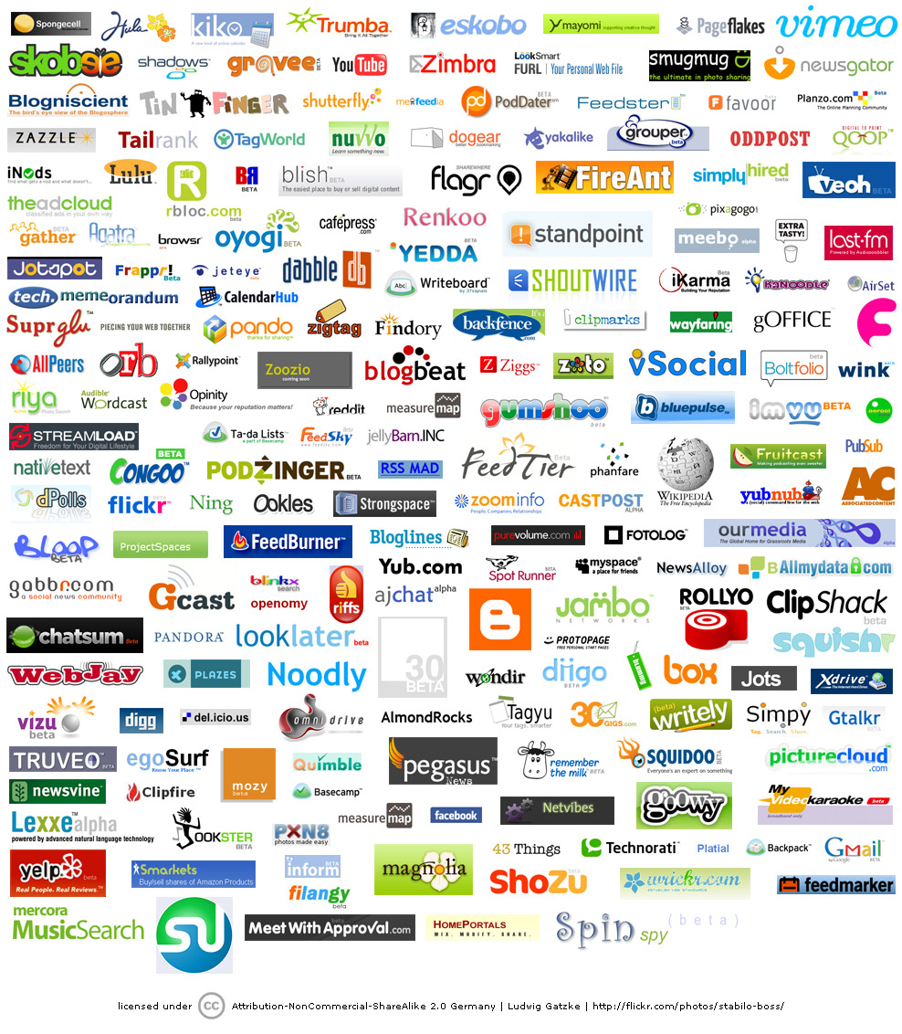
ECONOMIC IMPACT
Google
Market Cap(Jan 1, 2010):
$189 billion
Cisco Systems
networking gear Market cap (Jan 1, 2010):
$112 billion
Facebook
market cap:
$50 billion
www.bizjournals.com/austin/news/2010/11/15/facebooks... - Cached
Network Science: Introduction
Notes:
Economic Impact: From web search to social networking.
Some of the most successful companies of the 21st century, from Google to Facebook, Twitter, LinkedIn, Cisco to Apple and Akamai, base their technology and business model on networks. Indeed, Google is not only the biggest network mapping operation, building a comprehensive map of the WWW, but its search technology relies on the network characteristics of the Web.
Networks have gained particular popularity with the emergence of Facebook, the company with the oft-emphasized ambition to map out the social network of the whole planet. While Facebook was not the first social networking site, it is likely also not the last: an extensive ecosystem of social networking tools, from Twitter to Orkut, are attracting an impressive number of users (Image 1.6). The tools developed by network science fuel these sites, aiding everything from friend recommendation to advertising.

Slide 31
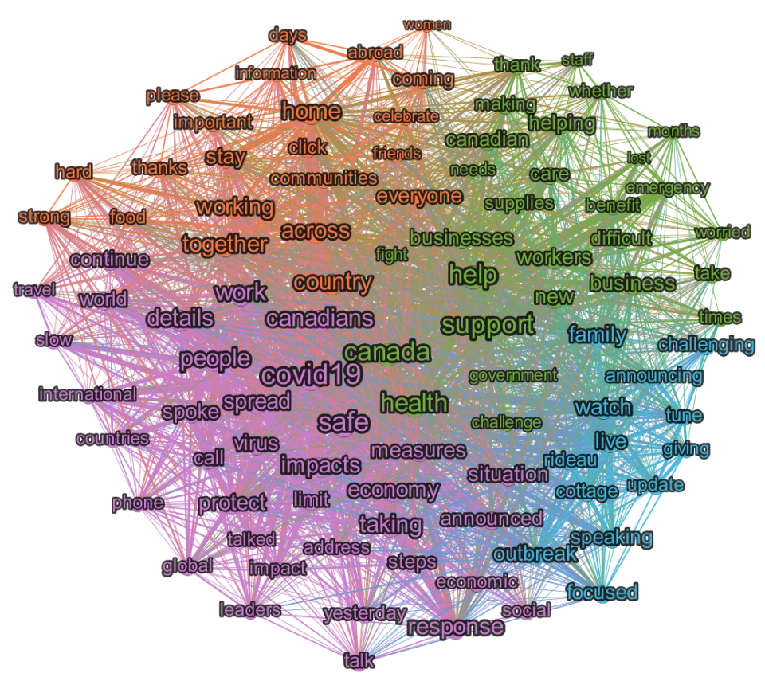
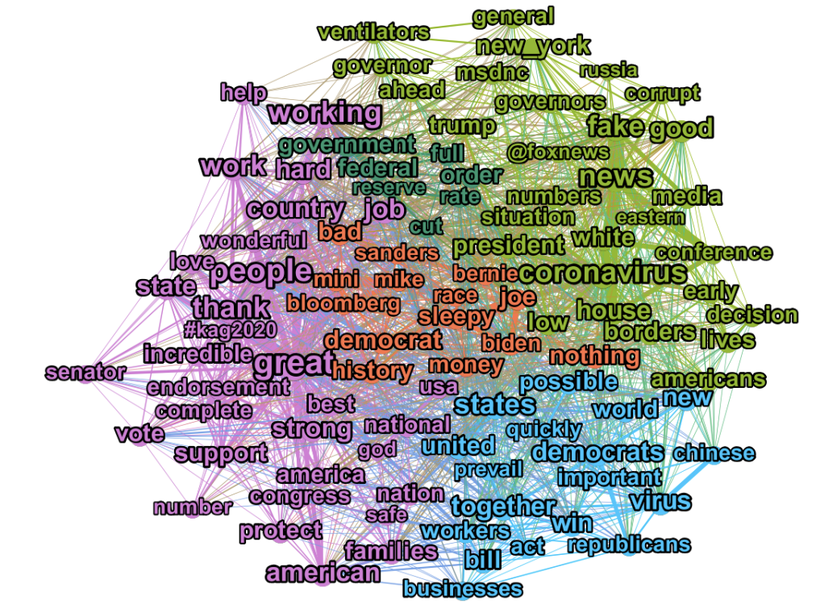
Social Networks
Keyword network of tweets (March of 2020)
Prime Minister Trudeau
President Trump
Taking; covid19; measures; Canadians; virus; spread; safe; response; impacts; …
Notes:
Small Number of Communities in Twitter Keyword Networks
Keyword network of tweets by President Trump from March of 2020
Keyword network created from tweets by Prime Minister Trudeau in March of 2020.

Slide 32
Social Networks
Keyword network of tweets (March of 2020)
Prime Minister Trudeau
President Trump
possible; new; world; states; quickly; prevail; together; bill; win; act, important …
Notes:
Small Number of Communities in Twitter Keyword Networks
Keyword network of tweets by President Trump from March of 2020
Keyword network created from tweets by Prime Minister Trudeau in March of 2020.

Slide 33
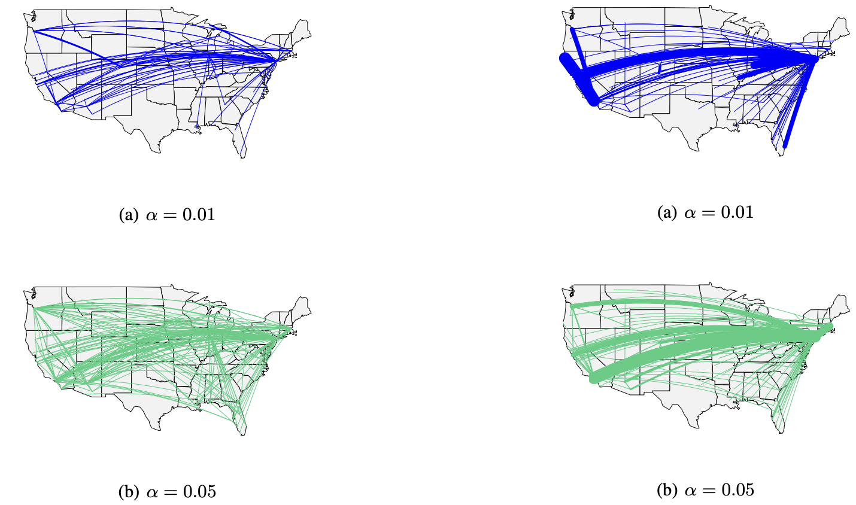
Social Networks
Facebook backbone structure network (Source: Structural Patterns of the Occupy Movement on Facebook
Pages-reshare
Pages-common
preserves 26.58%
and 42.7% of the edges
preserves 64.95%
and 70.65% of the edges
absence of geographical
correlation in the information
spreading and the emergence
of US major cities
Notes:
Backbone structure for the pages-reshares network,
pages-reshares network, preserves 26.58% of the total edge weight for α = 0.01 and 42.7% for α = 0.05.
We can notice the absence of geographical correlation in the information spreading and the emergence of US major cities – New York, Los Angeles, Chicago, Boston, Portland, Phoenix and Denver – as information diffusion leaders.
Backbone structure for the pages-common users network, for α = {0.01, 0.05}.
pages-common users network, preserves 64.95% of the total edge weight for α = 0.01 and 70.65% for α = 0.05.
We can notice the absence of geographical correlation in the activity of polarized users across pages and the emergence of US major cities – New York, Los Angeles, Boston, Portland and San Francisco – as polarized users’ activity exchanger.

Slide 34
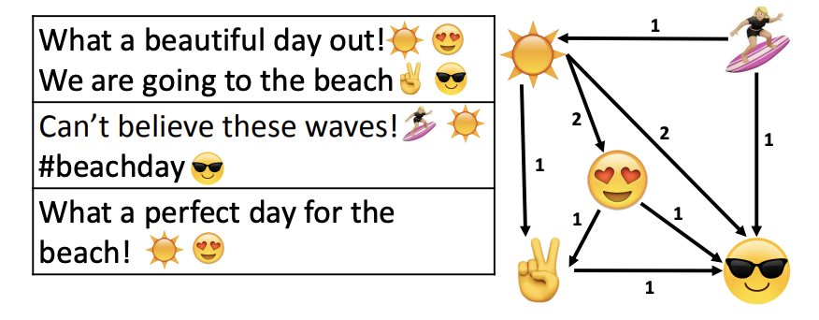
Social Networks
Representing Emoji Usage using Directed Networks: A Twitter Case Study
2015 Women World Cup United States won the event
Notes:
Representing Emoji Usage using Directed Networks: A Twitter Case Study
We extract the set of common emojis from top 10 popular emojis and not only the 5 shown in each of the first three columns of Table 4.
Whappened in that 2015 Women World Cup, we find that the United States won the event.
Hence it is not surprising that we have soccer ball, the United state’s flag, and a cup in the set of important emojis.
The same phenomenon can also be observed from the common emojis of rioTerms dataset also. It may support the idea that the common emojis can convey valuable information about the context of the conversation.

Slide 35
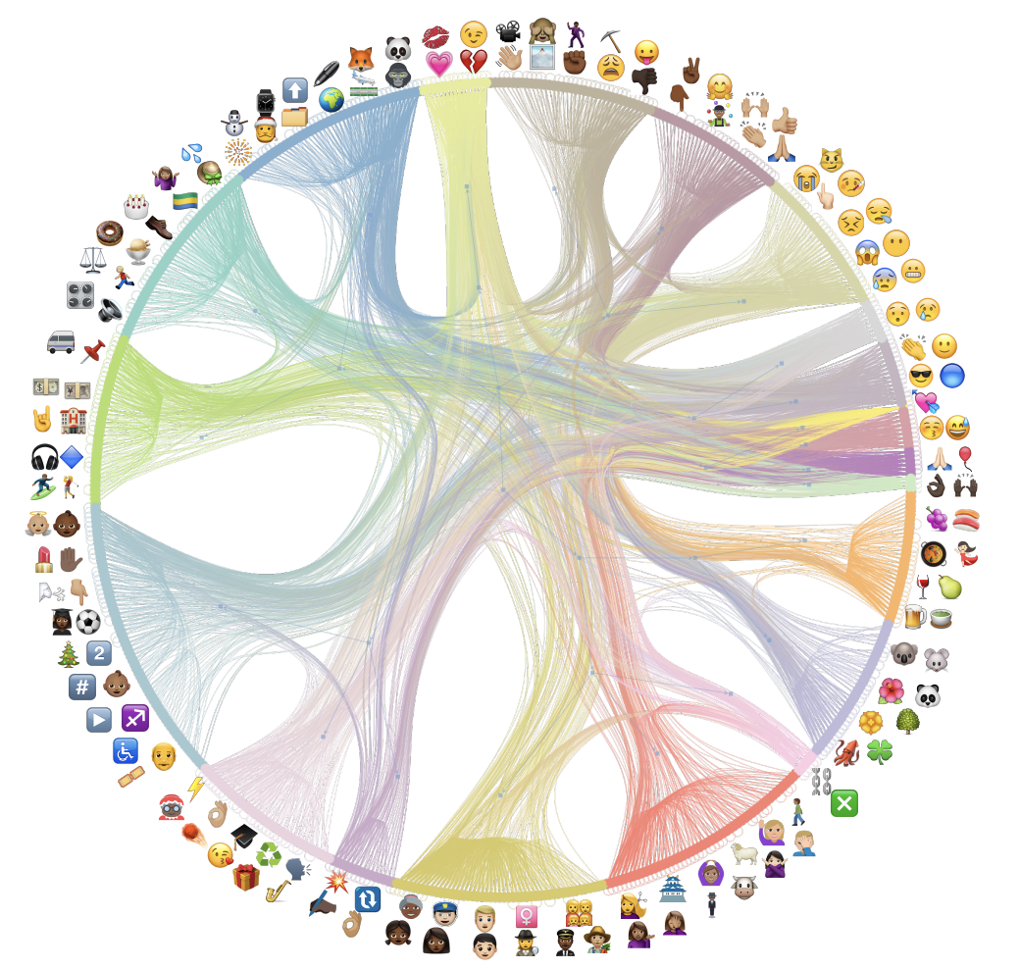
Social Networks
First level: 21 communities
Second level: 8 communities
Third level: 2 communities
What the community represents?
Notes:
Representing Emoji Usage using Directed Networks: A Twitter Case Study
Nested block model of the communities for Organ dataset. In this network, we have 21 communities in the first level, 8 communities in the second level, and 2 communities in the third level.
Emojis are picked from each community and put next to the corresponding community as a depiction of what the community represents.

Slide 36
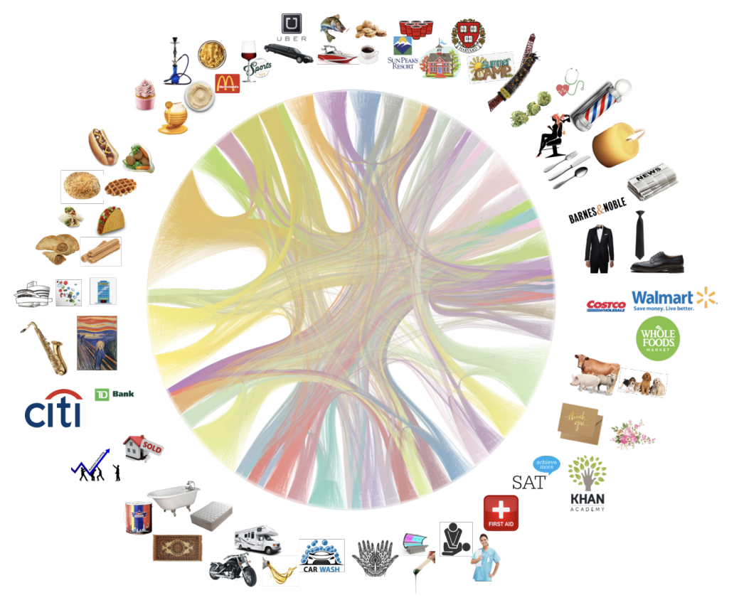
Social Networks
Case study with Yelp
Notes:
Short text Tagging using Nested Stochastic Block Model: A Yelp Case Study

Slide 37
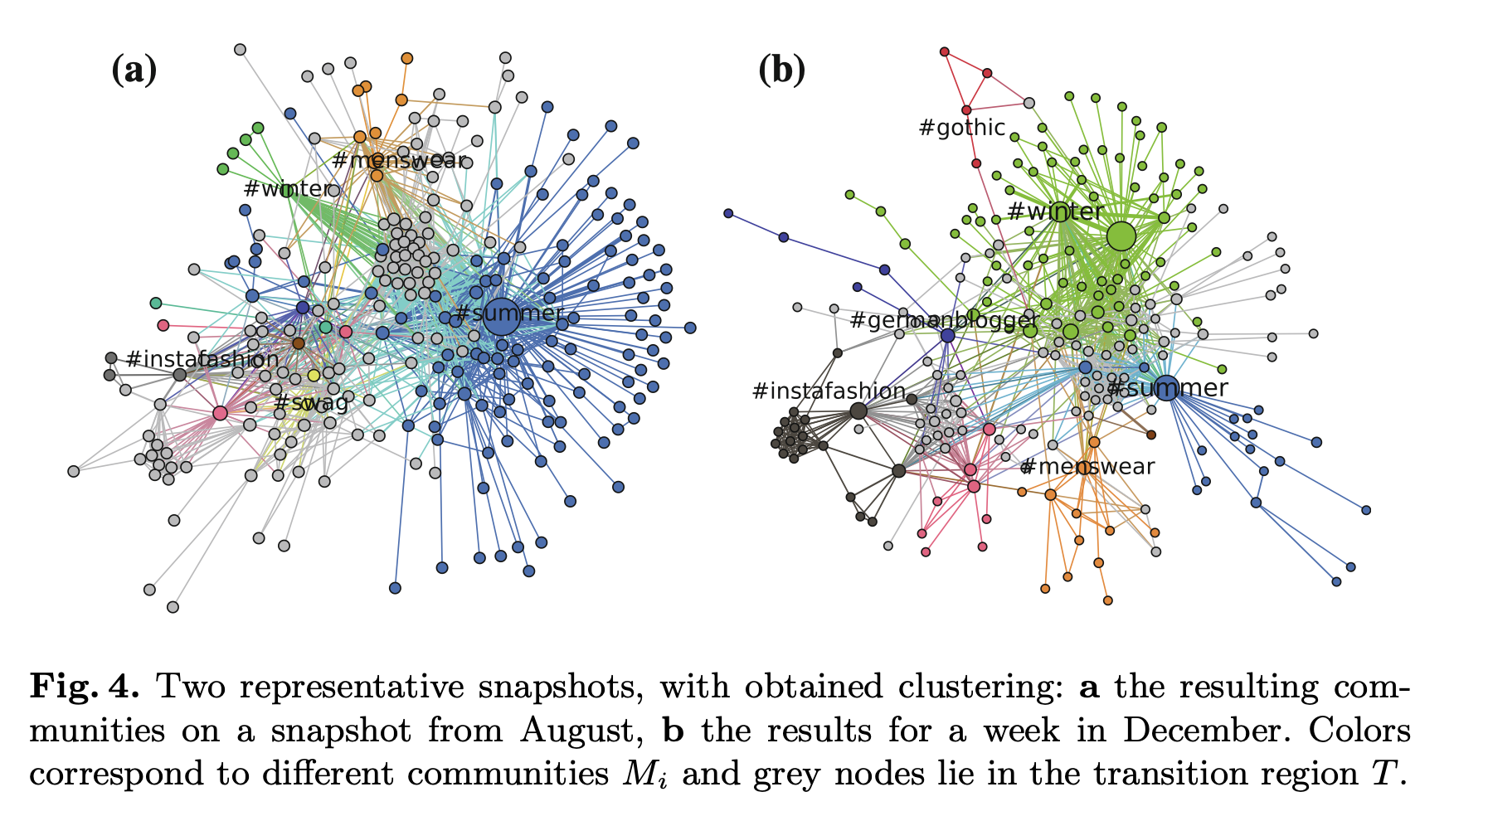
Dynamics of Hashtag-Communities
Notes:
2017: Capturing the Dynamics of Hashtag-Communities

Slide 38
Dynamics of Hashtag-Communities
Notes:
2017: Capturing the Dynamics of Hashtag-Communities

Slide 39
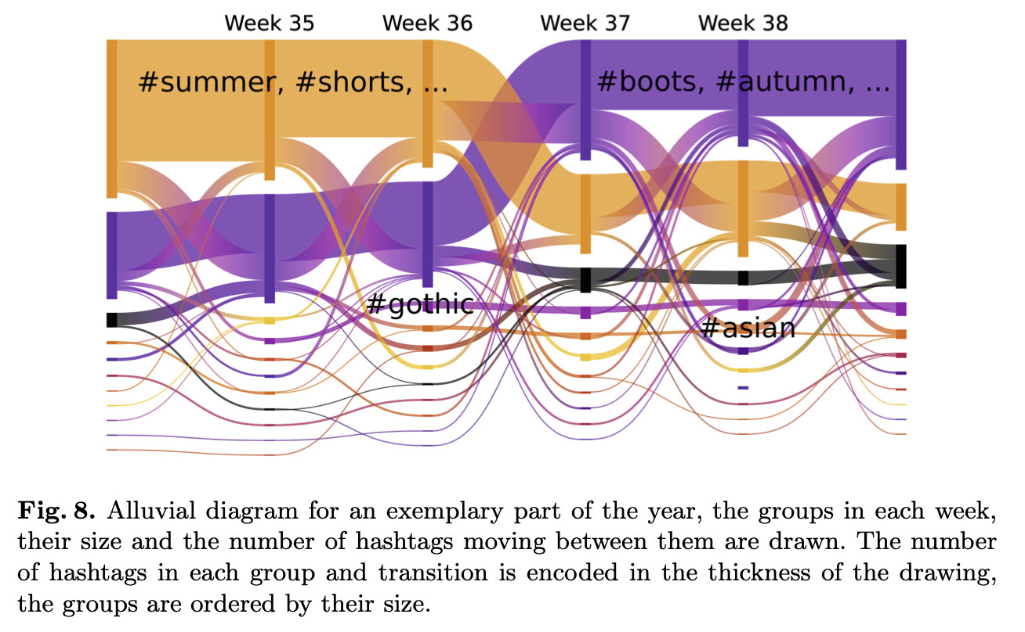
Dynamics of Hashtag-Communities
‘#summer’ community looses many members and the ‘#autumn’ group
becomes the biggest one in the first week of September
Notes:
2017: Capturing the Dynamics of Hashtag-Communities
where the ‘#summer’ community looses many members and the ‘#autumn’ group becomes the biggest one in the first week of September.
fashion-topics, there are quite many small communities existing in parallel to the big seasonal development, exemplary labeled with ‘#gothic’ and ‘#asian’. These groups outside of the mainstream of hashtags, showed to be very stable, as shown in Fig. 9, where an interesting effect of the incorporated memory can be observed. Since small communities suffer the most from temporal fluctuations in a matching without preceding timesteps, their lifetimes are greatly increased by small orders of memory. Since small developments can be equally important, especially if they are long living, this is a desirable effect.

Slide 40
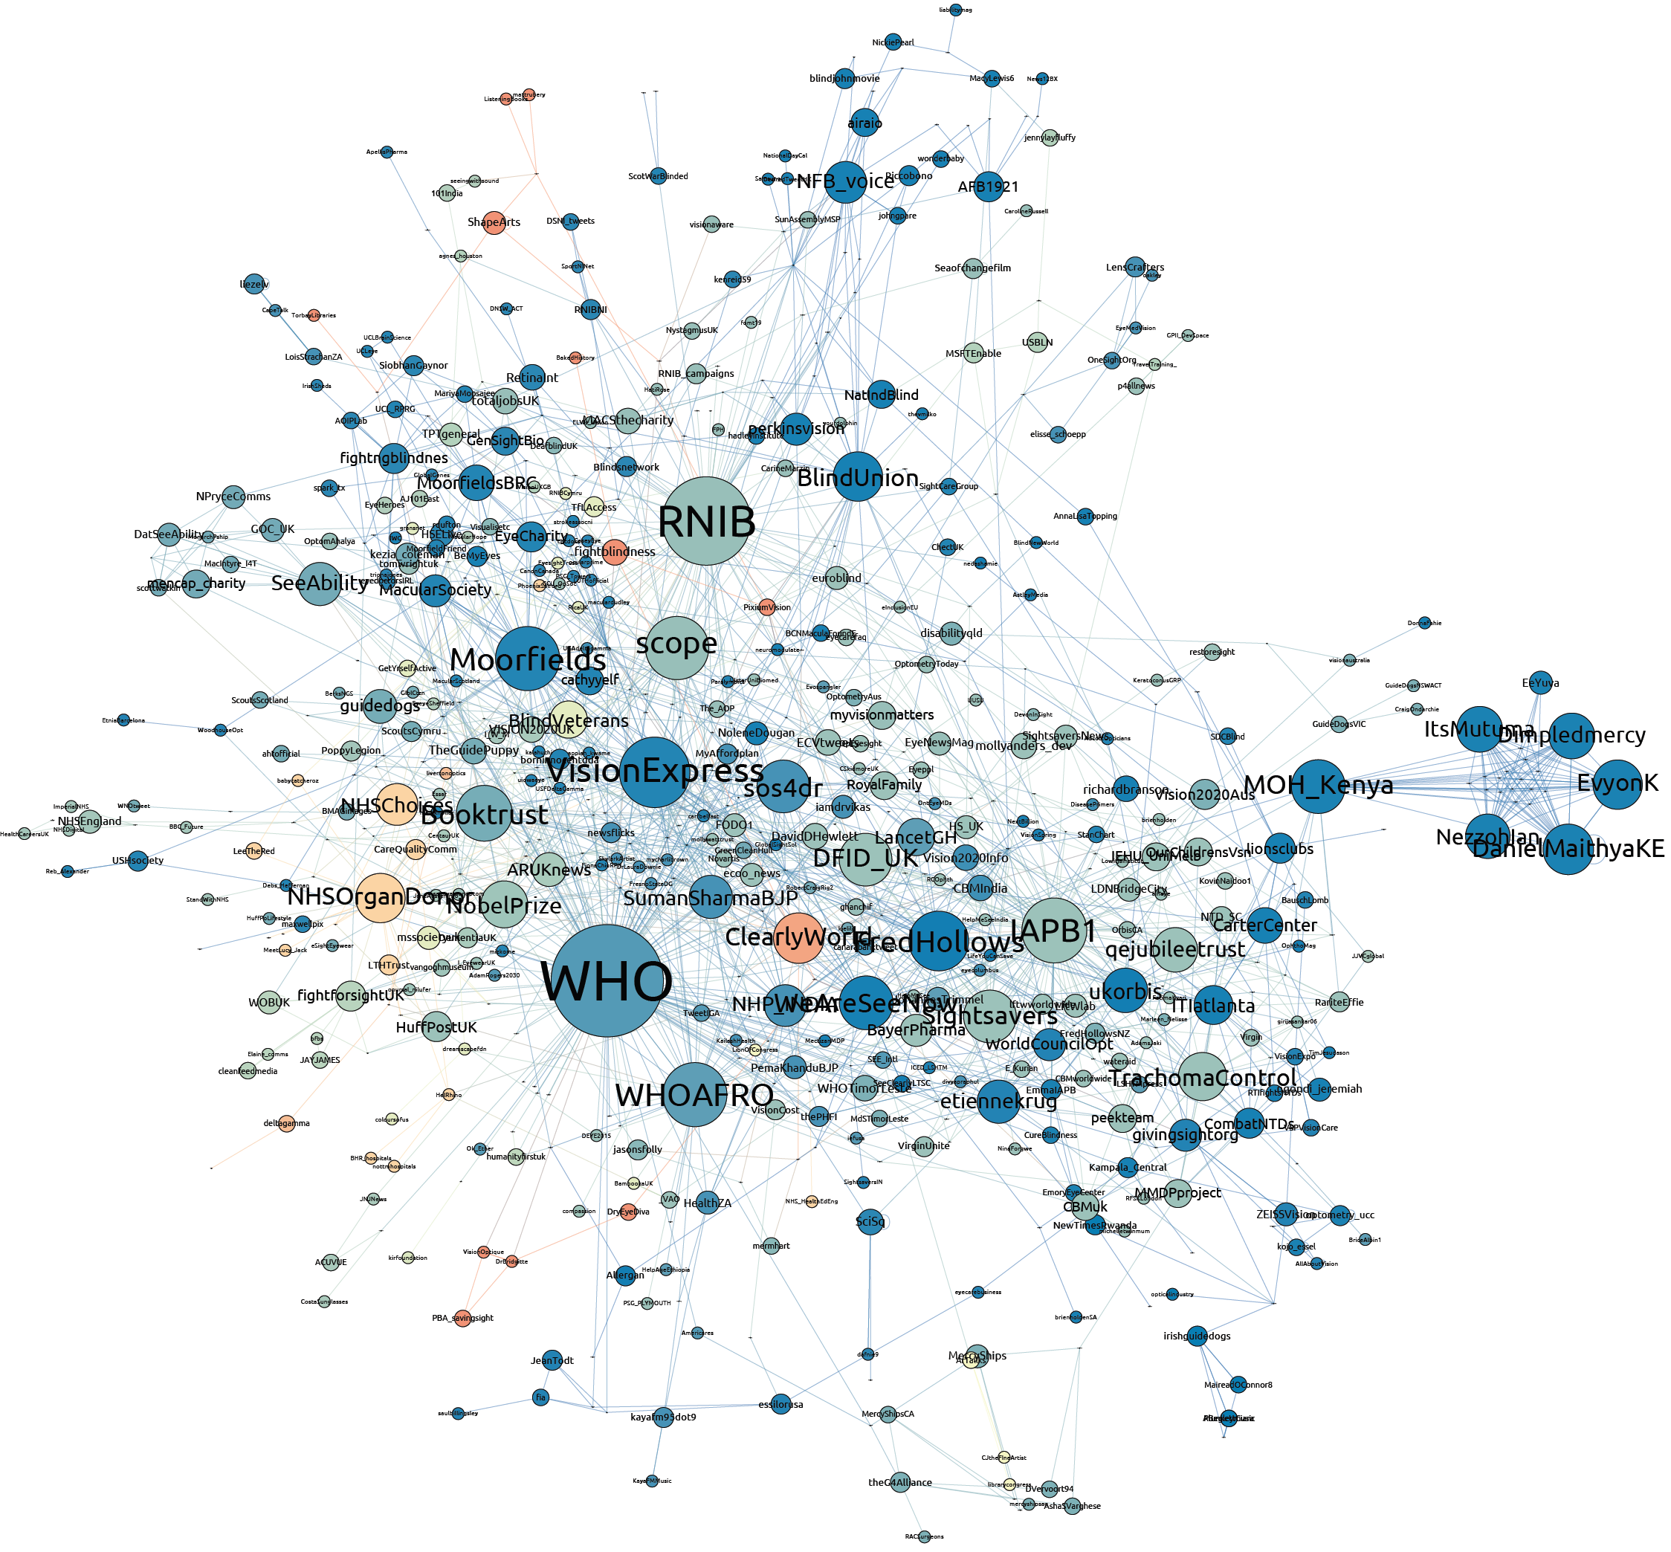
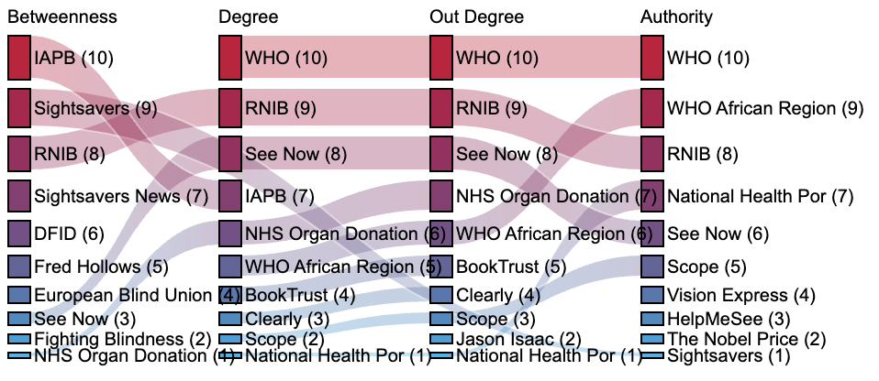
Disability awareness campaigns in Twitter

Slide 41
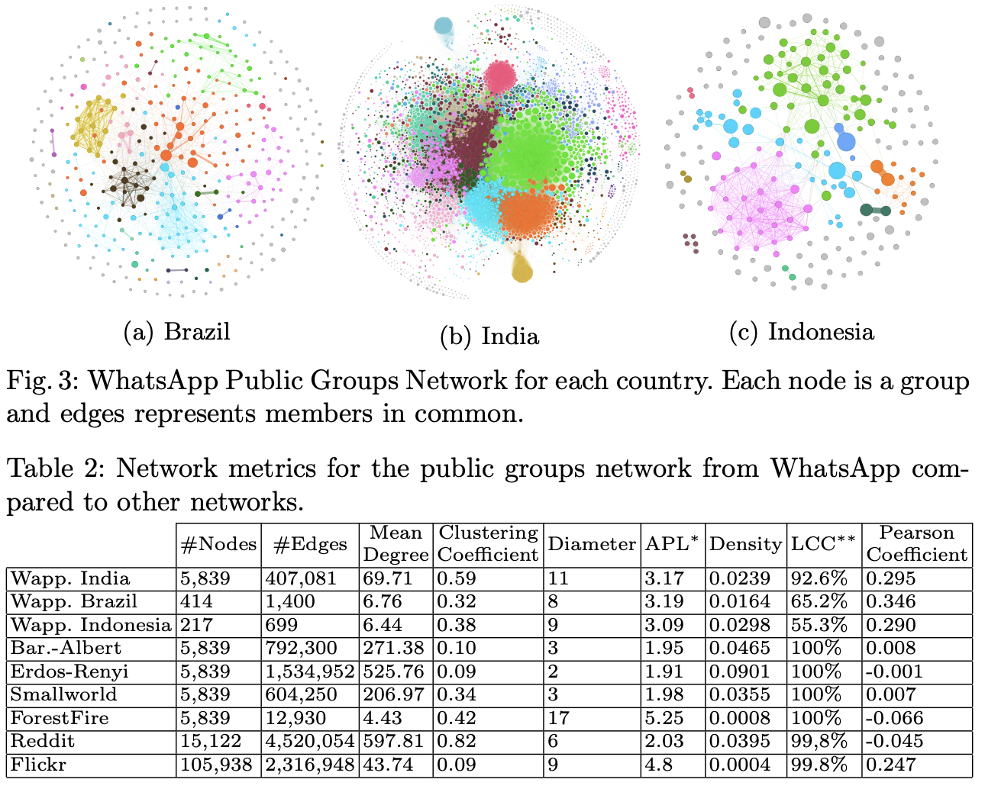
Social Networks
Notes:
Can WhatsApp Counter Misinformation by Limiting Message Forwarding?

Slide 42
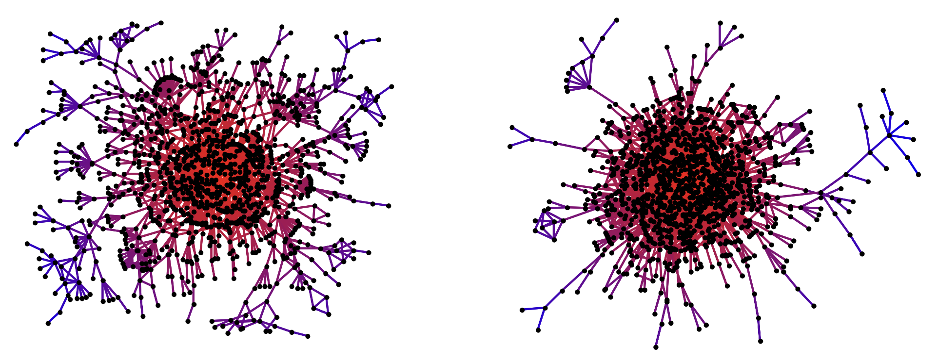
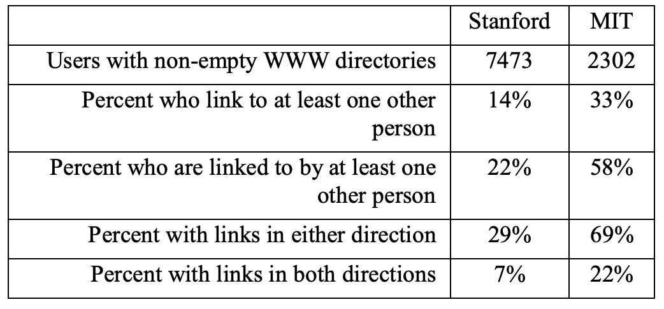
Networks of personal homepages
Stanford
MIT
how social bonds are created
social structure of university
communities
find communities
Source: Lada A. Adamic and Eytan Adar, ‘Friends and neighbors on the web’, Social Networks, 25(3):211-230, July 2003
Notes:
how social bonds are created
social structure of university communities.
find communities

Slide 43
Network of actor co-starring in movies
Question: how many movies away Brad Pitt and Bradley Cooper ?

Slide 44
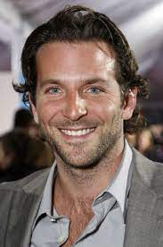
Network of actor co-starring in movies
Bradley Cooper
Nick Searcy
Brad Pitt
The Comebacks
Moneyball

Slide 45
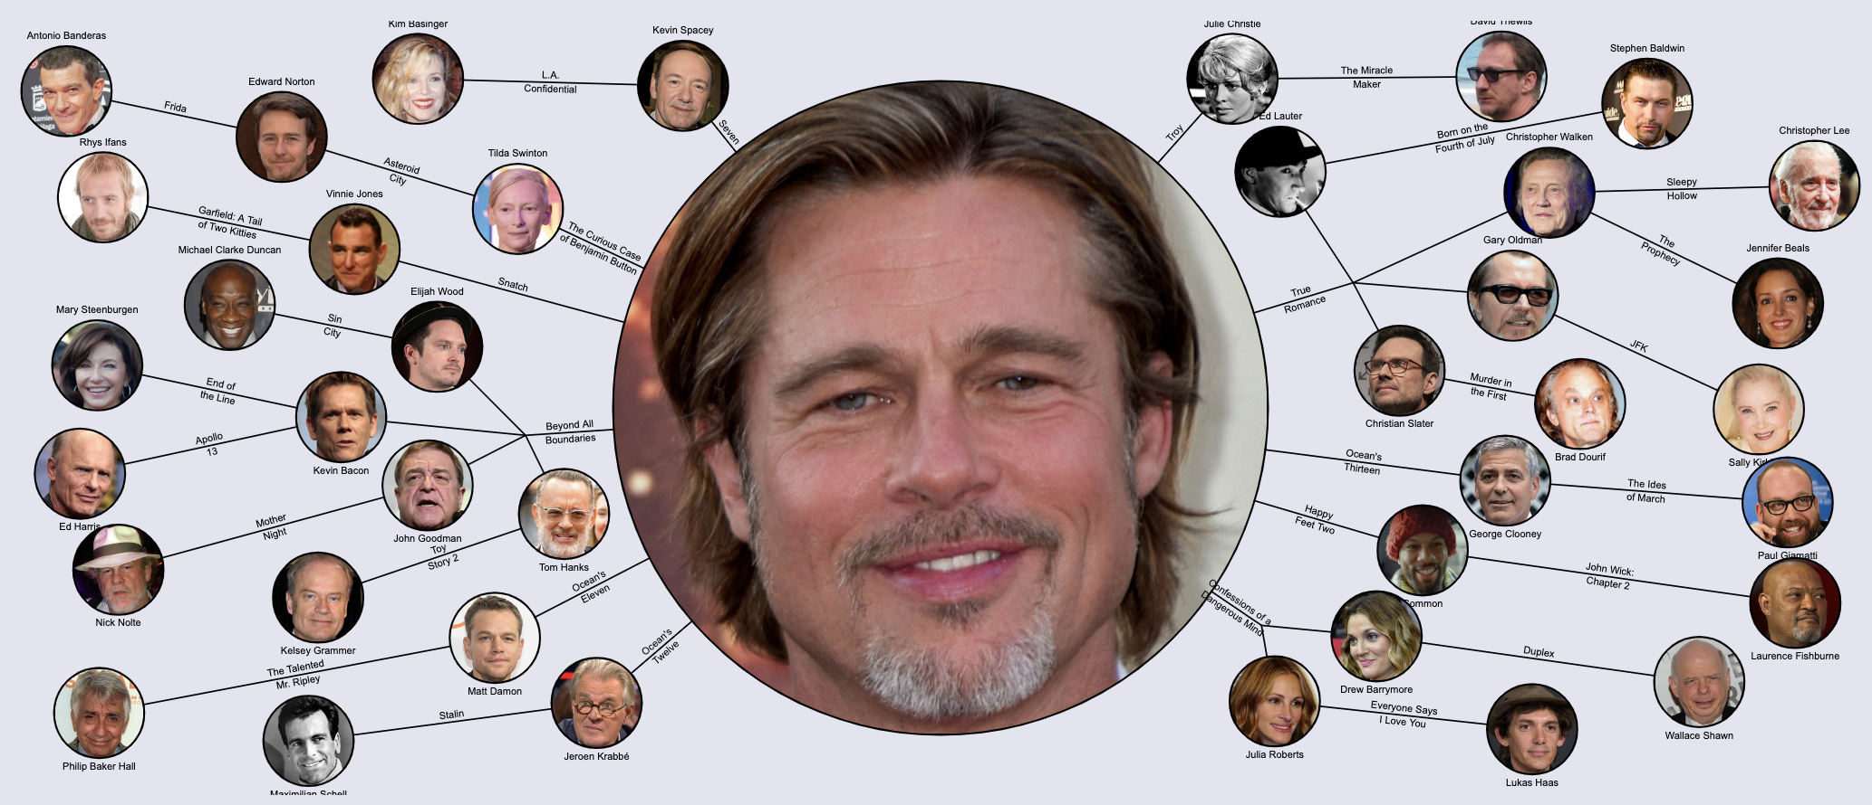
Network of actor co-starring in movies
Hollywood is small world and scale free small world
A few actors played in a lot of movies and a lot of actors played in few movies

Slide 46
Network of actor co-starring in movies
University of Viginia
The Oracle of Bacon
http://oracleofbacon.org/

Slide 47
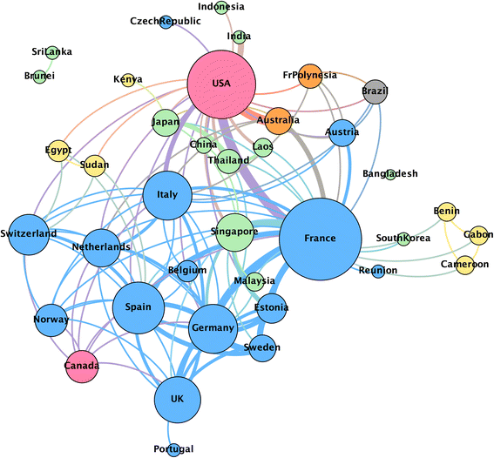
Networks of scientists’ co-authorship of papers
Co-authorship network in
health research
Source: Fonseca, B.d., Sampaio, R.B., Fonseca, M.V.d. et al. Co-authorship
network analysis in health research: method and potential use. Health Res Policy Sys 14, 34 (2016).

Slide 48
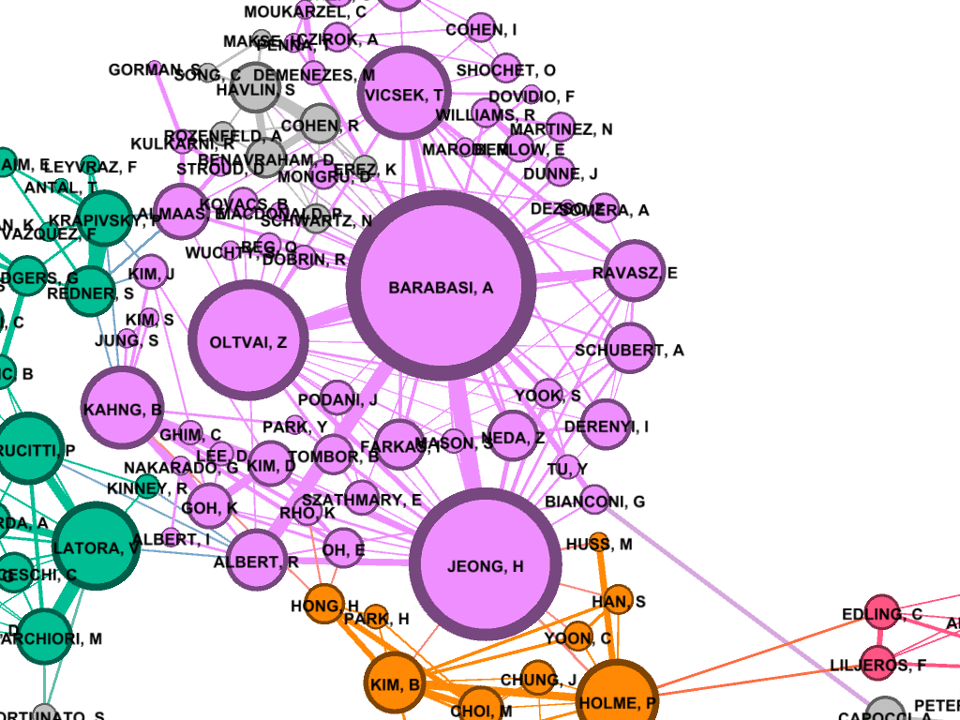
Networks of scientists’ co-authorship of papers
Co-authorship network in
network science
Source: https://studentwork.prattsi.org/infovis/visualization/coauthorship-network-science/

Slide 49
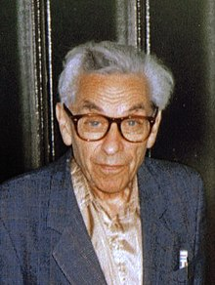
Networks of scientists’ co-authorship of papers
Paul Erdos
Source: https://mathscinet.ams.org/mathscinet/freeTools.html?version=2
Notes:
Paul Erdős (1913–1996) was an influential Hungarian mathematician who in the latter part of his life spent a great deal of time writing papers with a large number of colleagues, working on solutions to outstanding mathematical problems.^{[1]} He published more papers during his lifetime (at least 1,525^{[2]}) than any other mathematician in history.^{[1]} (Leonhard Euler published more total pages of mathematics but fewer separate papers: about 800.)^{[3]} Erdős spent a large portion of his later life living out of a suitcase, visiting his over 500 collaborators around the world.
The idea of the Erdős number was originally created by the mathematician's friends as a tribute to his enormous output. Later it gained prominence as a tool to study how mathematicians cooperate to find answers to unsolved problems. Several projects are devoted to studying connectivity among researchers, using the Erdős number as a proxy.^{[4]} For example, Erdős collaboration graphs can tell us how authors cluster, how the number of co-authors per paper evolves over time, or how new theories propagate.

Slide 50
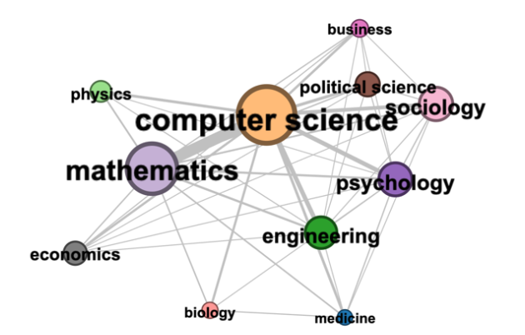
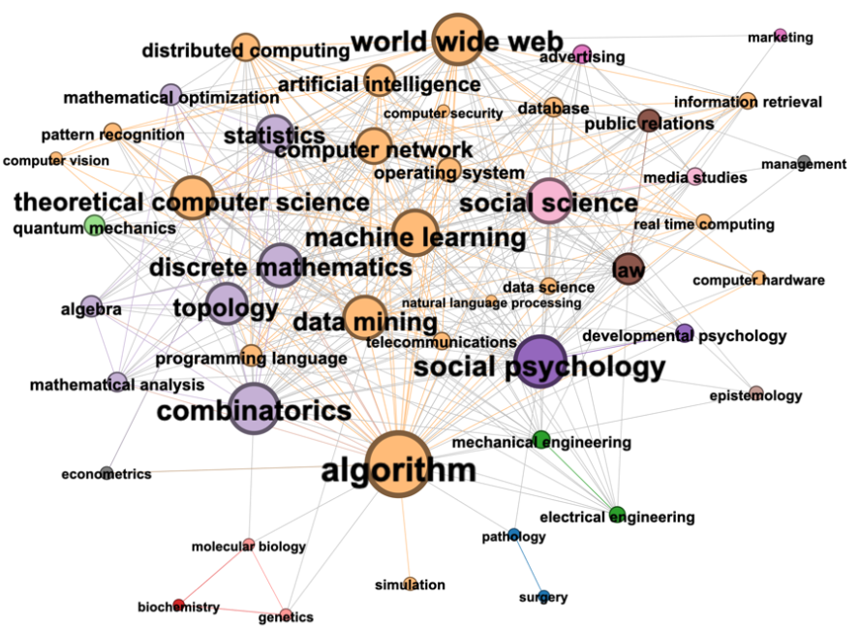
Field of Study (FoS) networks
FoS Networks for research published in 5 network science journals during 2015–2019.
Fields of study network
Sub-disciplines fields network
Node size: number of papers
attributed to a field of study.
Notes:
Navigating Multidisciplinary Research Using Field of Study Networks
FoS Networks for research published in 5 network science journals during 2015–2019.
Node size: number of papers attributed to a field of study.
In (b) nodes are coloured to represent the parent discipline of the field of study.
Edges are coloured to show the parent discipline if the edge is within a discipline/community.
Edges between communities are not coloured.

Slide 51
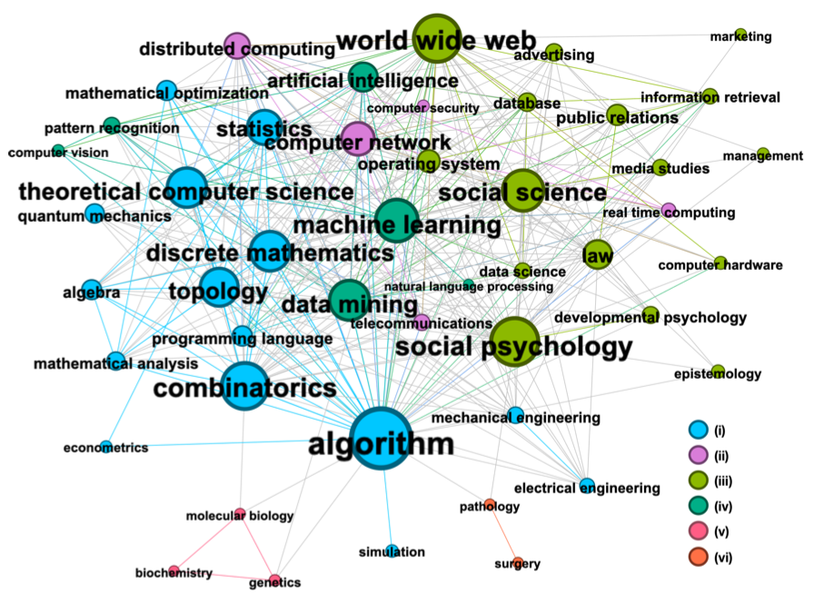
Field of Study (FoS) networks
Clusters identified by Louvain.
Notes:
Navigating Multidisciplinary Research Using Field of Study Networks
FoS Network for research published in 5 network science journals during 2015–2019.
Nodes are coloured to show clusters identified by Louvain.

Slide 52
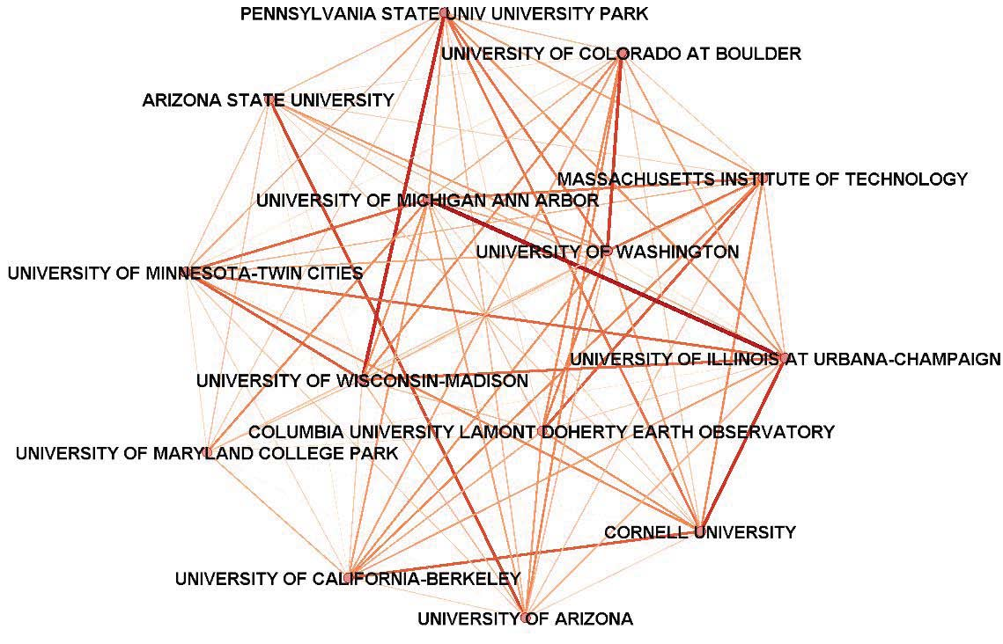
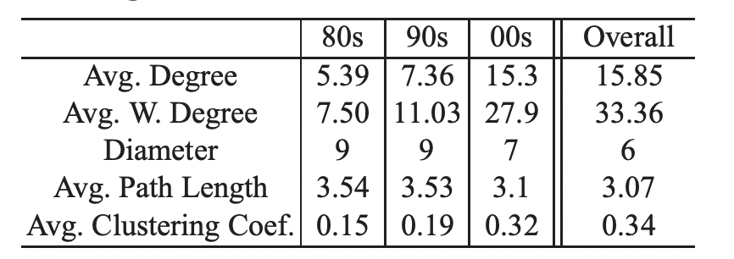
Funding Networks
Notes:
Edge is number of grants collaborated

Slide 53
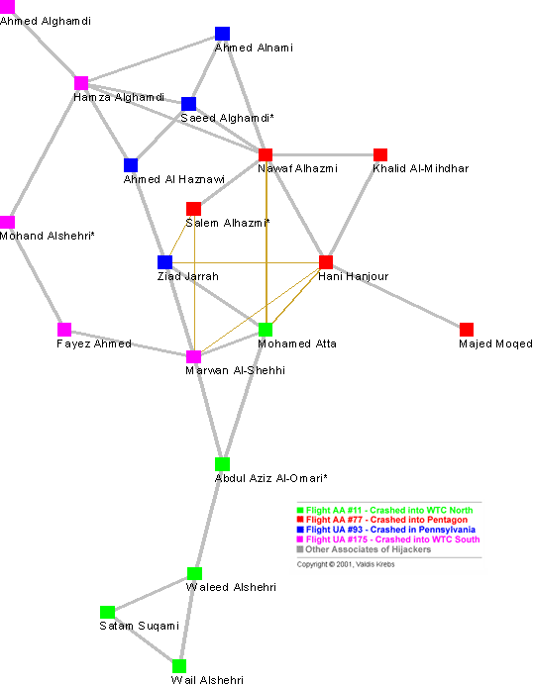
“Six degrees of Mohammed Atta” Uncloaking Terrorist Networks, by Valdis Krebs
Terrorist networks
Mohamed Atta was the leader
High centrality
degree
betweenness
closeness
For a small network of less than 20 nodes,
average path length of 4.75 steps.
Notes:
Six degrees of Mohammed Atta oku and provide fun fact
http://www.orgnet.com/hijackers.html
Edge weight: tie strength, living together or attending the same school or the same classes/training would have the strongest ties.
distant many of the hijackers on the same team
Usama bin Laden mentions:
"Those who were trained to fly didn't know the others. One group of people did not know the other group."
Mohamed Atta was the ring leader and Bin Laden confirmed it (he has higher centrality degree, betweenness, closeness)
Problems in criminal network
Incompleteness - the inevitability of missing nodes and links that the investigators will not uncover.
Fuzzy boundaries - the difficulty in deciding who to include and who not to include.
Dynamic - these networks are not static, they are always changing.

Slide 54
Terrorist networks
Problems in criminal network
Incompleteness
the inevitability of missing
nodes and links that the
investigators will not
uncover.
Fuzzy boundaries
the difficulty in deciding
who to include and who
not to include.
Dynamic
these networks are not
static, they are always
changing.
Notes:
Six degrees of Mohammed Atta oku and provide fun fact
http://www.orgnet.com/hijackers.html
Edge weight: tie strength, living together or attending the same school or the same classes/training would have the strongest ties.
distant many of the hijackers on the same team
Usama bin Laden mentions:
"Those who were trained to fly didn't know the others. One group of people did not know the other group."
Mohamed Atta was the ring leader and Bin Laden confirmed it (he has higher centrality degree, betweenness, closeness)
Problems in criminal network
Incompleteness - the inevitability of missing nodes and links that the investigators will not uncover.
Fuzzy boundaries - the difficulty in deciding who to include and who not to include.
Dynamic - these networks are not static, they are always changing.

Slide 55
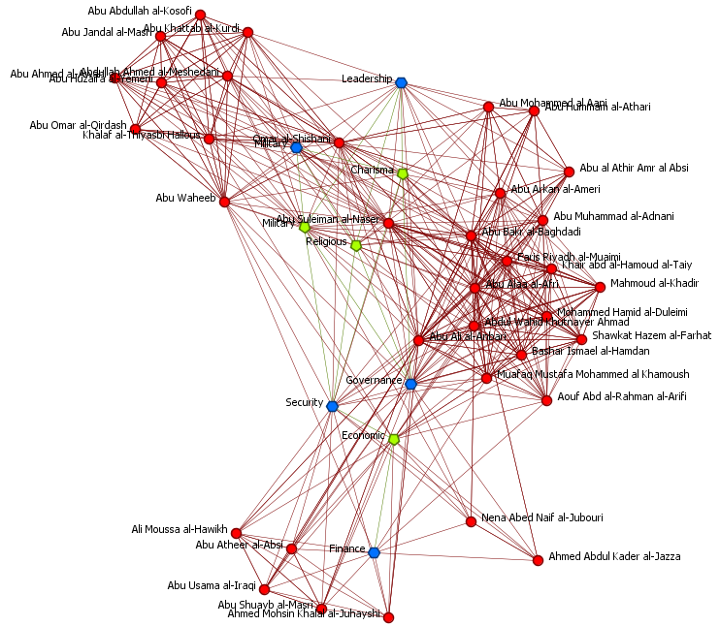
Strategic Destabilization of Terrorist Networks
Who has the highest
betweenness?
Khalid Sheykh Mohammad
Senior strategic planner
and propaganda figure
Ayman al-Zawahiri
Deputy leader at the time
current leader
Osama Bin Laden
Abu Musab al-Zarqawi
Faction commander and
senior military figure
Notes:
71% fragmentation after 4 node removals.
Abu Musab al-Zarqawi founded ISIS

Slide 56
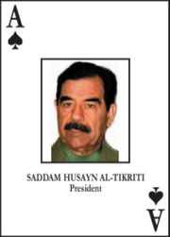
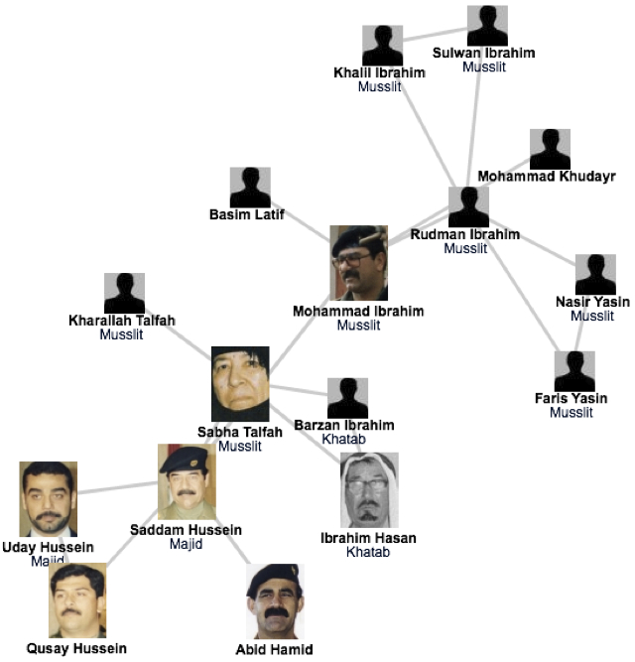
A SIMPLE STORY (1) The fate of Saddam and network science
Network Science: Introduction
Network Science: Introduction
Notes:
Invasion that started in March 19, 2003. Many of the regime's high ranking officials, including Saddam Hussein, avoided capture.
Hussein was last spotted kissing a baby in Baghdad in April 2003, and then his trace went cold.
designed a deck of cards, each card engraved with the images of the 55 most wanted.
It worked: by May 1, 2003, 15 men on the cards were captured, and by the end of the month another 12 were under custody.
Yet, the ace of spades (see Figure), i.e. Hussein himself, remained at large.
Col James Hickey, in charge of a series of raids known Operation Desert Scorpion, wanted to know the relationship between everyone killed or captured. The task fell to Lt. Col. Steve Russell, who was in direct charge of the raids. Then there was Brian Reed, the operations officer under Col. Hickey, who was exposed to social networks during his studies at West Point.
Realizing that capturing the faces of the Iraq regime was of little help in cornering Saddam himself, these men started to systematically reconstruct the social network of Saddam's inner circle. They did not rely on government documents and decrees, but rather gossip and family trees. Instead of focusing on military titles, they learned to understand the five names each Iraqi man had, listing the name of their father, grandfather, and the city of origin-- serving as a family tree.
As they meticulously pieced together an extensive diagram of who drank with whom and who is related to whom in the Tikrit region, where Saddam was from, they started to use network diagrams to guide the raids. In one of those raids they found over \$8 million in US currency, about \$1 million in Iraqi currency, jewelry worth over \$2 million, rifles and ammunition. Yet, the biggest prize was Saddam's family photo album, providing the faces of those that the family trusted, filling with intimate details their growing network diagram.
Their increasingly detailed maps consistently pointed to two individuals, Rudman Ibrahim and Mohammed Ibrahim. They served instead as Saddam's second-level bodyguards, numbering about 40 who ran the daily tasks, serving as his driver, cook, or mechanic.
Yet, Rudman, whom the investigators believed that he knew Hussein's whereabouts, had a heart attack and died within a few hours of his capture.
Next the investigators used their network diagram to identify individuals who could have known the whereabouts of Mohammad, dubbed the "fat man". Not a major player in the regime's power structure, while Saddam's whereabouts kept secret, Mohammed's social ties were not as protected as Saddam's.
once they found someone to turned Mohammed Ibrahim in, the same man escorted them to a farm near the Tigris river, reveling the spider hole that hid the dictator himself.

Slide 57
Thex
A SIMPLE STORY (1) The fate of Saddam and network science
The capture of Saddam Hussein:
shows the strong predictive power of networks.
underlies the need to obtain accurate maps of the networks we aim to study; and the often heroic difficulties we encounter during the mapping process.
demonstrates the remarkable stability of these networks: The capture of Hussein was not based on fresh intelligence, but rather on his pre-invasion social links, unearthed from old photos stacked in his family album.
shows that the choice of network we focus on makes a huge difference: the hierarchical tree, that captured the official organization of the Iraqi government, was of no use when it came to Saddam Hussein's whereabouts.
Network Science: Introduction
Network Science: Introduction

Slide 58
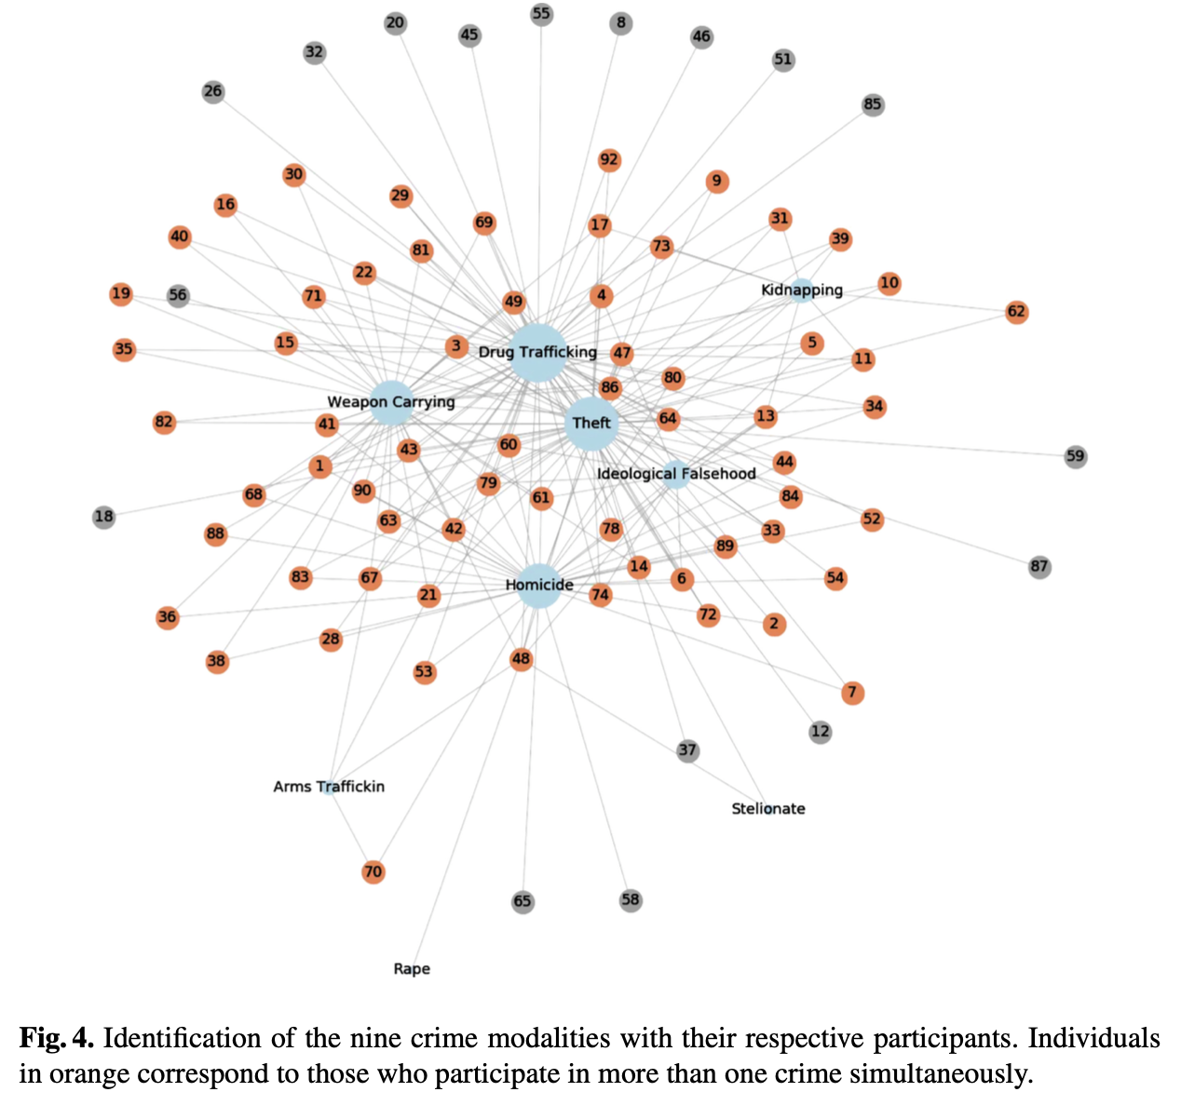
Criminal Network
Notes:
Diversity Analysis Exposes Unexpected Key Roles in Multiplex Crime Networks (Complenet2020)

Slide 59
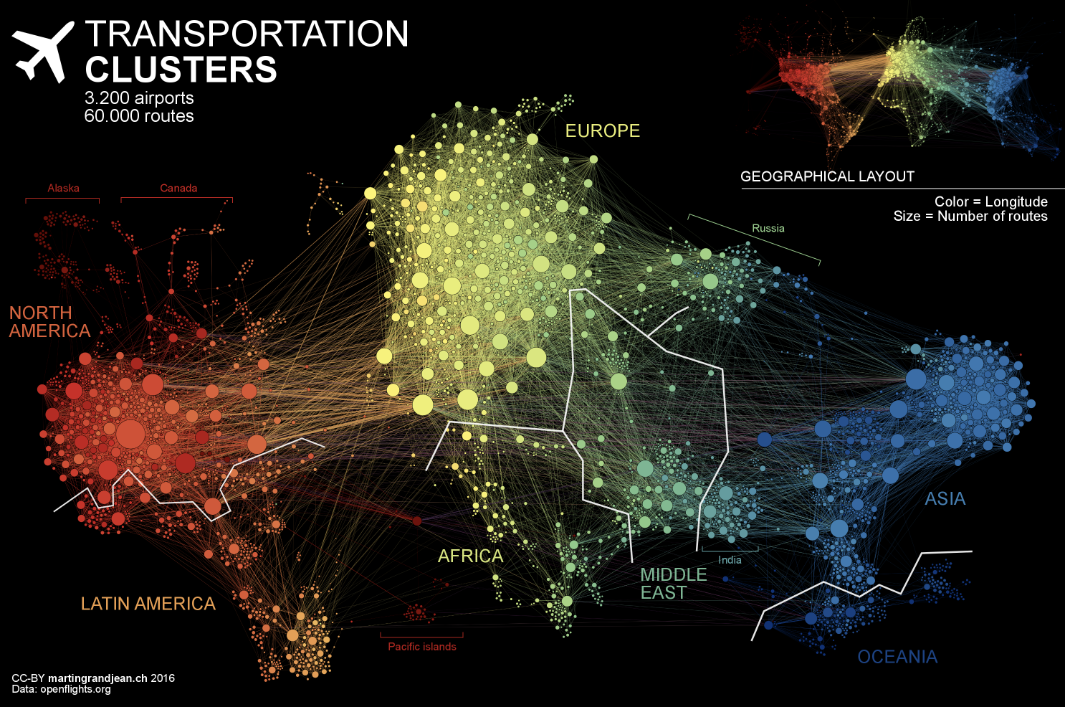
Air transportation

Slide 60
US Air transportation
Network backbone evolution

Slide 61
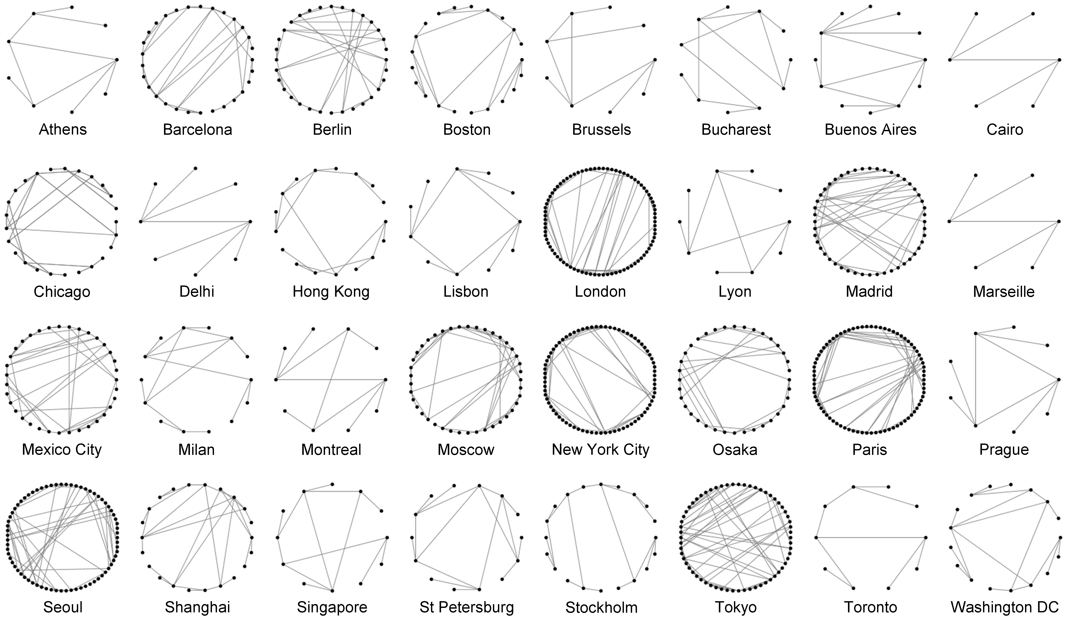
Transportation network
Network representation of metro systems
Why it is important ?
Redundancy, Efficiency …

Slide 62
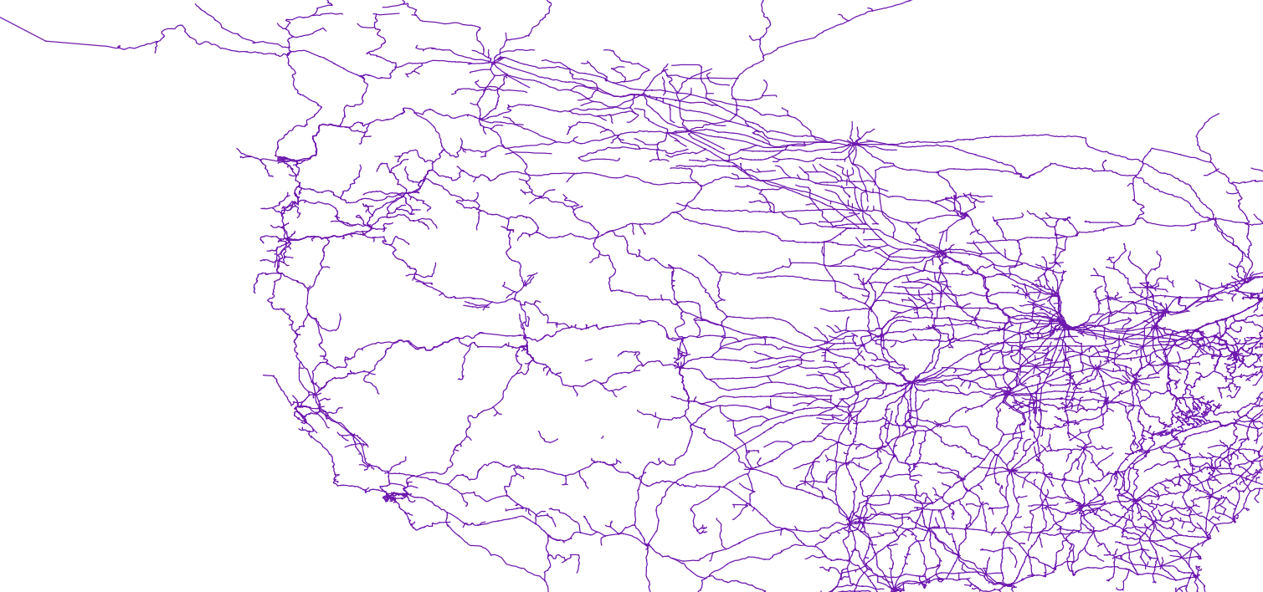
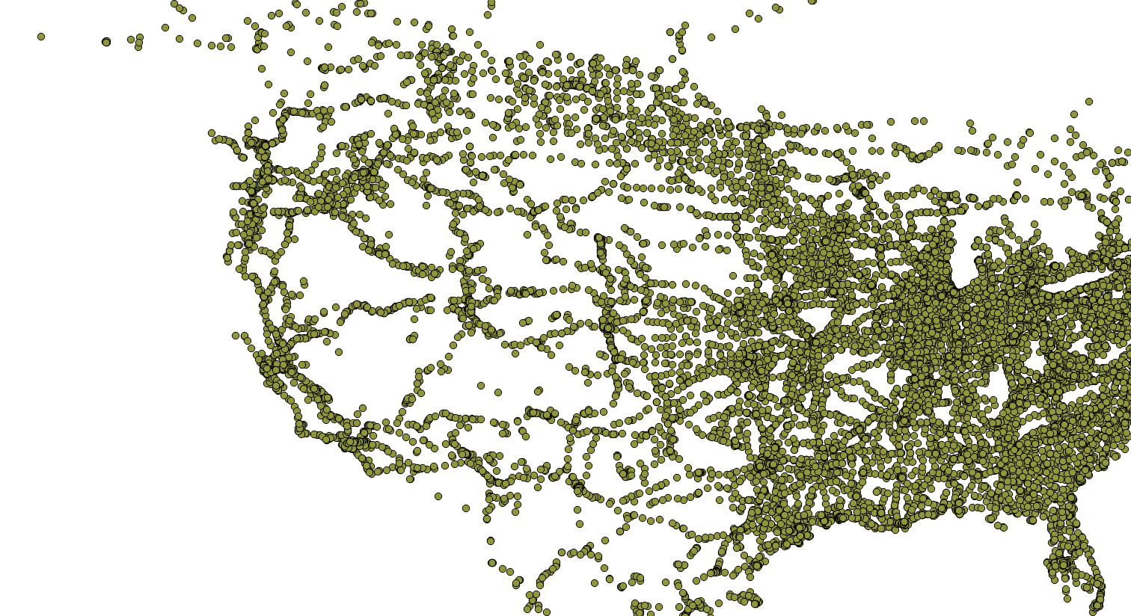
US railroad network

Slide 63
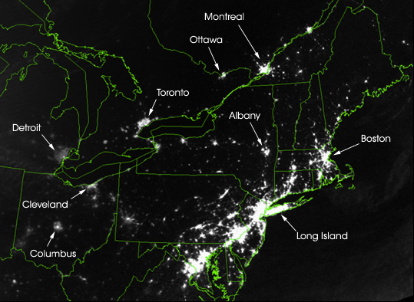
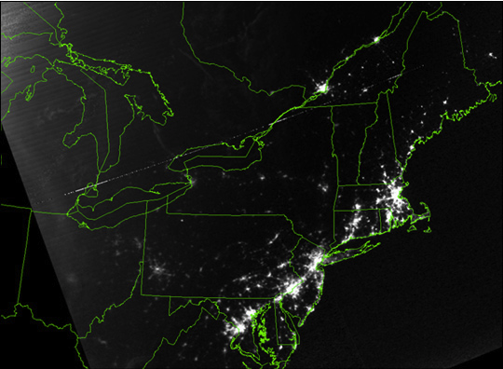
Thex
A SIMPLE STORY (2): August 15, 2003 blackout.
Vulnerability due to interconnectivity: cascading failure
When node fails it shifts load to another node
August 14, 2003: 9:29pm EDT
20 hours before
August 15, 2003: 9:14pm EDT
7 hours after
Network Science: Introduction
Network Science: Introduction
Notes:
At a first look the two satellite maps of Image 1.3a/b are indistinguishable: lights shining brightly in highly populated areas, and dark spaces marking vast uninhabited forests and oceans. Yet, upon closer inspection something strange becomes apparent. The light in several regions, Toronto, Detroit, Cleveland, Columbus, Long Island have simply disappeared. This is not a doctored shot from the next Armageddon movie but represents a real image of the US Northeast on August 14, 2003, the night of a blackout that left an estimated 45 million people in eight US states and another 10 million in Ontario without power. It illustrates a much ignored aspect of networks, one that will be an important theme in this book: vulnerability due to interconnectivity.
The 2003 blackout is a typical example of a cascading failure. When a network acts as a transportation system, a lo- cal failure shifts loads to other nodes. If the extra load is negligible, the rest of the system can seamlessly absorb it, and the failure remains effectively unnoticed. If the extra load is too much for the neighboring nodes to carry, they will either tip or redistribute the load to their neighbors. Either way, we are faced with a cascading failure, the magnitude of which depends on the network position and capacity of the nodes that have been removed in the first and subsequent rounds. Case in point is electricity: as it cannot be stored, when a line goes down, its power must be shifted to other lines. Most of the time, the neighboring lines have no difficulty carrying the extra load. If they do, they will also tip and redistribute their increased load to their neighbors.
Cascading failures can occur in most complex systems. They take place on the Internet, when traffic is rerouted to bypass malfunctioning routers, occasionally creating denial of service attacks on routers that do not have the capacity to handle extra traffic. We witnessed one in 1997, when the International Monetary Fund pressured the central banks of several Pacific nations to limit their credit. There was a cascading failure behind the 2009-2011 financial melt- down, when the US credit crisis paralyzed the economy of the globe, leaving behind scores of failed banks, corporations, and even bankrupt states. Cascading failures are occasionally our ally, however. The world wide effort to dry up the money supply of terrorist organizations is aimed at crippling terrorist networks, and doctors and researchers hope to induce cascading failures to kill cancer cells.
The Northeast blackout illustrates an important theme of this book: we must understand how the network structure affects the robustness of a complex system. We will there- fore develop quantitative tools to assess the interplay between network structure and dynamical processes on net- works and their impact on failures. Although such failures may appear chaotic and unpredictable, we will learn that they follow rather reproducible laws that can be quantified and even predicted using the tools of network science.

Slide 64
Thex
A SIMPLE STORY (2): August 15, 2003 blackout.
An important theme of this class:
we must understand how network structure affects the robustness of a complex system.
develop quantitative tools to assess the interplay between network structure and the dynamical processes on the networks, and their impact on failures.
We will learn that failures reality failures follow reproducible laws, that can be quantified and even predicted using the tools of network science.
Network Science: Introduction
Network Science: Introduction
Notes:
The Northeast blackout illustrates an important theme of this class: we must understand how network structure affects the robustness of a complex system. We will therefore develop the quantitative tools to assess the interplay between network structure and the dynamical processes on the networks, and their impact on failures. As chaotic as such a failure may seem, we will learn that in reality it follows rather reproducible laws, that can be quantified and even predicted using the tools of network science.
http://colli239.fts.educ.msu.edu/2003/08/15/us-and-canadian-cities-left-in-dark-august-2009/

Slide 65
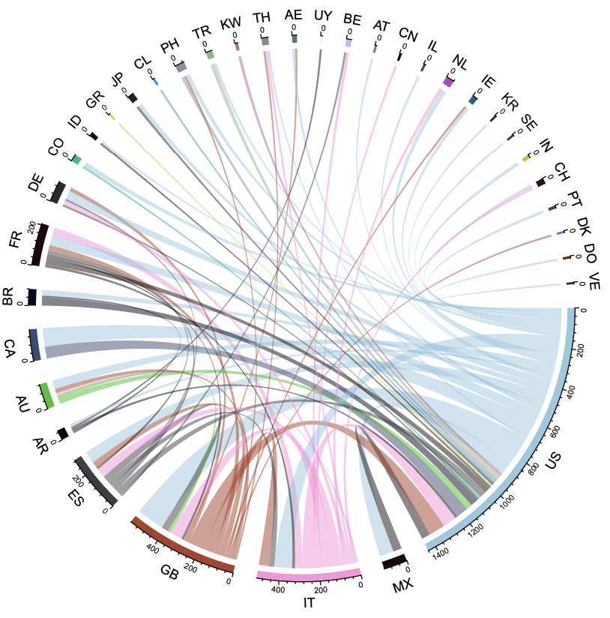
Migration
Characterising different communities of Twitter users: Migrants and natives
Edges: migrants moved from
one country to another
Color: nationality
4,940 migrant users
46,948 native users
163 countries
What is the bias?
Not everyone uses Twitter,
so US, IT, GB heavy
Notes:
Characterising different communities of Twitter users: Migrants and natives
Figure 2: The number of migrants who have moved from a country to another is represented by the links.
The colours represent the nationalities of migrants. We show only countries with at least 10 migrants for the visualisation purpose.
As a result, we identified nationalities of 197,464 users and the residence 57,299 users. Amongst them, the total number of users that have both the nationality and residence labels are 51,888.
Most importantly, we were able to identify 4,940 migrant users and 46,948 natives from our Twitter dataset. In total, we have identified 163 countries of nationalities for natives.
From the figure 1, we see that the most present countries are the United States of America, Italy, Great Britain and Spain in terms of nationality. This is due to several factors. First because Twitter’s main users are from the United States.
Second, we have large number of Italian nationalities present due to the fact that we initially selected the users whose geo-tags were from Italy.
Figure 2 displays the main migration links in our dataset for the countries that have at least 10 migrants. Overall, we have identified 144 countries of nationalities and 169 countries of residences for the migrants. In terms of migration patterns, it is interesting to also remark from our data that the U.S. and U.K have significant number of in and out-going links. In addition, France and Germany have mainly in-coming links.

Slide 66
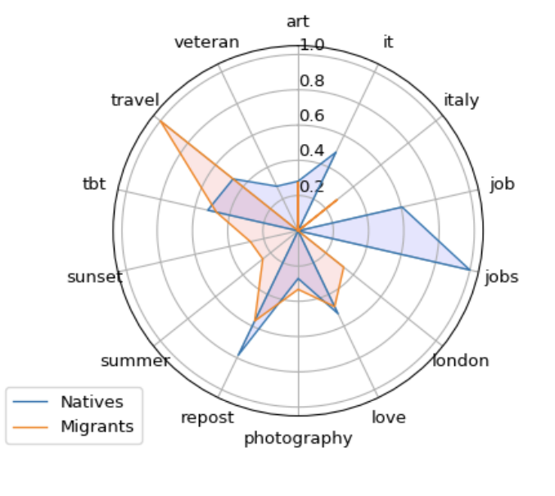
Migration
Top 10 hashtags used by migrants and natives (2018)
Common hashtags?
#tbt, #love and #art
Popular hashtags among natives?
#job, #jobs and #veteran
Popular hashtags among migrants?
#sunset, #photography and #summer
Notes:
Characterising different communities of Twitter users: Migrants and natives
What were the most popular hashtags used by natives and migrants in 2018?
In Figure 7 we display the top 10 hashtags used by the two communities with number of hashtags, scaled to [0, 1].
We observe that natives and migrants share some common interests but they also have differences. For instance, some of the common hashtags between natives and migrants are #tbt, #love and #art. Other hashtags such as #travel, and #repost are in the top list but the usage of these hashtags is much higher in one of the groups than the other. For instance, the hashtag #travel is much more used by migrants than the natives. This is interesting because the number of tweet locations of migrants also reflect their tendency to travel, more than natives. Followed by the hashtag #travel, migrants also used other hashtags such as #sunset, #photography, #summer, and hashtags for countries which show their interests in travelling. On the other hand, natives are more focused on hashtags such as #job, #jobs, and #veteran.

Slide 67
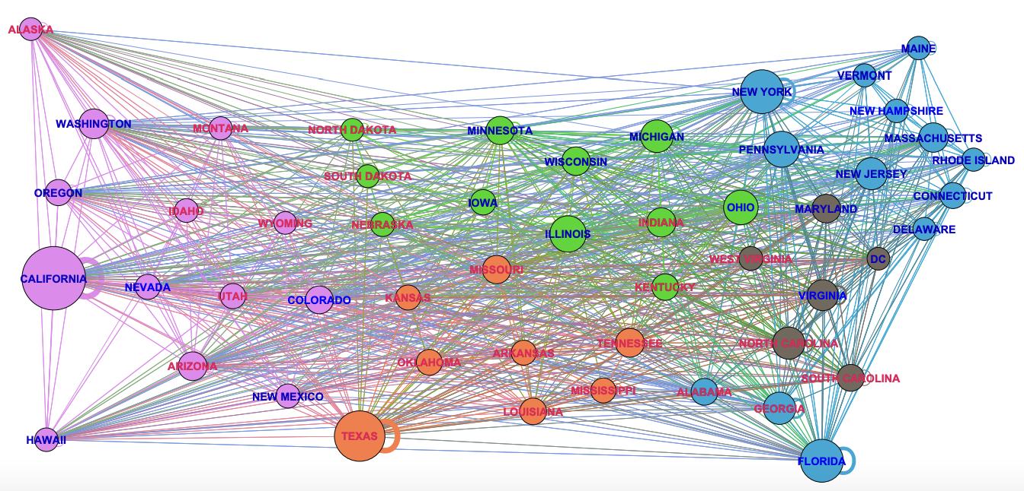
US Migration
How communities are formed?

Slide 68
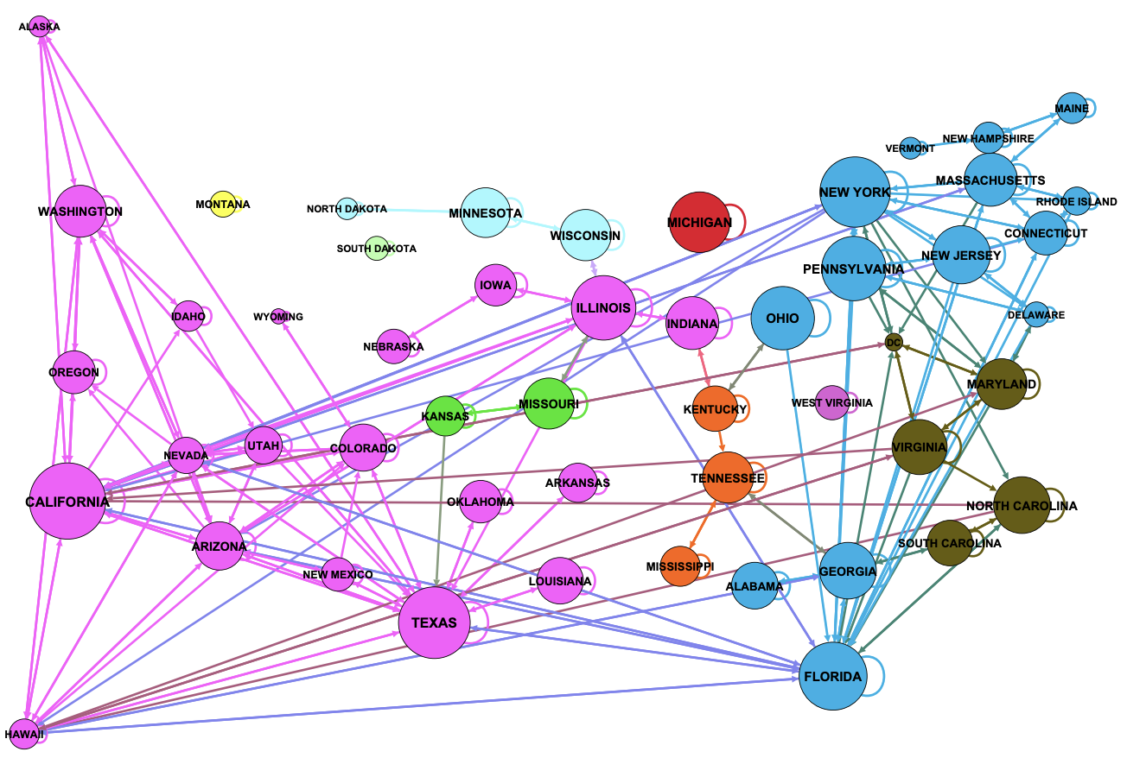
US Migration
How communities are formed?

Slide 69
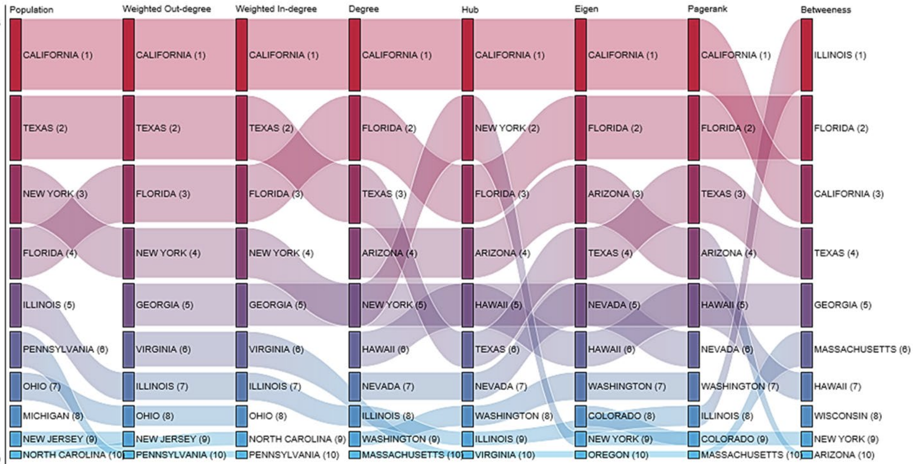
US Migration

Slide 70
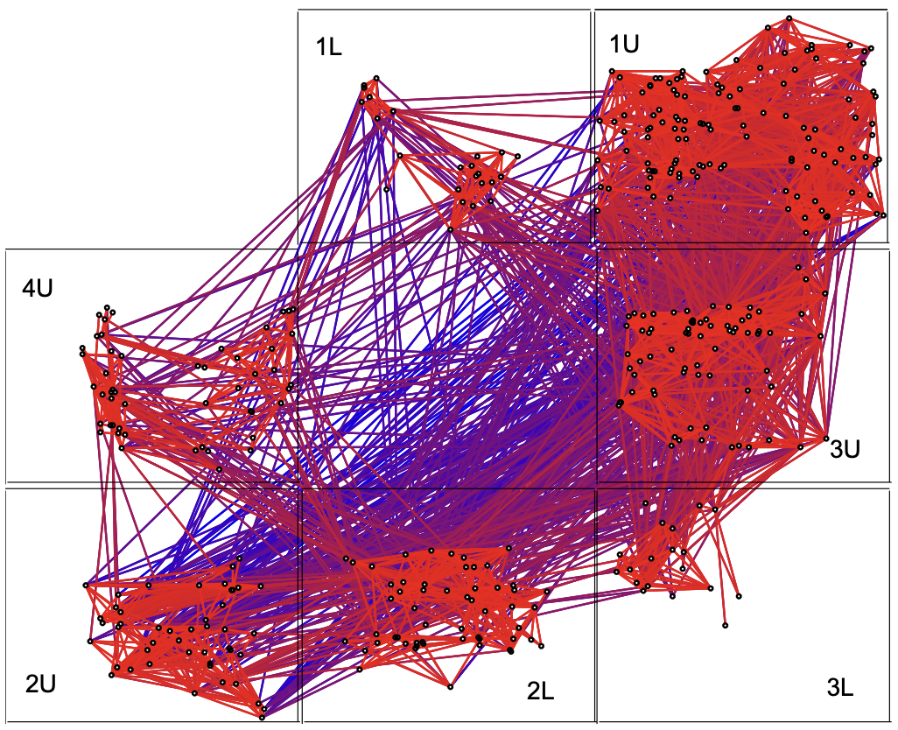
HP e-mail communication
Box represents a different floor in a building.
Red for nearby individuals,
blue for far away contacts (physical)
Notes:
Information Dynamics in the Networked World
DOI: 10.1023/A:1022077318642

Slide 71
Management
Barabasi Lab
Notes:
While traditionally management uses the official chain of command to understand the inner structure of an organization, it is increasingly evident that the informal network, capturing who really communicates with whom, matters even more for the success of a company. Accurate maps of this network can expose lack of communication between key units, can identify individuals who play an outsize role in bringing different departments and products together, and help higher management diagnose diverse organizational issues. Furthermore, there is increasing evidence in the management literature that the position of an employee within this network correlates with his/her productivity [18].
Therefore, several dozen consulting companies have emerged with expertise to map out the true structure of an organization. Established consulting firms, from IBM to SAP, have added social networking capabilities to their consulting business. These companies offer a host of services, from identifying opinion leaders to preventing employee churn and from identifying optimal groups for a task to modeling product diffusion (Image 1.10a/b/c/d). Hence lately network science tools are increasingly indispensable in management and business, enhancing productivity and boosting innovation within an organization.
Network science can therefore offer a microscope for higher management, helping them improve the company’s effectiveness by uncovering the true network behind any organization.
30 Let me show you how this works. Start from the list of a company’s employees, colored based on their location. This happens to be a Hungarian company that has three locations, one on Budapest and two others outside of the city.
This is not enough, however: To apply network science, we need a network: we need to know who listens to whom, who is asking for advice from whom. So a social network company, Maven 7, asked each employee: Whom do you ask for advice when it comes to decisions that impact the company, like, restructuring, advancement, and so on?

Slide 72
Barabasi Lab
Notes:
30 Why did they do map in the first place? The company had a major internal communication problem. The decisions of the higher management did not arrive to the workers, or what arrived had nothing do to with the real decisions. They wanted to find out where was the problem.
The map showed that several individuals do have quite a bit of influence in the company. They are the hubs. The problem was that none of the hubs were part of the leadership.

Slide 73
Barabasi Lab
Notes:
30: This is obvious here, where we colored the nodes based on their rank. The biggest hubs are not the company directors or the CEO. They are not part of the top management. Most are associates, a kind way to say, workers.
Who has the biggest influence? The safety and environmental manager. The only person whose job was to visit each location and talk with everyone. He had no links to the higher management. He was passing on information as collected along his trail. He was the oracle, running a gossip center.
So fire the guy? Well, he is not the problem. The problem is that higher management failed to put in place proper channels of communication, leaving behind a structural hole, which this fellow filled in.
But what does this have to do with control?

Slide 74
Links among blogs (2004 presidential election)
676 liberal and 659
conservative blogs
91% of links point
to blog of same persuasion
Conservative blogs show
greater tendency to link
82% of conservative blogs
linked to at least once; 84% link to at least one other blog
67% of liberal blogs are linked to at least once; 74% link to at least one other blog
Average # of links per blog is similar: 13.6 for liberal; 15.1 for conservative
Higher proportion of liberal blogs that are not linked to at all
Notes:
https://indico.ictp.it/event/a04190/session/83/contribution/62/material/0/0.pdf

Slide 75
Links among blogs (2004 presidential election)
Notes:
https://indico.ictp.it/event/a04190/session/83/contribution/62/material/0/0.pdf

Slide 76
Autonomous system (AS network)
Internet Core Networks

Slide 77
Internet Core Networks
Router network

Slide 78
Internet Core Networks

Slide 79
Internet as measured by Hal Burch and Bill Cheswick's Internet Mapping Project.

Slide 80
Recommender Systems
Friend suggestions
Community
Fake user detection

Slide 81
Recommender Systems
Recommending products
Ranking sellers
Bipartite graph
Reviews
Fake Review
User profile
Age
Gender
Season
Notes:
Got me onsite interview

Slide 82
Recommender Systems
Amazon book purchases
Books by female first authors
are significantly less likely than
expected to be bought by readers
who have chosen male authors
before.
Female first authors are only
slightly more likely than
expected to be bought by
readers who have chosen
female authors before
How?
Neighbourhood of nodes
Male first author
Female first author
Notes:
On the gender of books: author gender mixing in book communities
dataset of amazon.com book co-purchases,
author genders do not associate in a similar manner on the book market.
Books by female first authors are significantly less likely than expected to be bought by readers who have chosen male authors before;
this difference is substantial: the average femininity of the neighbourhood of a male-authored book is 0.14, which deviates from the expected 0.33 across the entire book market.
In contrast, books by female first authors are only slightly more likely than expected to be bought by readers who have chosen female authors before: the average femininity of the neighbourhood of a female-authored book is 0.39, fairly close to the expected 0.33 value. This same-gender preferential association is local: certain writing topics are “coloured” preferentially by one gender.
While this gender assortativity can be attributed to more than one cause (a gender’s preferential attachment to writing for one genre, or the buyers’ preferential attachment to the output of writers of one gender), the end result are gendered book communities. This conclusion is similar to that of other recent findings: strong maleto-male academic prosociality in [8], and male-dominated collaboration structures in engineering in [3].

Slide 83
Networks of Sexual and Drug Activity
Nodes in red have high betweenness
Notes:
Identifying Biomarkers for Important Nodes in Networks of Sexual and Drug Activity

Slide 84
Networks of Sexual and Drug Activity
Yellow nodes are crucial to partitions the network into some number
of disconnected components.
Notes:
Inferred Networks and the Social Determinants of Health 2021

Slide 85
Network Analysis of Music Preferences
English cluster
Spanish cluster
Notes:
Demographic Analysis of Music Preferences in Streaming Service Networks (Complenet 2020)
Creates matrix in which zero entry in the matrix at position i, j is a positive integer, indicating the total number of times the users from country i have streamed the song j. And compute cosine similarity of vectors
nodes represents the streaming counts.

Slide 86
Network Analysis of Music Preferences
Language has the biggest
influence on the
development of musical
communities
Classical genre
(almost have no words)
Notes:
Demographic Analysis of Music Preferences in Streaming Service Networks (Complenet 2020)
The main support of the hypothesis that language has the biggest influence on the development of musical communities is the fact that when looking at the genre which has almost no words at all - the classical genre, the communities that emerge are significantly more versatile in terms of language and geographical distance

Slide 87
Network Analysis of Music Preferences
Notes:
Demographic Analysis of Music Preferences in Streaming Service Networks (Complenet 2020)
Cluster with Sweden is not expected

Slide 88
Wrap up
Networks are everywhere and can be used to describe many, many systems
Network science research studies physical, biological, social, artificial, engineered, and other phenomena that arise in systems made of a large number of mutually interacting components whose macroscopic properties are not easy to understand or explain
By modeling networks we can start to understand their properties and the implications those properties have for processes occurring on the network

