Slide 1
Mathematics of Networks
CS 765: Complex Networks
Slides are adapted from
Constantine Dovrolis, Eileen Kraemer, Peter Dodds, and Sergei Maslov
and
Network Science by Albert-László Barabási

Slide 2
What are networks?
components: nodes, vertices N
interactions: links, edges L
system: network, graph (N, L)

Slide 3
What are networks?
Networks are collections of points joined by lines.
“Network” ≡ “Graph”
node
edge
points | lines | Domain
vertices | edges, arcs | math
nodes | links | computer science
sites | bonds | physics
actors | ties, relations | sociology

Slide 4
Network elements: edges
Directed (also called arcs)
  A -> B (E_{BA})
    A likes B, A gave a gift to B, A is B’s child
Undirected
  A <-> B or A – B
    A and B like each other
    A and B are siblings
    A and B are co-authors
Edge attributes
  weight (e.g. frequency of communication)
  ranking (best friend, second best friend…)
  type (friend, relative, co-worker)
  properties depending on the structure of the rest of the graph: e.g. betweenness
Multiedge: multiple edges between two pair of nodes
Self-edge: from a node to itself

Slide 5
Directed networks
girls’ school dormitory dining-table partners (Moreno, The sociometry reader, 1960)
first and second choices shown
2
2
Louise
2
Ada
1
Lena
1
1
1
Adele
Marion
2
2
1
2
2
1
Jane
1
2
2
Cora
2
1
Frances
2
1
2
Eva
1
Maxine
Mary
1
2
1
1
2
1
Anna
1
1
Edna
Ruth
Robin
Martha
2
1
Betty
2
2
1
2
1
2
2
Jean
1
2
1
2
1
2
1
Laura
Alice
1
Hazel
2
Helen
Hilda
2
1
Ellen
1
Who will be your friend?
2
Ella
Irene

Slide 6
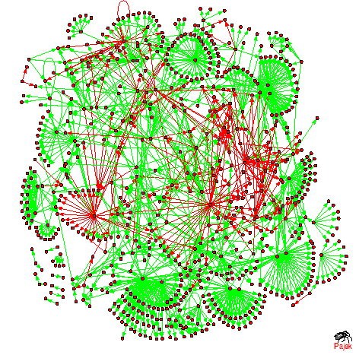

Edge weights can have positive or negative values
One gene activates/ inhibits another
One person trusting/ distrusting another
Research challenge:
  How does one ‘propagate’ negative feelings in a social network?
  Is my enemy’s enemy my friend?
Transcription regulatory
network in baker’s yeast
Notes:
Does - - is plus or is - - is negative
++ is it plus or is it negative
Depends on your research how you describe it, what about neutral values

Slide 7
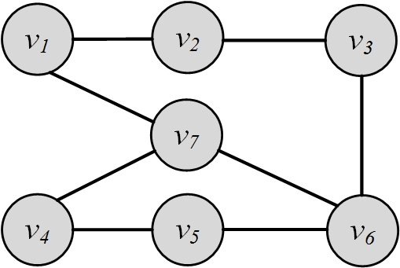
Graph Representation
Adjacency Matrix
Adjacency List
Edge List

Slide 8
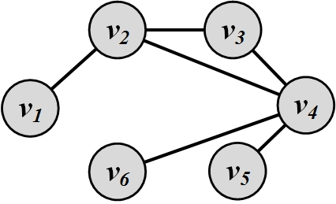
Graph Representation
Graph representation is straightforward
and intuitive, but it cannot be
effectively manipulated using
mathematical and computational tools
We are seeking representations that can store these two sets in a way such that
  Does not lose information
  Can be manipulated easily by computers
  Can have mathematical methods applied easily

Slide 9
Adjacency matrices
Representing edges (who is adjacent to whom) as a matrix
  A_{ij} = 1 if node i has an edge to node j
  = 0 if node i does not have an edge to j
  A_{ii} = 0 unless the network has self-loops
    If self-loop, A_{ii}=1
  A_{ij} = A_{ji} if the network is undirected,
  or if i and j share a reciprocated edge
j
i
i
j
i
Example:
0 | 0 | 0 | 0 | 0
0 | 0 | 1 | 1 | 0
0 | 1 | 0 | 1 | 0
0 | 0 | 0 | 0 | 1
1 | 1 | 0 | 0 | 0
2
3
A =
1
4
5

Slide 10
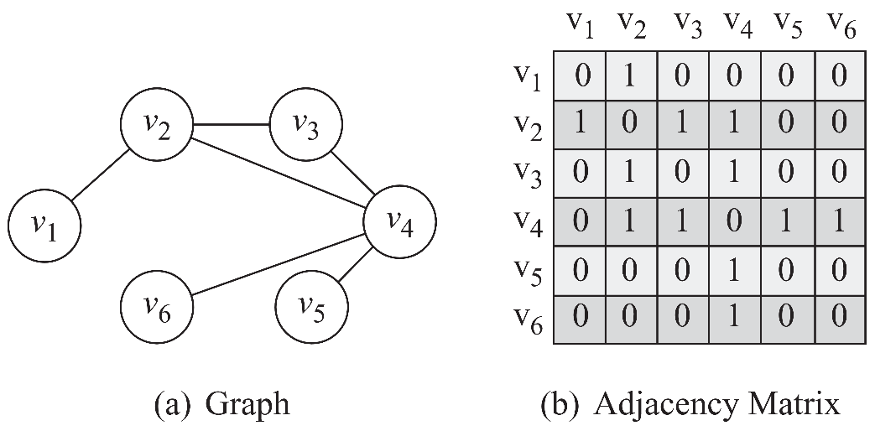
Adjacency Matrix (a.k.a. sociomatrix)
1, if there is an edge between nodes $v_{i}$ and $v_{j}$
0, otherwise
Diagonal Entries are self-links or loops
Real networks have very sparse Adjacency matrices
How it negatively impacts?

Slide 11
Adjacency List
In an adjacency list for every node, we maintain a list of all the nodes that it is connected to
The list is usually sorted based on the node order or other preferences

Slide 12
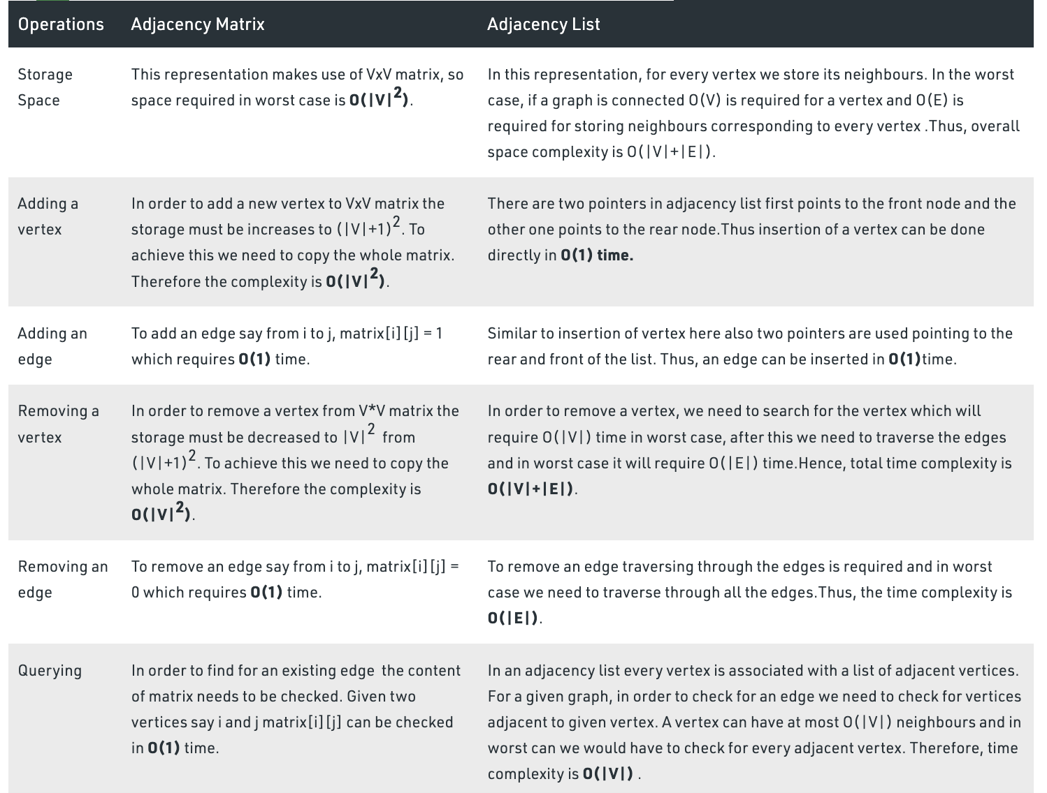
Adjacency Matrix vs Adjacency List

Slide 13

Edge List
In this representation, each element is an edge and is usually represented as $\left(u, v\right)$, denoting that node $u$ is connected to node $v$via an edge

Slide 14
Edge / Adjacency lists
Edge list
  2 3
  2 4
  3 2
  3 4
  4 5
  5 2
  5 1
Adjacency list
  is easier to work with if network is
    large
    sparse
  quickly retrieve all neighbors for a node
    1:
    2: 3 4
    3: 2 4
    4: 5
    5: 1 2
2
3
1
4
5

Slide 15
Types of Graphs
Null, Empty, Directed/Undirected/Mixed, Simple/Multigraph, Weighted, Signed Graph

Slide 16
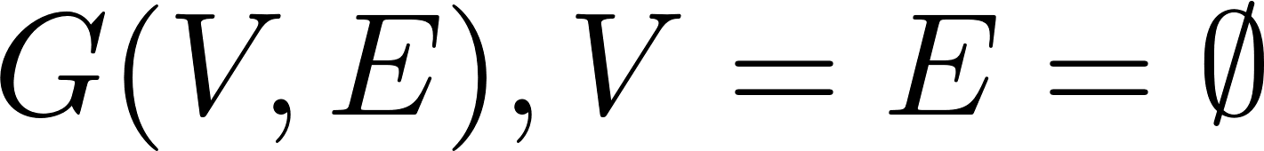
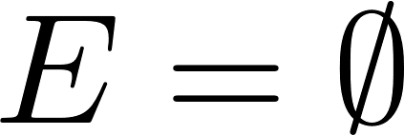
Null Graph and Empty Graph
A null graph is one where the node set is empty (there are no nodes)
  Since there are no nodes, there are also no edges
An empty graph or edge-less graph is one where the edge set is empty,
The node set can be non-empty
  A null-graph is an empty graph

Slide 17
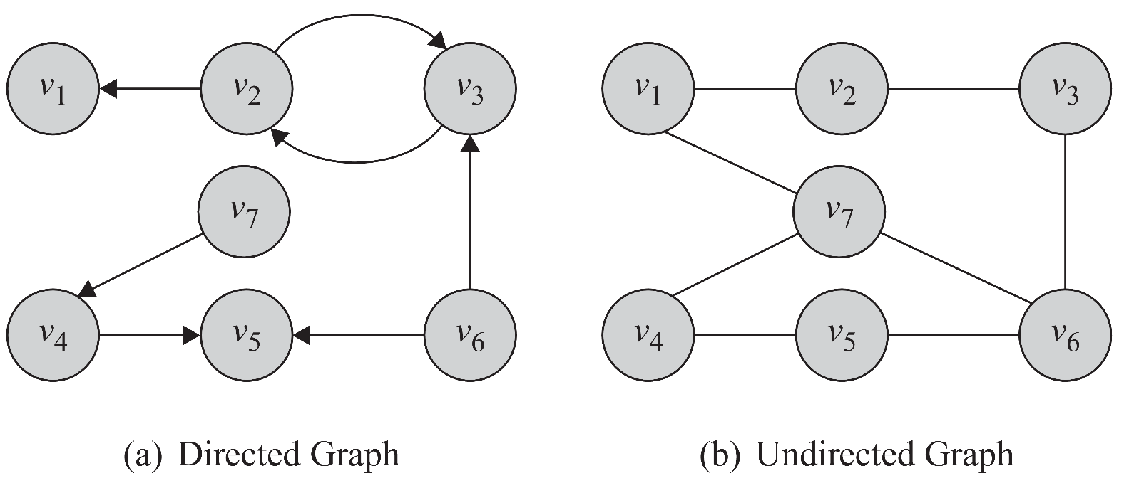

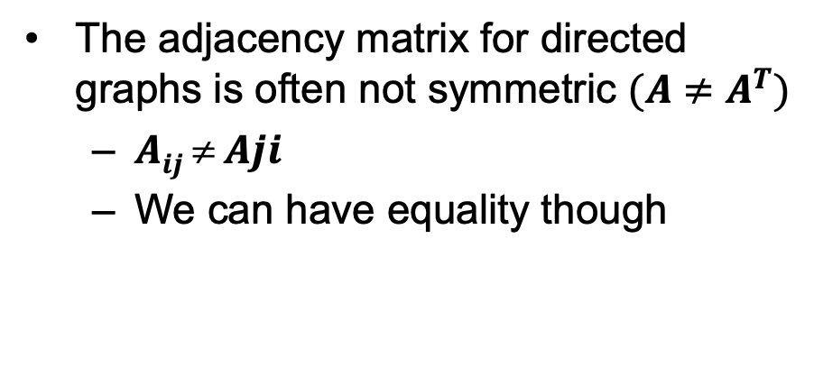
Directed/Undirected/Mixed Graphs
The adjacency matrix for directed graphs is often not symmetric $(A≠A^{T})$
  $Aij  Aji$
  We can have equality though
The adjacency matrix for undirected graphs is symmetric $(A=A^{T})$

Slide 18
Node Degree
Node network properties
  from immediate connections
    indegree
    how many directed edges (arcs) are incident on a node
    outdegree
    how many directed edges (arcs) originate at a node
    degree (in or out)
    number of edges incident on a node
indegree=3
outdegree=2
degree=5

Slide 19
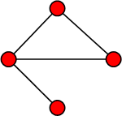
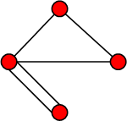
Simple Graphs and Multigraphs
Simple graphs are graphs where only a single edge can be between any pair of nodes
Multigraphs are graphs where you can have multiple edges between two nodes and loops
The adjacency matrix for multigraphs can include numbers larger than one, indicating multiple edges between nodes
Simple graph
Multigraph
Notes:
It is important for social network analysis as a pair can have more than one relations.

Slide 20
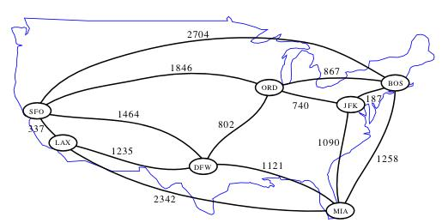

Weighted Graph
    A weighted graph $G(V, E, W)$is one where edges are associated with weights
For example, a graph could represent a map where nodes are airports and edges are routes between them
  The weight associated with each edge could represent the distance between the corresponding cities
Notes:
Image: http://www.cs.ucr.edu/~neal/2004/cs141/?ShortestPathsByDijkstras

Slide 21
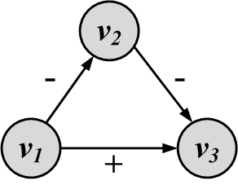
Signed Graph
When weights are binary (-1/1, +/-), we have a signed graph
It is used to represent friends or foes
It is also used to represent social status

Slide 22
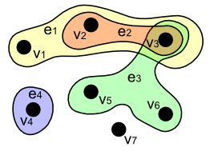
HyperGraphs
Edges join more than two nodes at a time (hyperEdge)
Affliation networks
Examples
  Families
  Coauthors, project members, etc

Slide 23
Bipartite (two-mode) networks
Edges occur only between two groups of nodes, not within those groups
For example, we may have individuals and events
  directors and boards of directors
  customers and the items they purchase
  metabolites and the reactions they participate in

Slide 24
In matrix notation
B_{ij}
  = 1 if node i from the first group
  links to node j from the second group
  = 0 otherwise
B is usually not a square matrix!
  for example: we have n customers and m products
i
j
1 | 0 | 0 | 0
1 | 0 | 0 | 0
1 | 1 | 0 | 0
1 | 1 | 1 | 1
0 | 0 | 0 | 1
B =

Slide 25
Going from a bipartite to a one-mode graph
group 1
Two-mode network
One mode projection
  Two nodes from the first group are connected if they link to the same node in the second group
  Naturally high occurrence of cliques
  Some loss of information
  Can use weighted edges to preserve group occurrences
group 2

Slide 26
Collapsing to a one-mode network
i
j
i and j are linked if they both link to k
P_{ij} = ∑_{k} B_{ik} B_{jk}
P’ = B B^{T}
  the transpose of a matrix swaps B_{xy} and B_{yx}
  if B is an nxm matrix, B^{T} is an mxn matrix
k=1
k=2
1 | 0 | 0 | 0
1 | 0 | 0 | 0
1 | 1 | 0 | 0
1 | 1 | 1 | 1
0 | 0 | 0 | 1
1 | 1 | 1 | 1 | 0
0 | 0 | 1 | 1 | 0
0 | 0 | 0 | 1 | 0
0 | 0 | 0 | 1 | 1
B =
B^{T} =

Slide 27
Matrix multiplication
General formula for matrix multiplication Z_{ij}= ∑_{k} X_{ik} Y_{kj}
Let Z = P’, X = B, Y = B^{T}
1 | 1 | 1 | 1 | 0
1 | 1 | 1 | 1 | 0
1 | 1 | 2 | 2 | 0
1 | 1 | 2 | 4 | 1
0 | 0 | 0 | 1 | 1
1 | 0 | 0 | 0
1 | 0 | 0 | 0
1 | 1 | 0 | 0
1 | 1 | 1 | 1
0 | 0 | 0 | 1
1 | 1 | 1 | 1 | 0
0 | 0 | 1 | 1 | 0
0 | 0 | 0 | 1 | 0
0 | 0 | 0 | 1 | 1
P’ =
=
1 | 1 | 1 | 1
1
1
0
0
1
1
= 1*1+1*1
+ 1*0 + 1*0
= 2
1
1
2
What are the diagonal values?

Slide 28
Collapsing a two-mode network to a one mode-network
Assume the nodes in group 1 are people and the nodes in group 2 are movies
P’ is symmetric
The diagonal entries of P’ give the number of movies each person has seen
The off-diagonal elements of P’ give the number of movies that both people have seen
1 | 1 | 1 | 1 | 0
1 | 1 | 1 | 1 | 0
1 | 1 | 2 | 2 | 0
1 | 1 | 2 | 4 | 1
0 | 0 | 0 | 1 | 1
1
1
P’ =
1
1
2

Slide 29
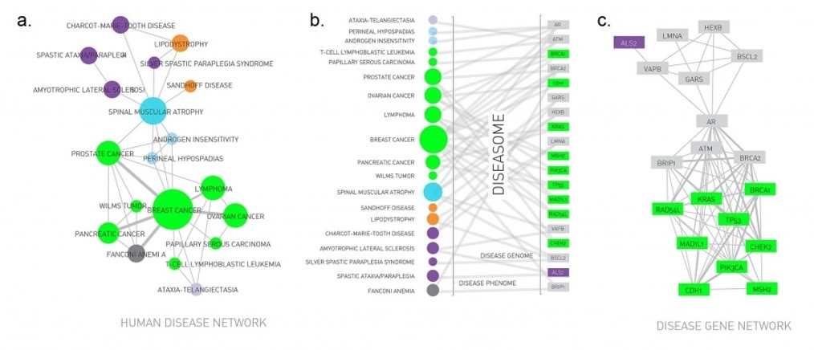
Human Disease Network
Disease network
Human Disease
Network (or diseaseome)
Gene network
Notes:
One projection of the diseaseome is the disease network, whose nodes are diseases. Two diseases are connected if the same genes are associated with them, indicating that the two diseases have common genetic origin. Figures (a)-(c) shows a subset of the diseaseome, focusing on cancers.
The Human Disease Network (or diseaseome) is a bipartite network, whose nodes are diseases (U) and genes (V). A disease is connected to a gene if mutations in that gene are known to affect the particular disease [4].
The second projection is the gene network, whose nodes are genes, and where two genes are connected if they are associated with the same disease.
The full diseaseome, connecting 1,283 disorders via 1,777 shared disease genes. After [1]. See Video 2.2 for the detailed map.

Slide 30
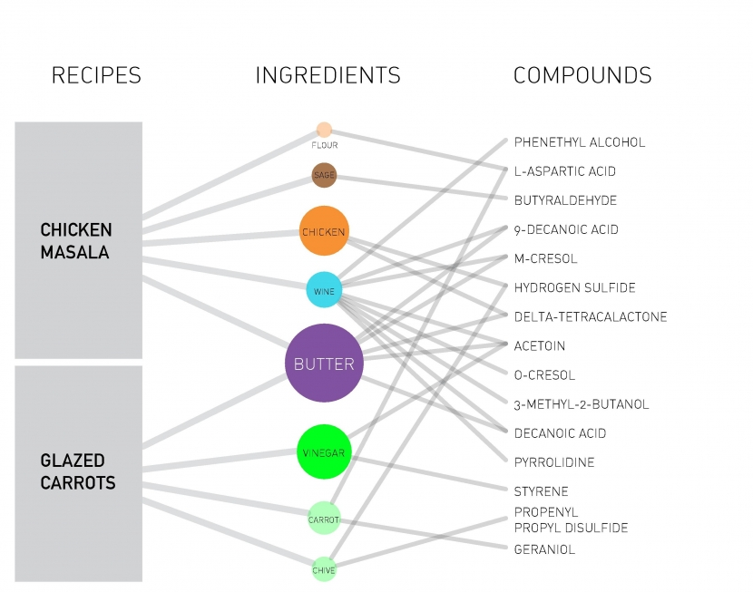
Multi-partite Networks
Notes:
The construction of the tripartite recipe-ingredient- compound network, in which one set of nodes are recipes, like Chicken Marsala; the second set corresponds to the ingredients each recipe has (like flour, sage, chicken, wine, and butter for Chicken Marsala); the third set captures the flavor compounds, or chemicals that contribute to the taste of each ingredient.

Slide 31
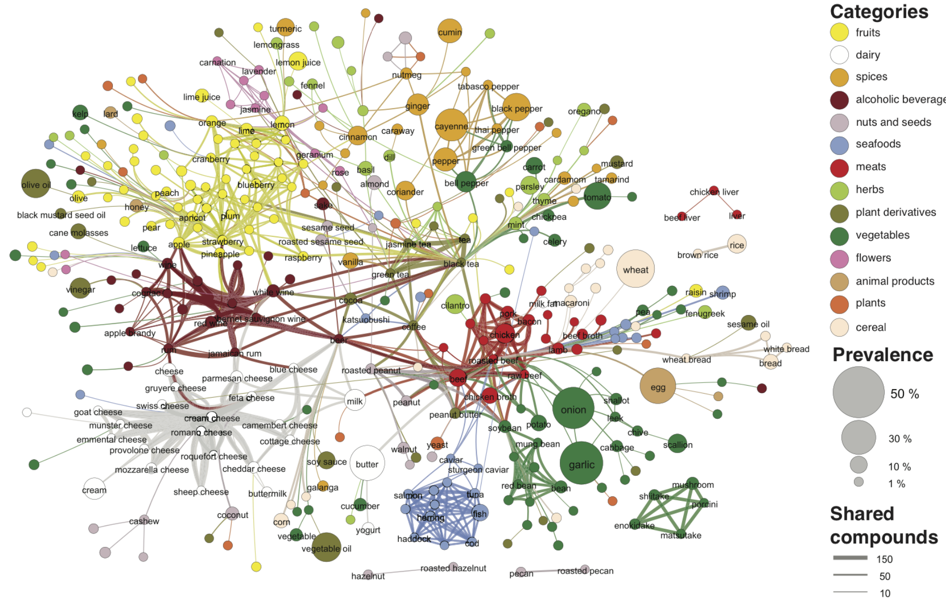
Multi-partite Networks
Each node denotes an ingredient, the node color indicates food category,
and node size reflects the ingredient prevalence in recipes.
Notes:
The ingredient or the flavor network represents a projection of the tripartite network. Each node denotes an ingredient; the node color indicating the food category and node size indicates the ingredient’s prevalence in recipes. Two ingredients are connected if they share a significant number of flavor compounds. Link thickness represents the number of shared compounds.

Slide 32
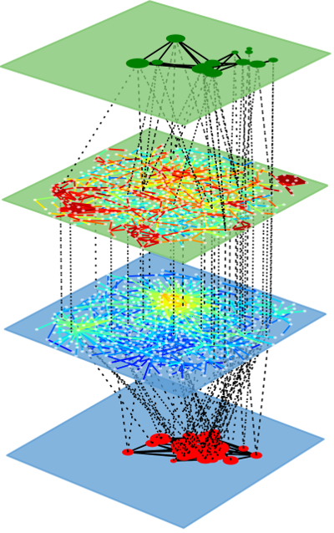
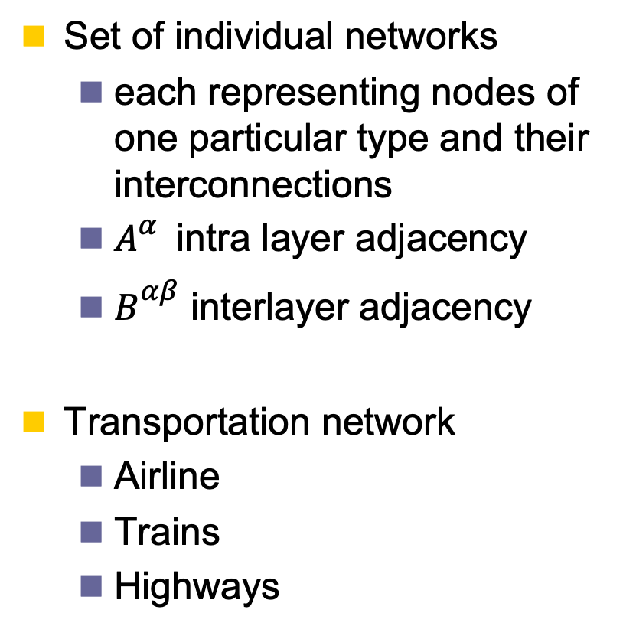
Multilayer Networks
Set of individual networks
  each representing nodes of one particular type and their interconnections
  $A_{}^{α}$ intra layer adjacency
  $B_{}^{αβ}$ interlayer adjacency
Transportation network
  Airline
  Trains
  Highways
How it can be used?

Slide 33
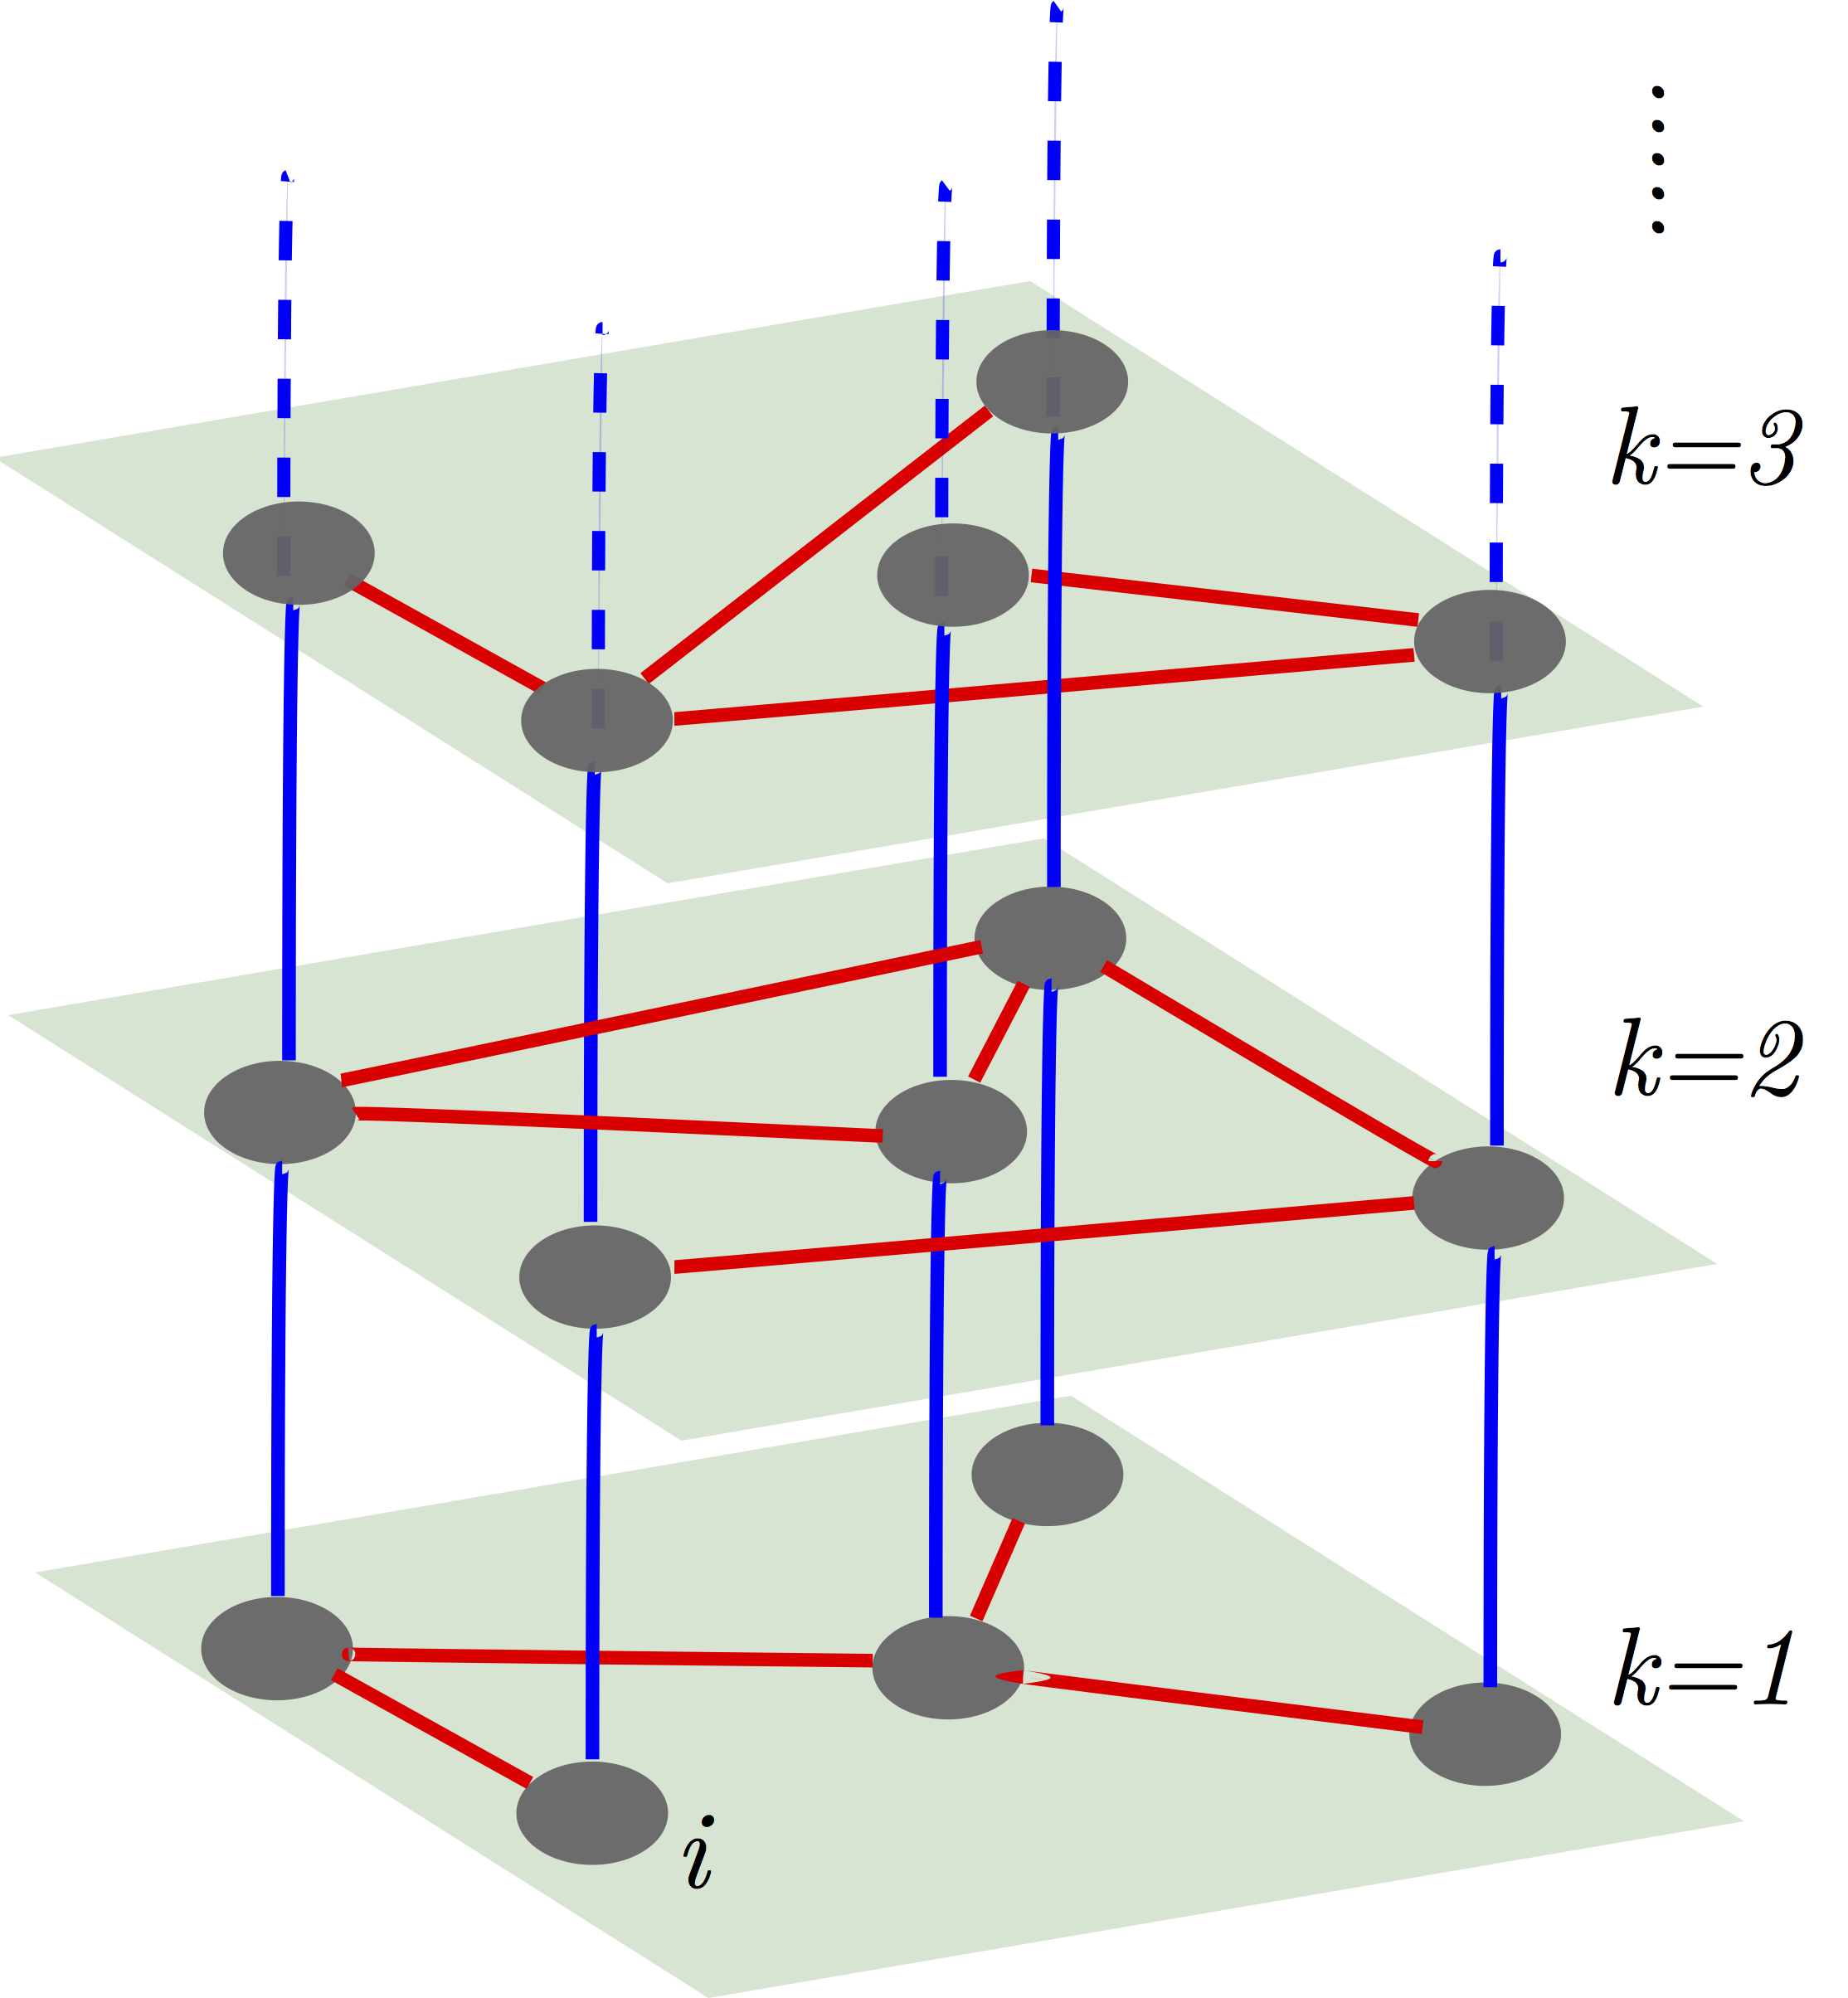
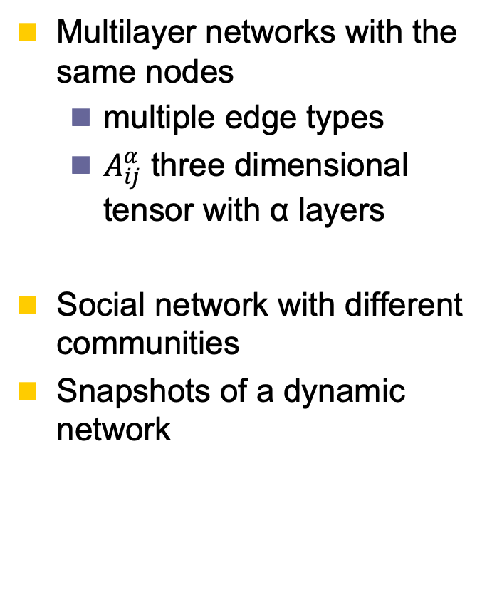
Multiplex Networks
Multilayer networks with the same nodes
  multiple edge types
  $A_{ij}^{α}$ three dimensional tensor with α layers
Social network with different communities
Snapshots of a dynamic network
How it can be used?

Slide 34
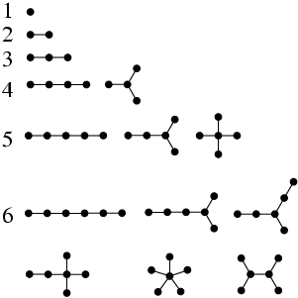
Trees
Trees are undirected graphs that contain no cycles
For n nodes, number of edges m = n-1
Any node can be dedicated as the root

Slide 35
Examples of trees
In nature
  trees
  river networks
  arteries (or veins, but not both)
Man made
  sewer system
Computer science
  binary search trees
  decision trees (AI)
Network analysis
  minimum spanning trees
    from one node – how to reach all other nodes most quickly
    may not be unique, because shortest paths are not always unique
    depends on weight of edges

Slide 36
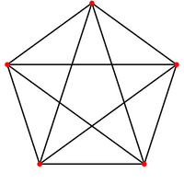
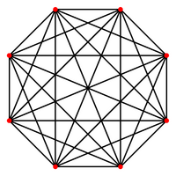
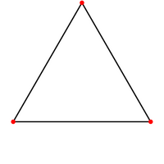
Cliques and complete graphs
K_{n} is the complete graph (clique) with K vertices
  each vertex is connected to every other vertex
  there are n*(n-1)/2 undirected edges
K₃
K₅
K₈

Slide 37
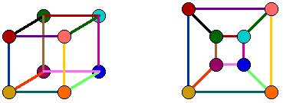
Planar graphs
A graph is planar if it can be drawn on a plane without any edges crossing

Slide 38
Bi-cliques (cliques in bipartite graphs)
  K_{m,n} is the complete bipartite graph with m and n vertices of the two different types
  K_{3,3} maps to the utility graph
    Is there a way to connect three utilities, e.g. gas, water, electricity to three houses without having any of the pipes cross?
Utility graph
K_{3,3}

Slide 39
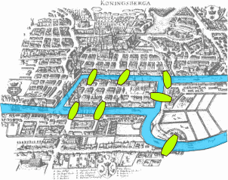
Eulerian Path
Euler’s Seven Bridges of Königsberg
  the first problem in graph theory
  1735
Is there a route that crosses each bridge only once and returns to the starting point?
e₁
B
C
e₂
e₆
A
D
A
e₅
D
e₄
B
e₃
e₇
B
http://barabasi.com/networksciencebook/chapter/2

Slide 40
A Characterization for Eulerian Graphs
Theorem: G is Eulerian ⬄ G is even and connected
Idea:
In an Eulerian circuit C, each time C goes through a vertex exactly two incident edges are used
The first edge of C is paired with the last one
Hence every vertex has even degree
Start (The 1st)
In
Out
End (The last)

Slide 41
Eulerian Circuits and Trails
A graph is Eulerian if it has a circuit containing all edges
(may repeat vertices but not edges)
Eulerian circuit: same start and end
Eulerian trail: different start and end
Each contains
all edges
without repetition

Slide 42
Eulerian and Hamiltonian paths
Hamiltonian path is self avoiding
Determining whether such paths and cycles exist in graphs is the Hamiltonian path problem, which is NP-complete.
Eulerian path: traverse each
edge exactly once
Hamiltonian path: visit
each vertex exactly once

Slide 43
Random walk
A walk that in each step the next node is selected randomly among the neighbors
  The weight of an edge can be used to define the probability of visiting it

Slide 44
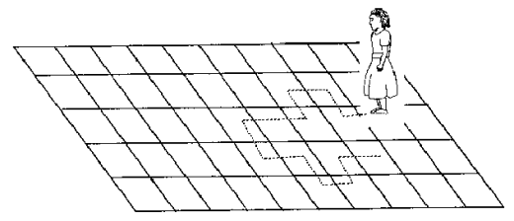
Random Walk: Example
Mark a spot on the ground
  Stand on the spot and flip the coin (or more than one coin depending on the number of choices such as left, right, forward, and backward)
  If the coin comes up heads, turn to the right and take a step
  If the coin comes up tails, turn to the left and take a step
  Keep doing this many times and see where you end up

Slide 45
Connectivity in Graphs
Adjacent nodes/Edges, Walk/Path/Trail/Tour/Cycle

Slide 46
Adjacent nodes and Incident Edges
Two nodes are adjacent, if they are connected via an edge.
Two edges are incident, if they share one end-point
When the graph is directed, edge directions must match for edges to be incident

Slide 47
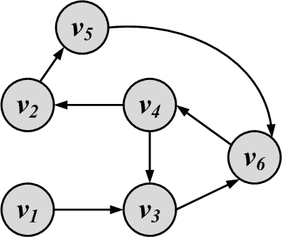
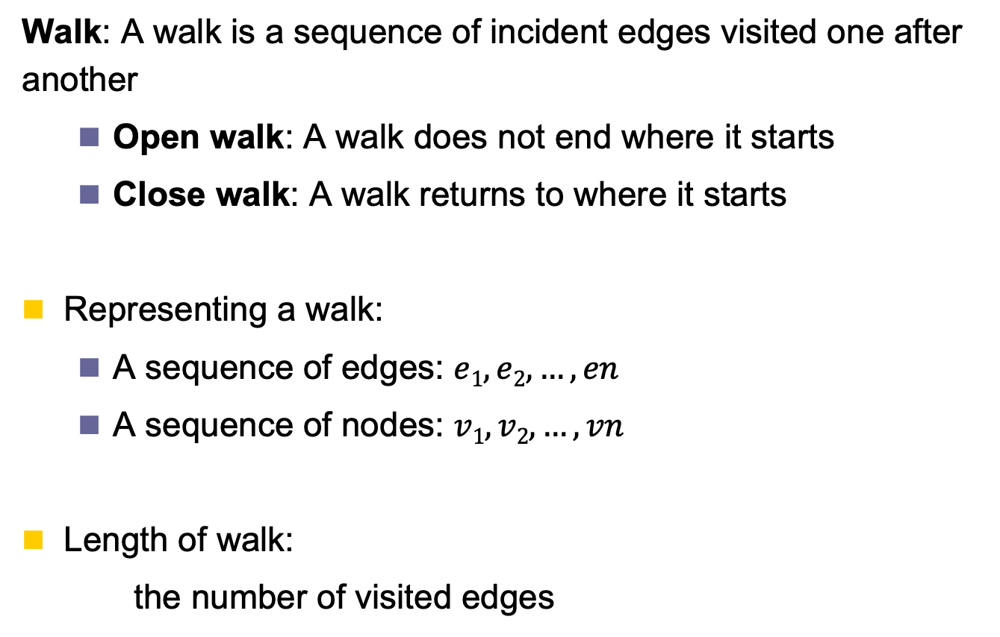
Walk
Walk: A walk is a sequence of incident edges visited one after another
  Open walk: A walk does not end where it starts
  Close walk: A walk returns to where it starts
Representing a walk:
  A sequence of edges: $e1, e2, …, en$
  A sequence of nodes: $v1, v2, …, vn$
Length of walk:
the number of visited edges
Length of walk= 8

Slide 48
Trail, Tour
A trail is a walk where no edge is visited more than once and all walk edges are distinct
A closed trail (one that ends where it starts) is called a tour or circuit

Slide 49
Path, Cycle
A walk where nodes and edges are distinct is called a path
A closed path is called a cycle
The length of a path or cycle is the number of edges visited in the path or cycle
Length of path= 4

Slide 50
Network Metrics
CS 765: Complex Networks
Slides are modified from Networks: Theory and Application by Lada Adamic

Slide 51
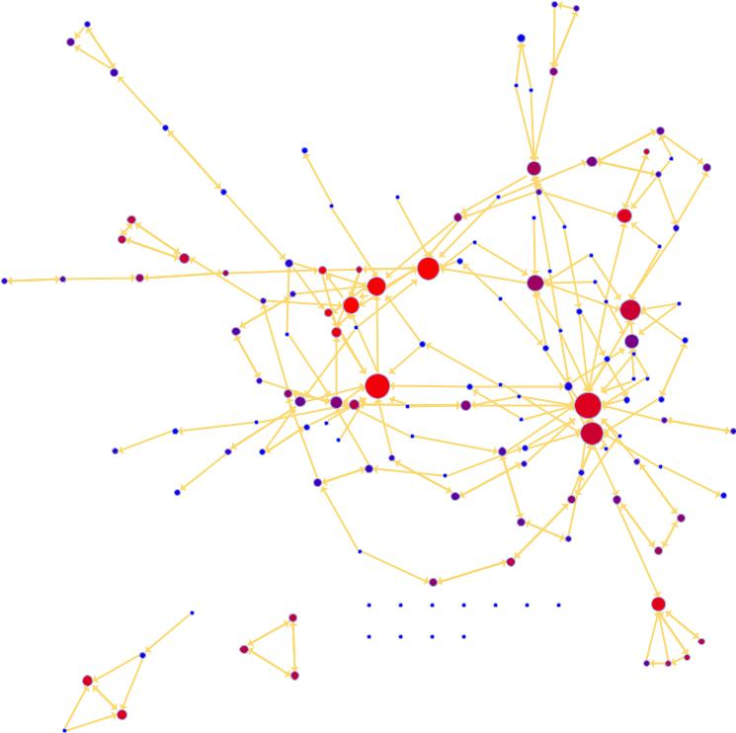
Characterizing networks:
Is everything connected?

Slide 52
Network metrics: components
If there is a path from every vertex in a network to every other, the network is connected
  otherwise, it is disconnected
Component: A subset of vertices such that there exist at least one path from each member of the subset to others
A singeleton vertex that is not connected to any other forms a size one component
Every vertex belongs to exactly one component

Slide 53
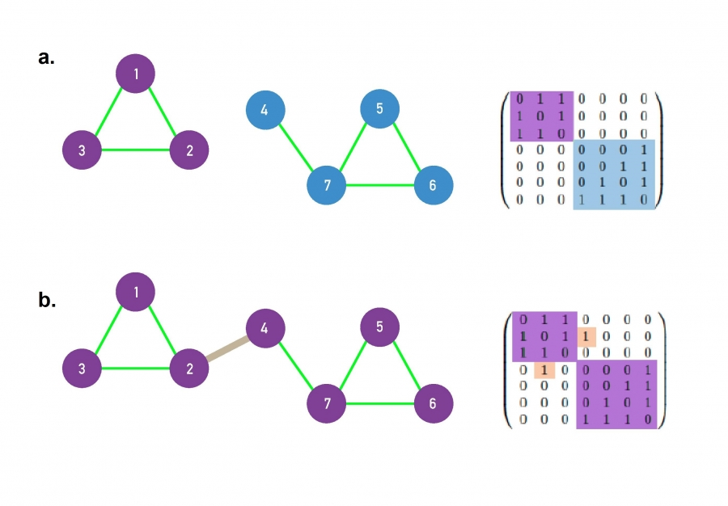
Connectedness

Slide 54
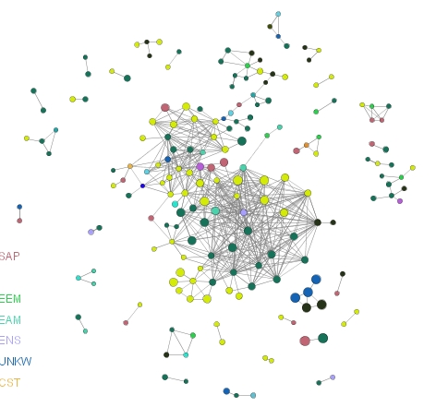
Network metrics: size of giant component
If the largest component encompasses a significant fraction of the graph, it is called the giant component
Pay attention in your projects?

Slide 55
Components in directed networks
Weakly connected components:
  Every node can be reached from every other node by following links in either direction
B
F
C
G
  Weakly connected components
    A B C D E
    G H F
A
H
D
E
Strongly connected components
  Each node within the component can be reached from every other node in the component by following directed links
B
C
F
G
  Strongly connected components
    B C D E
    A
    G H
    F
A
H
D
E

Slide 56
Components in directed networks
Every strongly connected component of more than one vertex has at least one cycle
Out-component: set of all vertices that are reachable via directed paths starting at a specific vertex v
  Out-components of all members of a strongly connected component are identical
In-component: set of all vertices from which there is a direct path to a vertex v
  In-components of all members of a strongly connected component are identical
F
G
B
A
C
H
D
E

Slide 57
Characterizing networks:
How far apart are things?

Slide 58
Network metrics: paths
A path is any sequence of vertices such that every consecutive pair of vertices in the sequence is connected by an edge in the network.
  For directed: traversed in the correct direction for the edges.
Path can visit itself (vertex or edge) more than once
  Self-avoiding paths do not intersect themselves.
Path length r is the number of edges on the path
  Called hops

Slide 59
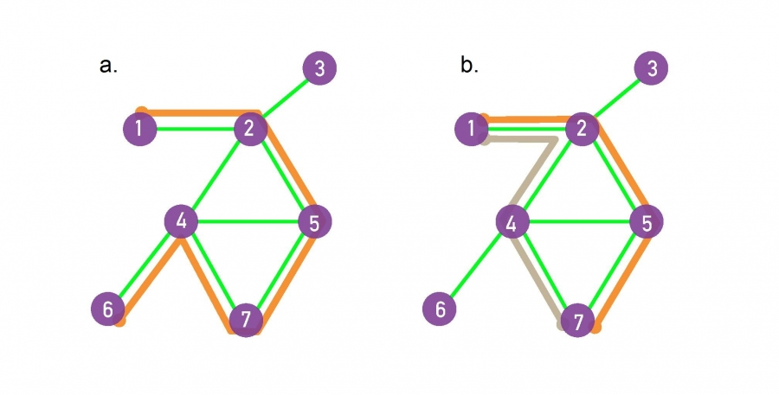
Paths
A path between nodes i₀ and i_{n} is an ordered list of n links P = {(i₀, i₁), (i₁, i₂), (i₂, i₃), ... ,(i_{n-1}, i_{n})}.
The length of the path is n.
  The path shown in orange in (a) follows the route 1→2→5→7→4→6, hence its length is n = 5
The shortest paths between nodes 1 and 7, or the distance d₁₇, correspond to the path with the fewest number of links that connect nodes 1 to 7.
  There can be multiple paths of the same length, as illustrated by the two paths shown in orange and grey.
The network diameter is the largest distance in
the network
  being d_{max} = 3 here.

Slide 60
Independent paths
Edge independent paths: if they share no common edge
Vertex independent paths: if they share no common vertex except start and end vertices
  Vertex-independent => Edge-independent
Also called disjoint paths
  These set of paths are not necessarily unique
Connectivity of vertices: the maximal number of independent paths between a pair of vertices
  Used to identify bottlenecks and resiliency to failures

Slide 61
Cut Sets and Maximum Flow
A minimum cut set is the smallest cut set that will disconnect a specified pair of vertices
  Need not to be unique
Menger’s theorem: If there is no cut set of size less than n between a pair of vertices, then there are at least n independent paths between the same vertices
  Implies that the size of min cut set is equal to maximum number of independent paths
    for both edge and vertex independence
Maximum Flow between a pair of vertices is the number of edge independent paths times the edge capacity

Slide 62
Network metrics: shortest paths
Shortest path (also called a geodesic path)
  The shortest sequence of links connecting two nodes
A and C are connected by 2 shortest paths
  A – E – B – C
  A – E – D – C
  geodesic distance is 3
If vertices are disconnected geodesic distance is infinite
Shortest paths are self avoiding paths
Not always unique
Diameter: the largest geodesic distance in graph
  The distance between A and C is the maximum for the graph: 3
B
3
C
A
2
1
3
D
E
2

Slide 63
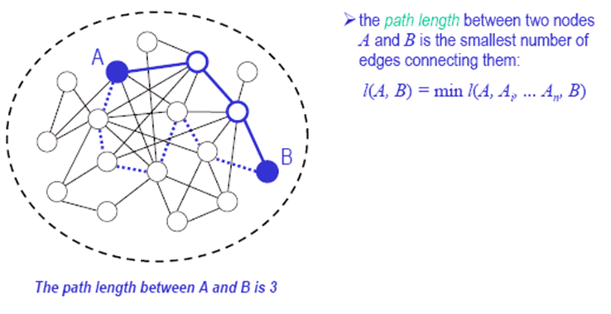
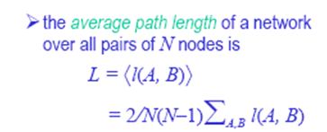

Structural metrics:
Average path length
1 ≤ L ≤ D ≤ N-1

Slide 64
PATHOLOGY: summary
Shortest Path
1
2
5
3
4
The path with the shortest length between two nodes (distance).
Network Science: Graph Theory

Slide 65
PATHOLOGY: summary
Diameter
Average Path Length
1
1
2
5
2
5
3
4
3
4
The longest shortest path in a graph
The average of the shortest paths for all pairs of nodes.
Network Science: Graph Theory

Slide 66
PATHOLOGY: summary
Cycle
Self-avoiding Path
1
1
2
5
2
5
3
4
3
4
A path with the same start and end node.
A path that does not intersect itself.
Network Science: Graph Theory

Slide 67
PATHOLOGY: summary
Eulerian Path
Hamiltonian Path
1
1
2
5
2
5
3
4
3
4
A path that traverses each link exactly once.
A path that visits each node exactly once.
Network Science: Graph Theory

Slide 68
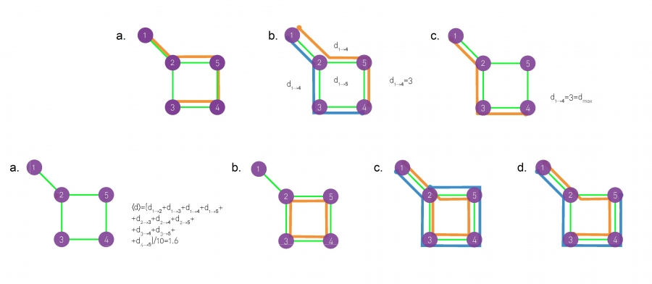
Paths
path
Shortest path
Diameter
Average path length
Cycle
Eulerian path
Hamiltonian path

Slide 69
Node degree
2
3
Outdegree =
1
5
4
example: outdegree for node
3 is 2, which we obtain by
summing the number of
non-zero entries in the 3rd row
0 | 0 | 0 | 0 | 0
0 | 0 | 1 | 1 | 0
0 | 1 | 0 | 1 | 0
0 | 0 | 0 | 0 | 1
1 | 1 | 0 | 0 | 0
A =
Indegree =
0 | 0 | 0 | 0 | 0
0 | 0 | 1 | 1 | 0
0 | 1 | 0 | 1 | 0
0 | 0 | 0 | 0 | 1
1 | 1 | 0 | 0 | 0
example: the indegree for node
3 is 1, which we obtain by
summing the number of
non-zero entries in the 3rd column
A =

Slide 70
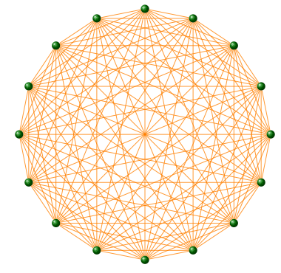
Node degrees
The maximum number of links a network
of N nodes can have is:
A graph with degree L=L_{max} is called a complete graph,
and its average degree is <k>=N-1

Slide 71
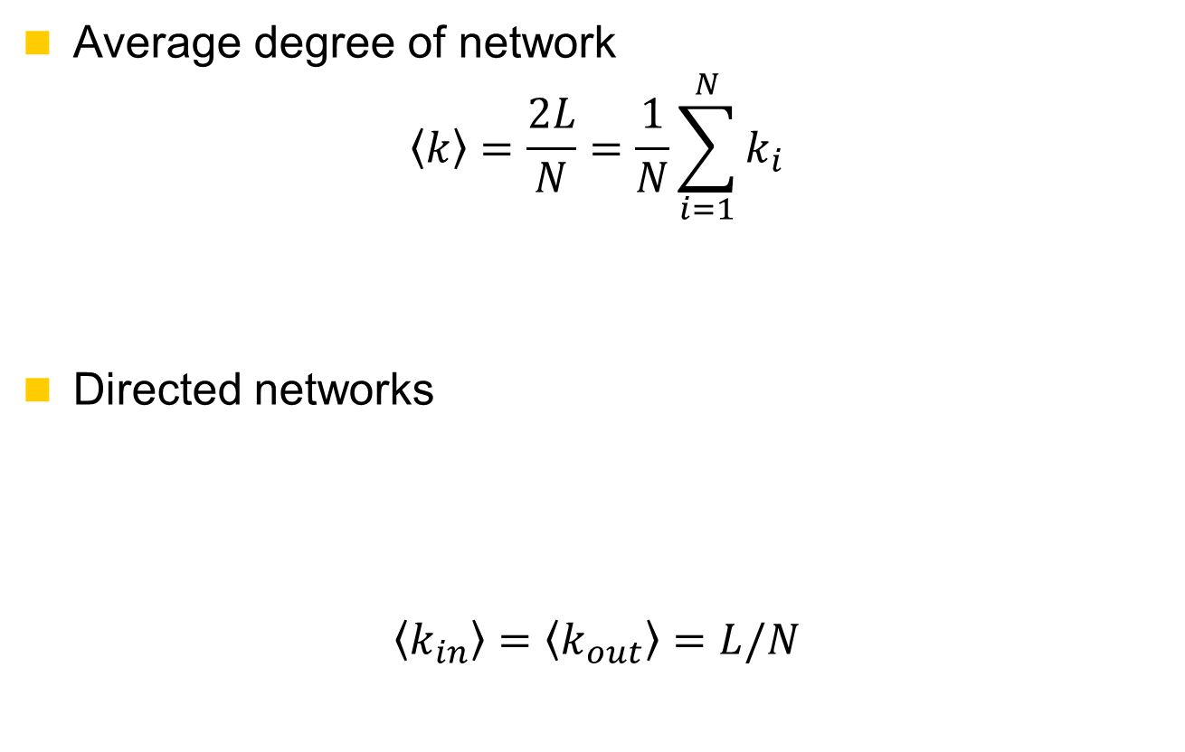
Node degrees

Slide 72
Degree sequence and Degree frequency
Degree sequence: An ordered list of the (in,out) degree of each node
  In-degree sequence:
    [2, 2, 2, 1, 1, 1, 1, 0] a, b, c, d, e, f, g, h
  Out-degree sequence:
    [2, 2, 2, 1, 1, 1, 1, 0] a, e, f, b, c, g, h, d
  (undirected) degree sequence:
    [3, 3, 3, 2, 2, 1, 1, 1] a, b, e, c, f, d, g, h
a
h
g
d
f
e
c
b
Degree frequency: A frequency count of the occurrence of each degree
  In-degree frequency:
    [(2,3) (1,4) (0,1)]
  Out-degree frequency :
    [(2,3) (1,4) (0,1)]
  (undirected) frequency :
    [(3,3) (2,2) (1,3)]

Slide 73
Degree distribution
The degree distribution is a function P(k), which gives the probability of a randomly chosen node from the graph having degree k
In-degree | 0 | 1 | 2 | 3
Frequency | 1 | 4 | 3 | 0
Distribution | 0.13 | 0.50 | 0.38 | 0.00
Out-degree | 0 | 1 | 2 | 3
Frequency | 1 | 4 | 3 | 0
Distribution | 0.13 | 0.50 | 0.38 | 0.00
Degree | 0 | 1 | 2 | 3
Frequency | 0 | 3 | 2 | 3
Distribution | 0.00 | 0.38 | 0.25 | 0.38

Slide 74
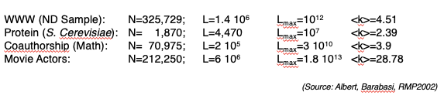
Degree distribution
Most networks observed in real systems are sparse:
L << L_{max}
or
<k> <<N-1.

Slide 75
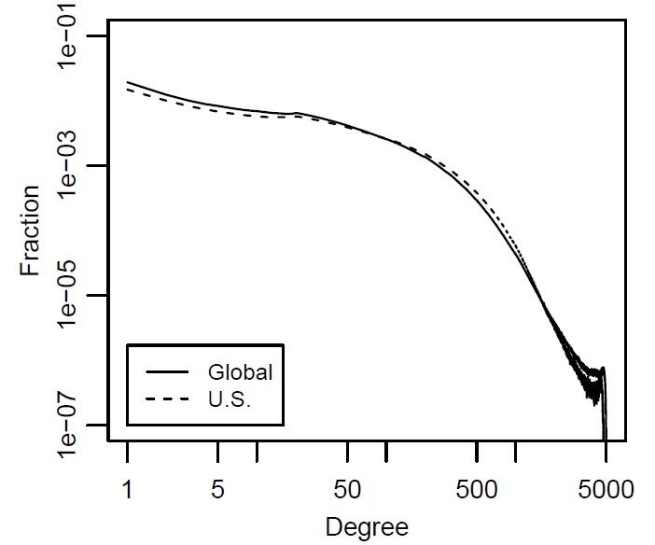
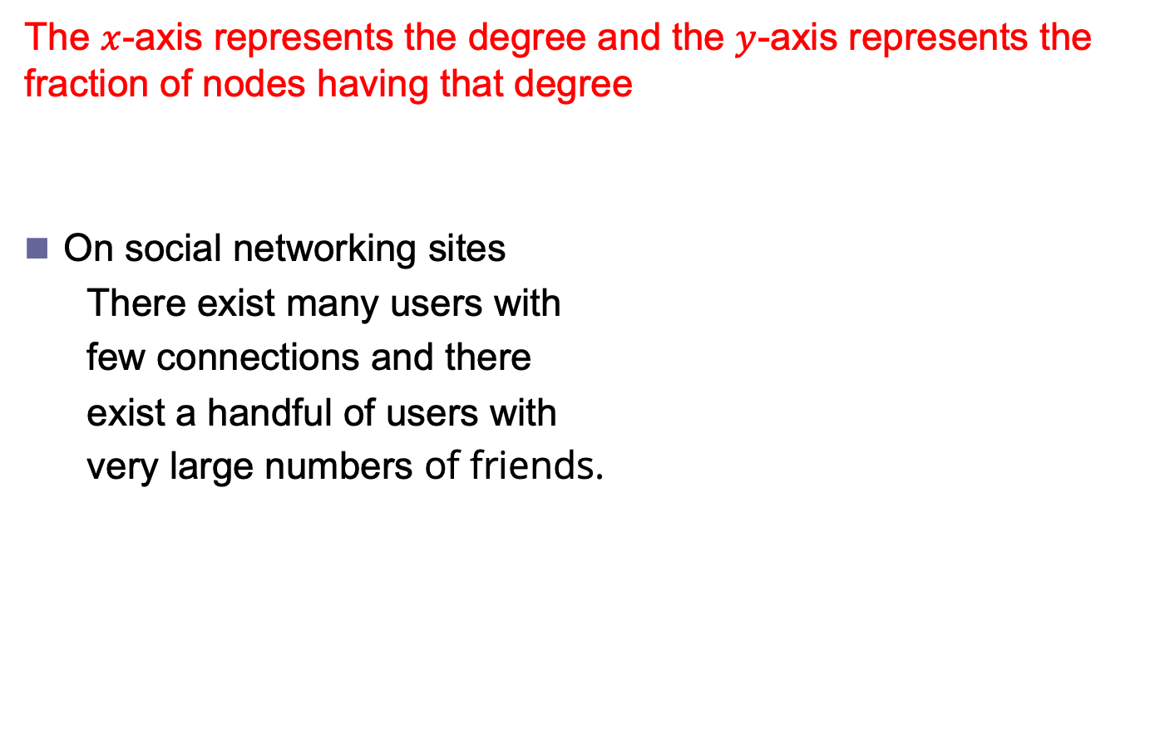
Degree Distribution Plot
  The $x$-axis represents the degree and the $y$-axis represents the fraction of nodes having that degree
  On social networking sites
    There exist many users with
    few connections and there
    exist a handful of users with
    very large numbers of friends.
Facebook
Degree Distribution

Slide 76
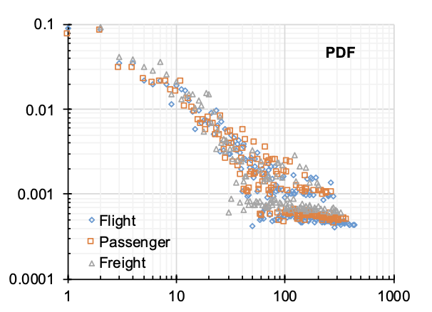
Degree Distributions
Degree distribution of air transportation network (2016)

Slide 77
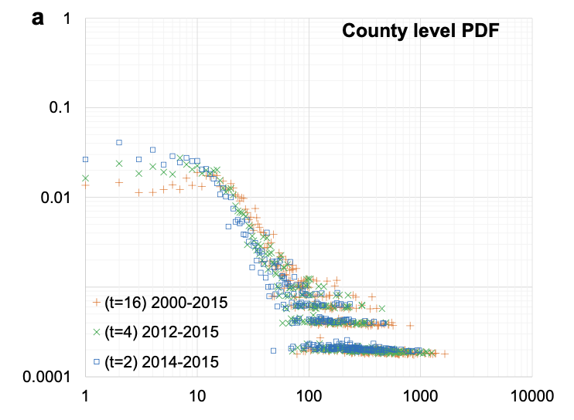
Degree Distributions
Degree distribution of US county migration network

Slide 78
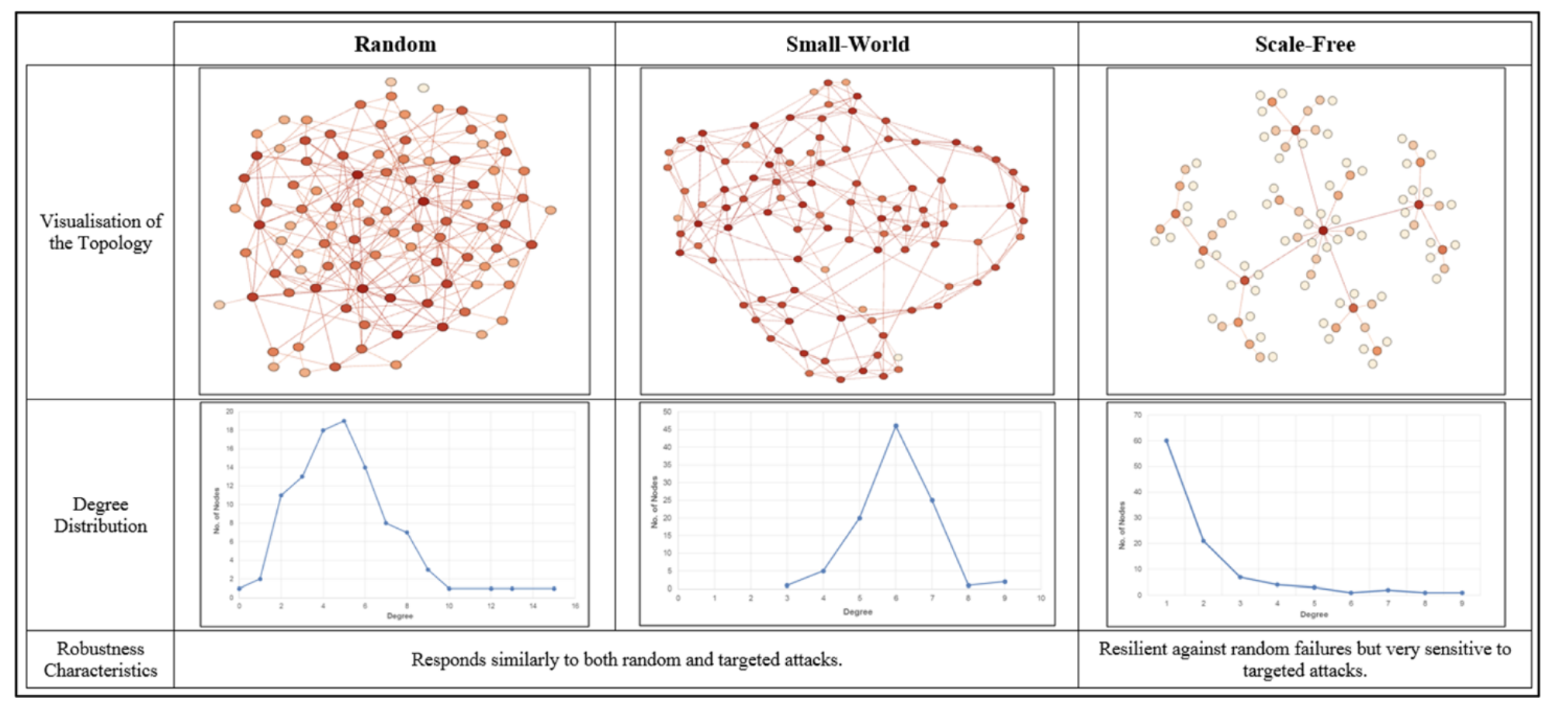
Degree Distributions

Slide 79
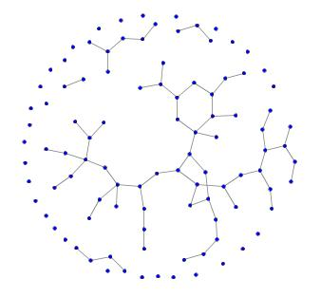
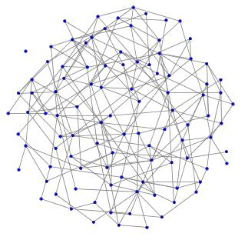
Characterizing networks:
How dense are they?

Slide 80
Network metrics: graph density
Of the connections that may exist between n nodes
  directed graph
  L_{max} = n*(n-1)
  undirected graph
  L_{max} = n*(n-1)/2
What fraction are present?
  density = L / L_{max}
  In real networks L << L_{max}
  For example, out of 12 possible connections,
  this graph has 7, giving it a density of 7/12 = 0.583
(Connections: Edges)

Slide 81
Graph density
Would this measure be useful for comparing networks of different sizes (different numbers of nodes)?
As n → ∞, a graph whose density reaches
  0 is a sparse graph
  a constant is a dense graph

Slide 82

Local Clustering Coefficient
Clustering coefficient measures transitivity in undirected graphs
Transitivity: a->b & b->c => a->c
Local clustering coefficient measures transitivity at the node level
  Commonly employed for undirected graphs
  Computes how strongly neighbors of a node $v$ (nodes adjacent to $v$) are themselves connected
In an undirected graph, the denominator can be rewritten as: n*(n-1)/2

Slide 83




Local Clustering Coefficient: Example
Thin lines depict connections to neighbors
Dashed lines are the missing connections among neighbors
Solid lines indicate connected neighbors
  When all neighbors are connected $C=1$
  When none of neighbors are connected $C=0$

Slide 84
Clustering Coefficient
The clustering coefficient captures the degree to which the neighbors of a given node link to each other. For a node I with degree k_{i} the local clustering coefficient is
C_{i} = L_{i} / ((k_{i} * (k_{i} – 1))/2) = (2*L_{i} ) / (k_{i} * (k_{i} – 1))
C_{i} = 0 if none of the neighbors of node i link to each other
C_{i} = 1 if all of the neighbors of node i link to each other
C_{i} is the probability that two neighbors of a node link to each other.
  Consequently C = 0.5 implies that there is a 50% chance that two neighbors of a node are linked.

Slide 85
Clustering Coefficient and Triples
Triple: an ordered set of three nodes,
  connected by two (open triple) edges or
  three edges (closed triple)
A triangle can miss any of its three edges
  A triangle has 3 Triples: ABC, BCA, CAB
  ABC and CBA are same triple

Slide 86




[Global] Clustering Coefficient
Average clustering coefficient and global clustering coefficient are different
  In some extreme cases they could differ considerably
Notes:
Abc bca cab

Slide 87

Clustering
What is local clustering of nodes?
What is global clustering?
What is average clustering?

Slide 88
Clustering

Slide 89
Clustering
ACB
ACF
ACD
BCD
BCF
CFD
CDF
CFG
CFE
CDE
FCD
FDE
FED
DFE
DFG
GFE
16 in total
b
a
Average clustering coefficient
((1+4+2+6)/6)/7
c
f
d
g
e
Notes:
ACB
ACF
ACD
BCD
BCF
CFD
CDF
CFG
CFE
CDE
FCD
FDE
FED
DFE
DFG
GFE

Slide 90
Redundancy
Suppose a network has N vertices and M edges.
If the number of edges is one less than the number of vertices,
then the network is a tree.
If M = N – 1, then the network is a tree, and….
If M > N – 1, then the network has circuits and is not a tree.
If a network has circuits, we say that the network has redundancy.
To determine if a network has redundancy, we let R be the redundancy
and use the formula R = M – (N – 1)
If R = 0, then the network has no redundancy and the network is a tree
If R > 0, then the network has redundancy and the network is not a tree
Notes:
process of providing multiple paths for traffic, so that data can keep flowing even in the event of a failure.

Slide 91


Reciprocity
If you become my friend, I’ll be yours
Reciprocity is simplified version of transitivity
  It considers closed loops of length 2
If node $v$ is connected to node $u$,
  $u$by connecting to $v$, exhibits reciprocity

Slide 92

Reciprocity
How likely is it that the node you point to will point to you as well.
$$r=\frac{1}{m}\sum_{ij}^{n}{A_{ij}A_{ji}}=\frac{1}{m}TrA^{2}$$
m: is number of edges
Tr: sum of diagonal entries
Notes:
Trace of a matrix is the sum of diagonal elements

Slide 93



Reciprocity: Example
Reciprocal nodes: $v1, v2$

Slide 94

Cocitation and Bibliographic coupling
Cocitation of two vertices i and j is the number of vertices that have outgoing edges to both
$$C_{ij}=\sum_{k=1}^{n}{A_{ik}A_{jk}=\sum_{k=1}^{n}{A_{ik}{A_{kj}}^{T}}}$$
$$C=AA^{T}$$
Bibliographic coupling is the number of vertices to which both point
$$B=\sum_{k=1}^{n}{A_{ki}A_{kj}=\sum_{k=1}^{n}{{A_{ik}}^{T}A_{kj}}}$$
$$B=A^{T}A$$
i
j
k
i
j
k

Slide 95



Social Balance Theory
Consistency in friend/foe relationships among individuals
Informally, friend/foe relationships are consistent when
In the network
  Positive edges demonstrate friendships ($wij=1$)
  Negative edges demonstrate being enemies ($wij=−1$)
Triangle of nodes $i, j$, and $k$, is balanced, if and only if
  $wij$ denotes the value of the edge between nodes $i$ and$j$

Slide 96


Social Balance Theory: Possible Combinations
For any cycle if the multiplication of edge values become positive, then the cycle is socially balanced

Slide 97

Keith Collins, Loubna Mrie - Quartz

Slide 98
Similarity
What interaction patterns are common?
  Reciprocity and Transitivity
  Balance and Status
Who are the like-minded users and how can we find these similar individuals?
  Similarity
Who are the central figures (influential nodes) in the network?
  Centrality

Slide 99
Structural Equivalence
Structural Equivalence:
  We look at the neighborhood shared by two nodes;
  The size of this shared neighborhood defines how similar two nodes are.
Example:
  Two brothers have in common
    sisters, mother, father, grandparents, etc.
    This shows that they are similar

Slide 100



Structural Equivalence: Definitions
Vertex similarity:
The neighborhood $N(v)$ often excludes the node itself $v$
  Issue?
    Connected nodes not sharing a neighbor will be assigned zero similarity
  Solution:
    We can assume nodes are included in their neighborhoods
Jaccard Similarity:
Cosine Similarity:

Slide 101

Similarity: Example

Slide 102

Similarity
Structural Equivalence: share many of the same neighbors
  Jaccard Similarity: $σ_{ij}=\frac{n_{ij}}{|n_{i}∪n_{j}|}$
  Cosine Similarity: $σ_{ij}=\frac{n_{ij}}{\sqrt{k_{i}k_{j}}}$
  Pearson Coefficient: Given degree of two nodes, how many common neighbors they have ($r_{ij}$)
  Euclidian Distance: $d_{ij}=\sum_{k}{{(A_{ik}−A_{jk})}^{2}}$
Regular Equivalence: neighbors are the same
  Katz Similarity: $σ_{ij}=α\sum_{kl}{A_{ik}A_{jl}σ_{kl}}$
  $σ=αAσ+I$

Slide 103
Homophily and Assortative Mixing
Assortativity: Tendency to be linked with nodes that are similar in some way
  Humans: age, race, nationality, language, income, education level, etc.
  Citations: similar fields than others
  Web-pages: Language
Disassortativity: Tendency to be linked with nodes that are different in some way
  Network providers: End users vs other providers

Slide 104

Assortativity: An Example
The friendship network in a US high school in 1994
Colors represent races,
  White: whites
  Grey: blacks
  Light Grey: hispanics
  Black: others
High assortativity between individuals of the same race

Slide 105
Assortativity Significance
Assortativity significance
  The difference between measured assortativity and expected assortativity
  The higher this difference, the more significant the assortativity observed
Example
  In a school, half the population is white and the other half is Hispanic.
  We expected 50% of the connections to be between members of different races.
  If all connections are between members of different races, then we have a significant finding

Slide 106

Modularity (enumerative)
measures the strength of division of a network into modules (groups, clusters)
+ if there are more edges between nodes of the same type than expected value
  - otherwise
$$Q=\frac{1}{2m}\sum_{ij}{\left(A_{ij}−\frac{k_{i}k_{j}}{2m}\right)δ\left(c_{i},c_{j}\right)}$$
$δ\left(c_{i},c_{j}\right)$ is 1 if c_{i} and c_{j} are of same type, and 0 otherwise

Slide 107
Measures and Metrics
Knowing the structure of a network, we can calculate various useful quantities or measures that capture particular features of the network topology.
  basis of most of such measures are from social network analysis
So far,
  Average path length, Diameter, Degree distribution, Density, Assortativity, Connectedness, Clustering coefficient,
Centrality
  Degree, Eigenvector, Katz, PageRank, Hubs, Closeness, Betweenness, ….
Several other graph metrics

Slide 108

Measures and Metrics
Notes:
This can be your starting point

Slide 109

Measures and Metrics
Notes:
This can be your starting point

Slide 110
Outline
Network metrics can help us characterize networks
This has is roots in graph theory
Today there are many network analysis tools to choose from

