Slide 1
Network centrality
Slides are adapted from
Constantine Dovrolis, Eileen Kraemer, Peter Dodds, and Sergei Maslov
and
Network Science by Albert-László Barabási

Slide 2
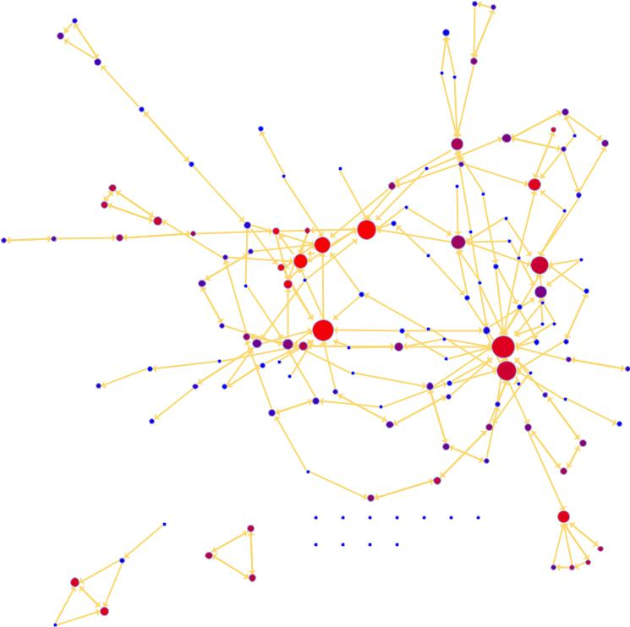
Characterizing networks:
Who is most central?
?
?
?
But why?

Slide 3
Everyday Understandings
What Vertices are Most Important?
Important = prominent
Important = admired
Important = linchpin
Important = listened to
Important = in the know
Important = gate keeper
Important = involved

Slide 4
Translations
Ordinary Description | Possible Network Interpretation
prominent | Vertex is “visible” to many other vertices
admired | Vertex is “chosen” by many other vertices
listened to | Vertex is “received” by many other vertices
in the know | Vertex is short distance from many sources of information
linchpin | Vertex irreplaceable part
gate keeper | Vertex stands between one part of graph and another
involved | Vertex connected to many parts of graph

Slide 5
Network centrality
Which nodes are most ‘central’?
Definition of ‘central’ varies by context/purpose
Local measure:
  degree
Relative to rest of network:
  closeness, betweenness, eigenvector (Bonacich power centrality), Katz, PageRank, …
How evenly is centrality distributed among nodes?
  Centralization, hubs and authorities, …

Slide 6
Centrality: who’s important based on their network position
In each of the following networks, X has higher centrality than
Y according to a particular measure
indegree
outdegree
betweenness
closeness

Slide 7
Outline
Degree centrality
  Centralization
Betweenness centrality
Closeness centrality
Eigenvector centrality
Katz centrality
Bonacich power centrality
PageRank
Influence
Hubs and Authorities
Applications

Slide 8
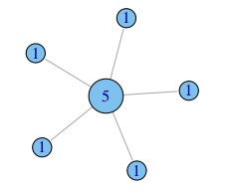
Degree centrality (undirected)
He who has many friends is most important.
When is the number of connections the best centrality measure?
  people who will do favors for you
  people you can talk to (influence set, information access, …)
  influence of an article in terms of citations (using in-degree)

Slide 9
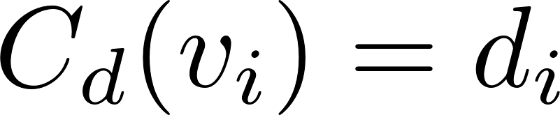
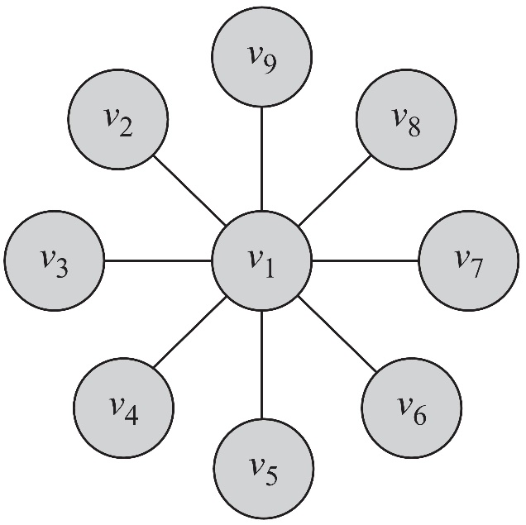
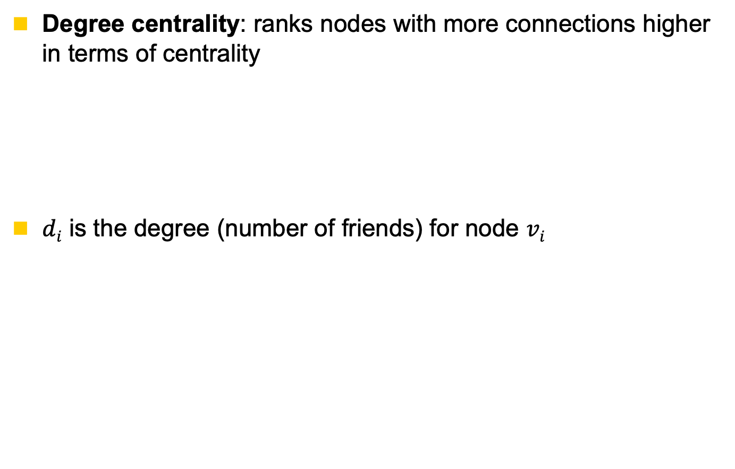
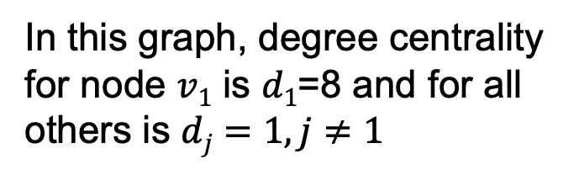
Degree Centrality
Degree centrality: ranks nodes with more connections higher in terms of centrality
$di$ is the degree (number of friends) for node $vi$
In this graph, degree centrality for node $v1$ is $d1$=8 and for all others is $dj=1, j≠1$

Slide 10
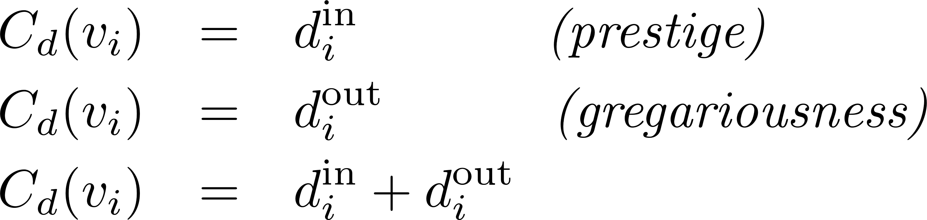
Degree Centrality in Directed Graphs
In directed graphs, we can either use the in-degree, the out-degree, or the combination as the degree centrality value:
  In practice, mostly in-degree is used
U
$d_{i}^{out}$ is the number of outgoing links for n$ode vi$

Slide 11
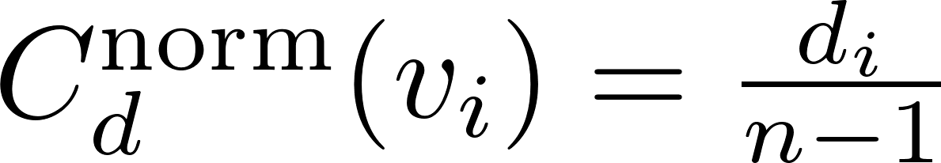
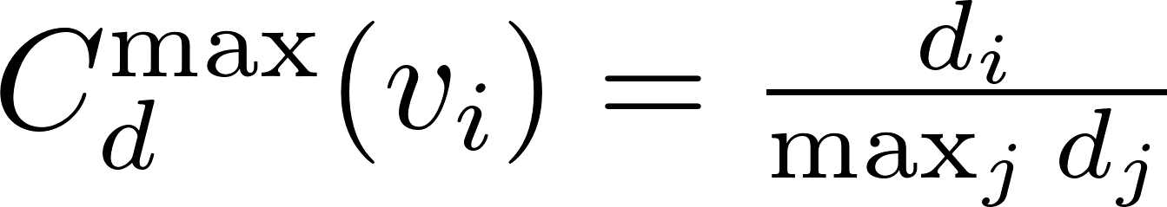
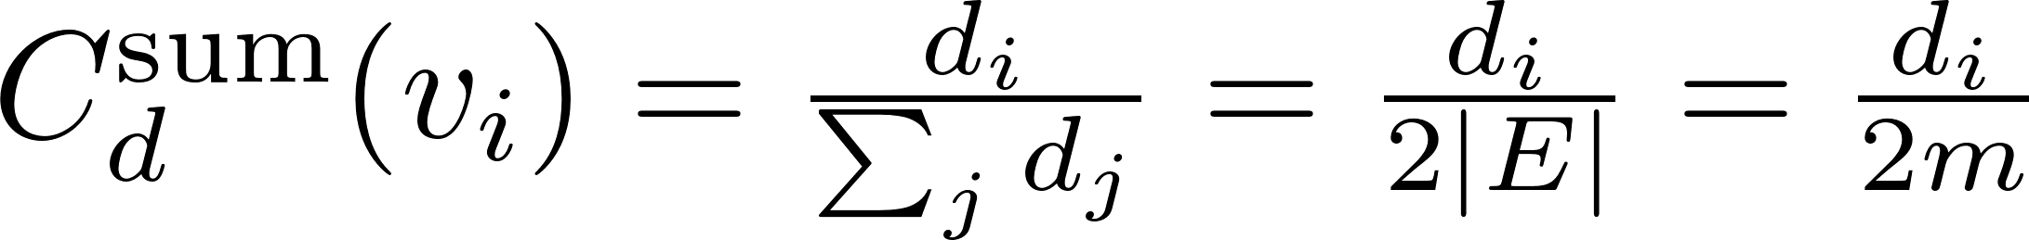
Normalized Degree Centrality
Normalized by the maximum possible degree
Normalized by the maximum degree
Normalized by the degree sum
Notes:
n – 1 is the maximum degree a node can have
2|E| = the total number of degrees,

Slide 12
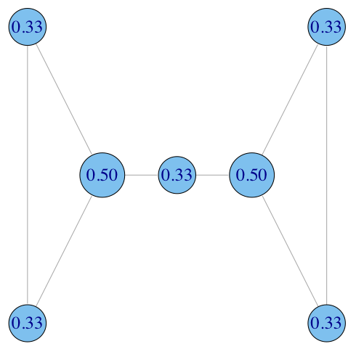
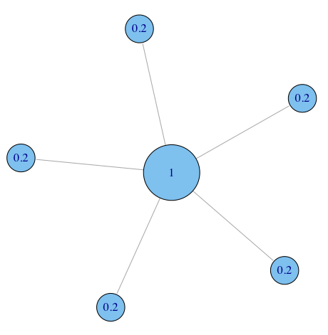

Degree: normalized degree centrality
divide by the max. possible, i.e. (N-1)
Notes:
Normalized degree centrality is mostly used in most of them, gephi pajek etc.

Slide 13
Degree Centrality (Directed Graph)Example
Node | In-Degree | Out-Degree | Centrality | Rank
A
B
C
D
E
F
G
1 | 3
1 | 2
2 | 3
3 | 1
2 | 1
2 | 2
2 | 1
1/2 | 1
1/3 | 3
1/2 | 1
1/6 | 5
1/6 | 5
1/3 | 3
1/6 | 5
Normalized by the maximum possible degree
Notes:
Out-degree is used

Slide 14
Degree Centrality (undirected Graph) Example
Node | Degree | Centrality | Rank
A
B
C
D
E
F
G
4
3
5
4
3
4
3
2/3 | 2
1/2 | 5
5/6 | 1
2/3 | 2
1/2 | 5
2/3 | 2
1/2 | 5

Slide 15
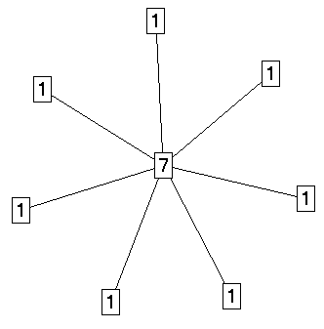
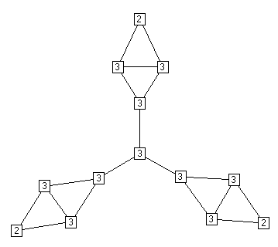
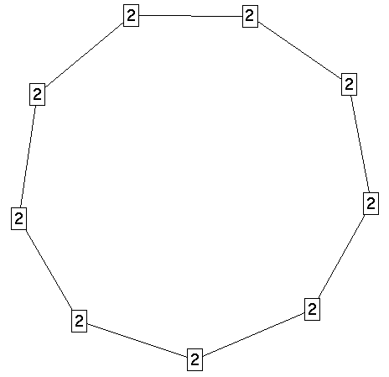
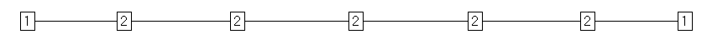
Degree Centrality in Social Networks
The most intuitive notion of centrality focuses on degree:
The actor with the most ties is the most important
Notes:
Higher degree centrality there is a higher chance of having higher other centralities like page rank, betweenness etc

Slide 16
Extensions of undirected degree centrality - prestige
degree centrality
  indegree centrality
    a paper that is cited by many others has high prestige
    a person nominated by many others for a reward has high prestige

Slide 17
Centralization: how equal are the nodes?
How much variation is there in the centrality scores among the nodes?
Freeman’s general formula for centralization:
(can use other metrics, e.g. gini coefficient or standard deviation)
maximum value in the network

Slide 18
Centralization: how equal are the nodes?
What is Degree Centralization Scores (Freeman)?
Freeman: 1.0
Freeman: .02
Freeman: 0.0
Freeman: .07
What does high or low Freeman score mean?

Slide 19
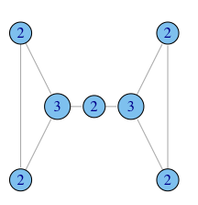
Degree centralization examples
C_{D} = 0.167
C_{D} = 1.0
C_{D} = 0.167

Slide 20
Degree centralization examples
example financial trading networks
Which network has high and low centralization?
What does high and low centralization mean?
high centralization
low centralization
one node trading with many others
trades are more evenly distributed

Slide 21
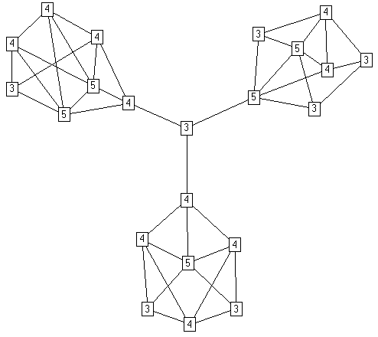
Degree Centrality in Social Networks
Degree centrality can be deceiving,
Why?
because it is a purely local measure

Slide 22
When degree isn’t everything
In what ways does degree fail to capture centrality in the following graphs?
ability to broker between groups
likelihood that information originating anywhere in the network reaches you…

Slide 23
Outline
Degree centrality
  Centralization
Betweenness centrality
Closeness centrality
Eigenvector centrality
Katz centrality
Bonacich power centrality
PageRank
Influence
Hubs and Authorities
Applications

Slide 24
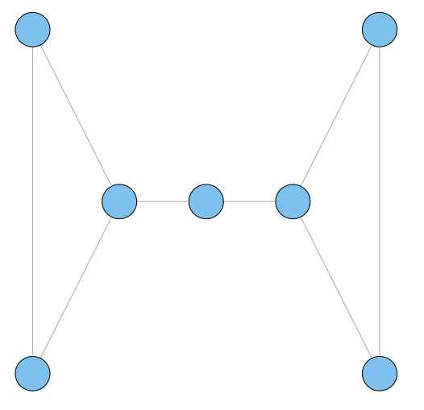
Betweenness: another centrality measure
intuition: how many pairs of individuals would have to go through you in order to reach one another in the minimum number of hops?
who has higher betweenness, X or Y?
Y
X

Slide 25

Betweenness on toy networks
non-normalized version:
A
B
C
D
E
A lies between no two other vertices
B lies between A and 3 other vertices: C, D, and E
C lies between 4 pairs of vertices (A,D),(A,E),(B,D),(B,E)
note that there are no alternate paths for these pairs to take, so C gets full credit

Slide 26
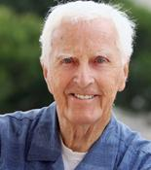
Betweenness centrality: definition
paths between j and k that pass through i
betweenness of vertex i
all paths between j and k
Where g_{jk} = the number of geodesics connecting j-k, and
g_{jk} = the number that actor i is on.
Usually normalized by:
number of pairs of vertices excluding the vertex itself
Linton Freeman

Slide 27
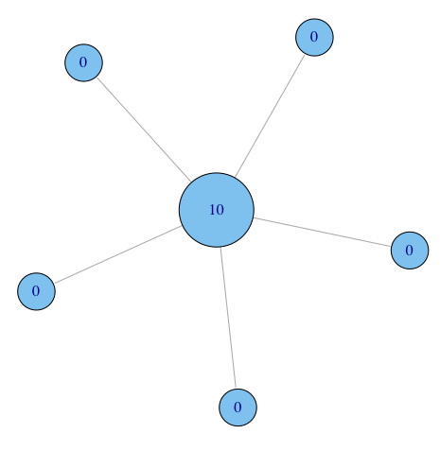
Betweenness on toy networks
non-normalized version:

Slide 28
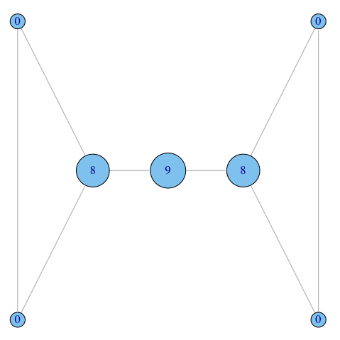
Betweenness on toy networks
non-normalized version:
broker

Slide 29
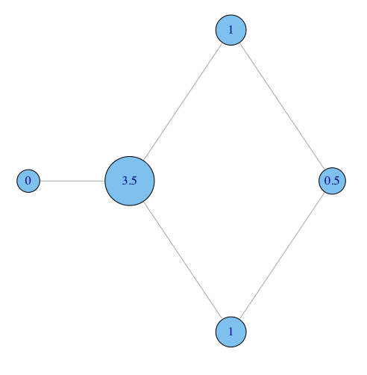
Betweenness on toy networks
non-normalized version:
why do C and D each have betweenness 1?
They are both on shortest paths for pairs (A,E), and (B,E), and so must share credit:
  ½+½ = 1
Can you figure out why B has betweenness 3.5 while E has betweenness 0.5?
C
A
B
E
D

Slide 30
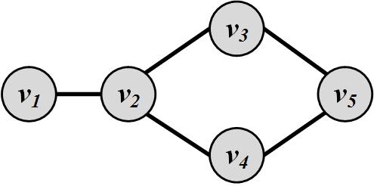

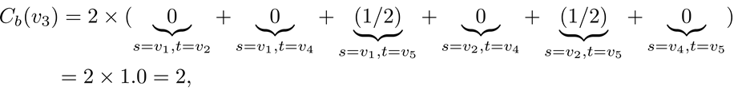
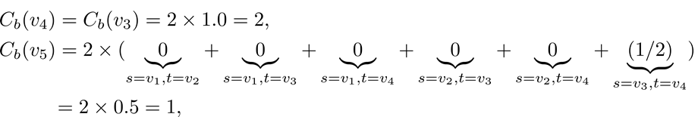
Betweenness Centrality: Example

Slide 31
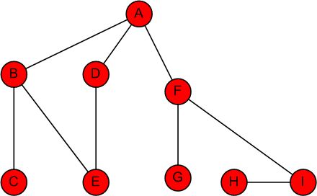
Betweenness Centrality: Example
Node | Betweenness Centrality | Rank
A | 16 + 1/2 + 1/2 | 1
B | 7+5/2 | 3
C | 0 | 7
D | 5/2 | 5
E | 1/2 + 1/2 | 6
F | 15 + 2 | 1
G | 0 | 7
H | 0 | 7
I | 7 | 4

Slide 32
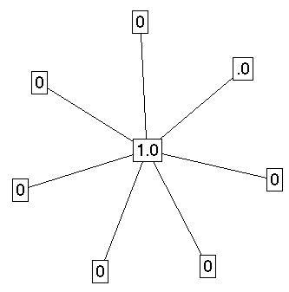
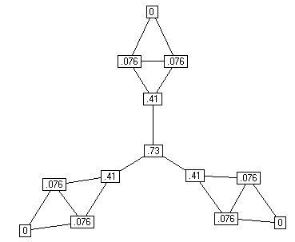
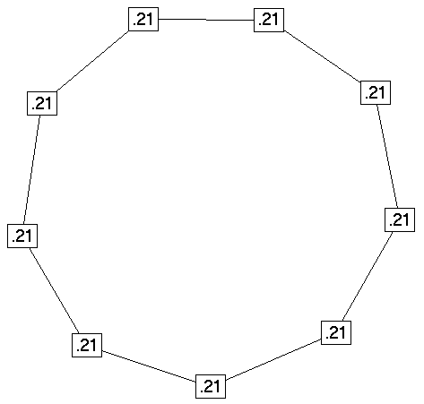
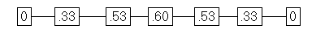
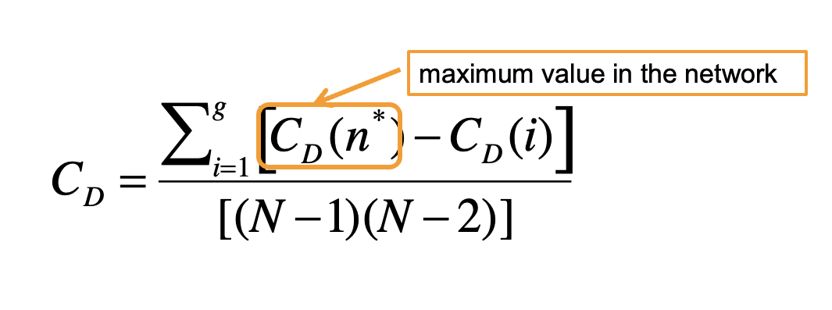
Betweenness Centrality in Social Networks
Centralization: 1.0
Centralization: .59
Centralization: 0
Centralization: .31

Slide 33
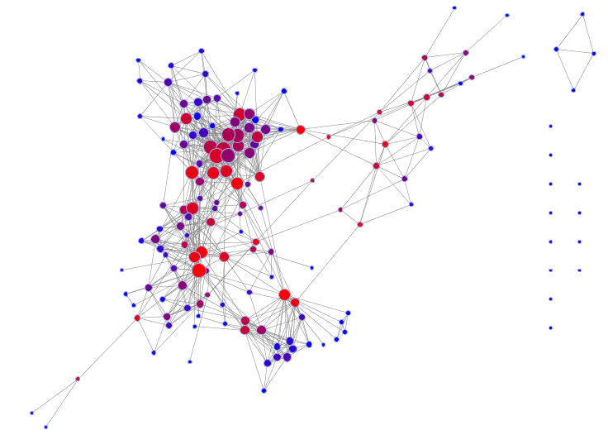
Example
Nodes are sized by degree, and colored by betweenness.
What about high degree but relatively low betweenness?
Can you spot nodes with high betweenness but relatively low degree?

Slide 34
Extending betweenness centrality to directed networks
We now consider the fraction of all directed paths between any two vertices that pass through a node
paths between j and k that pass through i
betweenness of vertex i
all paths between j and k
Only modification: when normalizing, we have
(N-1)*(N-2) instead of (N-1)*(N-2)/2, because we have twice as many ordered pairs as unordered pairs
Undirected network:
number of pairs of vertices excluding the vertex itself

Slide 35
Directed geodesics
A node does not necessarily lie on a geodesic from j to k if it lies on a geodesic from k to j
j
k

Slide 36
Alternative betweenness computations
Slight variations in geodesic path computations
  inclusion of self in the computations
Flow betweenness
  Based on the idea of maximum flow
    edge-independent path selection effects the results
    may not include geodesic paths
Random-walk betweenness
  Based on the idea of random walks
    yields ranking similar to geodesic betweenness
Many other alternative definitions exist based on diffusion, transmission or flow along network edges

Slide 37
Outline
Degree centrality
  Centralization
Betweenness centrality
Closeness centrality
Eigenvector centrality
Katz centrality
Bonacich power centrality
PageRank
Influence
Hubs and Authorities
Applications

Slide 38
Closeness: another centrality measure
What if it’s not so important to have many direct friends?
Or be “between” others
But one still wants to be in the “middle” of things,
  not too far from the center

Slide 39
Closeness centrality: definition
Closeness is based on the length of the average shortest path between a vertex and all vertices in the graph
Closeness Centrality:
d (i, j) is distance
between node i and j
  depends on inverse distance to other vertices
Normalized Closeness Centrality
Linton Freeman

Slide 40

Closeness centrality: toy example
A
B
C
D
E

Slide 41
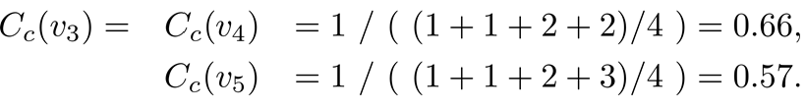
Closeness Centrality: Example
What is the closeness centrality for each vertex?

Slide 42
Closeness Centrality: Example (Undirected)
Node | A | B | C | D | E | F | G | H | I | Distance_Avg | Closeness Centrality | Rank
A | 0 | 1 | 2 | 1 | 2 | 1 | 2 | 3 | 2 | 1.750 | 0.571 | 1
B | 1 | 0 | 1 | 2 | 1 | 2 | 3 | 4 | 3 | 2.125 | 0.471 | 3
C | 2 | 1 | 0 | 3 | 2 | 3 | 4 | 5 | 4 | 3.000 | 0.333 | 8
D | 1 | 2 | 3 | 0 | 1 | 2 | 3 | 4 | 3 | 2.375 | 0.421 | 4
E | 2 | 1 | 2 | 1 | 0 | 3 | 4 | 5 | 4 | 2.750 | 0.364 | 7
F | 1 | 2 | 3 | 2 | 3 | 0 | 1 | 2 | 1 | 1.875 | 0.533 | 2
G | 2 | 3 | 4 | 3 | 4 | 1 | 0 | 3 | 2 | 2.750 | 0.364 | 7
H | 3 | 4 | 5 | 4 | 5 | 2 | 3 | 0 | 1 | 3.375 | 0.296 | 9
I | 2 | 3 | 4 | 3 | 4 | 1 | 2 | 1 | 0 | 2.500 | 0.400 | 5

Slide 43
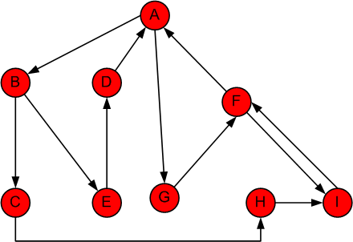
Closeness Centrality: Example (Directed)
Node | A | B | C | D | E | F | G | H | I | Distance_Avg | Closeness Centrality | Rank
A | 0 | 1 | 2 | 3 | 2 | 2 | 1 | 3 | 3 | 2.125 | 0.471 | 1
B | 3 | 0 | 1 | 2 | 1 | 4 | 4 | 2 | 3 | 2.500 | 0.400 | 2
C | 4 | 5 | 0 | 7 | 6 | 3 | 5 | 1 | 2 | 4.125 | 0.242 | 9
D | 1 | 2 | 3 | 0 | 3 | 3 | 2 | 4 | 5 | 2.875 | 0.348 | 3
E | 2 | 3 | 4 | 1 | 0 | 4 | 3 | 5 | 5 | 3.375 | 0.296 | 6
F | 1 | 2 | 3 | 4 | 3 | 0 | 2 | 4 | 4 | 2.875 | 0.348 | 4
G | 2 | 3 | 4 | 5 | 4 | 1 | 0 | 5 | 2 | 3.250 | 0.308 | 5
H | 4 | 4 | 5 | 6 | 5 | 2 | 4 | 0 | 1 | 3.875 | 0.258 | 8
I | 2 | 3 | 4 | 5 | 4 | 1 | 4 | 5 | 0 | 3.500 | 0.286 | 7

Slide 44

Closeness Centrality in Networks
Distance Closeness normalized
0 1 1 2 3 4 4 5 5 6 5 5 6 .021 .255
1 0 1 1 2 3 3 4 4 5 4 4 5 .027 .324
1 1 0 1 2 3 3 4 4 5 4 4 5 .027 .324
2 1 1 0 1 2 2 3 3 4 3 3 4 .034 .414
3 2 2 1 0 1 1 2 2 3 2 2 3 .042 .500
4 3 3 2 1 0 2 3 3 4 1 1 2 .034 .414
4 3 3 2 1 2 0 1 1 2 3 3 4 .034 .414
5 4 4 3 2 3 1 0 1 1 4 4 5 .027 .324
5 4 4 3 2 3 1 1 0 1 4 4 5 .027 .324
6 5 5 4 3 4 2 1 1 0 5 5 6 .021 .255
5 4 4 3 2 1 3 4 4 5 0 1 1 .027 .324
5 4 4 3 2 1 3 4 4 5 1 0 1 .027 .324
6 5 5 4 3 2 4 5 5 6 1 1 0 .021 .255

Slide 45
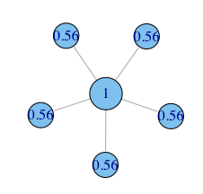
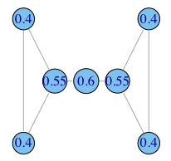
Closeness centrality: more examples

Slide 46
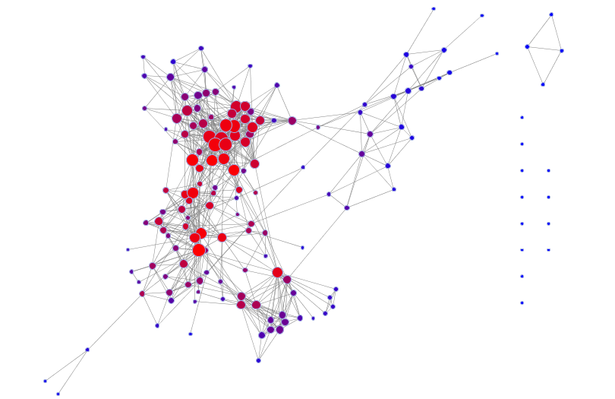
How closely do degree and betweenness correspond to closeness?
degree
  number of connections
  denoted by size
closeness
  length of shortest path to all others
  denoted by color

Slide 47
Closeness centrality
Typical distance increases logarithmically with network size
It is difficult to distinguish between central and less central vertices
A small change in network might considerably affect the centrality order

Slide 48
Extensions of undirected closeness centrality
Closeness centrality usually implies
  all paths should lead to you
  paths should lead from you to everywhere else
Usually consider only vertices from which the node i in question can be reached

Slide 49
Influence range
The influence range of i is the set of vertices who are reachable from the node i

Slide 50
Centrality Comparison
Comparing three centrality values
  Generally, the 3 centrality types will be positively correlated
  When they are not (or low correlation), it usually reveals interesting information
Low
Degree
Low
Closeness
Low
Betweenness
High
Degree
Node is embedded in a community that is far from the rest of the network
Node’s connections are redundant - communication bypasses the node
High
Closeness
Probably multiple paths in the network, node is near many people, but so are many others
Key node connected to important/active alters
High
Betweenness
Node's few ties are crucial for network flow
Very rare! Node monopolizes the ties from a small number of people to many others.
Notes:
Shunun her birine ornek graph koyabilirsin

Slide 51
Outline
Degree centrality
  Centralization
Betweenness centrality
Closeness centrality
Eigenvector centrality
Katz centrality
Bonacich power centrality
PageRank
Influence
Hubs and Authorities
Applications

Slide 52
Eigenvalues and eigenvectors
Eigenvalues and eigenvectors have their origins in physics
  in particular in problems where motion is involved
  their uses extend from solutions to stress and strain problems to differential equations and quantum mechanics
Eigenvectors are vectors that point in directions where there is no rotation
  Eigenvalues are the change in length of the eigenvector from the original length
The basic equation in eigenvalue problems is:
Slides from Fred K. Duennebier

Slide 53
Eigenvalues and eigenvectors
In words, this simple equation says that for the square matrix A, there is a vector x such that the product of Ax is equal to a SCALAR λ multiplied by x
The multiplication of vector x by a scalar constant is the same as stretching or shrinking the coordinates by a constant value
The vector x is called an eigenvector and the scalar λ, is called an eigenvalue.
(E.01)
https://youtu.be/ue3yoeZvt8E?t=2m27s

Slide 54

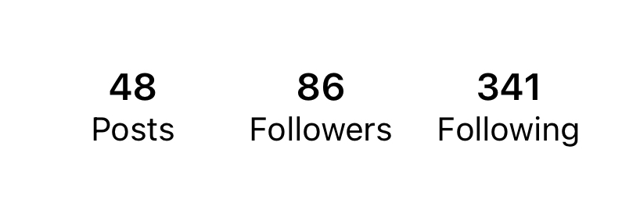
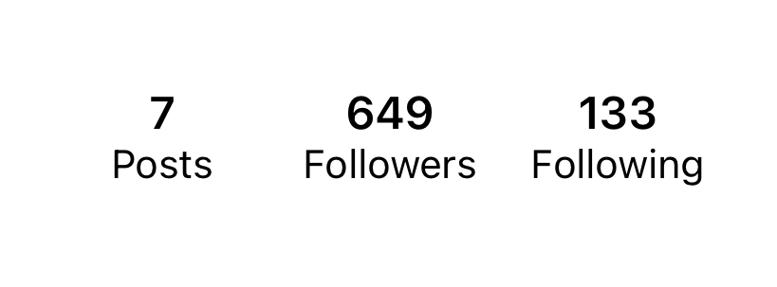
Centrality
Which one you will follow back?
A
B

Slide 55
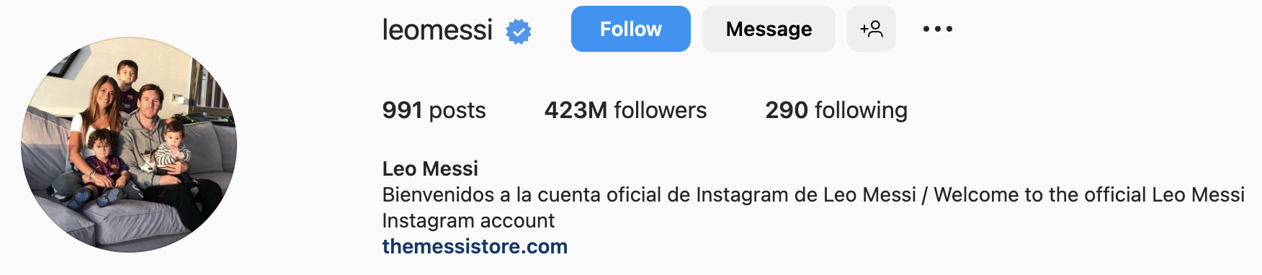


Centrality
Which one you will follow back?
A
B

Slide 56
Centrality
Which one you will follow back?
A
B

Slide 57

Eigenvector Centrality
Having more friends does not by itself guarantee that someone is more important
  Having more important friends provides a stronger signal
Phillip Bonacich
Eigenvector centrality generalizes degree centrality by incorporating the importance of the neighbors (undirected)
For directed graphs, we can use incoming or outgoing edges

Slide 58
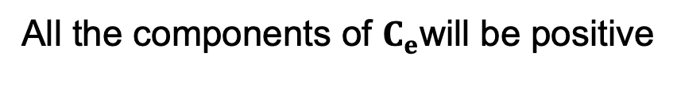
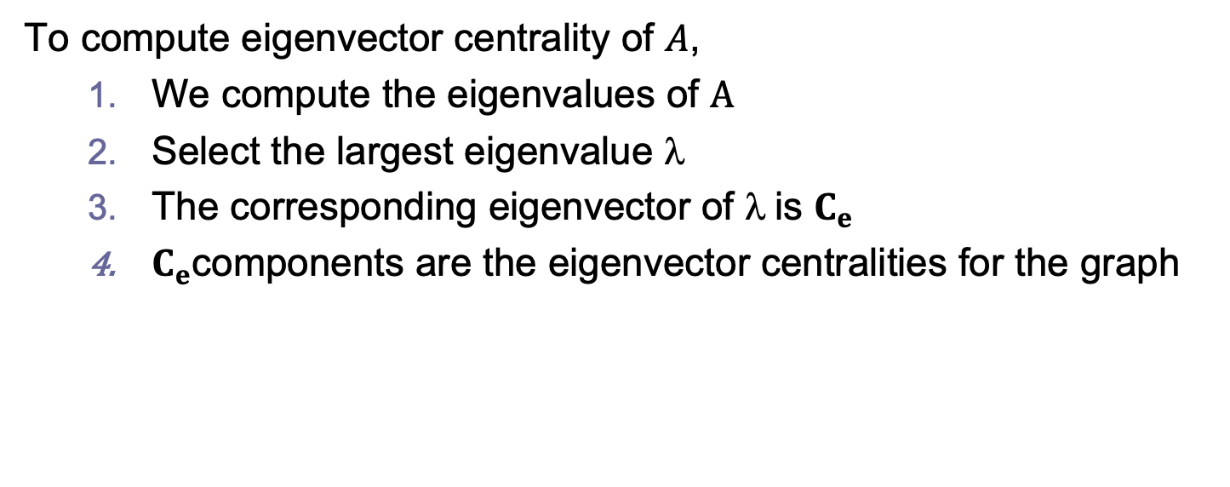
Eigenvector Centrality, cont.
To compute eigenvector centrality of $A$,
  We compute the eigenvalues of $A$
  Select the largest eigenvalue $$
  The corresponding eigenvector of $$is $C_{e}$
  $C_{e}$components are the eigenvector centralities for the graph
All the components of $C_{e}$will be positive

Slide 59
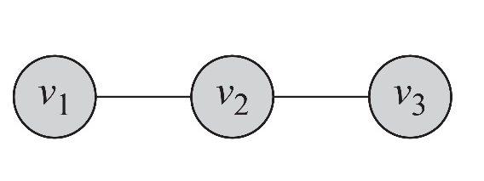
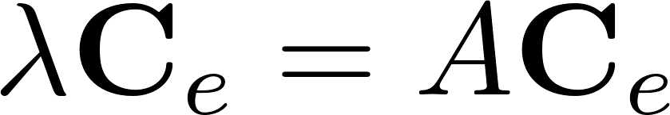
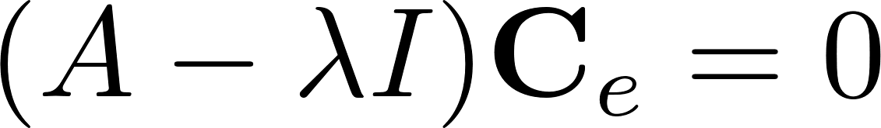
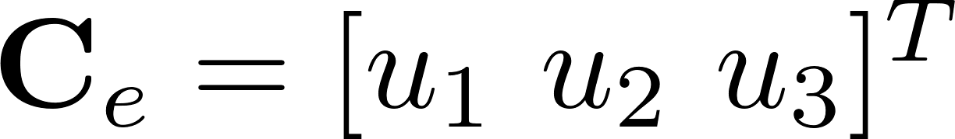
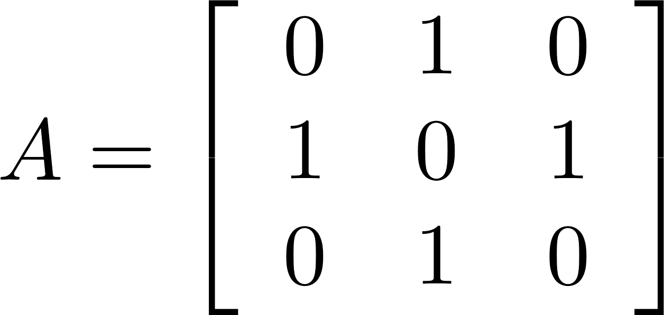
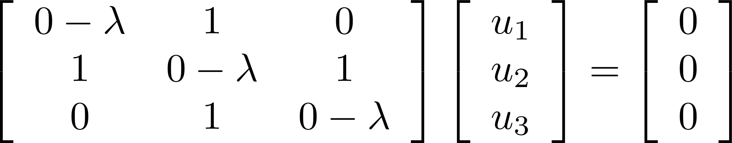
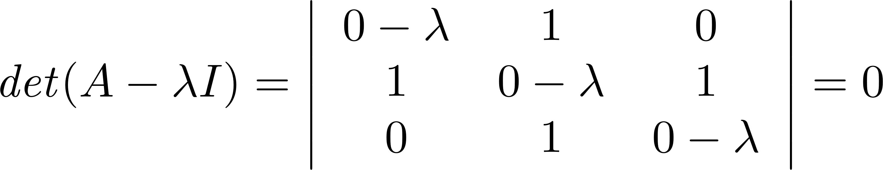




Eigenvector Centrality: Example
Eigenvalues are
Corresponding eigenvector
Largest Eigenvalue

Slide 60



Eigenvector Centrality: Example
λ = (2.68, -1.74, -1.27, 0.33, 0.00)
Eigenvalues Vector
λ_{max} = 2.68

Slide 61
Eigenvector Centrality
Can be calculated for directed graphs as well
  We need to decide between incoming or outgoing edges
A has no incoming edges, hence a centrality of 0
B has only an incoming edge from A
  Hence its centrality is also 0
Only vertices that are in a strongly connected component of two or more vertices or the out-component of such a component have non-zero centrality
A
B
E
C
D

Slide 62
Outline
Degree centrality
  Centralization
Betweenness centrality
Closeness centrality
Eigenvector centrality
Katz centrality
Bonacich power centrality
PageRank
Influence
Hubs and Authorities
Applications

Slide 63


Katz Centrality
A major problem with eigenvector centrality arises when it deals with directed graphs
Centrality only passes over outgoing edges and in special cases such as when a node is in a directed acyclic graph centrality becomes zero
Elihu Katz
To resolve this problem we add bias term $$ to the centrality values for all nodes
Eigenvector Centrality

Slide 64

Katz Centrality
What is $$?
Is a constant initial weight given to each vertex so that vertices with zero in degree (or out degree) are included in calculations.
After this augmentation, a random surfer on a particular webpage, has two options:
  He randomly chooses an out‐link to follow (𝐴_{i,j})
  He jumps to a random page (β)

Slide 65
Katz Centrality, cont.
Controlling term
Bias term
Rewriting equation in a vector form
vector of all 1’s
Katz centrality:
In practice we select $α < 1/λ$, where $λ$is the largest eigenvalue of $AT$

Slide 66




Katz Centrality Example
  Most important
  nodes!

Slide 67

Overview

Slide 68

Bonacich Power Centrality in Social Networks
a is a normalization constant
β determines how important the centrality of your neighbors is
A is the adjacency matrix (can be valued)
I is the identity matrix (1s down the diagonal)
1 is a matrix of all ones.

Slide 69
Bonacich Power Centrality in Social Networks
If β > 0, nodes have higher centrality when they have edges to other central nodes.
If β < 0, nodes have higher centrality when they have edges to less central nodes.

Slide 70


Bonacich Power Centrality: examples
β=.25
β=-.25
Why does the middle node have lower centrality than its
neighbors when b is negative?

Slide 71
Outline
Degree centrality
  Centralization
Betweenness centrality
Closeness centrality
Eigenvector centrality
Katz centrality
Bonacich power centrality
PageRank
Influence
Hubs and Authorities
Applications

Slide 72
PageRank
Problem with Katz Centrality:
  In directed graphs, once a node becomes an authority (high centrality), it passes all its centrality along all of its out-links
This is less desirable since not everyone known by a well-known person is well-known
Solution?
  we can divide the value of passed centrality by the number of outgoing links, i.e., out-degree of that node
  Each connected neighbor gets a fraction of the source node’s centrality

Slide 73

PageRank

Slide 74
PageRank: bringing order to the web
It’s in the links:
  links to URLs can be interpreted as endorsements or recommendations
  the more links a URL receives, the more likely it is to be a good/entertaining/provocative/authoritative/interesting information source
  but not all link sources are created equal
    a link from a respected information source
    a link from a page created by a spammer
an important page, e.g. reddit
Many webpages scattered
across the web
if a web page is
slashdotted, it gains attention

Slide 75

Ranking pages by tracking a drunk
A random walker following edges in a network for a very long time will spend a proportion of time at each node which can be used as a measure of importance

Slide 76
Trapping a drunk
Problem with pure random walk metric:
  Drunk can be “trapped” and end up going in circles

Slide 77
Ingenuity of the PageRank algorithm
Allow drunk to teleport with some probability
  e.g. random websurfer follows links for a while, but with some probability teleports to a “random” page
    bookmarked page or uses a search engine to start anew

Slide 78

PageRank algorithm
where p₁,p₂,...,p_{N} are the pages under consideration,
M(p_{i}) is the set of pages that link to p_{i},
L(p_{j}) is the number of outbound links on page p_{j}, and
N is the total number of pages.
(1-d) is the random jumping probability (d = 0.85 for google)

Slide 79
Example: probable location of random walker after 1 step
20% teleportation probability
1
6
8
t=0
2
7
5
t=1
3
4

Slide 80
Example: location probability after 10 steps
t=0
1
6
8
t=1
2
7
5
3
t=10
4

Slide 81

PageRank: Example
Step | A | B | C | D | E | F | G | Sum
1 | 0.143 | 0.143 | 0.143 | 0.143 | 0.143 | 0.143 | 0.143 | 1.000
2 | 0.071 | 0.048 | 0.190 | 0.167 | 0.190 | 0.119 | 0.214 | 1.000
3 | 0.024 | 0.063 | 0.238 | 0.147 | 0.190 | 0.087 | 0.250 | 1.000
4 | 0.032 | 0.079 | 0.258 | 0.131 | 0.155 | 0.111 | 0.234 | 1.000
5 | 0.040 | 0.086 | 0.245 | 0.152 | 0.142 | 0.126 | 0.210 | 1.000
6 | 0.043 | 0.082 | 0.224 | 0.158 | 0.165 | 0.125 | 0.204 | 1.000
7 | 0.041 | 0.075 | 0.219 | 0.151 | 0.172 | 0.115 | 0.228 | 1.000
8 | 0.037 | 0.073 | 0.241 | 0.144 | 0.165 | 0.110 | 0.230 | 1.000
9 | 0.036 | 0.080 | 0.242 | 0.148 | 0.157 | 0.117 | 0.220 | 1.000
10 | 0.040 | 0.081 | 0.232 | 0.151 | 0.160 | 0.121 | 0.215 | 1.000
11 | 0.040 | 0.077 | 0.228 | 0.151 | 0.165 | 0.118 | 0.220 | 1.000
12 | 0.039 | 0.076 | 0.234 | 0.148 | 0.165 | 0.115 | 0.223 | 1.000
13 | 0.038 | 0.078 | 0.236 | 0.148 | 0.161 | 0.116 | 0.222 | 1.000
14 | 0.039 | 0.079 | 0.235 | 0.149 | 0.161 | 0.118 | 0.219 | 1.000
15 | 0.039 | 0.078 | 0.232 | 0.150 | 0.162 | 0.118 | 0.220 | 1.000
Rank | 7 | 6 | 1 | 4 | 3 | 5 | 2

Slide 82

Effect of PageRank
PageRank
Node | Rank
A | 7
B | 6
C | 1
D | 4
E | 3
F | 5
G | 2

Slide 83


Centrality comparison

Slide 84
Centrality for a group of nodes

Slide 85

Group Centrality
All centrality measures defined so far measure centrality for a single node
  These measures can be generalized for a group of nodes
A simple approach is to replace all nodes in a group with a super node
  The group structure is disregarded
Let $S$ denote the set of nodes in the group and $V−S$ the set of outsiders

Slide 86



Group Centrality Example
Consider $S=\{v_{2},v_{3}\}$
Group degree centrality = 3
Group betweenness centrality
Group closeness centrality
V 4
V 3_2
V 5
V 1
= (1/1 + 1/1 +1/1) = 3

Slide 87


Group Centrality Example
Consider $S=\{v_{2},v_{3}\}$
Group degree centrality = 3
Group betweenness centrality = 3
Group closeness centrality
V 4
V 3_2
V 5
V 1
= (1+1+1) / (4-1) = 1

Slide 88
Outline
Degree centrality
  Centralization
Betweenness centrality
Closeness centrality
Eigenvector centrality
Katz centrality
Bonacich power centrality
PageRank
Influence
Hubs and Authorities
Applications

Slide 89
Hubs and Authorities
In directed networks, vertices that point to important resources should also get a high centrality
  e.g. review articles, web indexes
recursive definition:
  authorities are nodes that are linked to by good hubs
  hubs are nodes that links to good authorities

Slide 90


Hyperlink-Induced Topic Search
HITS algorithm: link analysis algorithm that rates Web pages, developed by Jon Kleinberg
The idea of this algorithm originated from the fact that an ideal website should link to other relevant sites and also being linked by other important sites

Slide 91
Outline
Degree centrality
  Centralization
Betweenness centrality
Closeness centrality
Eigenvector centrality
Katz centrality
Bonacich power centrality
PageRank
Influence
Hubs and Authorities
Applications

Slide 92

Friedkin: structural bases of influence
Interested in identifying the structural bases of power.
In addition to resources, he identifies:
  Cohesion
  Similarity
  Centrality
  Which are thought to affect interpersonal visibility and importance
Noah Friedkin
STRUCTURAL BASES OF INTERPERSONAL INFLUENCE IN GROUPS: A LONGITUDINAL CASE STUDY*

Slide 93
Friedkin: structural bases of influence
Centrality
They have greater access to information and can communicate their opinions to others more efficiently.

Slide 94
Friedkin: structural bases of influence
Cohesion
Members of a cohesive group are likely to be aware of each others opinions, because information diffuses quickly within the group (clique)
Members put importance on opinions of other group members, over non-group members.
Actors P and O are structurally cohesive if they are joint members of a cohesive group.
The greater the cohesion of P and O, the more likely they are to influence each other.
Cohesion: actors who are close to you

Slide 95
Friedkin: structural bases of influence
Structural Similarity
Two people may not be directly connected, but occupy a similar position in the structure.
As such, they have similar interests in outcomes that relate to positions in the structure.
P must know that O is in the same position, which means that the effect of similarity might be conditional on communication frequency (P should be aware of O)
Structural similar: actors who are in similar circumstance

Slide 96
Outline
Degree centrality
  Centralization
Betweenness centrality
Closeness centrality
Eigenvector centrality
Katz centrality
Bonacich power centrality
PageRank
Influence
Hubs and Authorities
Applications

Slide 97

Centrality in US migration network, county level

Slide 98

Centrality in US migration network, state level

Slide 99


Centrality in air transportation network
Betweenness centrality
Hub centrality

Slide 100

Using network algorithms (specifically proximity) to improve movie recommendations can pay off
Notes:
On September 18, 2009, Netflix announced team "BellKor's Pragmatic Chaos" as the prize winner (a Test RMSE of 0.8567), and the prize was awarded to the team in a ceremony on September 21, 2009.^{[27]} "The Ensemble" team had matched BellKor's result, but since BellKor submitted their results 20 minutes earlier, the rules award the prize to BellKor

Slide 101
Centrality wrap up
Degree, EigenVector, Katz, PageRank, Betweenness, Closeness
  many measures
  extensions to directed networks
The key question for centrality is knowing what is flowing through the network
  Whether the actor retains the good to pass to others (Information, Diseases) or whether they pass the good and then loose it (physical objects)
  Whether the key factor for spread is distance (disease with low pij) or multiple sources (information)
  The off-the-shelf measures do not always match the social process of interest, so researchers need to be mindful of this

