Slide 1
Lecture 10:
Network Resilience and Robustness
CS 765: Complex Networks
Slides are adapted from
Lada Adamic and
Albert-László Barabási with Emma K. Towlson and Sean P. Cornelius

Slide 2
Introduction
Network resilience and robustness
Effects of node and edge removal
  Example: power grid, terrorist network
Complex systems maintain their basic functions even under errors and failures
Cell → mutations
  There are uncountable number of mutations and other errors in our cells, yet, we do not notice their consequences.
Internet → router breakdowns
  At any moment hundreds of routers on the internet are broken, yet, the internet as a whole does not loose its functionality.

Slide 3
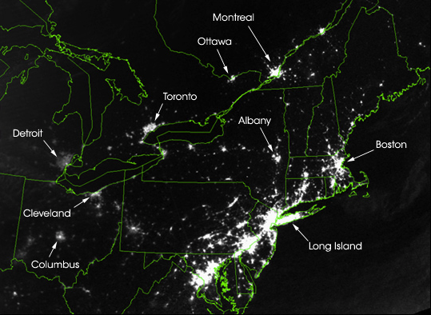
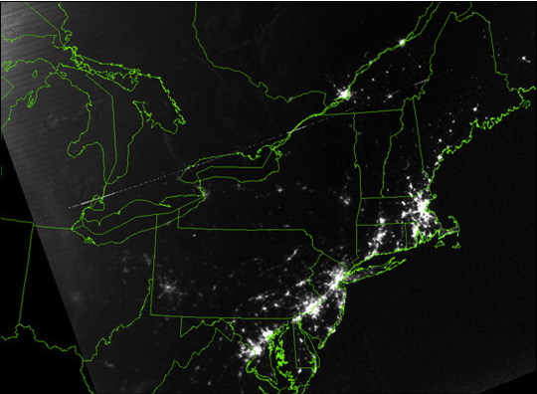
August 15, 2003 blackout
Thex
Vulnerability due to interconnectivity: cascading failure
When node fails it shifts load to another node
August 14, 2003: 9:29pm EDT
20 hours before
August 15, 2003: 9:14pm EDT
7 hours after
Network Science: Introduction

Slide 4
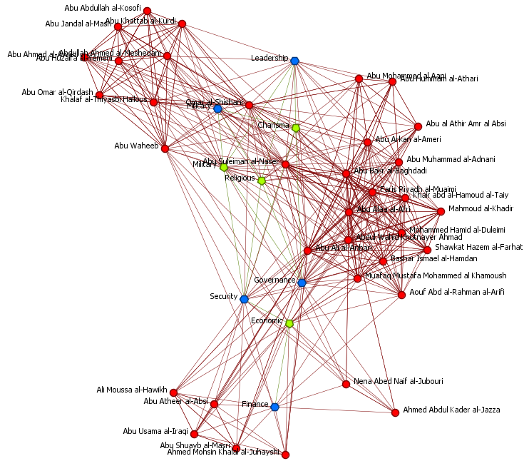
Strategic Destabilization of Terrorist Networks

Slide 5
Power-law networks are robust to random breakdown

Slide 6
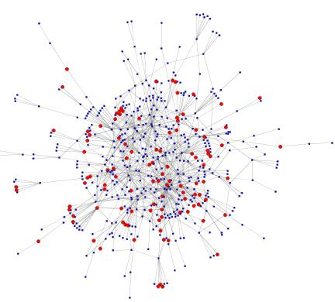
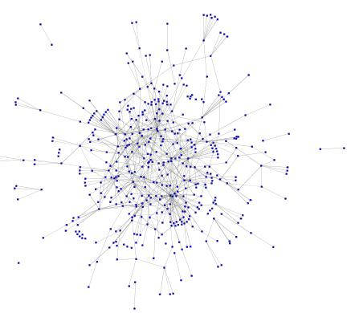
Scale-free networks are resilient with respect to random attack
Gnutella network
  20% of nodes removed
574 nodes in giant component
427 nodes in giant component (74%)
Notes:
Gnutella is a peer-to-peer network protocol. Founded in 2000, it was the first decentralized peer-to-peer network of its kind, leading to other, later networks adopting the model.
In June 2005, Gnutella's population was 1.81 million computers[2] increasing to over three million nodes by January 2006.[3] In late 2007, it was the most popular file-sharing network on the Internet with an estimated market share of more than 40%

Slide 7
But are especially vulnerable to targeted attack
Targeting and removing hubs can quickly break up the network

Slide 8
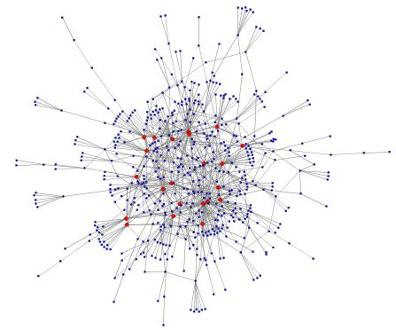
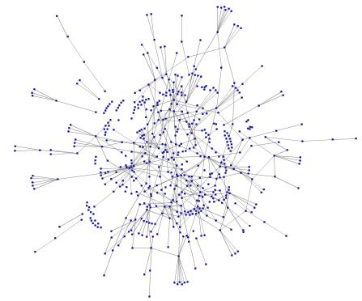
Targeted attacks are affective against scale-free networks
Gnutella network,
  22 most connected nodes removed (2.8% of the nodes)
574 nodes in giant component
301 nodes in giant component (52%)

Slide 9
Introduction
Edge removal
Bond percolation (deactivation): each edge is removed with probability p
  Corresponds to random failure of links
Targeted attack: causing the most damage to the network with the removal of the fewest edges
  Strategies: remove edges that are most likely to break apart the network or lengthen the average shortest path
    e.g. usually edges with high betweenness

Slide 10
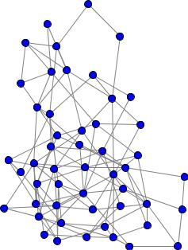
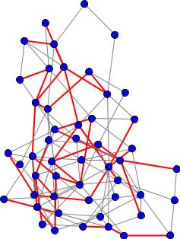
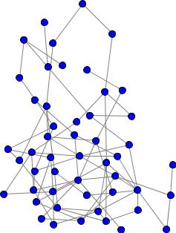
Percolation Theory
Network with 50 nodes, 116 edges, average degree 4.64 (116*2/50)
How many edges would you have to remove to break up a random graph?
after 25 % edge removal (29 edges) we are left with 87 edges, average degree 3.48 still well above threshold

Slide 11
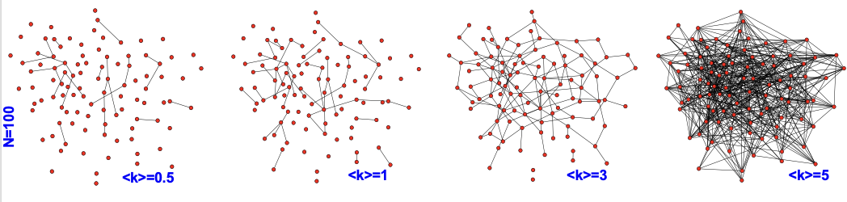
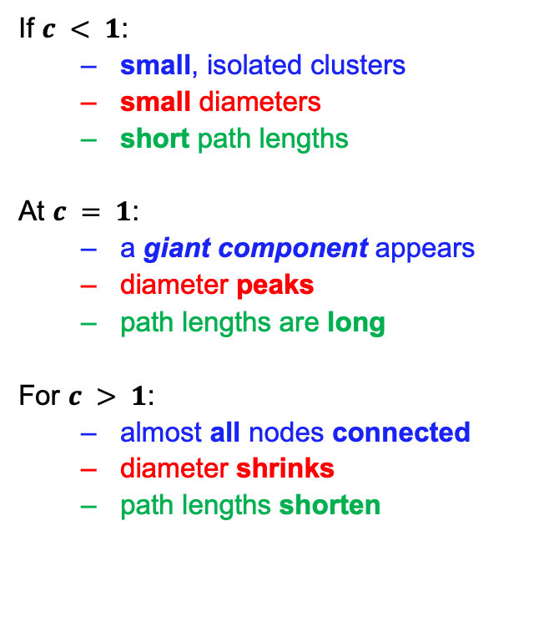
Percolation Theory
Percentage of nodes in largest component
Diameter of largest component
If $c < 1$:
  small, isolated clusters
  small diameters
  short path lengths
At $c = 1$:
  a giant component appears
  diameter peaks
  path lengths are long
For $c > 1$:
  almost all nodes connected
  diameter shrinks
  path lengths shorten
N-1
1.0
0
1.0
c
phase transition
c – average node degree
It is somewhat unexpected, however that one link is sufficient for the emergence of a giant component.

Slide 12
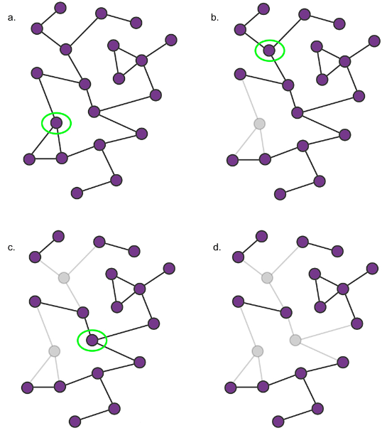
Percolation Theory
The removal of a single node has only limited impact on a network’s integrity.
The removal of several nodes, however, can break a network into several isolated components.

Slide 13
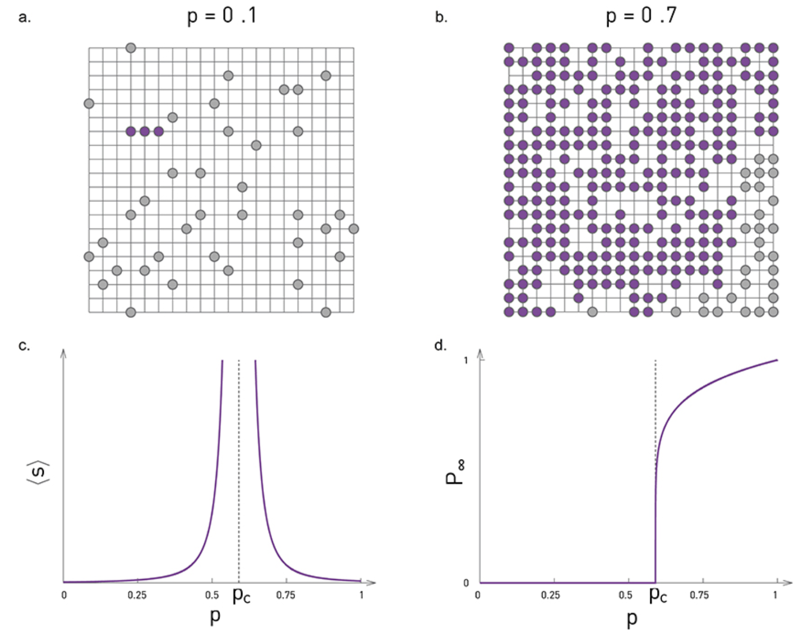
Percolation Theory
We place pebbles with probability p at each intersection.
Neighboring pebbles are considered connected, forming clusters
<s>: average cluster size
P∞: probability that a peeble belongs to the largest cluster

Slide 14
Percolation Theory
If p approaches a critical value p_{c}, these small clusters grow and merge, leading to the emergence of a large cluster at p_{c}.
This is called percolating cluster
In other words, at p_{c} we observe a phase transition from many small clusters to a percolating cluster that percolates the whole lattice

Slide 15
Percolation Theory
The average cluster size, 〈s〉, in function of p.
As we approach p_{c} from below, numerous small clusters merge and 〈s〉 diverges
The same divergence is observed above p_{c}, where to calculate 〈s〉 we remove the percolating cluster from the average.
The same exponent γ characterizes the divergence on both sides of the critical point.

Slide 16
Percolation Theory
For p < p_{c} all components are small, so P∞ is zero.
Once p reaches p_{c} a giant component emerges.
Consequently beyond p_{c} there is a finite probability that a node belongs to the largest component
P∞: probability that a peeble belongs to the largest cluster

Slide 17
Percolation Theory
Percolation theory predicts that these exponents are universal, meaning that they are independent of the nature of the lattice or the precise value of p_{c}. Therefore, whether we place the pebbles on a triangular or a hexagonal lattice, the behavior of 〈s〉, and P∞, is characterized by the same γ, β exponents.

Slide 18
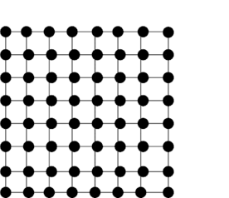
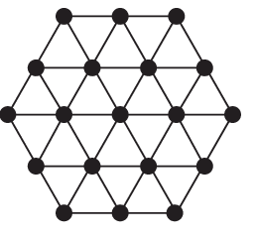
Percolation Theory
The value of p_{c} depends on the lattice type, hence it is not universal.
For example, for a two-dimensional square lattice the p_{c} ≈ 0.593, while for a two-dimensional triangular lattice p_{c} = 1/2.
The value of p_{c} also changes with the lattice dimension: for a square lattice p_{c} ≈ 0.593 (v = 2); for a simple cubic lattice (d = 3) p_{c} ≈ 0.3116.
In contrast with p_{c}, the critical exponents (γ, β) do not depend on the lattice type, but only on the lattice dimension.
In 2 dimensions γ=43/18, and β = 5/36 for any lattice.
In 3 dimensions γ=1.80, and β=0.41.
For any d > 6 we have γ=1, and β = 1, hence for large d the exponents are independent of d as well

Slide 19
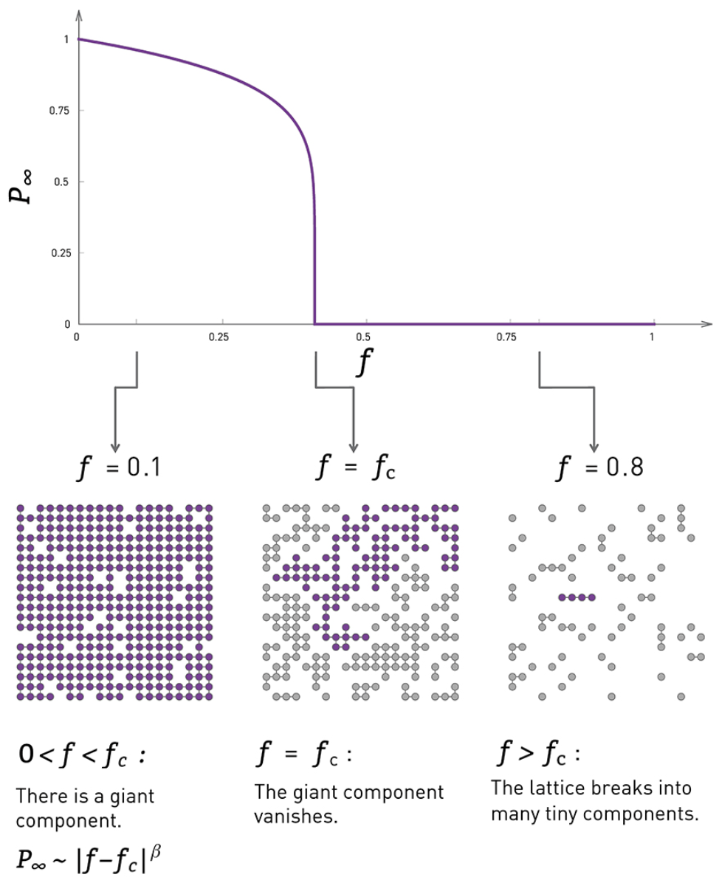
Percolation Theory - Network Breakdown as Inverse Percolation
Randomly remove an f fraction of nodes
For large f the giant component breaks into tiny disconnected components.
This fragmentation process is characterized by a critical threshold fc
For any f < fc we continue to have a giant component.
Once f exceeds fc, the giant component vanishes.

Slide 20
Percolation Theory - Network Breakdown as Inverse Percolation
This is illustrated by the f dependence of P∞ (probability that a node is part of the giant component)
P∞ is nonzero under fc, but it drops to zero as we approach fc.
The critical exponents characterizing this breakdown, γ and β, are the same as in the emergence of giant component.

Slide 21
Percolation Theory – Random Network
What, if the underlying network is not as regular as a square lattice?
For random networks the answer continues to be provided by percolation theory: Random networks under random node failures share the same scaling exponents as infinite-dimensional percolation.
  γ = 1 and β = 1, for the d > 6
In summary, the breakdown of a network under random node removal is not a gradual process. Rather, removing a small fraction of nodes has only limited impact on a network’s integrity. But once the fraction of removed nodes reaches a critical threshold, the network abruptly breaks into disconnected components.
Random node failures induce a phase transition from a connected to a fragmented network.
We can use the tools of percolation theory to characterize this transition in both regular and in random networks.

Slide 22
Percolation Theory – Scale Free Network
Many real networks are not regular, but have a scale-free topology
Scale-free networks do not appear to break apart under random failures.
  Reason: the hubs.
The likelihood of removing a hub is small.

Slide 23
Percolation Theory – Scale Free Network
Molloy-Reed criteria
For a giant component to exist each node that belongs to it must be
connected to at least two other nodes on average
Therefore, the average degree k_{i} of a randomly chosen node i that is
part of the giant component should be at least 2.
This prediction coincides with the necessary condition for the existence of a giant component in random networks

Slide 24
Percolation Theory – Scale Free Network
Robustness: we remove a fraction f of the nodes.
At what threshold f_{c} will the network fall apart (no giant component)?
Breakdown threshold:
f<f_{c}: the network is still connected (there is a giant cluster)
f>f_{c}: the network becomes disconnected (giant cluster vanishes)
Notes:
http://networksciencebook.com/chapter/8#advanced-8c

Slide 25
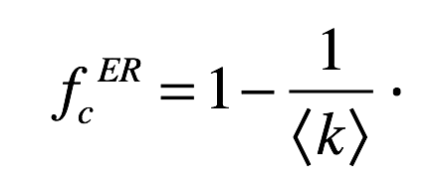
Percolation Theory – Scale Free Network
100 nodes with average degree 10
Fc = 1-0.1 = 0.9 (90%)
90 nodes should be removed
Node1: n1, n2, n3 … n10
Node2: n1, n2, n3 … n10
Molloy-Reed criteria
For a giant component to exist each node that belongs to it must be connected to at least two other nodes on average
Therefore, the average degree k_{i} of a randomly chosen node i that is
part of the giant component should be at least 2.
100 nodes with average degree 8
Fc = 1-1/8 = 7/8
Node1: n1, n2, n3 … n8
Node2: n1, n2, n3 … n8

Slide 26
Scale Free Network – Attack Tolerance
What if we target Hubs?
What will be the fc for a network under attack?
Hub removal changes the network in two ways
It changes the maximum degree of the network from k_{max} to k'_{max} as all nodes with degree larger than k'_{max} have been removed.
The degree distribution of the network changes from p_{k} to p’_{k’} , as nodes connected to the removed hubs will loose links, altering the degrees of the remaining nodes
Notes:
http://networksciencebook.com/chapter/8#advanced-8f

Slide 27
Scale Free Network – Attack Tolerance
Hub removal changes the network in two ways
It changes the maximum degree of the network from k_{max} to k'_{max} as all nodes with degree larger than k'_{max} have been removed.
The degree distribution of the network changes from p_{k} to p’_{k’} , as nodes connected to the removed hubs will loose links, altering the degrees of the remaining nodes
p_{k} = c ⋅ k^{−γ} where k = k_{min} ,…, k_{max} and c ≈ (γ − 1)/(k_{min}^{−γ+1} − k_{max}^{−γ+1} )
  from Power Law

Slide 28
Scale Free Network – Attack Tolerance
Scale
free
Random network
Notes:
http://networksciencebook.com/chapter/8#advanced-8f

Slide 29
Network Resilience and Robustness

Slide 30
Network Resilience and Robustness

Slide 31
Network Resilience and Robustness

Slide 32
Network Resilience and Robustness
Gnutella network,
  22 most connected nodes removed (2.8% of the nodes)
574 nodes in giant component
301 nodes in giant component (52%)

Slide 33
Network Resilience and Robustness
The average cluster size, 〈s〉, in function of p.
P∞: probability that a peeble belongs to the largest cluster

Slide 34
Network Resilience and Robustness
The value of p_{c} depends on the lattice type (square and triangular) and dimension.
The critical exponents (γ, β) do not depend on the lattice type, but only on the lattice dimension, but for any d > 6 we have γ=1, and β = 1.
Fraction of nodes (f_{c}) that need to be removed to break down the network is characterized by p_{c}. For regular/random network f_{c}=1-p_{c}.
For scale free networks
Molloy-Reed criteria: For a giant component to exist each node that belongs to it must be connected to at least two other nodes on average

Slide 35
Cascading failures

Slide 36
Cascading failures
Thex
August 14, 2003: 9:29pm EDT
20 hours before
August 15, 2003: 9:14pm EDT
7 hours after
Network Science: Introduction

Slide 37
Cascading failures - Failure Propagation Model
Failure Propagation Model
Each node contains an agent
An agent i can be in the state 0 (active or healthy) or 1 (inactive or failed), and is characterized by a breakdown threshold φi = φ for all i.
All agents are initially in the healthy state 0.
At time t = 0 one agent switches to state 1, corresponding to an initial component failure or to the release of a new piece of information.
In each subsequent time step we randomly pick an agent and update its state following a threshold rule
  If the selected agent i is in state 0, it inspects the state of its k_{i} neighbors and adopts state 1 (fails) if at least a φ fraction of its k_{i} neighbors are in state 1, otherwise it retains its original state 0.
  If the selected agent i is in state 1, it does not change its state

Slide 38
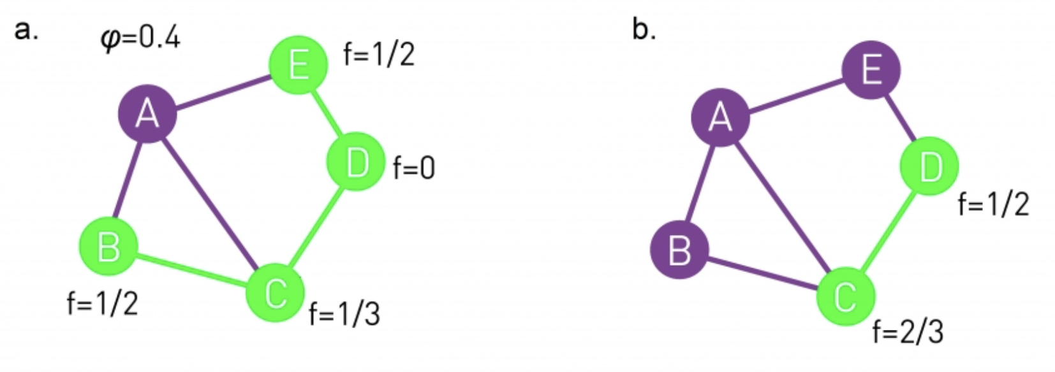
Cascading failures - Failure Propagation Model
Node A fails randomly which leads to failure of B and E.
  Subsequently node D and C also fails
Same impact is not observed if node B fails randomly.
A healthy node i changes its state if a φ fraction of its neighbors have failed. Depending on the local network topology, an initial perturbation can die out immediately, failing to induce the failure of any other node.

Slide 39
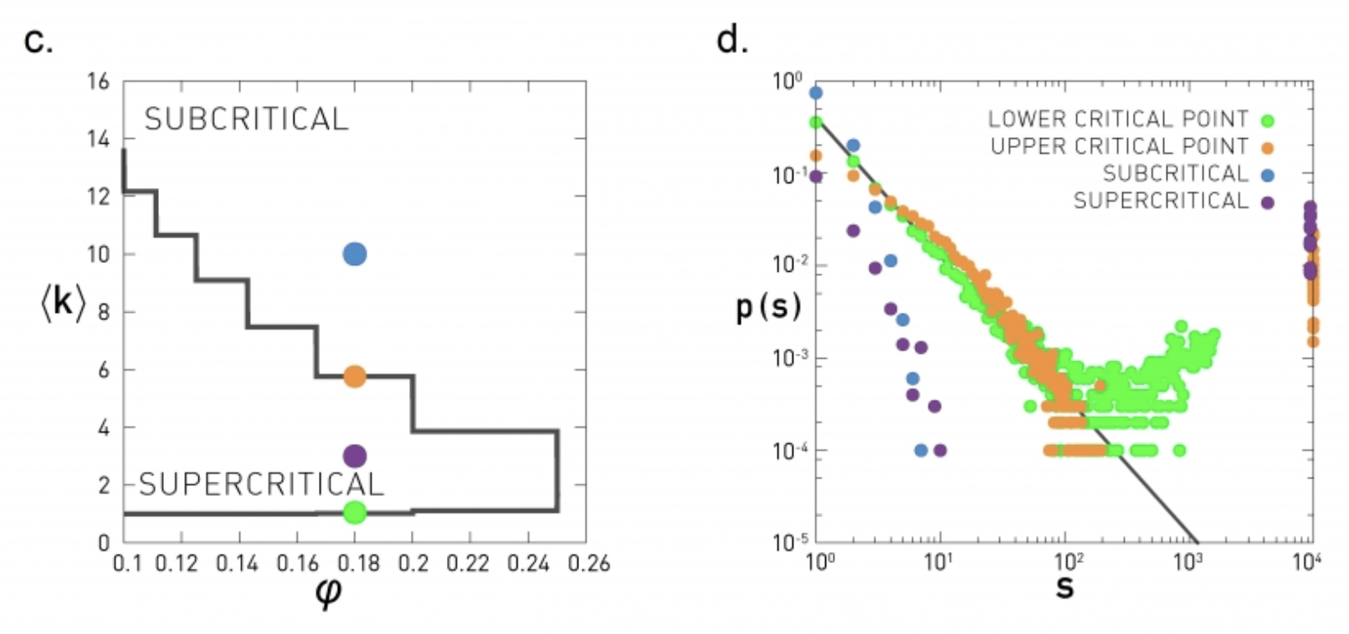
Cascading failures - Failure Propagation Model
Three regimes with distinct avalanche characteristics
Subcritical Regime: If 〈k〉 is high, changing the state of a node is unlikely to move other nodes over their threshold, as the healthy nodes have many healthy neighbors. In this regime cascades die out quickly and their sizes follow an exponential distribution. Hence the system is unable to support large global cascades (blue)
S: number of failed nodes

Slide 40
Cascading failures - Failure Propagation Model
Three regimes with distinct avalanche characteristics
Supercritical Regime: If 〈k〉 is small, flipping a single node can put several of its neighbors over the threshold, triggering a global cascade. In this regime perturbations induce major breakdowns (purple)
S: number of failed nodes

Slide 41
Cascading failures - Failure Propagation Model
Three regimes with distinct avalanche characteristics
Critical Regime: At the boundary of the subcritical and supercritical regime the avalanches have widely different sizes. Numerical simulations indicate that in this regime the avalanche sizes s follow power law with α = 3/2 if the underlying network is random (green and orange)
S: number of failed nodes

Slide 42
Cascading failures - Branching Model
Branching Model
The model starts with a single active node. In the next time step each active node produces k offsprings, where k is selected from a p_{k} distribution. If a node selects k = 0, that branch dies out. If it selects k > 0, it will have k new active sites. The size of an avalanche corresponds to the size of the tree when all active sites died out.
If degree distribution is scale free (between 2 < γ < 3) the avalanche size (a) depends on the degree exponent (γ). Beyond γ = 3, however, the avalanches behave as they would be spreading on a random network, in which case we have α =3/2.

Slide 43
Building Robustness

Slide 44
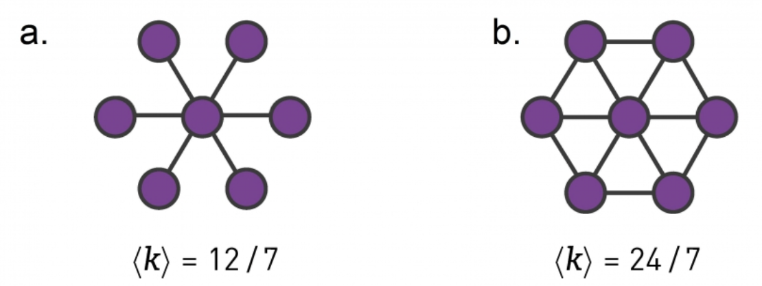
Building Robustness
We can enhance this network’s attack tolerance by connecting its peripheral nodes
The cost of the network b is 24/7, double of the cost 12/7 of the network a.
Can we maximize the robustness of a network to both random failures and targeted attacks without changing the cost?

Slide 45
Building Robustness
The robustness against random failures is captured by network’s percolation threshold f_{c}, which is the fraction of the nodes we must remove for the network to fall apart
To enhance a network's robustness we must increase f_{c}
f_{c} depends on 〈k〉 and 〈k²〉 and to maximize f_{c} and keep cost of <k>, we need to maximize 〈k²〉, thus we need to focus on k_{min} and k_{max}
A combination of analytical arguments and numerical simulations indicate that this too is best achieved by the bimodal degree distribution [1, 2, 3, 4]
describing a network in which an r fraction of nodes have degree k_{max} and the remaining (1 − r) fraction have degree k_{min}.
Maximum of f_{c}^{tot} is obtained when r = 1/N

Slide 46
Halting Cascading Failures
Cascading failure has two parts:
Initial failure: is the breakdown of the first node or link, representing the source of the subsequent cascade.
Propagation: is when the initial failure induces the failure of additional nodes and starts cascading through the network.
How the size of cascading can be reduced?
The size of a cascade can be reduced if we intentionally remove additional nodes right after the initial failure.
To limit the size of the cascades we must remove nodes with small loads and links with large excess load in the vicinity of the initial failure.

Slide 47
Robustness, Resilience, Redundancy
Robustness
A system is robust if it can maintain its basic functions in the presence of internal and external errors. In a network context robustness refers to the system's ability to carry out its basic functions even when some of its nodes and links may be missing.
Resilience
A system is resilient if it can adapt to internal and external errors by changing its mode of operation, without losing its ability to function. Hence resilience is a dynamical property that requires a shift in the system's core activities.
Redundancy
Redundancy implies the presence of parallel components and functions that, if needed, can replace a missing component or function. Networks show considerable redundancy in their ability to navigate information between two nodes, thanks to the multiple independent paths between most node pairs.

Slide 48
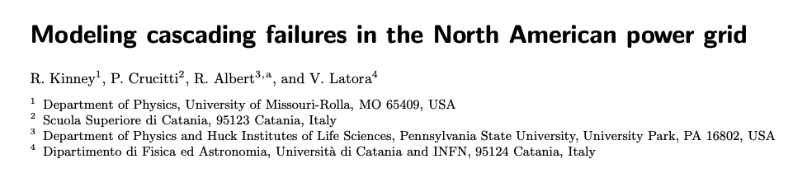
Related Studies
Data from North American power grid obtained from the POWERmap mapping system developed by Platts, the energy information and market services unit of the McGraw-Hill Companies.
N = 14,099 substations
  Generation substations set GG (NG = 1,633 elements) produce electric power to distribute.
  Transmission substations set GT (NT = 10,287 elements) transfer power along high voltage lines.
  Distribution substations set GD (ND = 2,179 elements) distribute power to small, local grids.
K = 19,657 transmission (power) lines

Slide 49
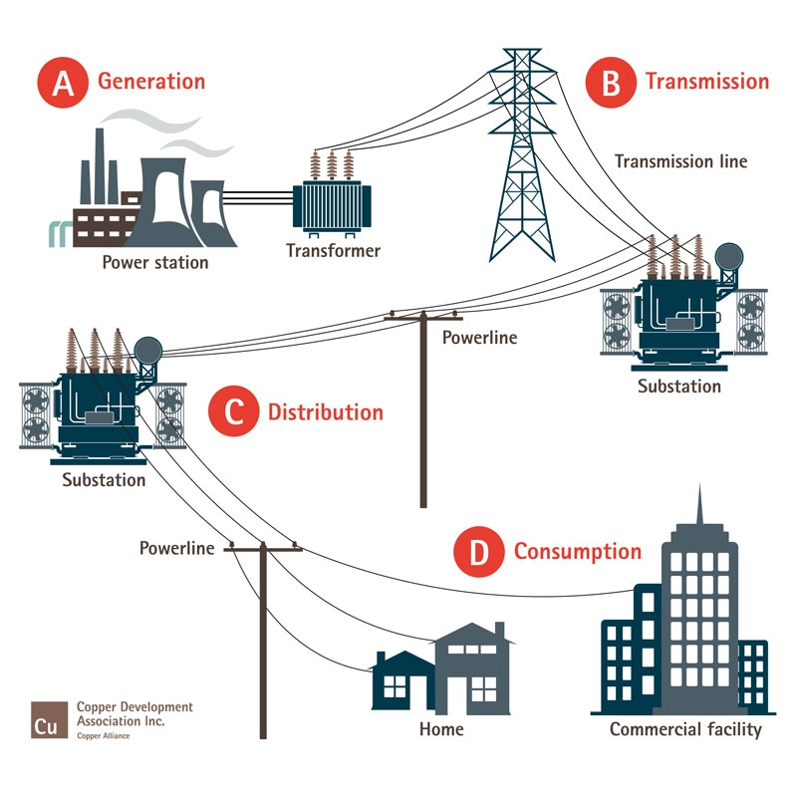
Related Studies

Slide 50

Related Studies
Weighted graph with N nodes (the substations) and K edges (the transmission lines)
N x N adjacency matrix {e_{ij}}. The element e_{ij} of this matrix is 0 if there is no direct line from the substation i to the substation j; otherwise it is a number in the range [0, 1] that represents the efficiency of the edge.
Initially, for all existing edges, e_{ij} is set equal to 1, meaning that all the transmission lines are working perfectly.
The efficiency of a path (succession of consecutive edges) between two nodes i and j as the harmonic composition of the efficiencies of component edges
The harmonic composition of N numbers x₁ , x₂ , x₃ , … x_{n} is

Slide 51
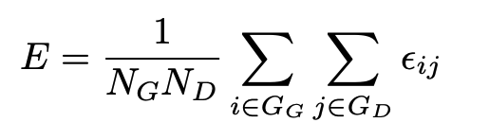
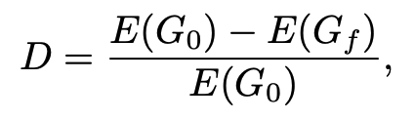
Related Studies
Average efficiency of the network
Where ε_{ij} is the efficiency of the most efficient path between the generator i and the distribution substation j (higher ε_{ij} value)
Damage D that a failure causes is the normalized efficiency loss
Where E(G₀) is the efficiency of the network before the occurrence of any breakdown and E(G_{f}) is the final efficiency that is reached by the system after the end of the transient due to a breakdown, i.e. when the network efficiency stabilizes.

Slide 52

Related Studies
Each generator transfers power to all the distribution substations through the transmission lines.
The generators also have transmitting capabilities, so they are both sources and intermediaries in power transmission.
The load (also called betweenness) of each node with transmitting capabilities is the number of most efficient paths from generators to distribution substations that pass through the node.
Each node i has a capacity C_{i} directly proportional to the initial load L_{i}
where α > 1 is the tolerance parameter that represents the ability of nodes to handle increased load thereby resisting perturbations.

Slide 53
Related Studies
If, due to external causes, a breakdown occurs at one or more nodes, so that they cannot work at all, the most efficient power transmission paths will change and the power/load, since it cannot be destroyed, will redistribute among the network.
This leads to a situation in which a certain number of nodes, forced to carry a load higher than their capacity, cannot function regularly anymore and show a degradation of their performance. Such a degradation can modify the most efficient paths, redistribute the load on the network, and cause new nodes to be overloaded.
If the overload caused by the initial breakdown is small, degradation will involve only a tiny part of the system, while if the overload to be reabsorbed is large enough, it will spread over the entire system in an avalanche mechanism, hindering any interaction among nodes.
Notes:
The degradation of performance is represented by the following dynamical model

Slide 54
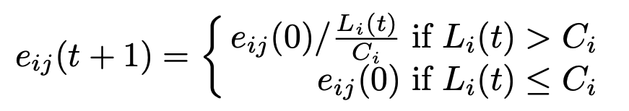
Related Studies
The degradation of performance is represented by the following dynamical model
Where j extends to all the first neighbors of i. In other words, when a node i is congested, it is assumed that the efficiency of power transportation from(to) i to(from) its first neighbors decreases linearly with the overload L_{i}(t)/C_{i}.
The effects of overload on nodes are reversible
Simulating a network failure involves removing a node from the network and monitoring the progression of overloading nodes.
Notes:
The degradation of performance is represented by the following dynamical model

Slide 55
Related Studies
If the tolerance parameter α is high enough the network does not present the cascading effect typical of the redistribution of flows and its efficiency remains unaffected by the failure.
If the tolerance parameter is very small, a cascading effect takes place and the transmission efficiency of the network degrades rapidly.

Slide 56
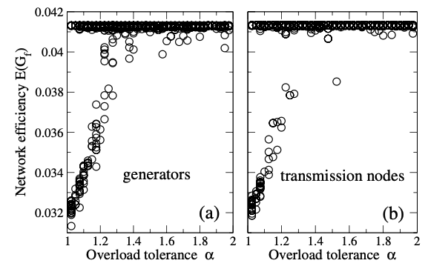
Related Studies
The efficiency of loss of randomly selected nodes for 40 different tolerance values.
A horizontal line of points close to the unperturbed efficiency, indicates no efficiency loss for any tolerance level.
Tolerance-dependent damage, a curve that initially increases linearly, then saturates at high tolerance levels. An efficiency loss (damage) of significant amount is possible after the loss of a single generator or transmission substation.

Slide 57
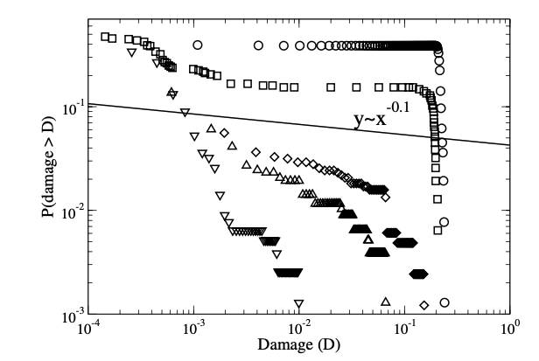
Related Studies
Cumulative damage distribution P (d > D), i.e. the probability of observing damage larger than a given value D
Cumulative damage distribution for five tolerance values: α = 1.025 (circles), α = 1.1 (squares), α = 1.2 (diamonds), α = 1.4 (upward triangles) and α = 1.8 (downward triangles).
Higher the tolerance value, the lower the probability to cause high damage
Notes:
Other interesting findings in terms of categorizing node types

Slide 58
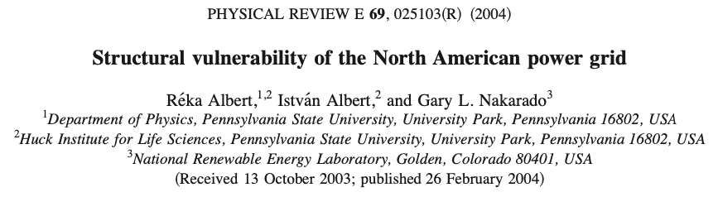
Related Studies
Data: POWERmap mapping system developed by Platts, the energy information and market services unit of the McGraw-Hill Companies.
Network representation of the power grid contains a single connected component, meaning that there is a path of transmission lines between any power plant and any distribution substation
Notes:
Other interesting findings in terms of categorizing node types

Slide 59
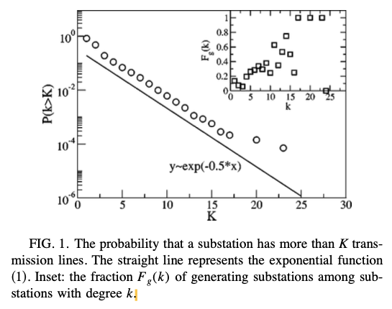

Related Studies
The cumulative degree distribution follows an exponential distribution.
The probability of high-degree nodes is less than in a scale-free network, but higher than in a random network with the same number of nodes and edges.

Slide 60
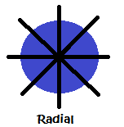
Related Studies
Measure the network redundancy with edge range
  Defined as the distance between the two end points of an edge if the edge connecting them were removed.
Parallel edges and short alternative paths are fairly frequent.
However, around 15% of the edges in the power grid have an infinite range.
Around 900 edges connecting generators and/or transmission substations are radial (in total 19,657 edges).
  These radial edges represent a clear vulnerability, as their loss disconnects their end points and creates isolated clusters in the power grid

Slide 61
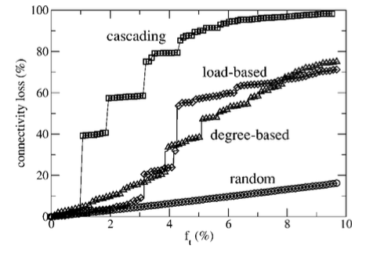
Related Studies
Connectivity loss: measures the decrease of the ability of distribution substations to receive power from the generators.
Even the removal of a single transmission node causes a slight connectivity loss.
For a random failure the connectivity loss is fairly low and stays proportional with the number of nodes lost.
For targeted failure loss is significant
  Only 4% of the nodes with high load may cause up to 60% loss of connectivity.

Slide 62
Related Studies
Periodically recalculate the load of all transmission nodes during node removal, and select the nodes with highest load to be deleted next (cascading failure)
Cascading failure has the most damaging effect, as the loss of only 2% of the high-load transmission substations leads to a connectivity loss of almost 60%, and all distribution substations become virtually powerless at f_{t} = 8% (removed fraction of transmission nodes ).

Slide 63
Summary
Network robustness is important topic (criminal network, infrastructure network)
Different network types (random, scale free) have different thresholds (f_{c}) to breakdown the network.
Modeling cascading breakdown of the network, and developing strategies to stop cascading failures is important to build robust systems.

Slide 64
References
[1] G. Paul, S. Sreenivas, and H. E. Stanley. Resilience of complex networks to random breakdown. Phys. Rev. E, 72: 056130, 2005.
[2] G. Paul, T. Tanizawa, S. Havlin, and H. E. Stanley. Optimization of robustness of complex networks. European Physical Journal B, 38: 187–191, 2004.
[3] A.X.C.N. Valente, A. Sarkar, and H. A. Stone. Two-peak and threepeak optimal complex networks. Phys. Rev. Lett., 92: 118702, 2004.
[4] T. Tanizawa, G. Paul, R. Cohen, S. Havlin, and H. E. Stanley. Optimization of network robustness to waves of targeted and random attacks. Phys. Rev. E, 71: 047101, 2005

