Slide 1
Lecture 11:
Search in Networks
CS 765: Complex Networks
Slides are adapted from
Lada Adamic

Slide 2

Introduction
2

Slide 3
Introduction
Poisson graph
number of
nodes found
93
19
15
11
7
3
1
3

Slide 4
Introduction
power-law graph
number of
nodes found
94
67
63
54
2
6
1

Slide 5
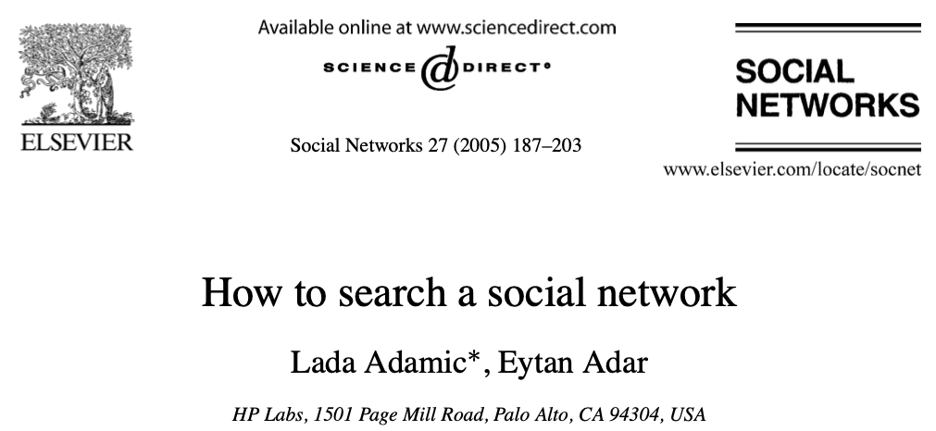
Search in Networks
How participants in a small world experiment are able to find short paths in a social network using only local information about their immediate contacts?

Slide 6
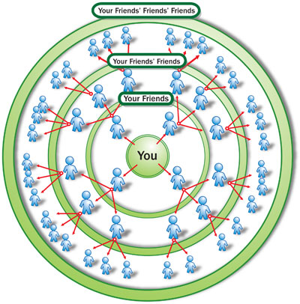
Small-World Model
A rumor is spreading over a social network.
  Assume all users pass it immediately to all of their friends
  An estimate: k^{d} = N, d=logN/logk
  N = 6.7 bln, k=50 friends, d=5.8

Slide 7
Search in Networks
Email logs at HP Labs
Individuals (nodes) had exchanged at least 6 emails both ways over the period of approximately 3 months.
430 individuals with a median number of 10 acquaintances and a mean of 12.9
On average 3.1 links separate any two individuals, and median is 3.
Three strategies to past the message
High Degree: best connected
The closest to the target in the organizational hierarchy
Proximity: located in closest physical proximity to the target.

Slide 8
Search in Networks
Best connected
Who are the best connected individuals?
High-degree strategy: selects the individual who is more likely to know the target by virtue of the fact that he/she knows so many people.
High-degree strategy: are effective in networks with a power-law degree distribution with an exponent γ close to 2 [1].
Unfiltered HP Labs email network (raw network) shows the power-law degree distribution.
[1] Adamic, Lada A., et al. "Search in power-law networks." Physical review E 64.4 (2001): 046135.

Slide 9
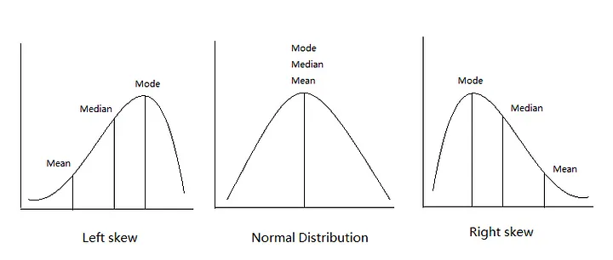
Search in Networks
Best connected
High-degree seeking search strategy is unsuitable for the filtered HP email network.
The median number of steps required to find a randomly chosen target from a random starting point was 16, and average was 43 steps, compared to the 3 steps in the average shortest path.
Why there is a discrepancy between the mean (43) and median (16) ?
The discrepancy between the mean and median is due to the existence of high-degree individuals and their contacts are easy to find, but others who do not have many links and do not have high-degree neighbors are difficult to locate using this strategy.

Slide 10
Search in Networks
The closest to the target in the organizational hierarchy
Passing the message to the contact closest to the target in the organizational hierarchy.
In our simulation individuals are allowed full knowledge of the organizational hierarchy (in actuality, employees can reference an online organizational chart). However, the communication network that they are trying to navigate is hidden to them beyond their immediate contacts.
At each step in the chain the message is passed to someone closer in the organizational hierarchy to the target.
The message does not need to travel all the way to the top of the organizational hierarchy and instead takes advantage of a shortcut created by individuals in different research groups communicating with one another.

Slide 11
Search in Networks
The closest to the target in the organizational hierarchy
The individuals closer together in the organizational hierarchy are more likely to email one another.
The relationship between separation in the hierarchy and probability of linking.

Slide 12
Search in Networks
The closest to the target in the organizational hierarchy
The probability of linking as a function of the group size.
Slight difference from the optimal, this means that far-flung (distance or remote) collaborations occur slightly more often.

Slide 13
Search in Networks
The closest to the target in the organizational hierarchy
The median number of steps is 4, which is close to the shortest path of 3.
The mean was 5 steps, slightly higher than the median because of the presence of a four hard to find individuals who had only a single link.
Excluding these four individuals as targets resulted in a mean of 4.5 steps.

Slide 14
Search in Networks
Proximity
Individuals’ locations are given by their building, the floor of the building, etc.
The general tendency of individuals in close physical proximity to communicate holds: over 87% of the 4000 email links are between individuals on the same floor.
The availability of other communication media, such as email, telephone, and instant messaging.

Slide 15
Search in Networks
Proximity

Slide 16
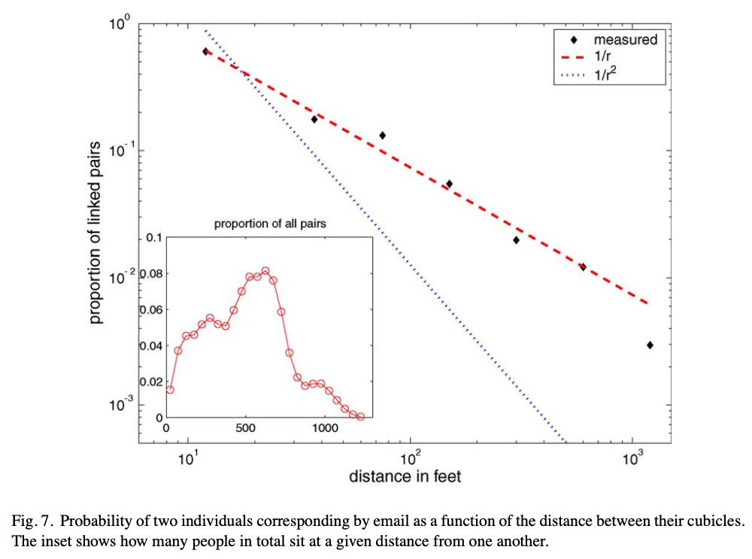
Search in Networks
Proximity
The median number of 6 steps, and a mean of 12 steps needed.

Slide 17
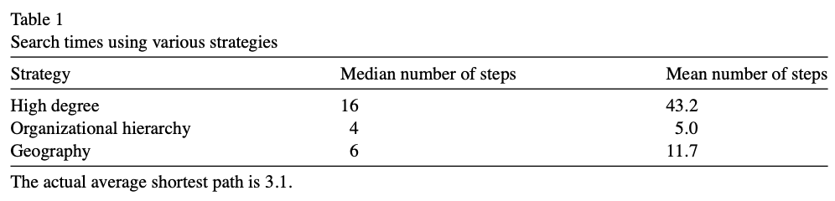
Search in Networks

Slide 18
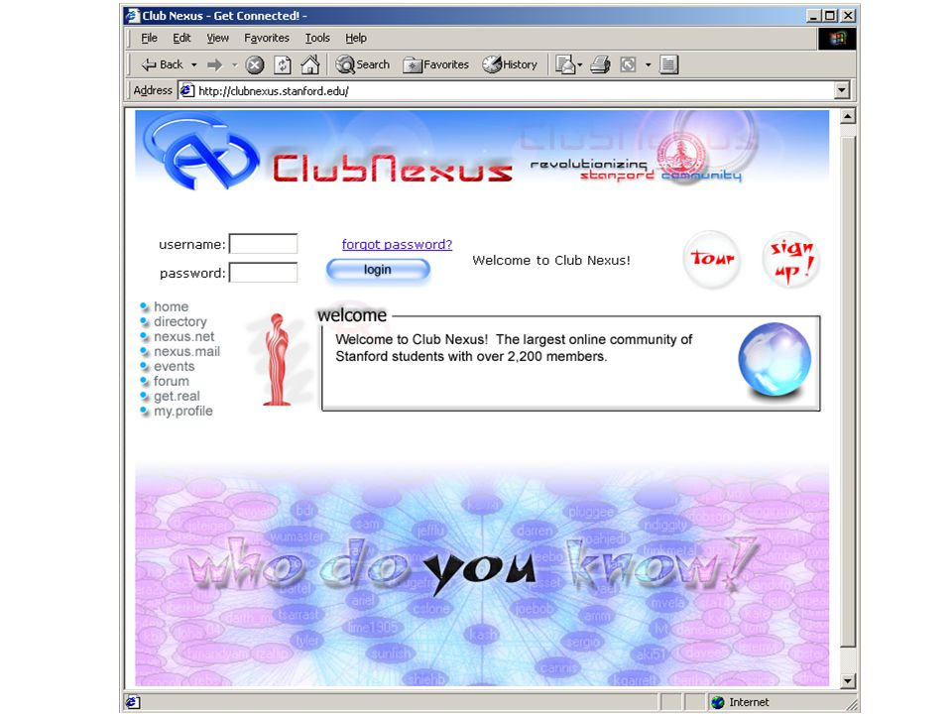
Search in Networks
Stanford Club Nexus

Slide 19
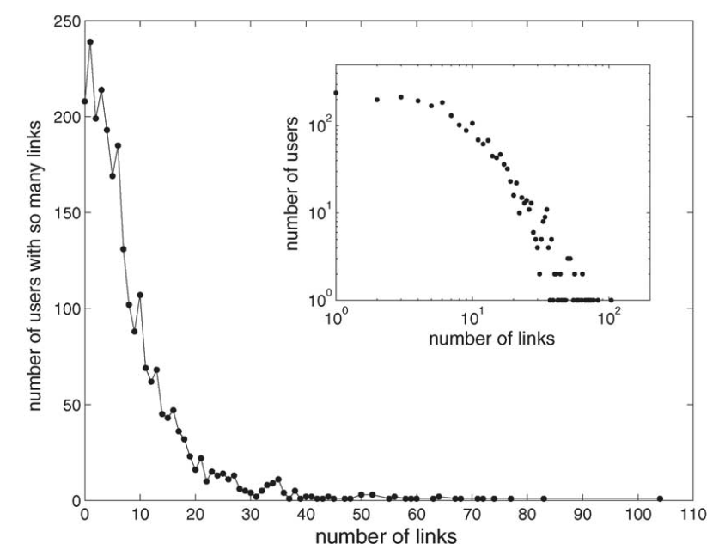
Search in Networks

Slide 20
Search in Networks
Utilizing the user profiles with 5 attributes simultaneously for the target and a person one is considering passing the message to.
Both undergraduate, both graduate, or one of each
Same year, a year apart, or more than a year apart
Both male, both female, or one of each
Same or different residences
Same or different major/department and school

Slide 21
Search in Networks

Slide 22
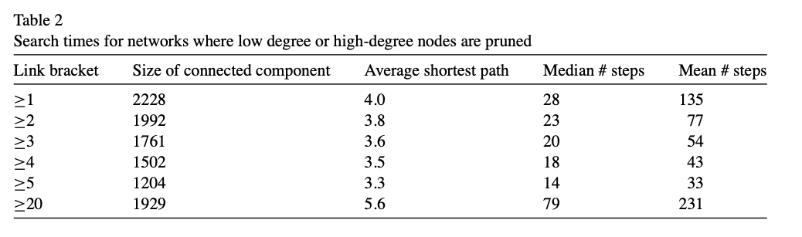
Search in Networks
No hierarchical structure.
Proximity is almost a binary variable
Most importantly, non-participation or missing data might have impacted the results by hiding connections that could be used in the search.

Slide 23

Search in Networks

Slide 24
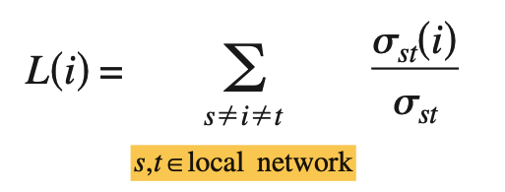
Search in Networks
Local Betweenness Centrality (LCB)
Each node in the network has information about its first and second neighbors.
Consider the local network formed by that node (which is called the root node), its first and second neighbors.
Then, the betweenness centrality, defined as the fraction of shortest paths going through a node, and calculated for the first neighbors in this local network.
Let L(i) be the LBC of a neighbor node i in the local network.
Then L(i) is given by

Slide 25
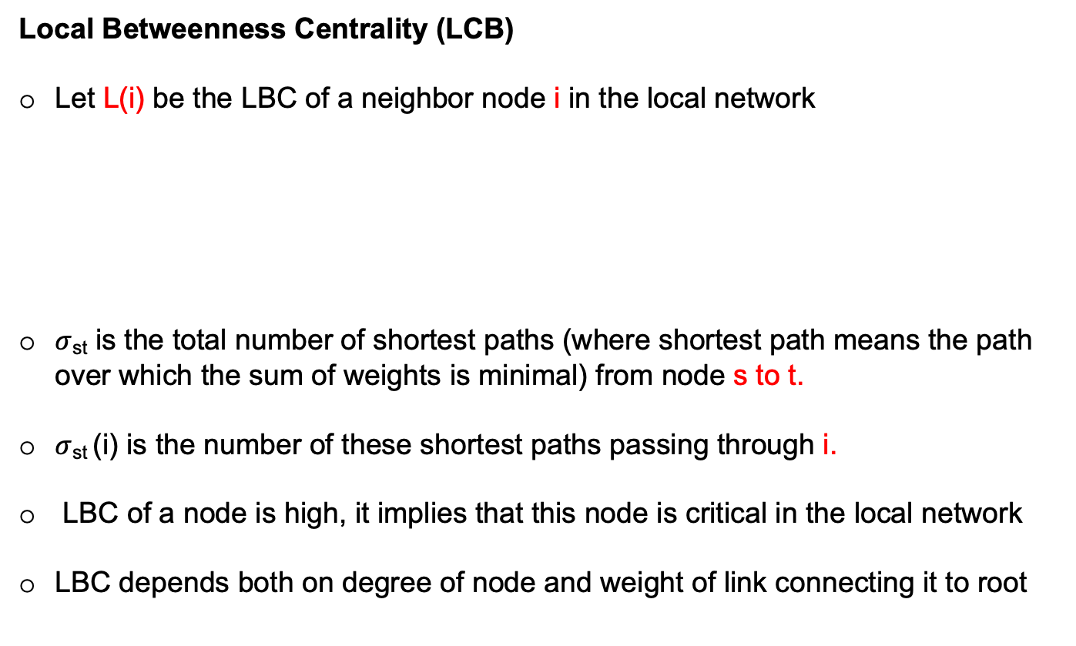
Search in Networks
Local Betweenness Centrality (LCB)
Let L(i) be the LBC of a neighbor node i in the local network
$σ$_{st} is the total number of shortest paths (where shortest path means the path over which the sum of weights is minimal) from node s to t.
$σ$_{st} (i) is the number of these shortest paths passing through i.
LBC of a node is high, it implies that this node is critical in the local network
LBC depends both on degree of node and weight of link connecting it to root

Slide 26
Search in Networks
L(2)= (4*(13-4-1) + Comb(4,2) ) * 2 = 76
L(3)= (2*(13-2-1) + Comb(2,2) ) * 2 = 42
L(4)= (2*(13-2-1) + Comb(2,2) ) * 2 = 42
L(2)= (4*(13-4-1) + Comb(4,2) ) * 2 = 76
L(3)=
(2*(13-2-1) + Comb(2,2) +
5*(13-5-1) -
5*2 ) * 2 = 92

Slide 27
Search in Networks
Choose a neighbor randomly: The node tries to reach the target by passing the message/query to a randomly selected neighbor.
Choose the neighbor with smallest edge weight: The node passes the message along the edge with minimum weight.
Choose the best-connected neighbor: The node passes the message to the neighbor which has the highest degree.
Choose the neighbor with the smallest average weight: The node passes the message to the neighbor which has the smallest average weight. The average weight of a node is the average weight of all the edges incident on that node.
Choose the neighbor with the highest LBC: The node passes the message to the neighbor which has the highest LBC.

Slide 28
Search in Networks
Randomly choose K pairs (source and target) of nodes.
In order to avoid passing the message to a neighbor that has already received it, a list l_{i} of all the neighbors that received the message is maintained at each node i.
During the search process, if node i passes the message to its neighbor j, which does not have any more neighbors that are not in the list l_{j}, then the message is routed back to the node i.
This particular neighbor j is marked to note that this node cannot pass the message any further.
The average path distance is calculated for each search strategy from the paths obtained for these K pairs.

Slide 29
Search in Networks
Evaluations on Random Network
High degree search and LBC did not perform well since the network is highly homogenous in node degree.

Slide 30
Search in Networks
Evaluations on Scale Free Network
The search strategy that utilizes the heterogeneities of both the edge weights and nodes’ degrees (the high LBC search) performs better than the other strategies.

Slide 31
Search in Networks
Evaluations on Scale Free Network
We observe that as the heterogeneity in the node degree decreases (i.e., as power-law exponent increases), the difference between the high LBC search and other strategies decreases.

Slide 32

Search in Networks
Evaluations on Unweighted Networks
In unweighted networks Highest LBC is similar to which of the strategies?
Random walk
Minimum edge weight
Highest degree
Minimum average node weight
$σ$_{st} is the total number of shortest paths (where shortest path means the path over which the sum of weights is minimal) from node s to t.
$σ$_{st} (i) is the number of these shortest paths passing through i.

Slide 33
Search in Networks
Are Neighbor with the highest LBC is always the same as the neighbor with the highest degree in unweighted networks?

Slide 34
Search in Networks
If there are two neighbors with the same degree (one with a common second neighbor and another without any) then the neighbor without any common second neighbors will have higher LBC.

Slide 35
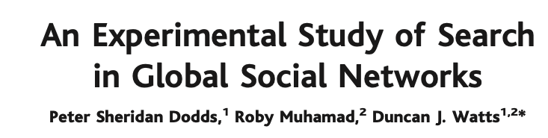
Search in Networks
Report results of the a global social-search experiment in which more than 60,000 e-mail users attempted to reach one of 18 target persons in 13 countries by forwarding messages to acquaintances.

Slide 36
Search in Networks
Participants registered online (http://smallworld.sociology.columbia. edu) and were randomly allocated one of 18 target persons from 13 countries.
Of the 98,847 individuals who registered, about 25% provided their personal information and initiated message chains.
Participant number increased with subsequent senders joining the chain. Including initial and subsequent senders, data were recorded on 61,168 individuals from 166 countries, constituting 24,163 distinct message chains.

Slide 37
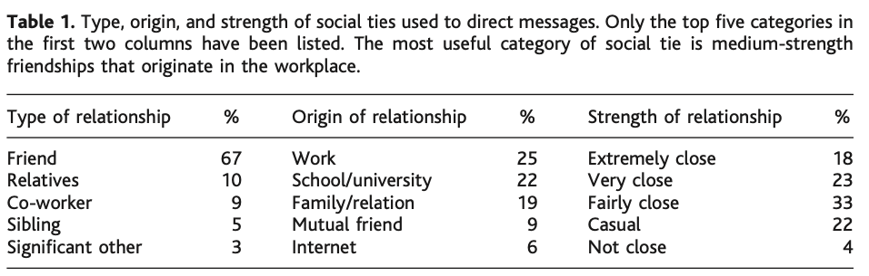
Search in Networks
When passing messages, senders typically used friendships in preference to business or family ties; however, almost half of these friendships were formed through either work or school affiliations.
Men passed messages more frequently to other men (57%), and women to other women (61%).

Slide 38
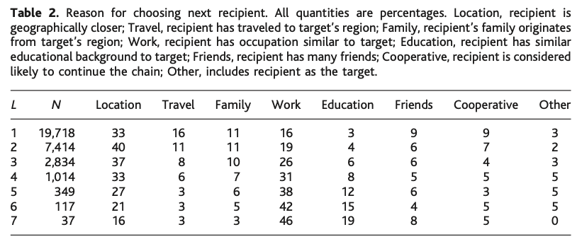
Search in Networks
Why senders considered their nominated acquaintance a suitable recipient.
Geographical proximity of the acquaintance to the target and similarity of occupation accounted for at least half of all choices.
Geography clearly dominated the early stages of a chain (when senders were geographically distant) but after the third step the occupation was dominant.
Highly connected individuals (hubs) were not the top selectied option.

Slide 39
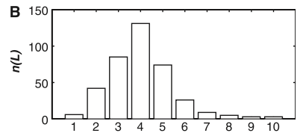
Search in Networks
Out of 24,163 chains 384 reached their targets
Average chain length is 4.05

