Slide 1
Lecture 12:
Information diffusion
CS 765: Complex Networks
Slides are modified from Lada Adamic, David Kempe, Bill Hackbor
And Leonid E. Zhukov

Slide 2
Introduction
Information diffusion: process by which a piece of information (knowledge) is spread and reaches individuals through interactions.
Sender(s): A sender or a small set of senders that initiate the information diffusion process.
Receiver(s): A receiver or a set of receivers that receive diffused information. Commonly, the set of receivers is much larger than the set of senders and can overlap with the set of senders.
Medium: This is the medium through which the diffusion takes place. For example, when a rumor is spreading, the medium can be the personal communication between individuals.

Slide 3
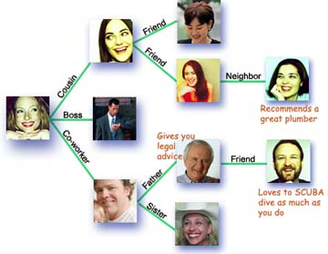
Introduction
Social network plays a fundamental role as a medium for the spread of INFLUENCE among its members
  Opinions, ideas, information, innovation…

Slide 4
Introduction
Factors influencing diffusion
Network structure (unweighted)
  density
  degree distribution
  clustering
  connected components
  community structure
Strength of ties (weighted)
  frequency of communication
  strength of influence
Spreading agent
  attractiveness and specificity of information

Slide 5
Information Cascade

Slide 6
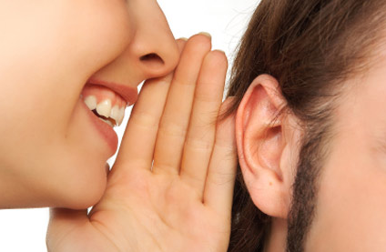
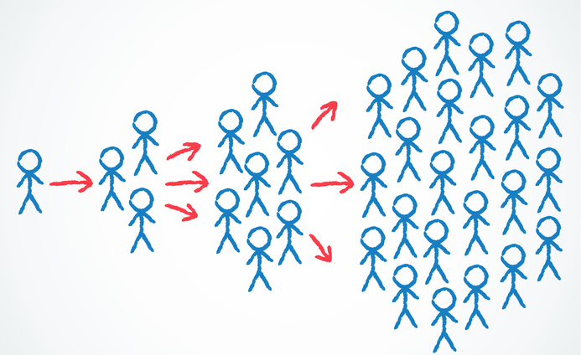
Information Cascade
Users often repost content posted by others in the network content is often received via immediate neighbors (friends).
Information propagates through friends
An information cascade: a piece of
information/decision cascaded among
some users, where individuals are connected
by a network and individuals are only observing
decisions of their immediate neighbors (friends).

Slide 7


Information Cascade
Between 1996/1997,
  Hotmail was one of the first internet business’s to become extremely successful utilizing viral marketing
  By inserting the tagline “Get your free e-mail at Hotmail” at the bottom of every e-mail sent out by its users
Hotmail was able to sign up 12 million users in 18 months
At the time, this was the fastest growth of any user- based company
  By the time Hotmail reached 66 million users, the company was establishing 270,000 new accounts each day

Slide 8
Information Cascade
Acceptance and Diffusion of Hybrid Corn Seed in Two Iowa Communities
By BRYCE RYAN AND NEAL GROSS

Slide 9
Information Cascade
Underlying Assumptions for Cascade Models
The network is a directed graph.
  Nodes are actors
  Edges depict the communication channels between them
A node can only influence nodes that it is connected to
Decisions are binary nodes can
  Active: the node has adopted the behavior/decision
  Inactive
An activated node can activate its neighboring nodes and activation is a progressive process, where nodes change from inactive to active, but not vice versa

Slide 10
Information Cascade
Influence response: diminishing returns and threshold (critical mass)
More friends activating higher chance to get activated
Until certain number of friends get activated the node stays inactivate

Slide 11
Information Cascade
Influence response: diminishing returns and threshold (critical mass)
Two models:
Independent Cascade Model (diminishing returns)
Linear Threshold Model (critical mass)
Notes:
https://link.springer.com/chapter/10.1007/978-3-319-23105-1_4

Slide 12
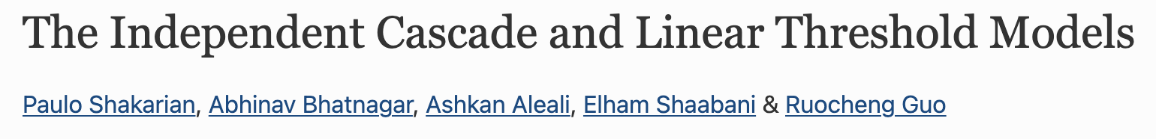
Information Cascade - Independent Cascade Model

Slide 13
Information Cascade - Independent Cascade Model
Independent Cascade Model (ICM)
There is a probability of influencing associated with each edge.
The probability P_{u,v} is the probability of u influencing v.
This probability can be assigned based on frequency of interactions, geographic proximity, or historical infection traces.
Each node, once activated, has the ability to influence its neighbor in the next time step based on the probability associated with that edge.

Slide 14
Information Cascade - Independent Cascade Model
Independent Cascade Model (ICM)
At each time step t where Xnew is the set of newly activated nodes at time t-1
Each node v ∈ Xnew infects the inactive neighbors with probability P_{u,v}

Slide 15
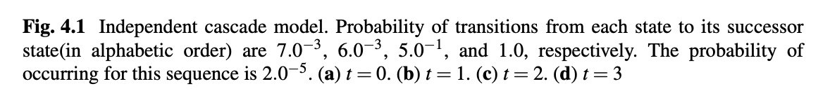
Information Cascade - Independent Cascade Model
Independent Cascade Model (ICM)
Notes:
An example of this model is shown in Fig. 4.1. Active nodes are shown in yellow dotted line. At initial time, two nodes C and D are activated. At the next time step, node C and D has a chance to activate their three neighbors (A, G, and H) and (B, E, and F) respectively. According to Fig. 4.1b, only three nodes A, H, and E are successfully activated and the initial active nodes change to gray (denoting it stays active but no chance to activate others). In the next time step, two nodes G and F become active, and the previous active nodes A, E, and H change to gray. At time t = 2, two nodes F and G become active. Node G’s neighbors are active, so it does not have a chance to activate any nodes. Node F has an option to activate node I; however it fails as shown in our given example in Fig. 4.1d. Since there is no more new active node, the diffusion process stopped.

Slide 16
Information Cascade - Independent Cascade Model
Independent Cascade Model (ICM)

Slide 17
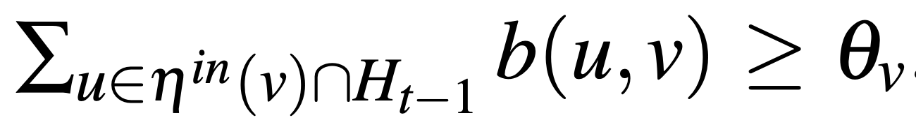
Information Cascade - Independent Cascade Model
Linear Threshold Model
Each directed edge (u,v) ∈ E has a non-negative weight b(u,v).
For any node v ∈ V, the total incoming edge weights sum to less than or equal to one
Each node v selects a threshold θ_{v} in the interval [0,1] uniformly at random.
At each time step t where H_{t−1} is the set of nodes activated at time t − 1 or earlier, each inactive node becomes active if
An inactive node is influenced by all of its active neighbors at each time step.

Slide 18
Information Cascade - Independent Cascade Model
Linear Threshold Model

Slide 19
Influence Maximization
Given
A limited budget B for initial advertising
  e.g. give away free samples of product
Estimates for influence between individuals
Goal
Trigger a large cascade of influence
  e.g. further adoptions of a product
Question
Which set of individuals should B target at?
Application besides product marketing
Spread an innovation
Detect stories in blogs

Slide 20
Influence Maximization
2. Nemhauser, George L and Wolsey, Laurence A and Fisher, Marshall L. An analysis of approximations for maximizing submodular set functions. (1978) 14(1) 265–294.

Slide 21
Influence Maximization

Slide 22
Influence Maximization

Slide 23
Epidemics

Slide 24
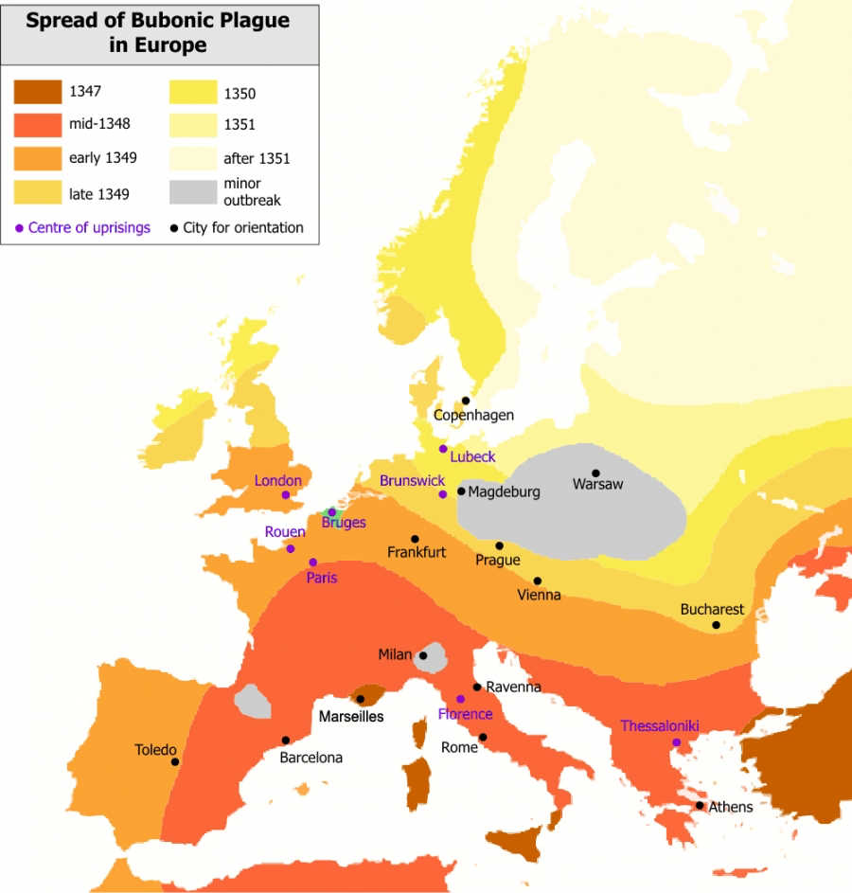
Epidemics
The Great Plague
The Black Death, one of the most devastating pandemics in human history, was an outbreak of bubonic plague caused by the bacterium Yersinia pestis. The figure shows the gradual advance of the disease throughout Europe, taking years to sweep the continent. It started in China and traveled along the Silk Road to reach Crimea around 1346. From there, probably carried by Oriental rat fleas on the black rats that were regular passengers on merchant ships, spread throughout the Mediterranean and Europe. Its slow spread reflected the slow travel speed of its era. The black death is estimated to have killed 30% to 60% of Europe's population. The resulting devastation has caused a series of religious, social and economic upheavals, having a profound impact on the history of Europe.
After Roger Zenner, Wikipedia.

Slide 25
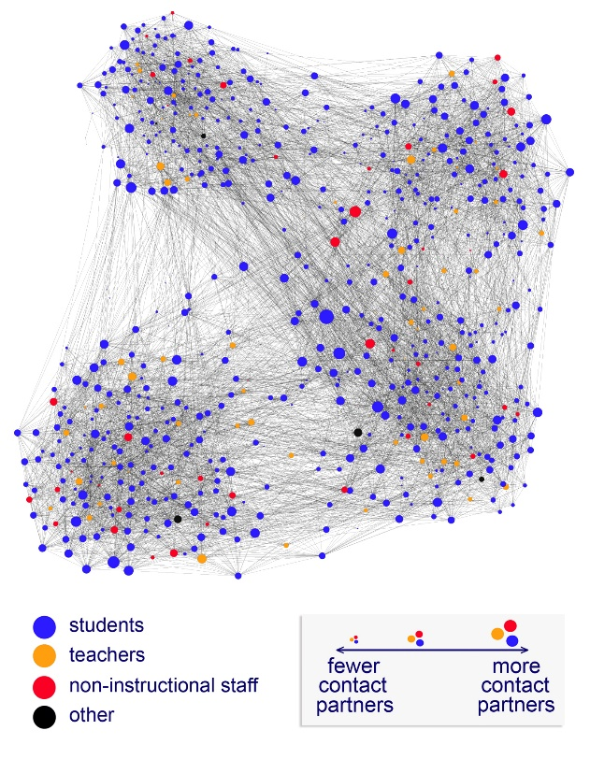
Epidemics
Epidemics describes the process by which diseases spread. This process consists of
A pathogen
  The disease being spread
A population of hosts
  Humans, animals, plants, etc.
A spreading mechanism
  Breathing, drinking, sexual activity, etc.

Slide 26
Epidemics
Epidemic Modeling frameworks in general rely on two fundamental hypotheses
Homogenous Mixing
This hypothesis assumes that each individual has the same chance of coming into contact with an infected individual.
It eliminates the need to know the precise contact network on which the disease spreads, replacing it with the assumption that anyone can infect anyone else.
Compartmentalization
Individuals can move between compartments. For example, at the beginning of a new influenza outbreak everyone is in the susceptible state. Once an individual comes into contact with an infected person, she can become infected. Eventually she will recover and develop immunity, losing her susceptibility to the the particular strain of influenza.

Slide 27
Epidemics
Compartmentalization: Epidemic models classify each individual based on the stage of the disease affecting them. The simplest classification assumes that an individual can be in one of three states or compartments:
Susceptible (S): Healthy individuals who have not yet contacted the pathogen.
Infectious (I): Contagious individuals who have contacted the pathogen and hence can infect others.
Recovered (R): Individuals who have been infected before, but have recovered from the disease, hence are not infectious.

Slide 28
Epidemics
Basic Epidemic Models are:
Susceptible-Infected (SI)
Susceptible-Infected-Susceptible (SIS)
Susceptible-Infected-Recovered (SIR)

Slide 29

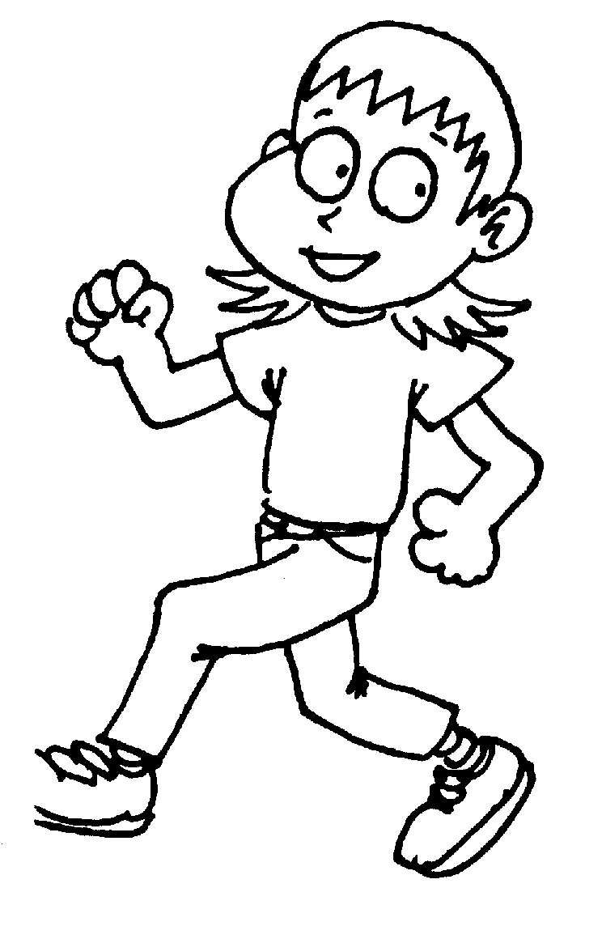
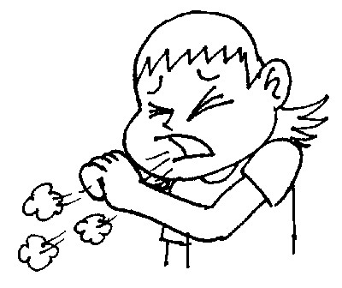

Epidemics
S
I
R
Infection
Removal
Recovery
Recovery
Susceptible
(healthy)
Infected
(sick)
Removed
(immune / dead)

Slide 30
Epidemics
Susceptible-Infected (SI)
S
I
R
Infection
Removal
Recovery
Recovery
Susceptible
(healthy)
Infected
(sick)
Removed
(immune / dead)

Slide 31
Epidemics
Susceptible-Infected (SI)
Population of N individuals
S(t) the number of individuals who are susceptible (healthy) at time t
I(t) the number individuals that have been already infected
At time t=0 everyone is susceptible (S(0)=N) and no one is infected (I(0)=0)
Each individual has <k> contacts
The likelihood that the disease will be transmitted from an infected to a healthy individual in a unit time: β

Slide 32
Epidemics
Susceptible-Infected (SI)
If a single individual becomes infected at time t=0 (i.e. I(0)=1), how many individuals will be infected at some later time t?
The probability that the infected person encounters a susceptible individual is S(t)/N
Therefore the infected person comes into contact with 〈k〉S(t)/N susceptible individuals in a unit time.
Since I(t) infected individuals are transmitting the pathogen, at rate β, the average number of new infections dI(t) during a timeframe dt is

Slide 33

Epidemics
Susceptible-Infected (SI)
Since I(t) infected individuals are transmitting the pathogen, at rate β, the average number of new infections dI(t) during a timeframe dt is
With the initial condition i₀= i(t=0), the fraction of infected individuals increases in time as

Slide 34
Epidemics
Susceptible-Infected (SI)
At the beginning the fraction of infected individuals increases exponentially
  Early on an infected individual encounters only susceptible individuals, hence the pathogen can easily spread.
The characteristic time required to reach an 1/e fraction (about 36%) of all susceptible individuals is T=1/β⟨k⟩
Either increasing the number of links <k> (density) or β enhances the speed of the pathogen
With time an infected individual encounters fewer and fewer susceptible individuals. Hence the growth of i slows for large t.
The epidemic ends when everyone has been infected, i.e. when i(t→∞)=1 and s(t→∞)=0

Slide 35
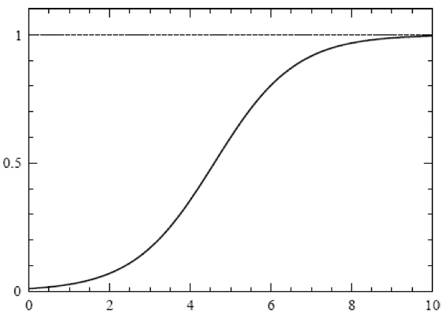
Epidemics
Susceptible-Infected (SI)
As i(t)→ 1.
If i(t) is small,
Fraction Infected i(t)
saturation
exponential
outbreak
Time (t)

Slide 36
Epidemics
Susceptible-Infected-Susceptible (SIS)
S
I
R
Infection
Removal
Recovery
Recovery
Susceptible
(healthy)
Infected
(sick)
Removed
(immune / dead)

Slide 37
Epidemics
Susceptible-Infected-Susceptible (SIS)
Pathogens are eventually defeated by the immune system (treatment)
To capture this fact we need to allow the infected individuals to recover
Infected individuals recover at a fixed rate μ, becoming susceptible again
where μ is the recovery rate and the μi term captures the rate at which the population recovers from the disease.
The fraction of infected individuals in function of time

Slide 38
Epidemics
Susceptible-Infected-Susceptible (SIS)
The fraction of infected individuals in function of time
where the initial condition i₀=i(t=0) gives C=i₀/(1–i₀ –µ/β〈k〉).
SIS model the epidemic has two possible outcomes
  Endemic State (μ < β〈k〉)
  Disease-free State (μ > β〈k〉)

Slide 39
Epidemics
Susceptible-Infected-Susceptible (SIS)
SIS model the epidemic has two possible outcomes
Endemic State (μ < β〈k〉)
  For low recovery rate the fraction of infected individuals, i, follows a logistic curve similar to the one observed for the SI model.
  Yet, not everyone is infected, but i reaches a constant i(∞) < 1 value
  In this stationary or endemic state the number of newly infected individuals equals the number of individuals who recover from the disease, hence the infected fraction of the population does not change with time.
  We can calculate i(∞) by setting di/dt=0 in
  And obtain

Slide 40
Epidemics
Susceptible-Infected-Susceptible (SIS)
SIS model the epidemic has two possible outcomes
Disease-free State (μ > β〈k〉)
  For a sufficiently high recovery rate the exponent in
  is negative.
  Therefore, i decreases exponentially with time, indicating that an initial infection will die out exponentially.
  Because in this state the number of individuals cured per unit time exceeds the number of newly infected individuals.

Slide 41
Epidemics
Susceptible-Infected-Recovered (SIR)
S
I
R
Infection
Removal
Recovery
Susceptible
(healthy)
Infected
(sick)
Removed
(immune / dead)
For some pathogens, individuals develop immunity after they recover from the infection.
Hence, instead of returning to the susceptible state, they are “removed” from the population. These recovered individuals do not count any longer from the perspective of the pathogen as they cannot be infected, nor can they infect others.

Slide 42
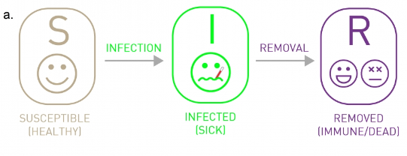
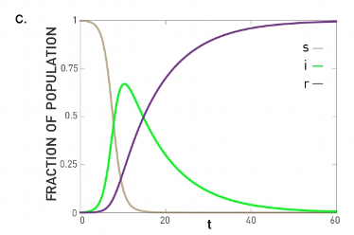
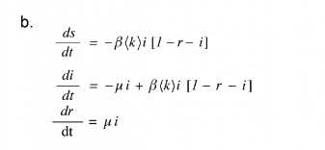
Epidemics
Susceptible-Infected-Recovered (SIR)

Slide 43
Epidemics
Susceptible-Infected-Recovered (SIR)
In contrast with the SIS model, in the SIR model recovered individuals enter a recovered state, meaning that they develop immunity rather than becoming susceptible again.
  Flu, SARS and Plague are diseases with this property
The differential equations governing the time evolution of the fraction of individuals in the susceptible s, infected i and the removed r state.

Slide 44
Epidemics
In summary, depending on the characteristics of a pathogen, we need different models to capture the dynamics of an epidemic outbreak
SI, SIS, and SIR models agree with each other in the early stages of an epidemic: When the number of infected individuals is small, the disease spreads freely and the number of infected individuals increases exponentially.
The outcomes are different for large times
SI model everyone becomes infected
SIR model everyone recovers at the end
  Endemic State (μ < β〈k〉)
  Disease-free State (μ > β〈k〉)

Slide 45
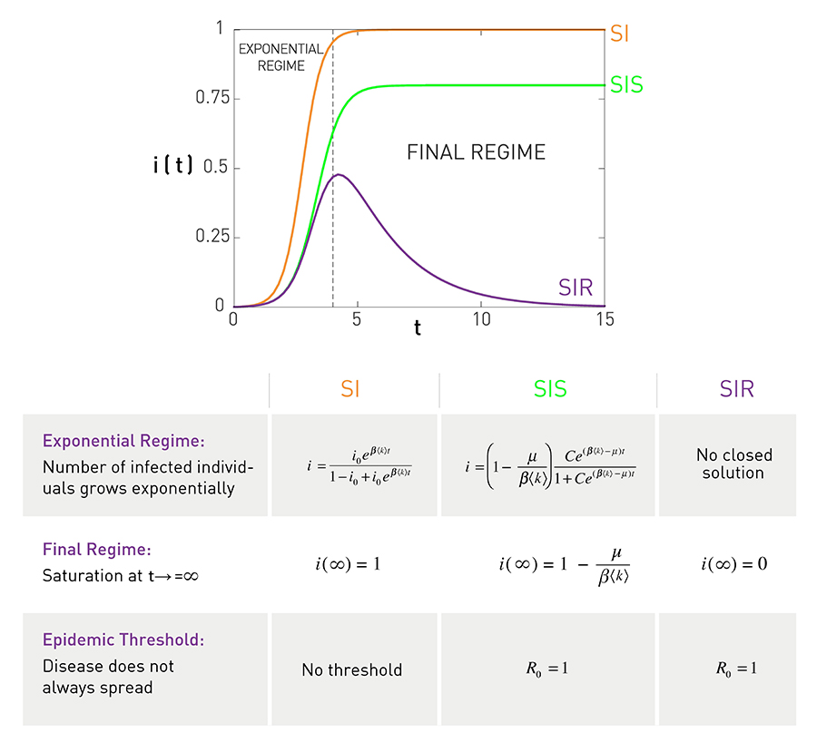
Epidemics
Exponential Regime
Exponential growth in the number of infected individuals during the early stages of the epidemic.
Final Regime
SI model everyone becomes infected, i(∞)=1
SIS model a finite fraction of individuals are infected i(∞) < 1
SIR model all infected nodes recover, hence the number of infected individuals goes to zero i(∞)=0.

Slide 46
System Dynamics and Causal Loops

Slide 47
System Dynamics and Causal Loops
Define the issue you are trying to understand
  “despite our new sales effort, market share continues to fall”
List the variables that seem to be important
  outcomes (profit, quality, market share)
  decisions (price, production pressure)
Sketch the behavior of a few key variables
Determine the appropriate time horizon for your analysis
market share
time

Slide 48
System Dynamics and Causal Loops

Slide 49
System Dynamics and Causal Loops

Slide 50
System Dynamics and Causal Loops
Balancing loops, denoted with a B, work to bring systems towards stability.
R means reinforcing loop

Slide 51
System Dynamics and Causal Loops

Slide 52
System Dynamics and Causal Loops

Slide 53
System Dynamics and Causal Loops
Infection Rate = Contacts Between Infected And Uninfected*Infectivity
Contacts Between Infected And Uninfected = Total Susceptible Contacts*
Probability of Contact with Infected Person
Probability of Contact with Infected Person = Infected Population
Total Population
Susceptible Contacts = Susceptible Population* Contact Frequency

Slide 54
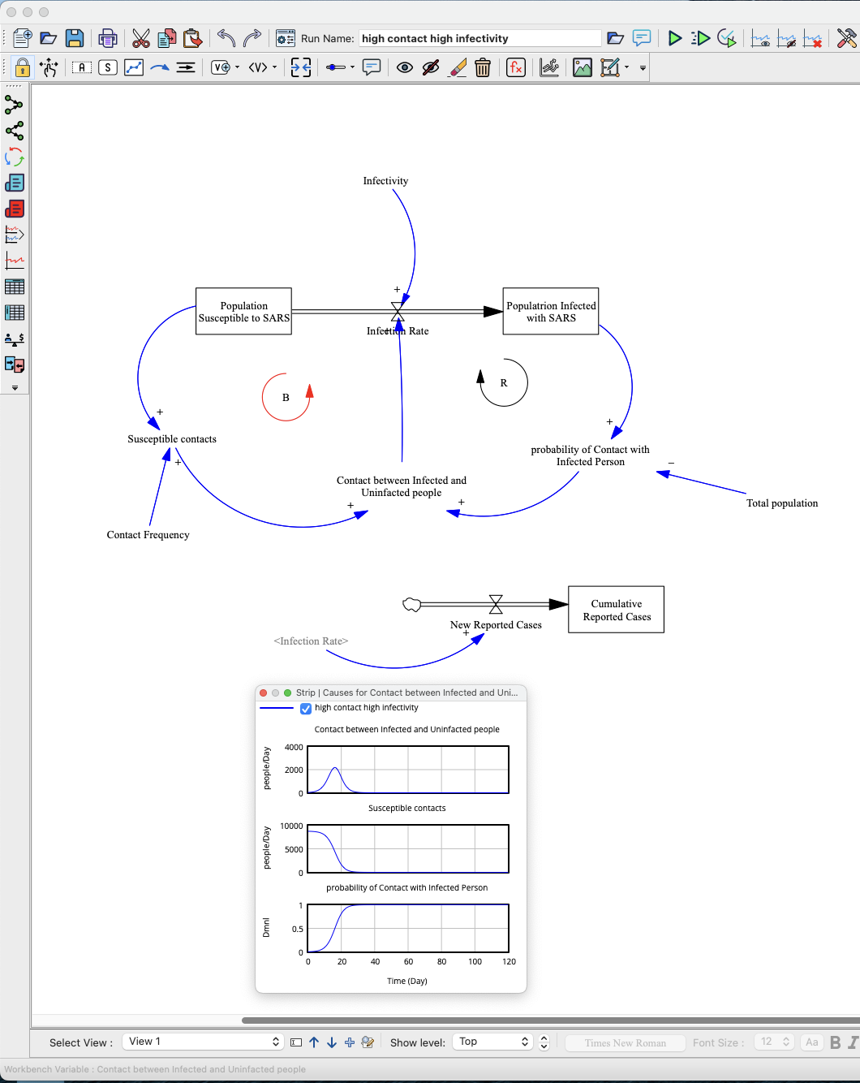

System Dynamics and Causal Loops

