Slide 1
Lecture 6:
Network models
CS 765: Complex Networks
Slides are adapted from
Huan Liu, Lei Tang, Nitin Agarwal, Reza Zafarani and
Constantine Dovrolis, Eileen Kraemer, Peter Dodds, and Sergei Maslov and
Network Science by Albert-László Barabási and
Leonid Zhukov

Slide 2
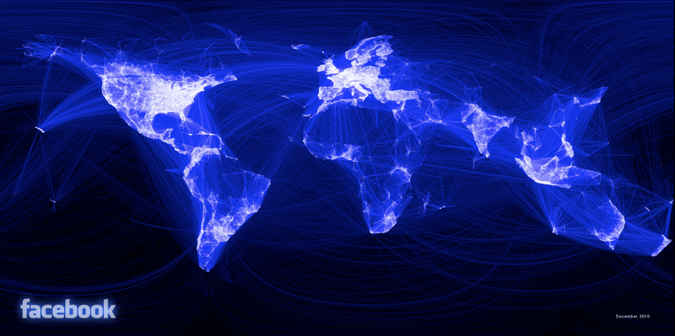
Why should I use network models?
Facebook
May 2011:
  721 millions users.
  Average number of friends: 190
  A total of 68.5 billion friendships
May 2018:
  2.23 Billion users
What are the principal underlying processes that help initiate these friendships?
How can these seemingly independent friendships form this complex friendship network?
There are many networks with billions of nodes/edges.
  They are complex and it is difficult to analyze them

Slide 3
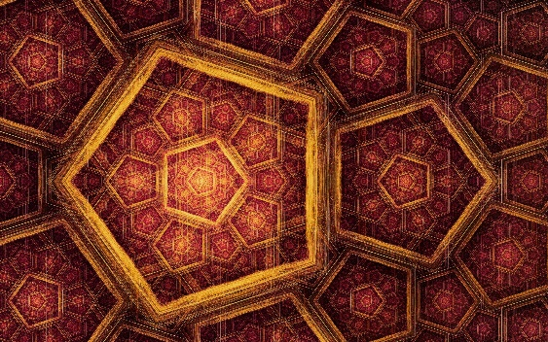
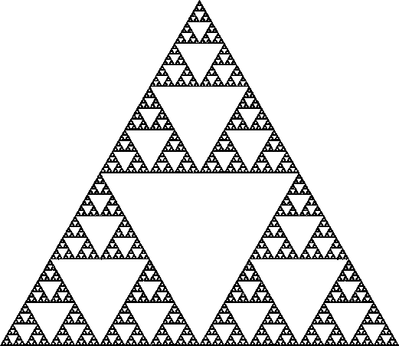

So, what do we do?
Design models that generate graphs
  The generated graphs should be similar to real-world networks.
If we can guarantee that generated graphs are similar to real-world networks:
  We can analyze simulated graphs instead of real-networks (cost-efficient)
  We can better understand real-world networks by providing concrete mathematical explanations; and
  We can perform controlled experiments on synthetic networks when real-world networks are unavailable.
What are properties of real-world networks that should be accurately modeled?

Slide 4
Network Models
Regular graphs
Random graphs
Small-World Model
Preferential Attachment

Slide 5
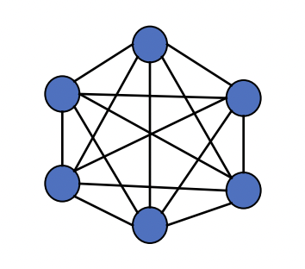
Regular networks – fully connected
Fully connected networks have the
LOWEST path length and diameter
  L=D=1
The HIGHEST clustering coefficient
  C=1
The HIGHEST number of edges
  E=N(N-1)/2
Degree distribution p_{k}: is the probability that a
randomly selected node has degree k
Degree distribution: N-1

Slide 6
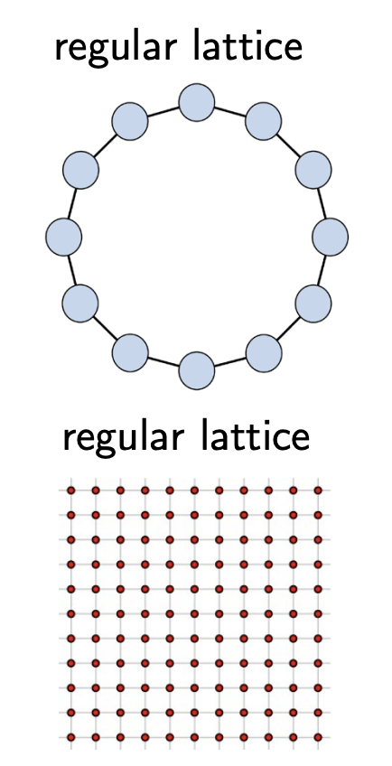
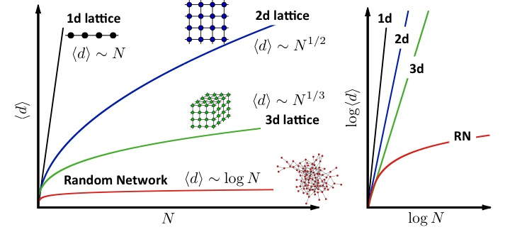
Regular networks – Lattice
Distances grow polynomially with system size
  For 1d lattice the network diameter
  and the average path length scale linearly
In networks, distances grow logarithmically
with network size

Slide 7
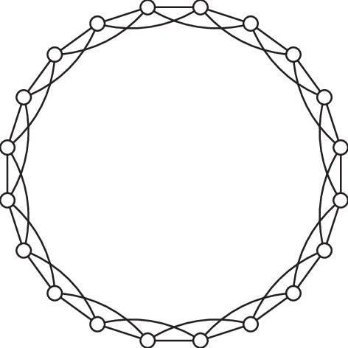
Regular networks – Lattice: ring world
Nodes connect to K nearest neighbors and K<<N
High average path length
High clustering coefficient
Degree distribution is K

Slide 8
Network Models
Regular graphs
Random graphs
Small-World Model
Preferential Attachment

Slide 9
Random Graphs
We have to assume how friendships are formed
  The most basic form:
Random Graph assumption:
Edges (i.e., friendships) between nodes (i.e., individuals) are formed randomly.
We discuss two random graph models $G(N,p)$ and $G(N,l)$

Slide 10
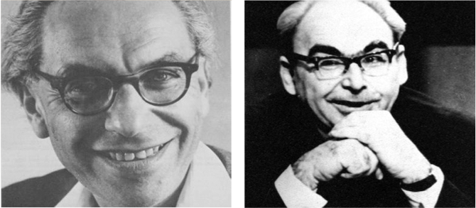
Random Graphs
Pál Erdös
(1913-1996)
Alfréd Rényi
(1921-1970)
Erdös-Rényi model (1960)
Connect with probability p
p=1/6 N=10
<k> ~ 1.5

Slide 11
Random Graphs
Definition:
A random graph is a graph of N nodes where each pair of nodes is connected by probability p.

Slide 12
Random Graphs
Consider a graph with a fixed number of nodes 𝑛
Any of the n(n-1) edges can be formed independently, with probability p
p=1/6 N=12
L=8
L=10
L=7

Slide 13
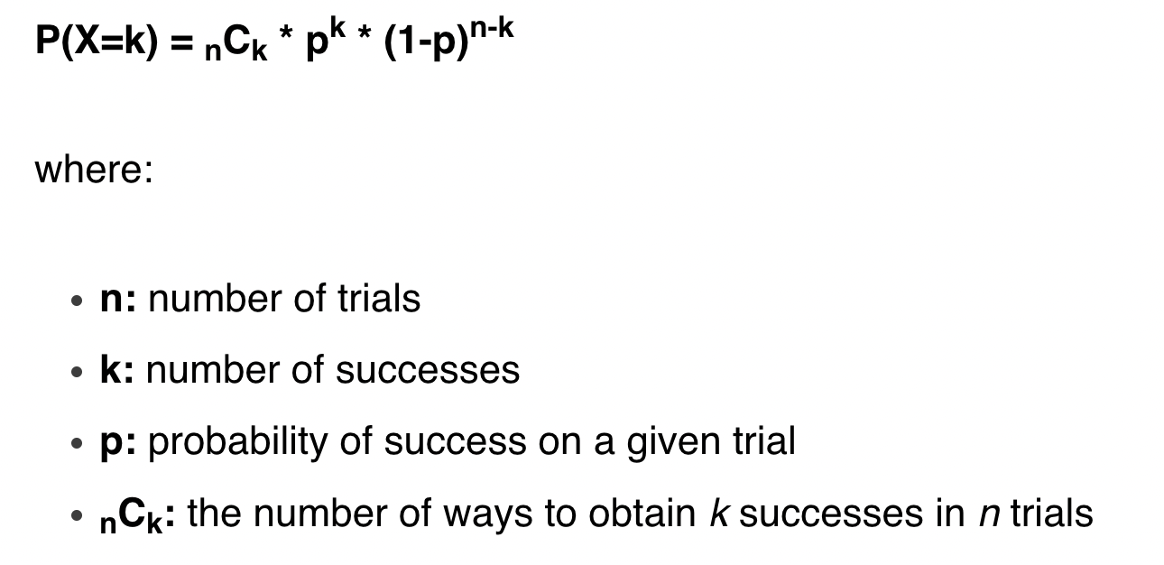
Random Graphs
The Binomial distribution describes the probability of
obtaining k successes in n binomial experiments.
If a random variable X follows a binomial distribution,
then the probability that X = k successes can be found by the
following formula:

Slide 14
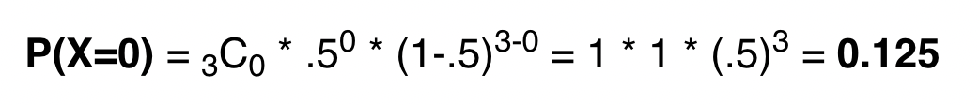
Random Graphs
For example, suppose we flip a coin 3 times. Using the
binomial formula we can determine the probability of obtaining
0 heads during these 3 flips:

Slide 15

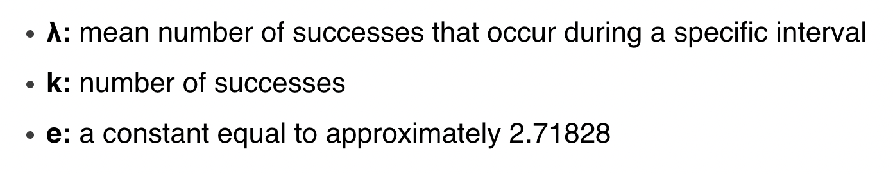
Random Graphs
The Poisson distribution describes the probability of
experiencing k events during a fixed time interval.
If a random variable X follows a Poisson distribution, then
the probability that X = k events can be found by the following
formula:

Slide 16
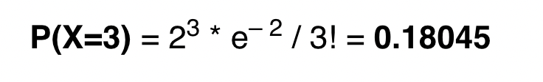
Random Graphs
For example, suppose a hospital experiences an average of
2 births per hour. We can use the Poisson distribution formula to
determine the probability of experiencing 3 births in a given hour:

Slide 17
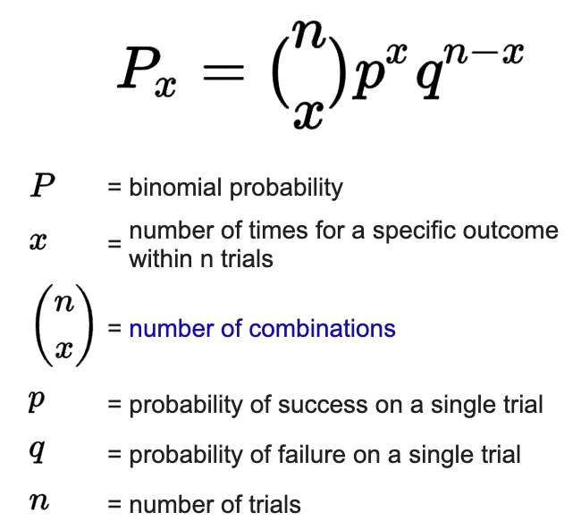
Random Graphs
P(L): the probability to have exactly L links in a network of N nodes and probability p:
The maximum number of links in a network of N nodes.
Binomial distribution...
Number of different ways we can choose L links among all potential links.

Slide 18
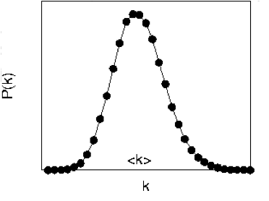
DEGREE DISTRIBUTION OF A RANDOM GRAPH
Select k
nodes from N-1
probability of
missing N-1-k
edges
probability of
having k edges
As the network size increases, the distribution becomes increasingly narrow—we are increasingly confident that the degree of a node is in the vicinity of <k>.
Network Science: Random Graphs

Slide 19
DEGREE DISTRIBUTION OF A RANDOM GRAPH
Select k
nodes from N-1
probability of
missing N-1-k
edges
probability of
having k edges
For large N and small k, we arrive to the Poisson distribution:
Network Science: Random Graphs

Slide 20
DEGREE DISTRIBUTION OF A RANDOM GRAPH
For large N and small k, we can use the following approximations:
for
Network Science: Random Graphs

Slide 21
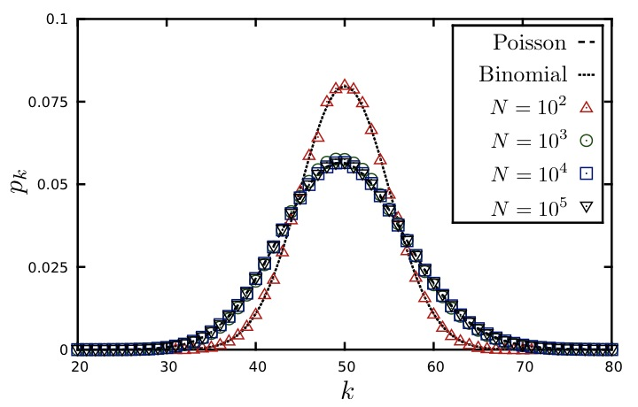
DEGREE DISTRIBUTION OF A RANDOM GRAPH
<k>=50
P(k)
Degree distributions of random networks with the same average degree (K),
but different sizes (N), are indistinguishable from each other.
Network Science: Random Graphs
Notes:
Degree distributions of random networks with the same average degree K, but different sizes, are indistinguishable from each other.

Slide 22
DEGREE DISTRIBUTION OF A RANDOM GRAPH
According to sociological research, a typical person knows about 1,000
individuals on a first name basis, so k=1,000 (Average person)
The probability to find an individual with degree k>2,000 is 10⁻²⁷. Hence the
chance of finding an individual with 2,000 acquaintances is so tiny that such
nodes are virtually inexistent in a random society. (Celebrity)
A random society would consist of mainly average individuals, with everyone
with roughly the same number of friends (random modeling)
It would lack outliers, individuals that are highly popular
Network Science: Random Graphs
Notes:
Degree distributions of random networks with the same average degree K, but different sizes, are indistinguishable from each other.

Slide 23
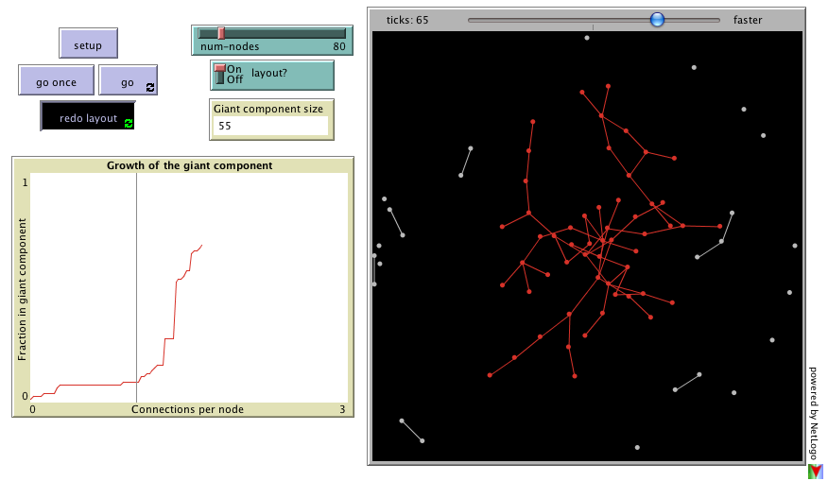
EVOLUTION OF A RANDOM NETWORK
What happens to the size of the giant component as the density of the network increases?
http://ccl.northwestern.edu/netlogo/models/GiantComponent
Notes:
Degree distributions of random networks with the same average degree K, but different sizes, are indistinguishable from each other.

Slide 24
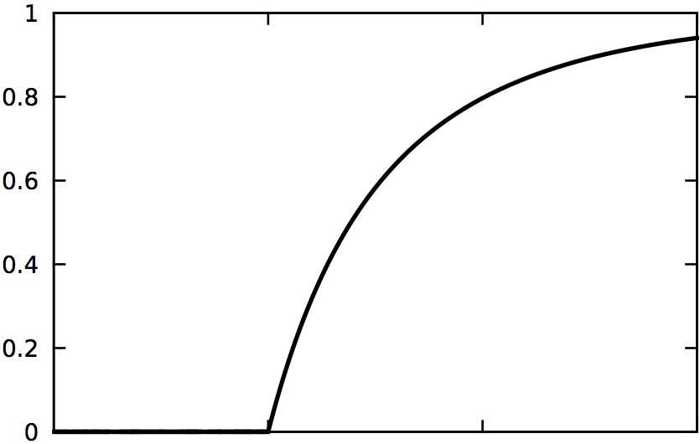
EVOLUTION OF A RANDOM NETWORK
disconnected nodes ➔ NETWORK.
<k>
How does this transition happen?

Slide 25
EVOLUTION OF A RANDOM NETWORK
<k_{c}>=1 (Erdos and Renyi, 1959)
The fact that at least one link per node is necessary to have a giant component is not unexpected. Indeed, for a giant component to exist, each of its nodes must be linked to at least one other node.
It is somewhat unexpected, however that one link is sufficient for the emergence of a giant component.

Slide 26
EVOLUTION OF A RANDOM NETWORK
I:
Subcritical
<k> < 1
II:
Critical
<k> = 1
III:
Supercritical
<k> > 1
IV:
Connected
<k> > ln N
<k>
N=100
<k>=0.5
<k>=1
<k>=3
<k>=5

Slide 27
EVOLUTION OF A RANDOM NETWORK
I:
Subcritical
<k> < 1
II:
Critical
<k> = 1
III:
Supercritical
<k> > 1
IV:
Connected
<k> > ln N
<k>
Subcritical
No giant component.
The largest cluster is a tree
Supercritical
Giant component has loops
Critical
Unique giant component.
Connected
Giant component is dense

Slide 28
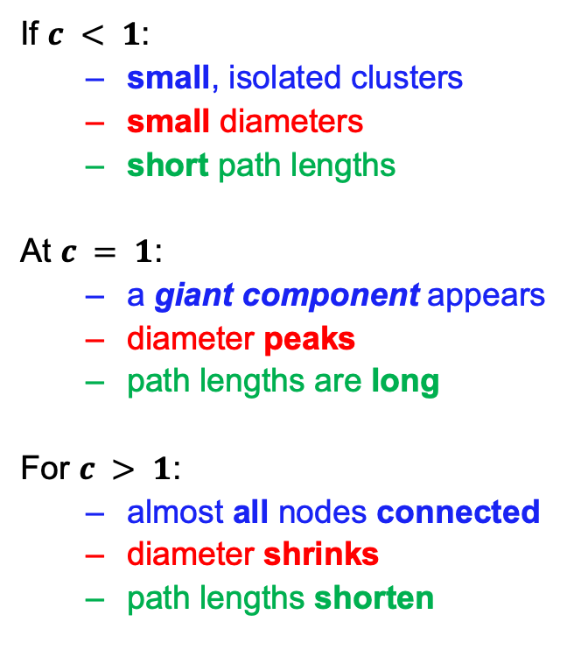
EVOLUTION OF A RANDOM NETWORK
If $c < 1$:
  small, isolated clusters
  small diameters
  short path lengths
At $c = 1$:
  a giant component appears
  diameter peaks
  path lengths are long
For $c > 1$:
  almost all nodes connected
  diameter shrinks
  path lengths shorten
Percentage of nodes in largest component
Diameter of largest component
N-1
1.0
0
1.0
c
phase transition
c – average node degree

Slide 29
Network Models
Regular graphs
Random graphs
Small-World Model
Preferential Attachment

Slide 30
Random Graphs
G(N, p) Model: each pair of N nodes is connected with probability of p
Binomial distribution...
Select k
nodes from N-1
probability of
missing N-1-k
edges
probability of
having k edges
For large N and small k, we arrive to
the Poisson distribution:

Slide 31
Random Graphs
Degree distributions of random networks with the same average degree (K), but different sizes (N), are indistinguishable from each other.
It would lack outliers, individuals that are highly popular.

Slide 32
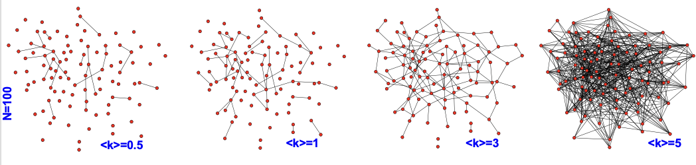
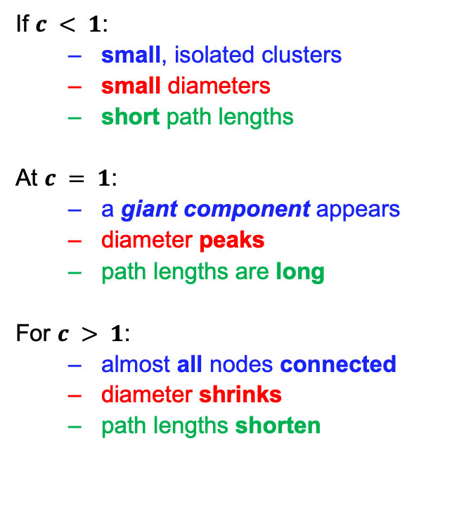
Random Graphs
Percentage of nodes in largest component
Diameter of largest component
If $c < 1$:
  small, isolated clusters
  small diameters
  short path lengths
At $c = 1$:
  a giant component appears
  diameter peaks
  path lengths are long
For $c > 1$:
  almost all nodes connected
  diameter shrinks
  path lengths shorten
N-1
1.0
0
1.0
c
phase transition
c – average node degree
It is somewhat unexpected, however that one link is sufficient for the emergence of a giant component.

Slide 33
ARE REAL NETWORKS LIKE RANDOM GRAPHS?
As quantitative data about real networks became available, we can
compare their topology with the predictions of random graph theory.
Note that once we have N (number of nodes) and <k> (average degree) for a random network, from it we can derive every measurable property.
Average path length:
Clustering Coefficient:
Degree Distribution:
Network Science: Random Graphs

Slide 34
DISTANCES IN RANDOM GRAPHS
Random graphs tend to have a tree-like topology with almost constant node degrees.
Network Science: Random Graphs

Slide 35
DISTANCES IN RANDOM GRAPHS
In most networks this offers a better approximation to the average distance between two randomly chosen nodes, ⟨d⟩, than to d_{max} . Because ⟨d⟩ is averaged over all pairs of nodes. Hence large fluctuations in d are diminished by the averaging. In contrast d_{max} is often dominated by a few extreme paths.
We will call the small world phenomena the property that the average path length or the diameter depends logarithmically on the system size. Hence, ”small” means that ⟨d⟩ is proportional to log N, rather than N.
The 1/log⟨k⟩ term implies that denser the network, the smaller will be the distance between the nodes.
Network Science: Random Graphs
Notes:
Strictly speaking Eq. (22) predicts the scaling of the network diameter, dmax. Yet, in most networks it offers a better approximation to the average distance between two randomly chosen nodes, ⟨d⟩, than to dmax. This is because ⟨d⟩ is averaged over all pairs of nodes. Hence large fluctuations in d are diminished by the averaging. In contrast dmax is often dominated by a few extreme paths.
We will call the small world phenomena the property that the average path length or the diameter depends logarithmically on the system size. Hence, ”small” means that ⟨d⟩ is proportional to logN, rather than N, as captured by Eq. (23).
(iv) The 1/log⟨k⟩ term implies that denser the network, the smaller will be the distance between the nodes.
(Albert-László Barabási)

Slide 36
ARE REAL NETWORKS LIKE RANDOM GRAPHS?
As quantitative data about real networks became available, we can
compare their topology with the predictions of random graph theory.
Note that once we have N (number of nodes) and <k> (average degree) for a random network, from it we can derive every measurable property.
Average path length:
Clustering Coefficient:
Degree Distribution:
logN/log<k>
Network Science: Random Graphs

Slide 37
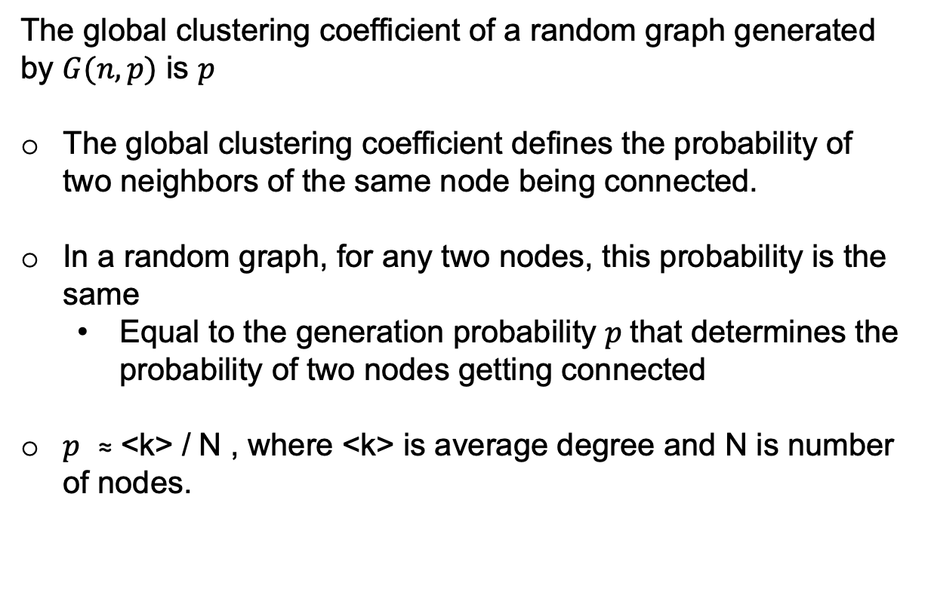
Global Clustering Coefficient
The global clustering coefficient of a random graph generated by $G(n, p)$ is $p$
The global clustering coefficient defines the probability of two neighbors of the same node being connected.
In a random graph, for any two nodes, this probability is the same
  Equal to the generation probability $p$that determines the probability of two nodes getting connected
$p$ ≈ <k> / N , where <k> is average degree and N is number of nodes.
Notes:
N*(N-1)*p = L (links)
2*L = total degree
2*L/N = <k> average degree
N*(N-1)*p * 2 / N = <k>
(N-1)*2*p = <K>

Slide 38
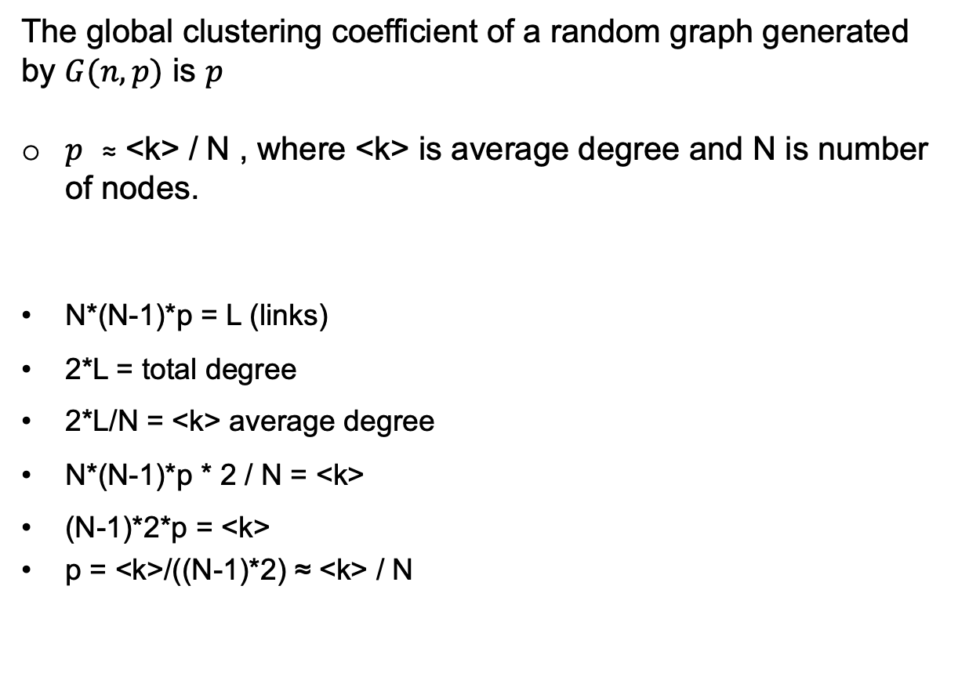
Global Clustering Coefficient
The global clustering coefficient of a random graph generated by $G(n, p)$ is $p$
$p$ ≈ <k> / N , where <k> is average degree and N is number of nodes.
N*(N-1)*p = L (links)
2*L = total degree
2*L/N = <k> average degree
N*(N-1)*p * 2 / N = <k>
(N-1)*2*p = <k>
p = <k>/((N-1)*2) ≈ <k> / N
Notes:
N*(N-1)*p = L (links)
2*L = total degree
2*L/N = <k> average degree
N*(N-1)*p * 2 / N = <k>
(N-1)*2*p = <K>

Slide 39
ARE REAL NETWORKS LIKE RANDOM GRAPHS?
As quantitative data about real networks became available, we can
compare their topology with the predictions of random graph theory.
Note that once we have N (number of nodes) and <k> (average degree) for a random network, from it we can derive every measurable property.
Average path length:
Clustering Coefficient:
Degree Distribution:
logN/log<k>
p ≈ <k> / N
Network Science: Random Graphs

Slide 40

PATH LENGTHS IN REAL NETWORKS
Prediction:
logN/log<k>
Real networks have short distances
like random graphs.
Network Science: Random Graphs

Slide 41

CLUSTERING COEFFICIENT
Prediction:
p ≈ <k> / N
C_{rand} (Clustering Coefficient) underestimates with orders of magnitudes the clustering coefficient of real networks.
Network Science: Random Graphs

Slide 42
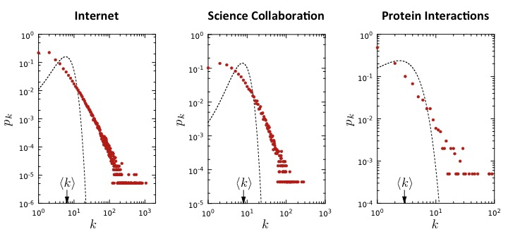
THE DEGREE DISTRIBUTION
Prediction:
Network Science: Random Graphs

Slide 43
ARE REAL NETWORKS LIKE RANDOM GRAPHS?
As quantitative data about real networks became available, we can
compare their topology with the predictions of random graph theory.
Note that once we have N (number of nodes) and <k> (average degree) for a random network, from it we can derive every measurable property.
Average path length:
Clustering Coefficient:
Degree Distribution:
logN/log<k>
p ≈ <k> / N
Network Science: Random Graphs

Slide 44
IS THE RANDOM GRAPH MODEL RELEVANT TO REAL SYSTEMS?
Most important: we need to ask ourselves, are real networks random?
The answer is simply: NO
There is no network in nature that we know of that would be described by the random network model.
Network Science: Random Graphs
Notes:
You would not be in the class today if the society would not have internal organizing principles, that make its underlying network deviate from random. Schools, churches, cities, states, etc, are all examples of deviations from randomness, that affect the network topology
I would not be able to continue teaching this class if my molecules would decide to react with each other randomly. My very ability to stay alive is rooted in the organizing principles that govern the structure and the function of the cellular network, that results in deviations from randomness.

Slide 45
Network Models
Regular graphs
Random graphs
Small-World Model
Preferential Attachment

Slide 46
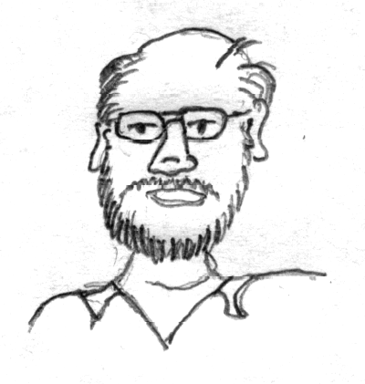
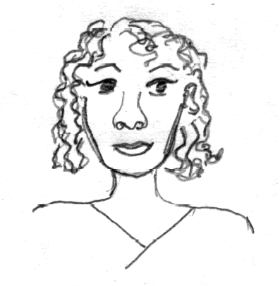
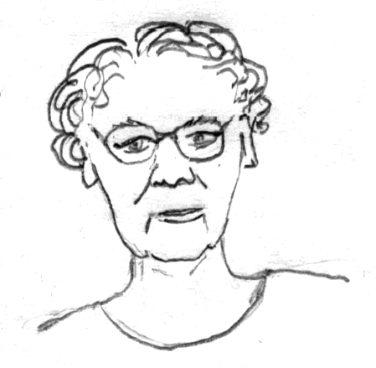
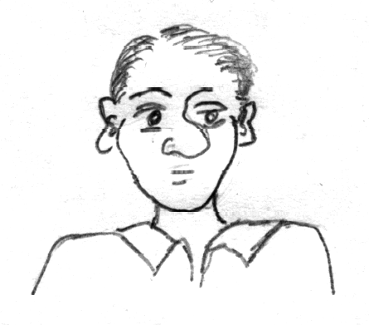
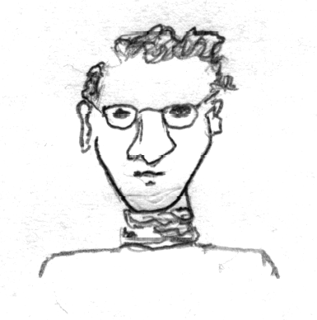
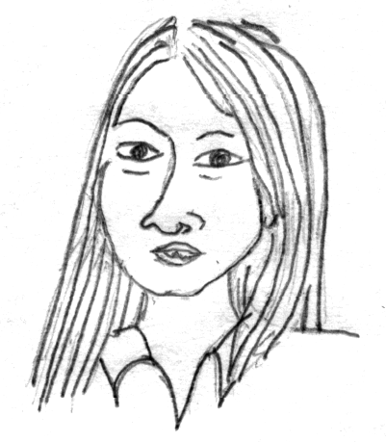
46
Small-World Model
A friend of a friend is also frequently a friend
But only six hops separate any two people in the world
Arnold S. – thomashawk, Flickr;
http://creativecommons.org/licenses/by-nc/2.0/deed.en

Slide 47
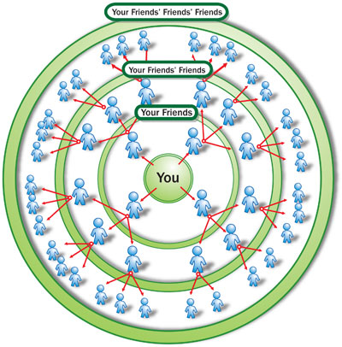
Small-World Model
A rumor is spreading over a social network.
  Assume all users pass it
  immediately to all of their
  friends
  An estimate: k^{d} = N, d=logN/logk
  N = 6.7 bln, k=50 friends, d=5.8

Slide 48
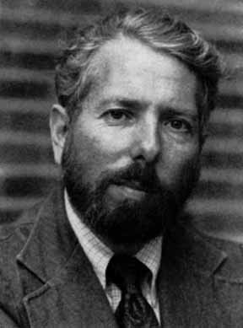
Milgram’s Experiment
296 random people from Nebraska (196 people) and Boston (100 people) were asked to send a letter (via intermediaries) to a stock broker in Boston
S/he could only send to people they personally knew.
Stanley Milgram (1933-1984)
Among the letters that found the target (64), the average number of links was around six.

Slide 49
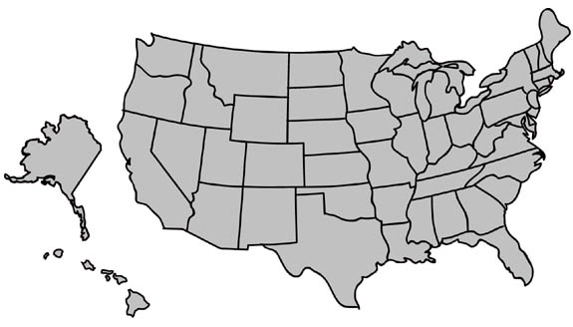
Milgram’s Experiment
MA
NE
Instructions:
Given a target individual (stockbroker in Boston), pass the message to a person you correspond with who is “closest” to the target.

Slide 50
Milgram’s Experiment
Average Number of Intermediate people is 5.2

Slide 51

Milgram’s experiment repeated
Email experiment
Dodds, Muhamad, Watts,
Science 301, (2003)
18 targets
13 different countries
60,000+ participants
24,163 message chains
384 reached their targets
average path length 4.0

Slide 52
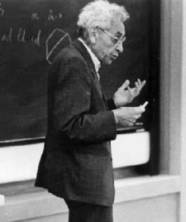
Erdös Number
Erdös Number: Number of links required to connect scholars to Erdös, via co-authorship papers
Erdös wrote 1500+ papers with 507 co-authors.
The Erdös Number Project allows you to compute your Erdös number:
  http://www.oakland.edu/enp/
Connecting path lengths, among mathematicians only:
  Avg. is 4.65 and Maximum is 13
Paul Erdös (1913-1996)

Slide 53
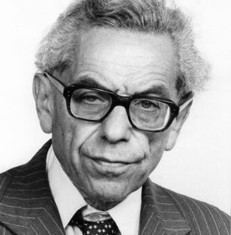

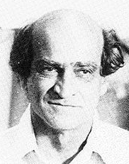
Erdös Number
Paul Erdös (1913-1996)
Albert Einstein (1879-1955)
Erdös, Paul, B. Rothschild, and E. G. Straus. "Polychromatic Euclidean Ramsey theorems." Journal of Geometry 20.1 (1983): 28-35.
Ernst Gabor Straus
(1922-1983)
Einstein, Albert, and Ernst Gabor Straus. "A generalization of the relativistic theory of gravitation, II." Annals of Mathematics (1946): 731-741.

Slide 54
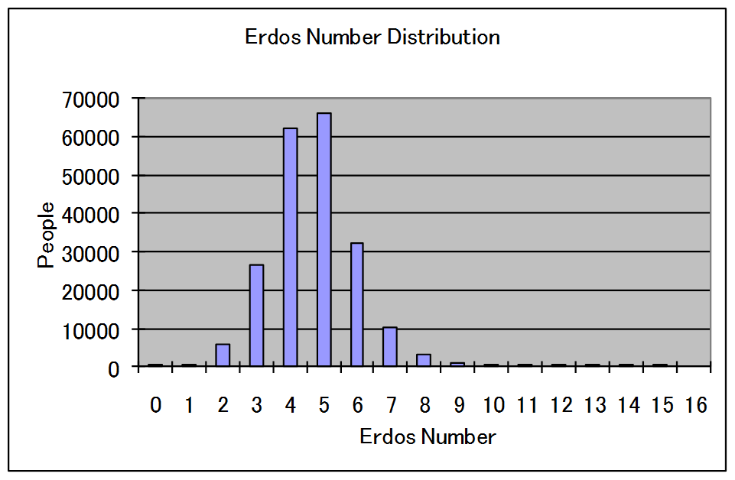
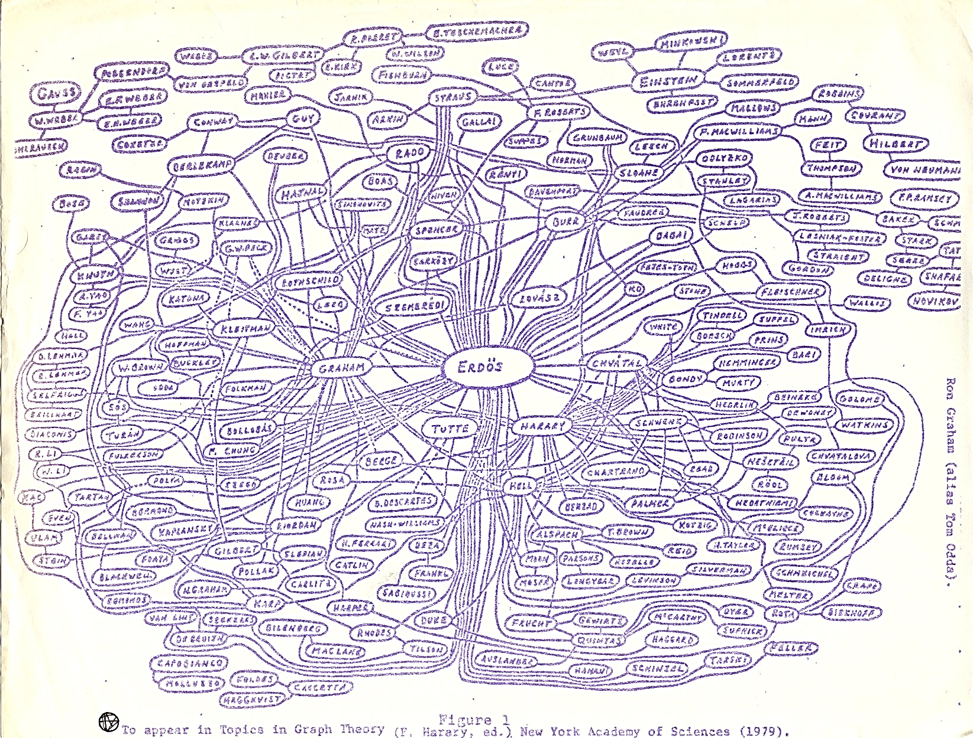
Erdös Number
The median Erdös number is 5
The mean is 4.65
The standard deviation is 1.27
Erdös Number Project:
http://www.oakland.edu/enp/index.html
Erdos Number {Mehmet Gunes} = 3

Slide 55
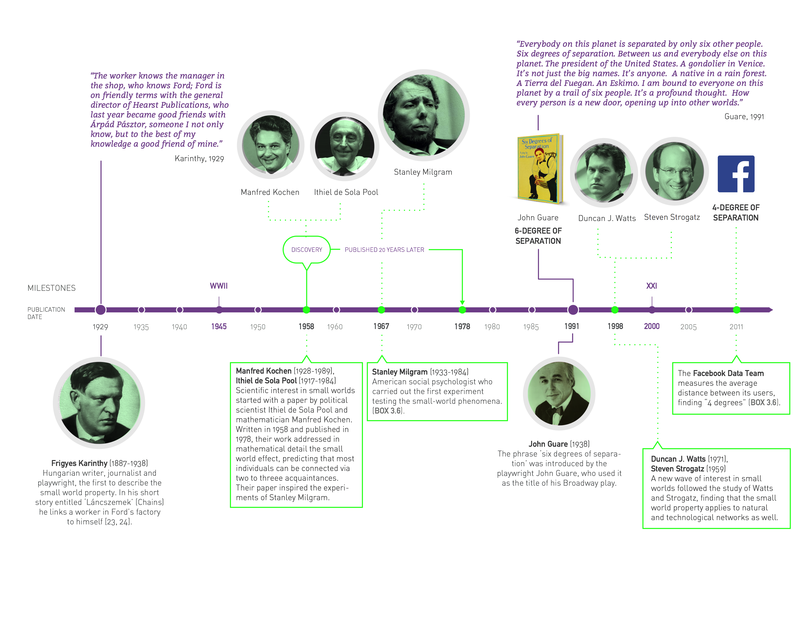
Image by Matthew Hurst
Blogosphere
Notes:
Frigyes Karinthy: https://short-stories.co/stories/chains-4w0n6QJmNDr
Manfred Kochen and Ithiel de Sola Pool: "Contacts and Influences”
Mathematician Manfred Kochen and political scientist Ithiel de Sola Pool wrote a mathematical manuscript, "Contacts and Influences", while working at the University of Paris in the early 1950s, during a time when Milgram visited and collaborated in their research. Their unpublished manuscript circulated among academics for over 20 years before publication in 1978. It formally articulated the mechanics of social networks, and explored the mathematical consequences of these (including the degree of connectedness). The manuscript left many significant questions about networks unresolved, and one of these was the number of degrees of separation in actual social networks.
Milgram took up the challenge on his return from Paris, leading to the experiments reported in "The Small World Problem" in the May 1967 (charter) issue of the popular magazine Psychology Today, with a more rigorous version of the paper appearing in Sociometry two years later. The Psychology Today article generated enormous publicity for the experiments, which are well known today, long after much of the formative work has been forgotten.

Slide 56
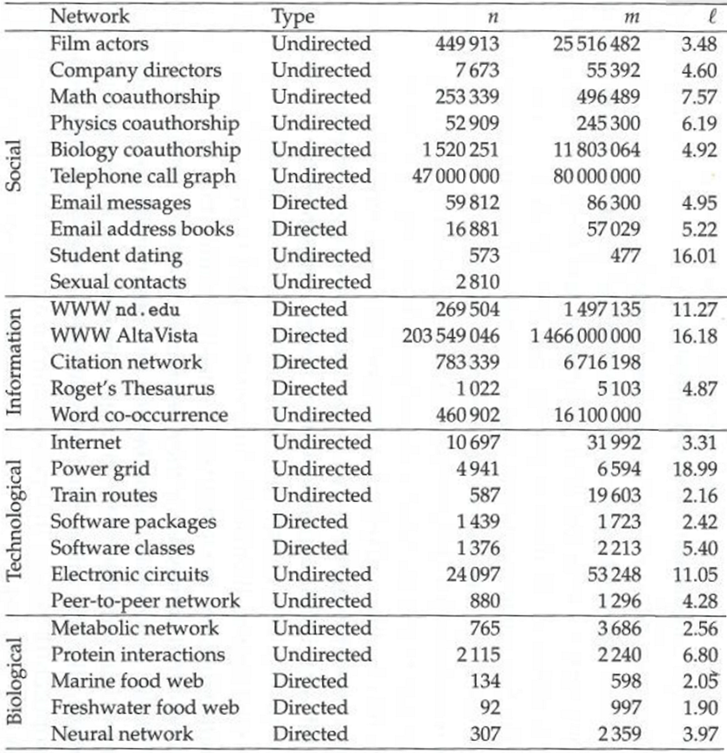
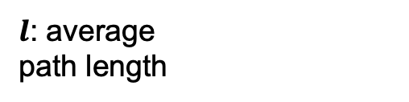
Average Path Length for Real-World Networks
$l$: average
path length
Source: M. E. J Newman

Slide 57
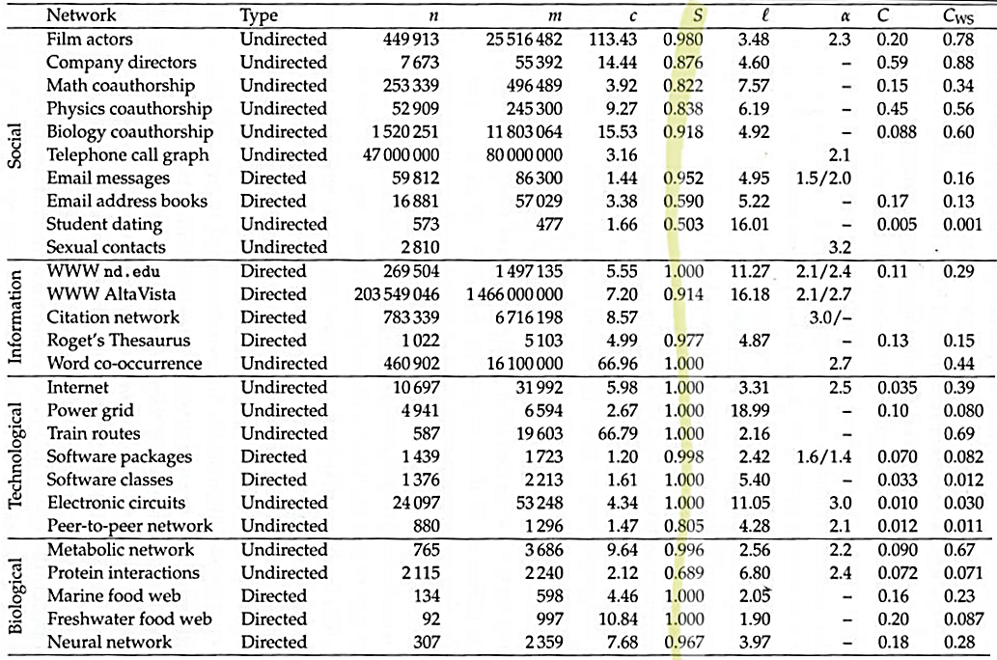
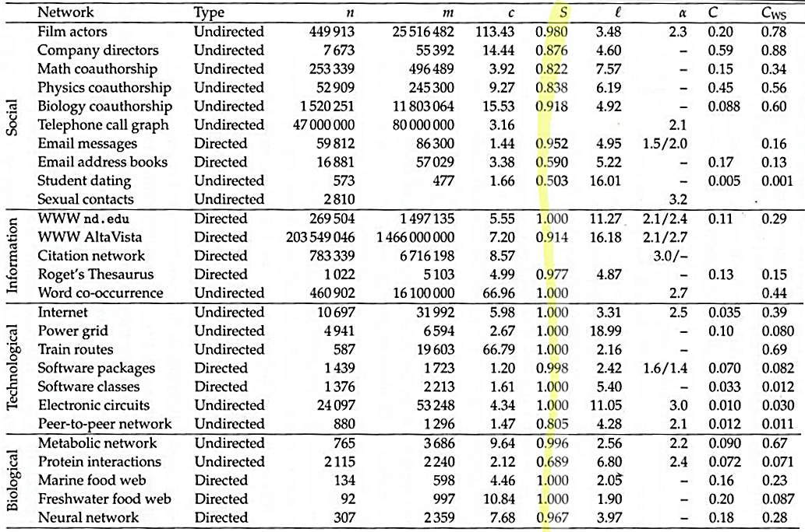
Clustering Coefficient for Real-World Networks
Source: M. E. J Newman

Slide 58
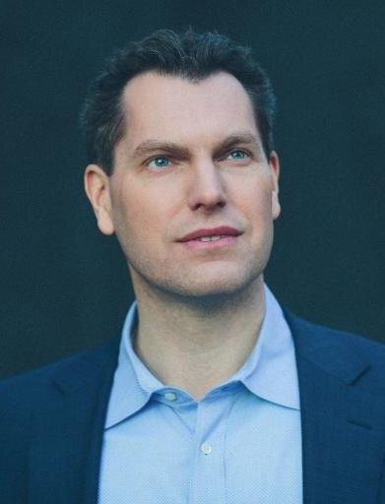
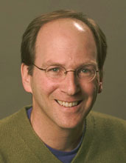
Small-world Model
Small-world model
  or the Watts-Strogatz (WS) model
  A special type of random graph
  Exhibits small-world properties:
    Short average path length
    High clustering coefficient
It was proposed by Duncan J. Watts and Steven Strogatz
Watts, Duncan J., and Steven H. Strogatz. "Collective dynamics of ‘small-world’networks." nature 393.6684 (1998): 440-442.

Slide 59
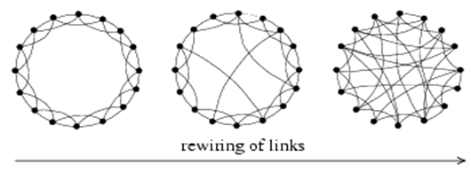
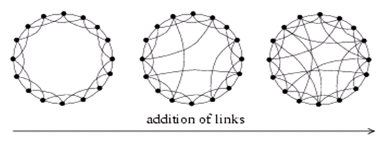
Watts-Strogatz model:
Generating small world graphs
Select a fraction of edges
Reposition on of their endpoints
Add a fraction of additional
edges leaving underlying lattice
intact
As in many network generating algorithms
  Disallow self-edges
  Disallow multiple edges
Source: Watts, D.J., Strogatz, S.H.(1998) Collective dynamics of 'small-world' networks. Nature 393:440-442.

Slide 60
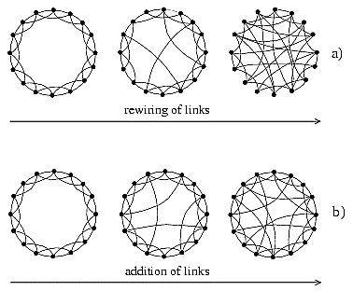
Generating a Small-World Graph
Generating a Small-World Graph
The lattice has a high, but fixed, clustering coefficient
The lattice has a high average path length
The model starts with a regular lattice and starts adding random edges [through rewiring]

Slide 61
Generating a Small-World Graph
Generating a Small-World Graph
As in many network generating algorithms
Disallow self-edges
Disallow multiple edges

Slide 62
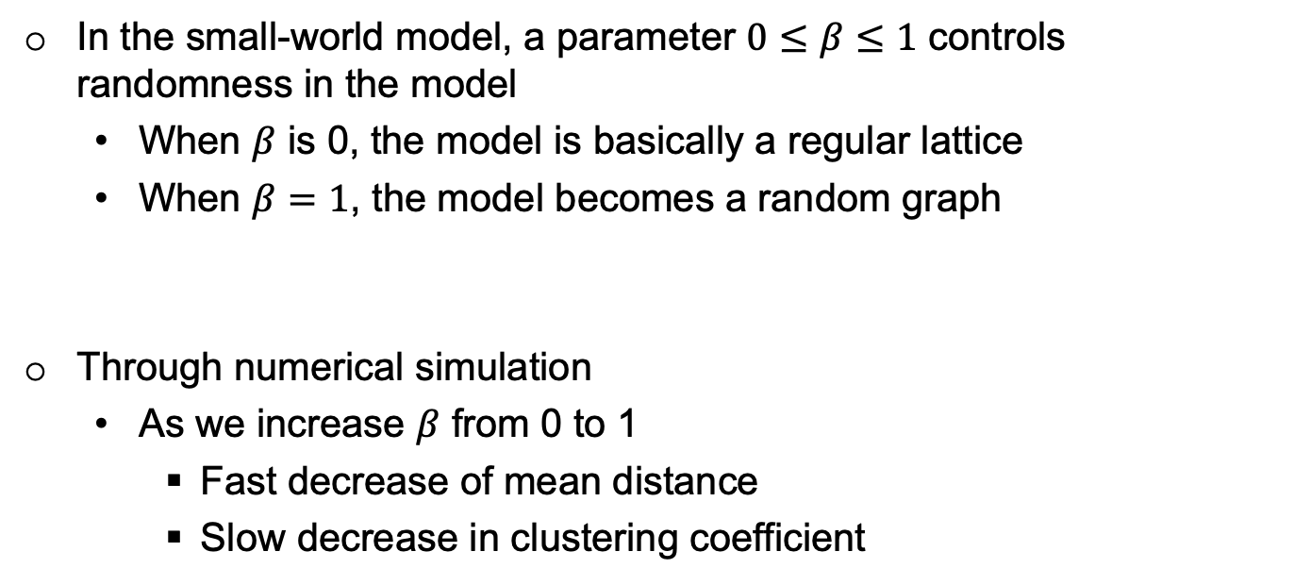
Generating a Small-World Graph
Generating a Small-World Graph
In the small-world model, a parameter $0≤β≤1$ controls randomness in the model
  When $β$ is 0, the model is basically a regular lattice
  When $β=1$, the model becomes a random graph
Through numerical simulation
  As we increase $β$ from 0 to 1
    Fast decrease of mean distance
    Slow decrease in clustering coefficient

Slide 63
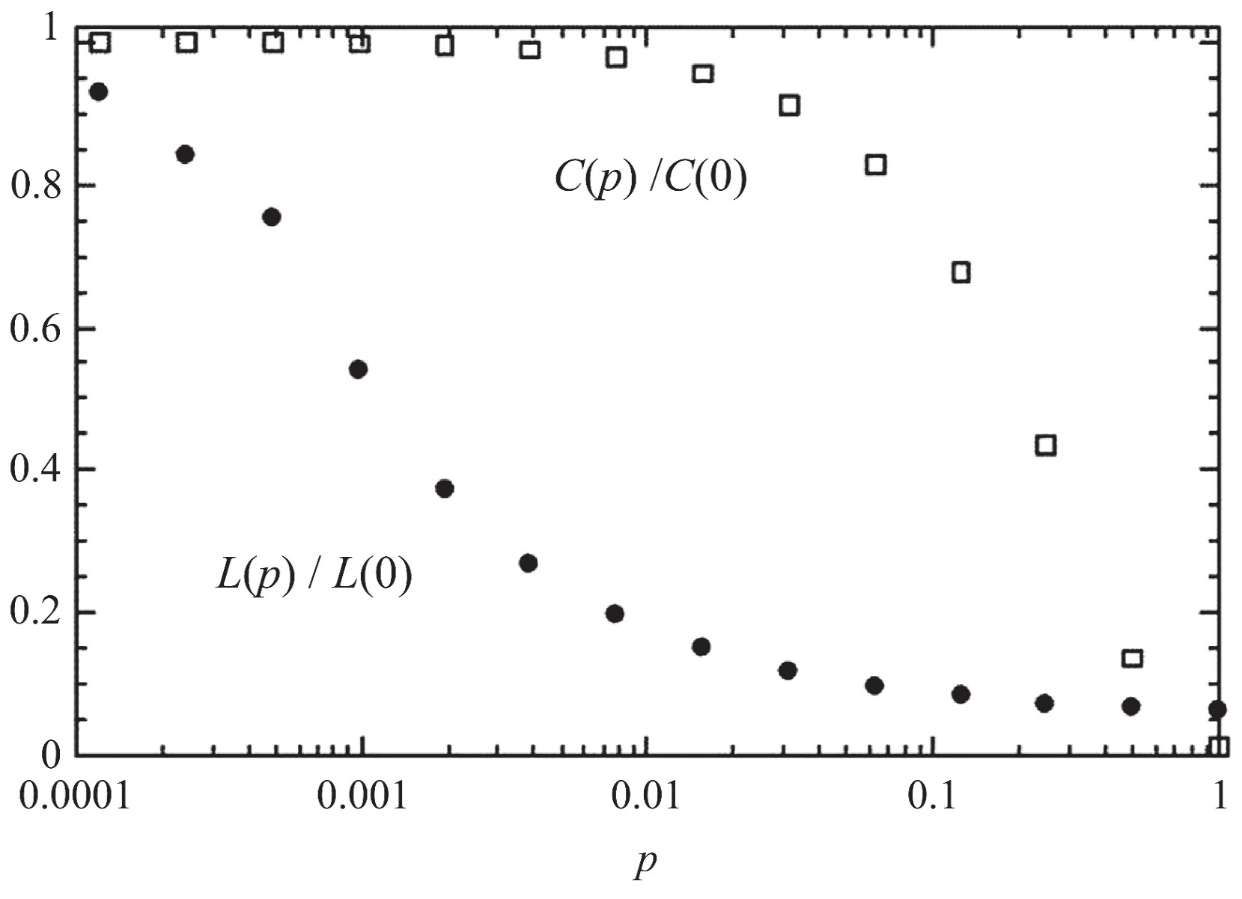
Watts/Strogatz model
Numerical simulation:
We increase 𝑝 (i.e., 𝛽) from 0 to 1
𝐿(0) is the average path length of the regular lattice
𝐶(0) is the clustering coefficient of the regular lattice
For any 𝑝, 𝐿(𝑝) denotes the average path length of the small-world graph and C(𝑝) denotes its clustering coefficient
From Graph Theory to Models of EconomicNetworks. A Tutorial Michael D. Konig and Stefano Battiston

Slide 64
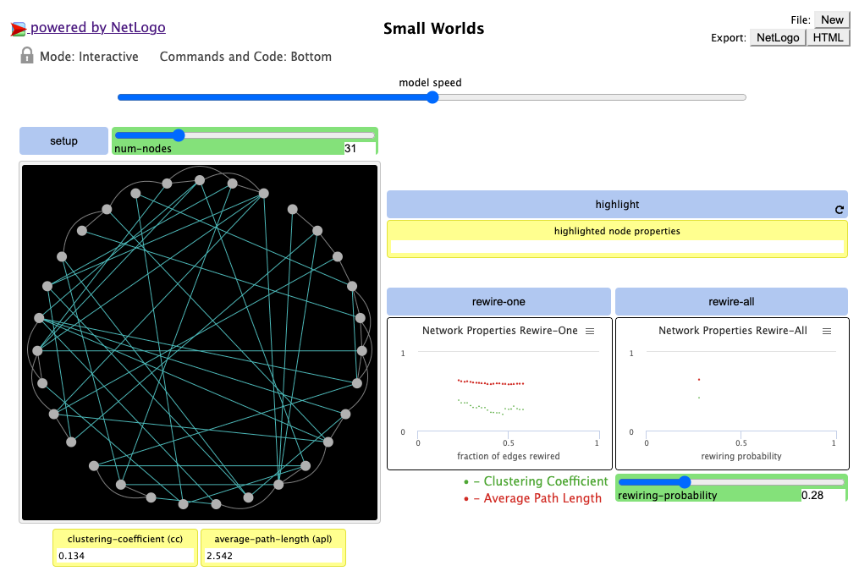
Watts/Strogatz model: Demo
http://ccl.northwestern.edu/netlogo/models/SmallWorlds

Slide 65

Degree Distribution
k: is a degree
z: edges that are not rewired
p: probability of rewiring
From Graph Theory to Models of EconomicNetworks. A Tutorial Michael D. Konig and Stefano Battiston

Slide 66

Degree Distribution
From Graph Theory to Models of EconomicNetworks. A Tutorial Michael D. Konig and Stefano Battiston

Slide 67

Degree Distribution
From Graph Theory to Models of EconomicNetworks. A Tutorial Michael D. Konig and Stefano Battiston

Slide 68

Degree Distribution
What is strange?
Even at p = 1, graph is not a purely random graph
From Graph Theory to Models of EconomicNetworks. A Tutorial Michael D. Konig and Stefano Battiston

Slide 69
Network Models
Regular graphs
Random graphs
Small-World Model
Preferential Attachment

Slide 70
Scale-Free Networks
Wealth Distribution:
  Most individuals have average capitals,
  Few are considered wealthy.
  Exponentially more individuals with average capital than the wealthier ones.
City Population:
  A few metropolitan areas are densely populated
  Most cities have an average population size
Social Media:
  We observe the same phenomenon regularly when measuring popularity

Slide 71
Scale-Free Networks
Site Popularity:
Many sites are visited less than a 1,000 times a month
A few are visited more than a million times daily
User Activity:
Social media users are often active on a few sites
Some individuals are active on hundreds of sites
Product Price:
There are exponentially more modestly priced products for sale compared to expensive ones.
Friendships:
Many individuals with a few friends and a handful of users with thousands of friends

Slide 72

Power-law distribution
A power law is a relationship that describes a functional form between two variables
where one variable is proportional to a power of the other.
The relative frequency of an event is inversely proportional to its size or magnitude
raised to some power.
The power-law exponent. In many natural and social systems, the power law exponent is observed to be between 2 and 3.
Power-law intercept
(depends on the particular data
set being analyzed)
Function of k, in our case fraction of users with degree k
Variable, in our case k=node degree
Notes:
The negative sign in front of the exponent indicates that the relationship is an inverse relationship, meaning that as x increases, P(x) decreases

Slide 73


Power-law distribution

Slide 74
Scale-Free Networks
Many real world networks contain hubs: highly connected nodes
many nodes with few edges
number of nodes
a few nodes with a very large number
of edges
number of edges

Slide 75
Scale-Free Networks

Slide 76
Power-law distribution
A power-law will appear as a straight line on a log-log plot:
A deviation from a straight line could indicate a different distribution:
  exponential
  lognormal
log(# nodes)
A power-law distribution
  Small occurrences: common
  Large instances: extremely rare
log(# edges)

Slide 77

Power-law distribution
Which region will sell
more?
# People searching
Detail of the query
  57% of Amazon’s sales is from the long tail
Notes:
https://www.practicalecommerce.com/content-marketing-can-drive-long-tail-seo#:~:text=Long%2Dtail%20Conversions,look%20for%20a%20specific%20title.

Slide 78
Scale-Free Networks
What do you
notice?
Notes:
Average degree in figure is 2
But graph figure it is 10
So graph figure does not exactly show the network but (assuming it is 2)
- Random graphs was not able to capture low degree and high degree nodes.
Many nodes with low degree
Existence of too large nodes in power law

Slide 79

Power-law distribution
Networks with a power-law degree distribution are called Scale-Free networks
Moby Dick
scientific papers 1981-1997
AOL users visiting sites ‘97
bestsellers 1895-1965
AT&T customers on 1 day
California 1910-1992
Source: MEJ Newman, ’Power laws, Pareto distributions and Zipf’s law’
Notes:
power law is evident only in the tail
x_{min} > 100 citations

Slide 80
Power-law distribution
Hubs

Slide 81
Power-law distribution

Slide 82

Discrete vs. Continuum formalism
Discrete Formalism
As node degrees are always positive integers, the discrete formalism captures the probability that a node has exactly k links:
Continuum Formalism
In analytical calculations it is often convenient to assume that the degrees can take up any positive real value:
INTERPRETATION:
Network Science: Scale-Free Property
Notes:
Alpha = (y-1)kmin^(y1-)

Slide 83

Discrete vs. Continuum formalism
Notes:
Alpha = (y-1)kmin^(y1-)

Slide 84
The size of the biggest hub
All real networks are finite → let us explore its consequences.
→ We have an expected maximum degree, k_{max}
Estimating k_{max}
P(k) ~ k^{-y}
Why: the probability to have a node larger than k_{max} should not exceed the prob. to have one node, i.e. 1/N fraction of all nodes
Notes:
Alpha = (y-1)kmin^(y1-)

Slide 85
Finite scale-free networks
Expected maximum degree, k_{max}
k_{max}, increases with the size of the network
  the larger a system is, the larger its biggest hub
For γ>2 k_{max} increases slower than N
  the largest hub will contain a decreasing fraction of links as N increases.
For γ=2 k_{max}~N.
  the size of the biggest hub is O(N)
For γ<2 k_{max} increases faster than N: condensation phenomena
  the largest hub will grab an increasing fraction of links. Anomaly!

Slide 86
Power-law distribution
Scale Free

Slide 87

Power-law distribution
k is a degree distribution and p_{k} is a probability of observing that degree.
The degree distribution of a network generated by the Barabási-Albert model.
The plot show for a single network of size N=100,000.
It shows both the linearly-binned (red symbols) and log-binned version (green symbols).
The straight line is added to guide the eye and has slope -3.
Notes:
The degree distribution of a network generated by the Barabási-Albert model. The plot show for a single network of size N=100,000 and m=3 and . It shows both the linearly-binned (red symbols) as well as the log-binned version (green symbols) o. The straight line is added to guide the eye and has slope -3, corresponding to the resulting network’s degree exponent.

Slide 88


What does it mean to be scale free?
What does it mean to be scale free?
Notes:
causes only a proportionate scaling of the function itself

Slide 89

What does it mean to be scale free?
What does it mean to be scale free?
A power law looks the same no mater what scale we look at it
Given f(x) = a * x^{-k}, scaling argument x by constant factor c causes only a proportionate scaling of the function itself
  f(cx) = a * (cx)^{-k} = c^{-k} * f(x)
Scaling with c implies multiplying original f(x) with constant c^{-k} (direct proportionality)
Notes:
causes only a proportionate scaling of the function itself

Slide 90

What does it mean to be scale free?
A power law looks the same no mater what scale we look at it
Given f(x) = a * x^{-k}, scaling argument x by constant factor c causes only a proportionate scaling of the function itself
  f(cx) = a * (cx)^{-k} = c^{-k} * f(x)
Scaling with c implies multiplying original f(x) with constant c^{-k} (direct proportionality)
Notes:
causes only a proportionate scaling of the function itself

Slide 91
What does it mean to be scale free?
Given f(x) = a * x^{-k}, scaling argument x by constant factor c causes only a proportionate scaling of the function itself
  f(cx) = a * (cx)^{-k} = c^{-k} * f(x)
Scaling with c implies multiplying original f(x) with constant c^{-k} (direct proportionality)
Produces the linear relationship when logarithms are taken of both f(x) and x
  log(f(x)) = -k*log(x) + log(a)
  log(a) is constant, and -k is slope
  If x_new = log(x)
    => y_new = log(f(x)) = -k * x_new + log(a)
  x-> c*x => f(cx) = a * (cx)^{-k} = c^{-k} * f(x)
  log(f(cx)) = -k*log(c) - k*log(x) + log(a)
  y_new = -k*log(c) - k*x_new+ log(a)
log(f(x)) = y_new
log(x) = x_new
Notes:
causes only a proportionate scaling of the function itself
https://www.transum.org/Maths/Activity/Graph/Desmos.asp
K=2
A=10
Log(c)=3
y=-2x+10
y=-2x+10 - 2 * 3

Slide 92
Power-law distribution
Lack of well-defined average value:
mean is well-defined but the variance is not

Slide 93

What does it mean to be scale free?
Notes:
Average node degree: add number of nodes (integral (kp(k))) and divide it by N: to converge y>2
Fluctuation is infinite
There is no characteristic degree like in poisson degree distribution

Slide 94
What does it mean to be scale free?
(to converge)
(to converge)
Notes:
Average node degree: add number of nodes (integral (kp(k))) and divide it by N: to converge y>2
<k^2> Network grows and average degree is now <k^2>
Fluctuation is infinite
There is no characteristic degree like in poisson degree distribution

Slide 95

What does it mean to be scale free?
(to converge)
(to converge)
Values of k:
2,2,2, 3,3, 4,4, 5,5, 6,6,6
2*(3/12) + 3*(2/12) + 4*(2/12) + 5*(2/12) + 6*(3/12) = 4 (mean of values of k)
Notes:
First moment - mean
https://www.thoughtco.com/what-are-moments-in-statistics-3126234

Slide 96

What does it mean to be scale free?
Values of k:
2,2,2, 3,3, 4,4, 5,5, 6,6,6
4*(3/12) + 9*(2/12) + 16*(2/12) + 25*(2/12) + 36*(3/12) = 18.33
(to converge)
(to converge)
Notes:
First moment - mean
https://www.thoughtco.com/what-are-moments-in-statistics-3126234

Slide 97
What does it mean to be scale free?
Values of k:
2,2,2, 3,3, 4,4, 5,5, 6,6,6
<k> = 2*(3/12) + 3*(2/12) + 4*(2/12) + 5*(2/12) + 6*(3/12) = 4 (mean of values of k)
Values of k:
2,2,2, 3,3, 4,4, 5,5, 6,6,6
<k²> = 4*(3/12) + 9*(2/12) + 16*(2/12) + 25*(2/12) + 36*(3/12) = 18.33
<k²> - <k> ² = 18.33 – 16 = 2.33
Variance (2,2,2, 3,3, 4,4, 5,5, 6,6,6) ≈ 2.33
Notes:
Average node degree: add number of nodes (integral (kp(k))) and divide it by N: to converge y>2
Fluctuation is infinite
There is no characteristic degree like in poisson degree distribution

Slide 98
What does it mean to be scale free?
Notes:
Average node degree: add number of nodes (integral (kp(k))) and divide it by N: to converge y>2
Fluctuation is infinite
There is no characteristic degree like in poisson degree distribution

Slide 99
What does it mean to be scale free?
(to converge)
(to converge)
Notes:
Average node degree: add number of nodes (integral (kp(k))) and divide it by N: to converge y>2
<k^2> Network grows and average degree is now <k^2>
Fluctuation is infinite
There is no characteristic degree like in poisson degree distribution

Slide 100
What does it mean to be scale free?
2<y 2>y>3 y>3
Note: a= y
Notes:
Fluctuation is infinite
There is no characteristic degree like in poisson degree distribution
https://www.youtube.com/watch?v=Q7M79w1ZAy8&list=PLriUvS7IljvkGesFRuYjqRz4lKgodJgh2&index=2

Slide 101
What does it mean to be scale free?
Notes:
Fluctuation is infinite
There is no characteristic degree like in poisson degree distribution

Slide 102
What does it mean to be scale free?
Notes:
Fluctuation is infinite
There is no characteristic degree like in poisson degree distribution

Slide 103
What does it mean to be scale free?
<k>: average degree

Slide 104
Power-law distribution
k is a degree distribution and p_{k} is a probability of observing that degree.
The degree distribution of a network generated by the Barabási-Albert model.
The plot show for a single network of size N=100,000.
It shows both the linearly-binned (red symbols) and log-binned version (green symbols).
The straight line is added to guide the eye and has slope -3.
Notes:
The degree distribution of a network generated by the Barabási-Albert model. The plot show for a single network of size N=100,000 and m=3 and . It shows both the linearly-binned (red symbols) as well as the log-binned version (green symbols) o. The straight line is added to guide the eye and has slope -3, corresponding to the resulting network’s degree exponent.

Slide 105
Many real world networks are power law
 | Power law exponent (in/out degree)
film actors | 2.3
telephone call graph | 2.1
email networks | 1.5/2.0
sexual contacts | 3.2
WWW | 2.3/2.7
AS-level Internet | 2.5
Router-level Internet | 2.0
Link-level Internet | 2.7
peer-to-peer | 2.1
metabolic network | 2.2
protein interactions | 2.4

Slide 106
Power-law distribution
Some regions deviate from scale free
Moby Dick
scientific papers 1981-1997
AOL users visiting sites ‘97
bestsellers 1895-1965
AT&T customers on 1 day
California 1910-1992
Source: MEJ Newman, ’Power laws, Pareto distributions and Zipf’s law’

Slide 107
Scale Free Network

Slide 108
Network Models
Regular graphs
Random graphs
Small-World Model
Preferential Attachment

Slide 109

Preferential Attachment
Random attachment: new node picks any existing node to attach to
Preferential attachment: new node picks from existing nodes according to their degrees
http://www.ladamic.com/netlearn/NetLogo4/RAndPrefAttachment.html

Slide 110


Preferential Attachment
Main assumption:
When a new user joins the network, the probability of connecting to existing nodes is proportional to existing nodes’ degrees
Proposed by Albert-László Barabási and Réka Albert
Barabási–Albert (BA) model is an algorithm for generating random scale-free networks using a preferential attachment mechanism
Albert-László Barabási and Réka Albert. "Emergence of scaling in random networks." science 286.5439 (1999): 509-512.

Slide 111
Image by Matthew Hurst
Blogosphere

Slide 112

Notes:
The discovery of the Barabási-Albert model is recounted in Linked [9], describing a workstop in Porto, Portugal, attended by the first author of the model: “During the summer of 1999 very few people were thinking about networks, and there were no talks on the subject during this workshop. But networks were very much on my mind. I could not help carrying with me on the trip our unresolved questions: Why hubs? Why power-laws? […] Before I left for Europe, Réka Albert and I agreed that she would analyze these networks. On June 14, a week after my departure, I received a long email from her detailing some ongoing activities. At the end of the message there was a sentence added like an afterthought: “I looked at the connectivity distribution too, and in almost all systems (IBM, actors, power grid), the tail of the distribution follows a power law.” Réka’s email suddenly made it clear that the Web was by no means special. I found myself sitting in the conference hall paying no attention to the talks, thinking about the implications of this finding. If two networks as different as the Web and the Hollywood acting community both display power-law degree distribution, then some universal law or mechanism must be responsible. If such a law existed, it could potentially apply to all networks. During the first break between talks I decided to withdraw to the quiet of the seminary where we were housed during the workshop. I did not get far, however. During the fifteen-minute walk back to my room a potential explanation occurred to me, one so simple and straightforward that I doubted it could be right. I immediately returned to the university to fax Réka, asking her to verify the idea using the computer. A few hours later she emailed me the answer. To my great astonishment, the idea worked.” The two images above reproduce the fax sent on June 14, 1999 from Porto, describing the algorithm that we call today the Barabási-Albert model.

Slide 113
Constructing Scale-free Networks

Slide 114
Preferential Attachment Model

Slide 115
Preferential Attachment Model
  Start with an initial set of m₀ fully connected nodes
    e.g. m₀ = 3
  Now add new vertices one by one
  New node connects to an existing vertex in proportion to the number of edges that vertex already has → preferential attachment
  Easiest if you keep track of edge endpoints in one large array and select an element from this array at random
    The probability of selecting any one vertex will be proportional to the number of times it appears in the array – which corresponds to its degree
3
1
2
1 1 2 2 2 3 3 4 5 6 6 7 8 ….

Slide 116
Preferential Attachment Model
3
To start, each vertex has an equal number of edges (2)
  the probability of choosing any vertex is 1/3
We add a new vertex with 2 edges
  draw 2 random elements from the array – suppose they are 2 and 3
Now the probabilities of selecting 1,2,3,or 4 are 2/10, 3/10, 3/10, 2/10
Add a new vertex, draw a vertex for it to connect from the array
1 1 2 2 3 3
1
2
3
4
1
2
1 1 2 2 2 3 3 3 4 4
5
3
4
1
2
1 1 2 2 2 3 3 3 3 4 4 4 5 5

Slide 117







Preferential Attachment Model
$\text{Directed} \text{Graph}$
Node $v$arrives
$P(1) =1/7$
$P(2) =1/7$
$P(3) =2/7$
$P(4) =0$
$P(5) =3/7$
$$P(1)=1/7$$
$$v$$
$$P(5)=3/7$$
$$P(2)=1/7$$
$$P(4)=0$$
1
5
$$P(3)=2/7$$
2
3
4

Slide 118
Preferential Attachment Model
j
j
j
j
Degree of node i after some time interval
Degree of node i at time t
During the time interval new node arrives and brings m edges and probability of m edges to connect node i is P(k_{i} )

Slide 119
Preferential Attachment Model
j
j
j
j
j
j
Plug in values from above
Total degree = total edges * 2
Total edges = edges added in each interval (m) * total time (t)

Slide 120
Preferential Attachment Model
j
j
With separation of variables
When node is just added it’s degree is m

Slide 121
Preferential Attachment Model
What do you see?
Notes:
Ti time when it joins

Slide 122
Preferential Attachment Model
m=1
What do you see?
Notes:
Ti time when it joins

Slide 123



In social networks, it’s nice to be a hub
mike

Slide 124




But it depends on what you’re sharing…

Slide 125








Spread of computer worms
can be affected by the
underlying network

Slide 126
Preferential Attachment Model
Notes:
Ti time when it joins

Slide 127

Real-World Networks and Simulated Graphs

Slide 128
Preferential Attachment Model
Notes:
Ti time when it joins

Slide 129
Preferential Attachment Model
Notes:
Ti time when it joins

Slide 130
Preferential Attachment Model
m: number of edges new node brings
Notes:
Ti time when it joins

Slide 131
Power-law networks are robust to random breakdown

Slide 132
But are especially vulnerable to targeted attack
Targeting and removing hubs can quickly break up the network

Slide 133
Preferential Attachment Model
The older are richer
  Nodes accumulate links as time goes on
  Preferential attachment will prefer wealthier nodes, who tend to be older and had a head start
Preferential attachment leads to power law networks…
Barabási–Albert (BA) model is an algorithm for generating random scale-free networks using a preferential attachment mechanism
BA networks are not clustered

