Slide 1
Lecture 7:
Network evolution
CS 765: Complex Networks
Slides are adapted from
Jurij Leskovec, Jon Kleinberg and Christos Faloutsos
Huan Liu, Lei Tang, Nitin Agarwal, Reza Zafarani and
Constantine Dovrolis, Eileen Kraemer, Peter Dodds, and Sergei Maslov and
Network Science by Albert-László Barabási and
Leonid Zhukov

Slide 2
Network evolution
What can we do with graphs?
What patterns or “laws” hold for most real-world graphs?
How do the graphs evolve over time?
Can we generate synthetic but “realistic” graphs?

Slide 3
Network evolution
As individual nodes and edges come and go, how do aggregate features change?
degree distribution?
clustering coefficient?
average shortest path?

Slide 4
Network evolution
Why is all this important?
Graph generation – Synthetic graphs for simulations
Graph sampling – many real world graphs are too large to deal with
Predictions – predicting future from the past
Anomaly detection – abnormal behavior, evolution

Slide 5
Network evolution
How do graphs evolve over time?
Conventional Wisdom:
  Constant average degree: the number of edges grows linearly with the number of nodes
  Slowly growing diameter: as the network grows the distances between nodes grow
Findings:
  Densification Power Law: networks are becoming denser over time
  Shrinking Diameter: diameter is decreasing as the network grows
Notes:
(1′) Empirical observation: densification power laws. The networks are becom- ing denser over time with the average degree increasing (and hence with the number of edges growing superlinearly in the number of nodes). More- over, the densification follows a power-law pattern.
(2′) Empirical observation: shrinking diameters. The effective diameter is, in many cases, actually decreasing as the network grows.

Slide 6
Network evolution
Conventional Wisdom:
  Constant average degree: the number of edges grows linearly with the number of nodes
  Slowly growing diameter: as the network grows the distances between nodes grow
Preferential attachment [Albert & Barabasi, 99]:
  Add a new node, create M out-links
  Probability of linking a node is proportional to its degree
Notes:
(1′) Empirical observation: densification power laws. The networks are becom- ing denser over time with the average degree increasing (and hence with the number of edges growing superlinearly in the number of nodes). More- over, the densification follows a power-law pattern.
(2′) Empirical observation: shrinking diameters. The effective diameter is, in many cases, actually decreasing as the network grows.

Slide 7
Network evolution
Conventional Wisdom:
  Constant average degree: the number of edges grows linearly with the number of nodes
  Slowly growing diameter: as the network grows the distances between nodes grow
Random Network Modeling and Watts–Strogatz model
  Distance: logN/log<k>
Preferential Attachment
  Distance: logN/loglogN
Notes:
(1′) Empirical observation: densification power laws. The networks are becom- ing denser over time with the average degree increasing (and hence with the number of edges growing superlinearly in the number of nodes). More- over, the densification follows a power-law pattern.
(2′) Empirical observation: shrinking diameters. The effective diameter is, in many cases, actually decreasing as the network grows.

Slide 8
Network evolution
Findings:
  Densification Power Law: networks are becoming denser over time
  Shrinking Diameter: diameter is decreasing as the network grows
Densification Power Law -> Shrinking Diameter ?
  It is possible to construct examples of graphs evolving over time that exhibit one of these properties but not the other
Notes:
(1′) Empirical observation: densification power laws. The networks are becom- ing denser over time with the average degree increasing (and hence with the number of edges growing superlinearly in the number of nodes). More- over, the densification follows a power-law pattern.
(2′) Empirical observation: shrinking diameters. The effective diameter is, in many cases, actually decreasing as the network grows.

Slide 9
Network evolution
Graphs evolving over a time follows densification power law (or growth power law)
Densification power law: e(t) ∝ n(t)ª
  e(t): number of edges at time t
  n(t): number of nodes at time t
  a: exponent that generally lies strictly between 1 and 2
  Log(e(t))/Log(n(t))=a
a=1 linear growth
a=2 quadratic growth

Slide 10
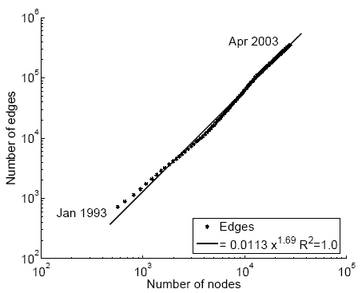
Network evolution
Citations among physics papers
1992:
  1,293 papers,
  2,717 citations
2003:
  29,555 papers,
  352,807 citations
For each month M, create a graph of all citations up to month M (124 months)
E(t)
1.69
N(t)
Notes:
slope is a = 1.68 (also called densification exponent)
This data covers papers in the period from January 1993 to April 2003 (124 months). It begins within a few months of the inception of the arXiv, and thus represents essentially the complete history of its HEP–TH section. For each month m (1 ≤ m ≤ 124), we create a citation graph using all papers pub- lished up to month m. For each of these graphs, we plot the number of nodes versus the number of edges on a logarithmic scale and fit a line.

Slide 11
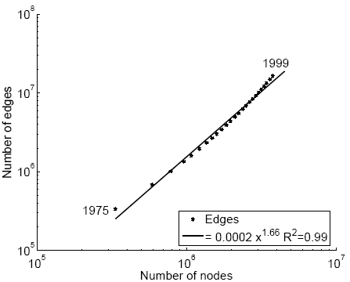
Network evolution
Citations among patents granted
1975
  334,000 nodes
  676,000 edges
1999
  2.9 million nodes
  16.5 million edges
Each year is a datapoint (24 years)
E(t)
1.66
N(t)

Slide 12
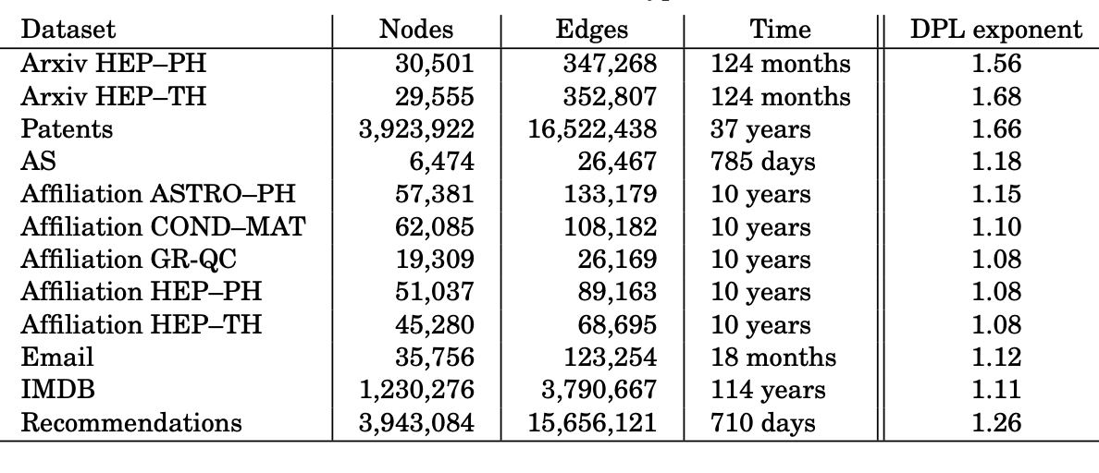
Network evolution
Densification Power Law (DPL)

Slide 13
Evolution of the Diameter
Prior work on Power Law graphs hints at Slowly growing diameter:
  diameter ~ O(log N)
  diameter ~ O(log log N)
What is happening in real data?
Diameter shrinks over time
  As the network grows the distances between nodes slowly decrease

Slide 14
Evolution of the Diameter
Let g(d) denote the fraction of connected node pairs whose shortest connecting path has length at most d.
Effective diameter of the network is the value of d at which the function g(d) achieves the value 0.9.

Slide 15
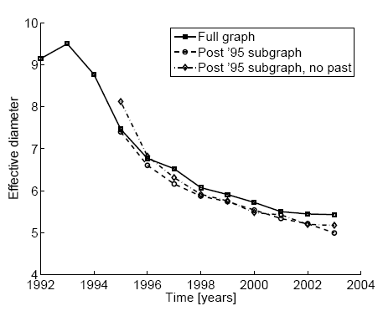
Shrinking Diameters
diameter
Citations among physics papers
1992 –2003
One graph per year
time [years]

Slide 16
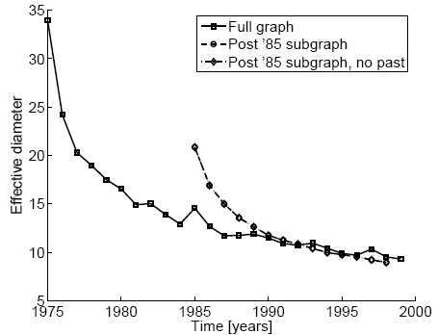
Shrinking Diameters
diameter
Patent citation network
25 years of data
time [years]

Slide 17
Evolution of the Diameter
Prior work on Power Law graphs hints at Slowly growing diameter:
  diameter ~ O(log N)
  diameter ~ O(log log N)
What is happening in real data?
Diameter shrinks over time
  As the network grows the distances between nodes slowly decrease

Slide 18
Shrinking Diameters
There are several factors that could influence the Shrinking diameter
  Possible sampling problems
  Disconnected components
    Network may consist of small disconnected components
  Missing past effects
    Network does not have data reaching all the way back to the network’s birth

Slide 19
Shrinking Diameters
There are several factors that could influence the Shrinking diameter
  Possible sampling problems
    Approximate Neighborhood Function
    Exhaustive breadth-first search from a subset of the nodes chosen uniformly at random
  Disconnected components
    Giant component accounts for a significant fraction of all nodes
  Missing past effects
    Issue observed in only citation network
  None of them matter

Slide 20
Network evolution
Observations: Densification Power Law & Shrinking Diameter
Existing graph generation models do not capture the Densification Power Law and Shrinking diameters
Can we find a simple model of local behavior, which naturally leads to observed phenomena?
Community Guided Attachment – obeys Densification
Forest Fire model – obeys Densification, Shrinking diameter (and Power Law degree distribution)

Slide 21
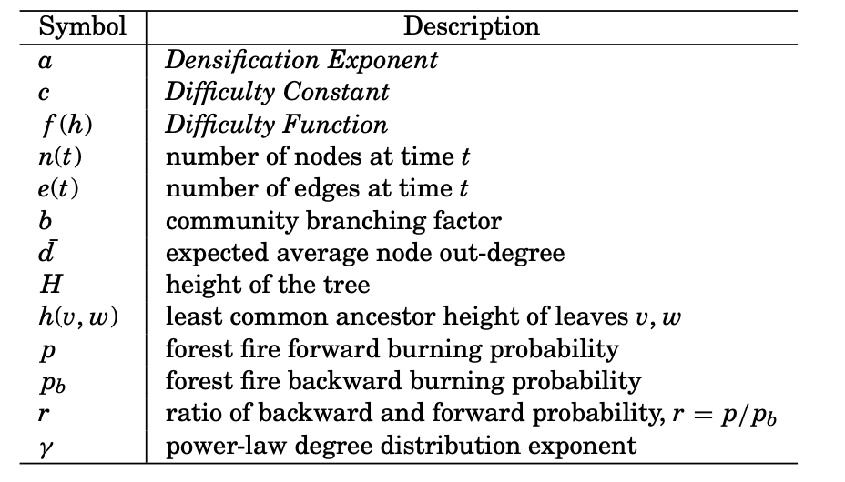
Network evolution

Slide 22
Community Guided Attachment

Slide 23
Community Guided Attachment
E(t) ∝ N(t)ª
University
Let’s assume the community structure
One expects many within-group friendships and fewer cross-group ones
How hard is it to cross communities?
Science
Arts
CS
Math
Drama
Music
Self-similar university
community structure

Slide 24
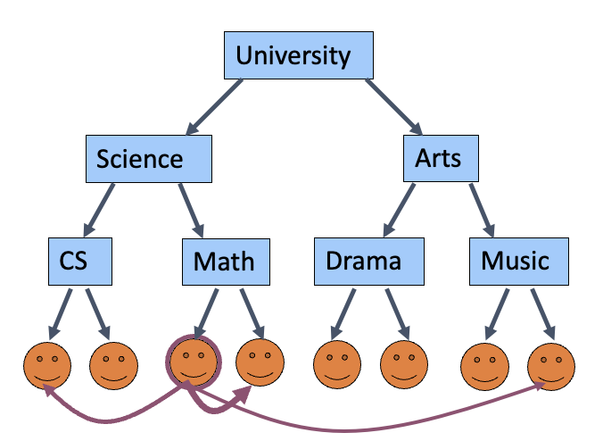
Community Guided Attachment
Define recursive structure of communities-within-communities as a tree T of height H
h(v, w) is the height of least common ancestor of leaf nodes v and w
Function f of h(v, w) is a probability that v and w form an edge
Function f decreases with h
If the function f is scale-free (f (h) = c^{−h}), with 1 < c < b
then the Community Guided Attachment obeys
the densification power law
Notes:
Define recursive structure of communities-within-communities as a tree T of height H
V leaves of the tree, and n = |V|
h(v, w) define the standard tree distance of two leaf nodes v and w
h(v, w) is the height of their least common ancestor
function f of h(v, w) is a probability that
v and w form an edge
f is difficulty function
f decrease with h
branching factor (number of children at each node)

Slide 25
Community Guided Attachment
If the function f is scale-free (f (h) = c^{−h}), with 1 < c < b then the Community Guided Attachment obeys the densification power law
c is difficulty constant and intuitively, cross-communities links become harder to form as c increases.
b is a branching factor (number of children at each node)
Densification power law: e(t) ∝ n(t)ª
Power law exponent: a = 2 − log_{b}(c)
If c = 1: easy to cross communities
  Then: a=2, quadratic growth of
  edges – near clique
If c = b: hard to cross communities
  Then: a=1, linear growth of
  edges – constant out-degree
Notes:
Define recursive structure of communities-within-communities as a tree T of height H
V leaves of the tree, and n = |V|
h(v, w) define the standard tree distance of two leaf nodes v and w
h(v, w) is the height of their least common ancestor
function f of h(v, w) is a probability that
v and w form an edge
f is difficulty function
f decrease with h
branching factor (number of children at each node)

Slide 26
Community Guided Attachment
Densification power law: e(t) ∝ n(t)ª
If the function f is scale-free (f (h) = c^{−h}), with 1 < c < b then the Community Guided Attachment obeys the densification power law
Values of c and b?
Function h(v, w) ?
Room for Improvement
Community Guided Attachment explains Densification Power Law
Issues:
  Requires explicit Community structure
  Does not obey Shrinking Diameters

Slide 27
The Forest Fire Model

Slide 28
The Forest Fire Model
How do authors identify references?
Find first paper and cite it
Follow a few citations, make citations
Continue recursively
From time to time make new query

Slide 29
The Forest Fire Model
A node arrives
Randomly chooses an initial node
Starts burning nodes (with probability p) and adds links to burned nodes
“Fire” spreads recursively
Notes:
Essentially, nodes arrive one at a time and form outlinks to some subset of the earlier nodes; to form outlinks, a new node v attaches to a node w in the existing graph, and then begins burning links outward from w, linking with a certain probability to any new node it discovers. One can view such a process as intuitively corresponding to a model by which an author of a paper identifies references to include in the bibliography.

Slide 30
The Forest Fire Model
Parameters
  forward burning probability p
  backward burning probability p_{b}
  ratio of backward and forward probability, r = p/ p_{b}
G_{t} is graph constructed till time t > 1
  G₁ will consist of just a single node
Node v joins the network at time t > 1 and forms out links to nodes in G_{t}

Slide 31
The Forest Fire Model
Node v first chooses an initial node w uniformly at random and forms a link to w
Generate two random numbers, x and y, that are geometrically distributed with means p/(1 − p) and rp/(1 − rp), respectively
Node v selects x out-links and y in-links of w incident to nodes that were not yet visited (w₁, w₂,...,w_{x+y} other ends of the selected links)
  If not enough in or out links are available, v selects as many as it can
Node v forms out links to w₁, w₂, ..., w_{x+y}, and then applies step(ii) recursively to each of w₁, w₂,...,w_{x+y}
  As the process continues, nodes cannot be visited a second time, preventing the construction from cycling.
Notes:
Selecting multiple initial Ws
How x and y neighbors of w is selected
W is chosen random (not sure if it is good idea)

Slide 32
The Forest Fire Model
The burning of links in the Forest Fire begins at w, spreads to w₁, ..., w_{x+ y} , and proceeds recursively until it dies out.
Selecting multiple initial W nodes.
W is chosen randomly?
How x and y neighbors of w are selected?
Notes:
Selecting multiple initial Ws
How x and y neighbors of w is selected
W is chosen random (not sure if it is good idea)

Slide 33
The Forest Fire Model
Heavy-tailed in-degrees: model has a rich-get-richer flavor, highly-linked nodes can easily be reached by a newcomer no matter which initial node it starts from.
Heavy-tailed out-degrees: the recursive nature of link formation provides a reasonable chance for a new node to burn many edges and thus produce a large out-degree.
Communities: the model also has a copying flavor, a newcomer copies several of the neighbors of his/her W (and then continues recursively).

Slide 34
The Forest Fire Model
Densification power law: a newcomer will have a lot of links near the community of his/her initial W node, a few links beyond this, and significantly fewer farther away. Intuitively, this is similar to Community Guided Attachment, although without an explicit set of communities.
Shrinking diameter: experimental analysis show that graph diameter shrinks

Slide 35
The Forest Fire Model
p = 0.37, p_{b} = 0.33
decreasing diameter
densifying graph
a = 1.32
p = 0.38, p_{b} = 0.35
decreasing diameter
densifying graph
a = 1.57
Notes:
forward- burning probability p, and by increasing the backward-burning probability pb

Slide 36
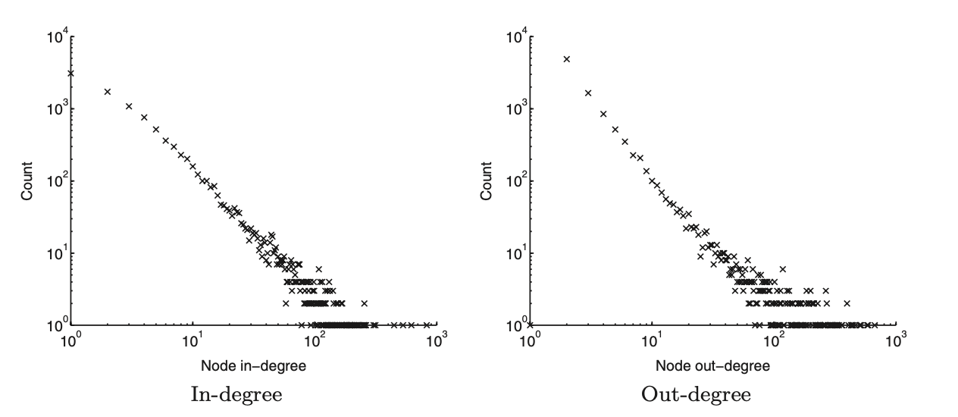
The Forest Fire Model
Forward burning probability: 0.37
Backward burning probability: 0.32
Notes:
forward- burning probability p, and by increasing the backward-burning probability pb

Slide 37
Extensions to the Forest Fire Model
Orphans
isolated nodes
start graph with n₀ > 1 nodes at time t = 1
probability q > 0 that a newcomer will form no links
diameter decreases even faster
Notes:
forward- burning probability p, and by increasing the backward-burning probability pb

Slide 38
Extensions to the Forest Fire Model
Burning a fixed percentage of neighbors
fire burns a fixed percentage of node’s edges, that is, the number of burned edges is proportional to the node’s degree
nonheavy-tailed degree distribution
diameter decreases even faster
Notes:
forward- burning probability p, and by increasing the backward-burning probability pb

Slide 39
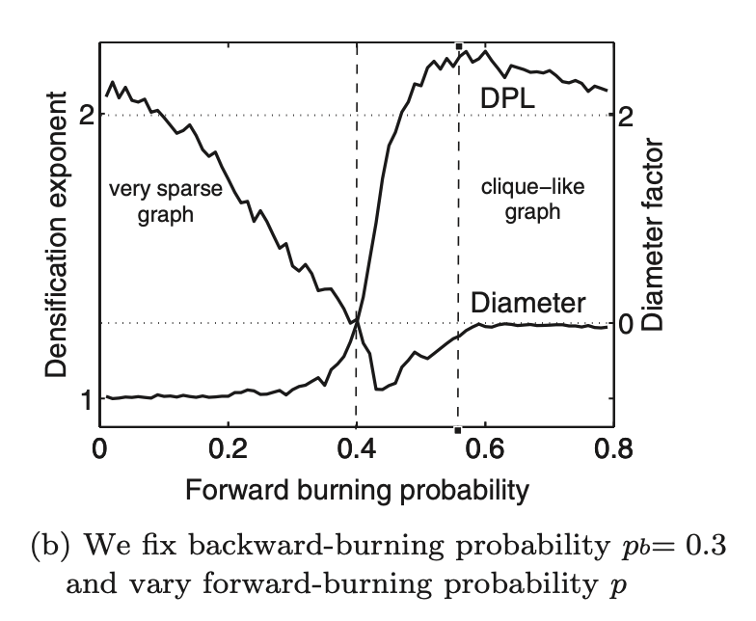
Forest Fire Model
Densification Power Law -> Shrinking Diameter ?
  It is possible to construct examples of graphs evolving over time that exhibit one of these properties but not the other
Notes:
forward- burning probability p, and by increasing the backward-burning probability pb

Slide 40
Wrap Up
Network Evolution
Graph generation
Graph sampling
Predictions
Anomaly detection
Conventional Wisdom
Constant average degree: the number of edges grows linearly with the number of nodes
  Preferential attachment: create M out-links
Slowly growing diameter: as the network grows the distances between nodes grow
  Distance Random Network Modeling and WS model: logN/log<k>
  Distance Preferential Attachment: logN/loglog<N>
Notes:
forward- burning probability p, and by increasing the backward-burning probability pb

Slide 41
Wrap Up
Findings
Densification Power Law: networks are becoming denser over time
  e(t) ∝ n(t)ª
Shrinking Diameter: diameter is decreasing as the network grows
Notes:
forward- burning probability p, and by increasing the backward-burning probability pb

Slide 42
Wrap Up
Proposed Models
Community Guided Attachment
  Leads to Densification Power Law
Forest Fire Model
  Heavy-tailed in- and out-degrees
  Densification Power Law
  Shrinking diameter
Notes:
forward- burning probability p, and by increasing the backward-burning probability pb

Slide 43
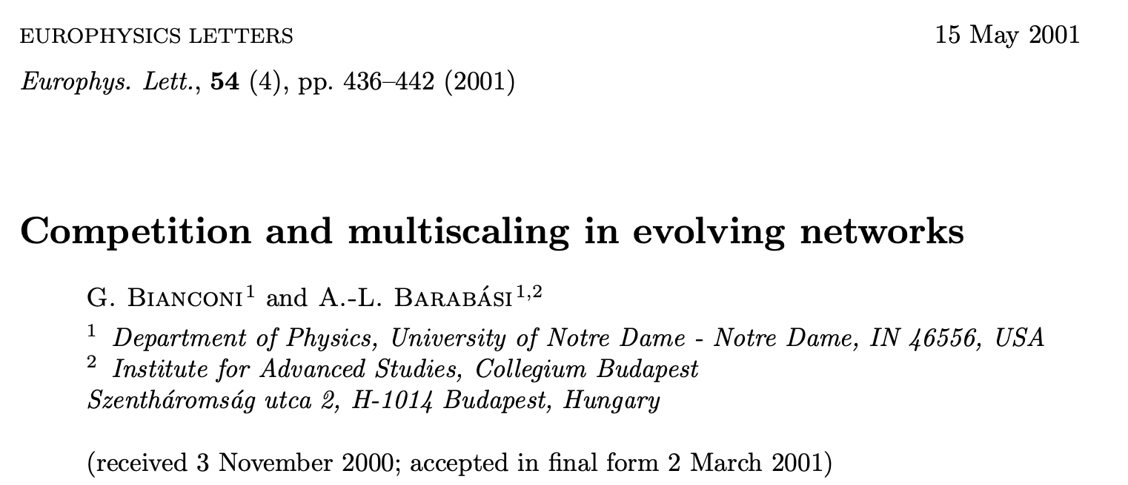
Bianconi-Barabasi model
Notes:
Screen Shot 2023-03-28 at 4.12.36 AM

Slide 44
Bianconi-Barabasi model
Scale – Free network
Growth, implying that networks continuously expand by the addition of new nodes
Preferential attachment, mimicking the fact that a new node links with higher probability to nodes that already have a large number of links.
Scale-free model predicts the emergence of a power law connectivity distribution

Slide 45
Bianconi-Barabasi model
The scale-free model neglects an important aspect of competitive systems
Growth rate does not depend on node’s age alone
What else might impact the growth of the node in a network?
  Google vs Yahoo
  iPhone vs Nokia
Not all nodes are equally successful in acquiring links
Intrinsic quality of the nodes (node’s fitness)
  Social skills of an individual
  The content of a web page
  Content of a scientific article

Slide 46
Bianconi-Barabasi model
Nodes increase their connectivity in time as
k_{i}(t) = (t/t_{i})^{β}
where β = 1/2 and t_{i} is the time at which node i has been added into the system.
The oldest nodes will have the highest number of links, since they had the longest timeframe to acquire them

Slide 47
Bianconi-Barabasi model
Even a relatively young node with a few links can acquire links at a high rate if it has a large fitness parameter.

Slide 48
Bianconi-Barabasi model
Model depends on fitness distributions ρ(η)
Not all ρ(η) distributions will result in a power law
  If ρ(η) decays exponentially, then k(t) follows a complex combination of logarithmic and power law behavior
Distribution classes of ρ(η) that support a power law P(k)

Slide 49
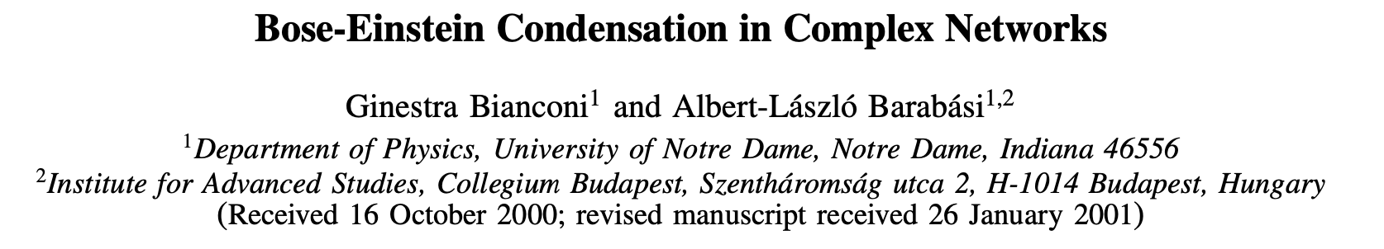
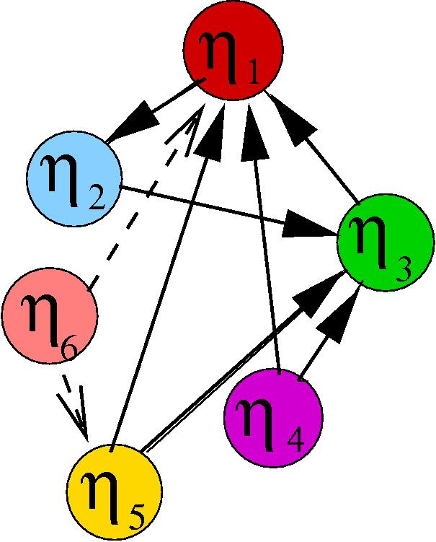
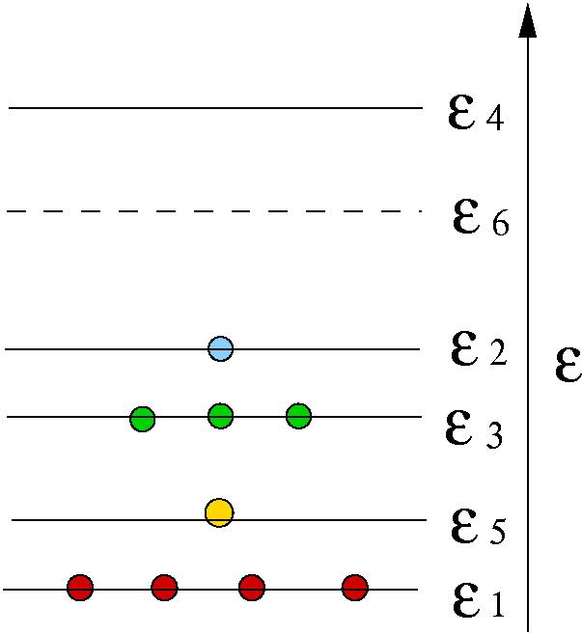
Bianconi-Barabasi model
Network
Bose gas
Fitness η → Energy level ε
New node with fitness η → New energy level ε
Link pointing to node η → Particle at level ε
Network → quantum gas

