Slide 1
Lecture 8:
Network Data Mining Essentials
CS 765: Complex Networks
Slides are adapted from
R. Zafarani, M. A. Abbasi, and H. Liu, Social Networks Mining: An Introduction, Cambridge University Press, 2014, and
Prof. Ehud Gudes Department of Computer Science Ben-Gurion University, Israel

Slide 2

Introduction
Data production rate has increased dramatically (Big Data) and we are able store much more data
  E.g., purchase data, social media data, cellphone data
Businesses and customers need useful or actionable knowledge to gain insight from raw data for various purposes
Notes:
Actionable: having practical value, handy

Slide 3
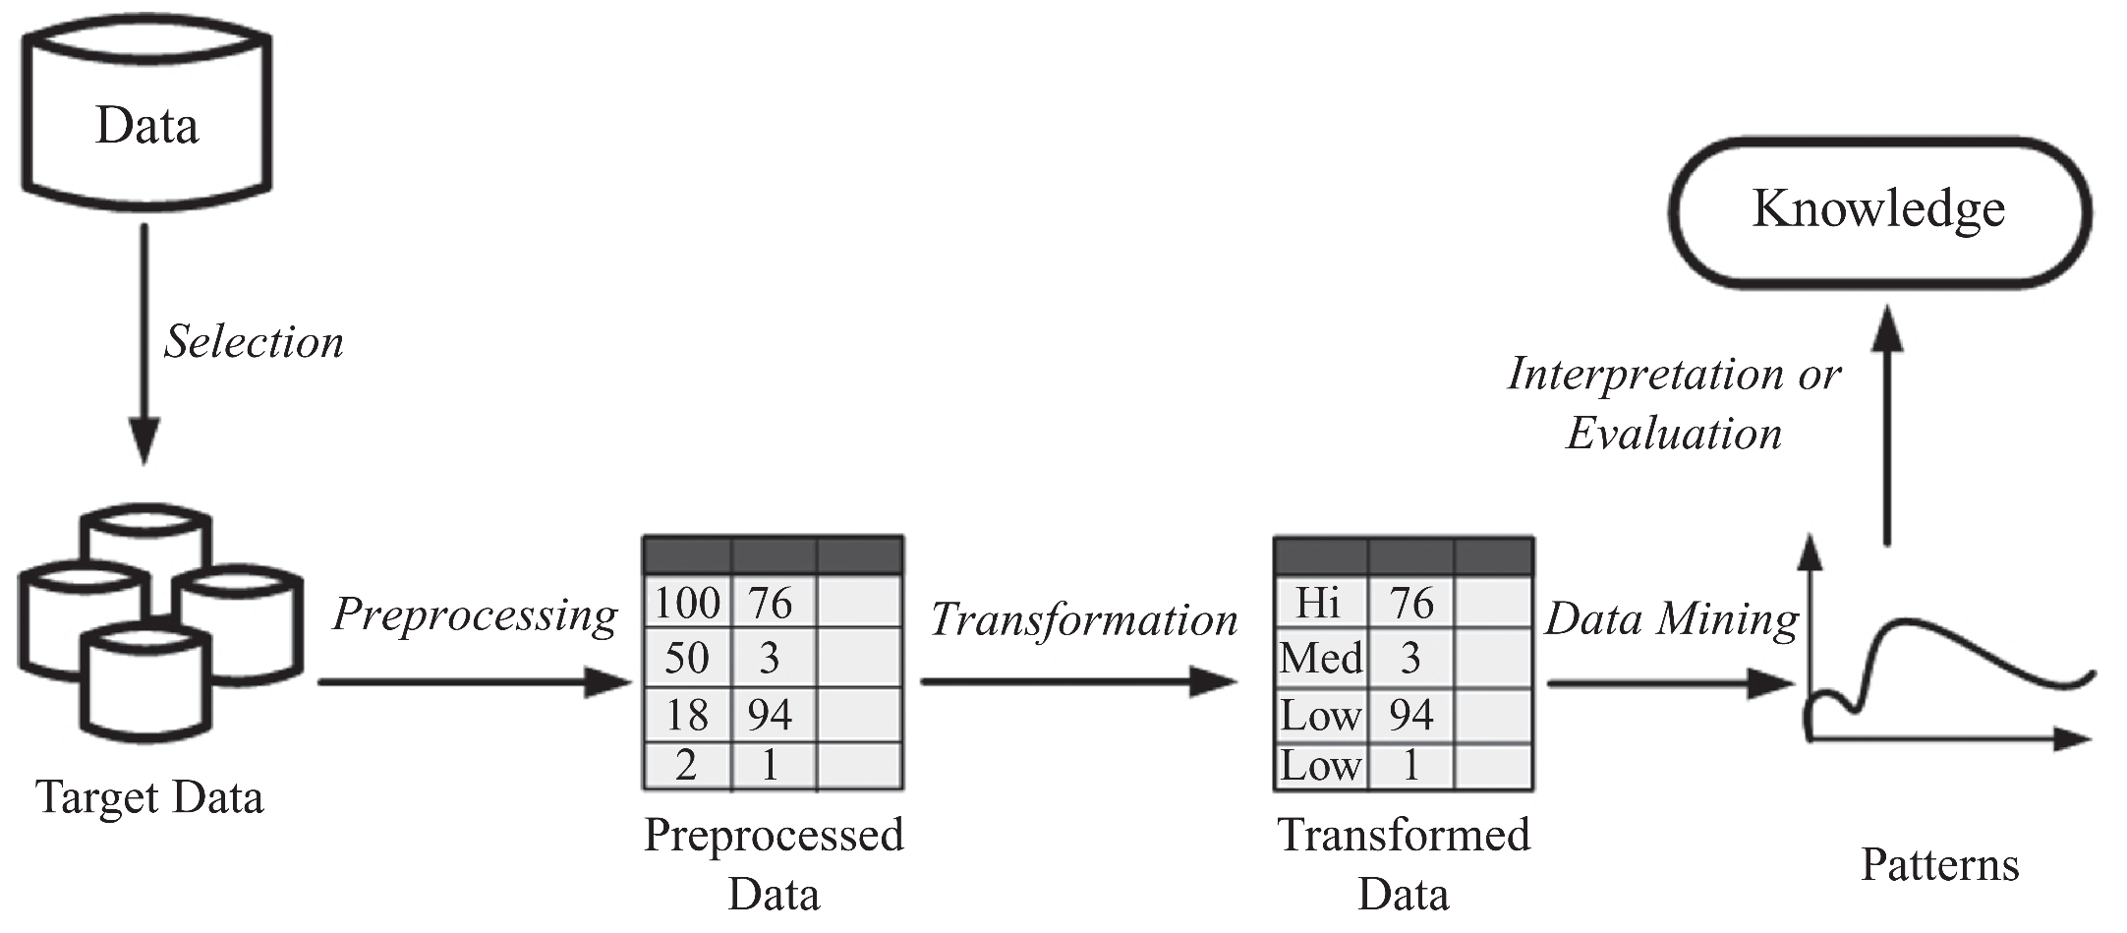
Introduction

Slide 4
Data Mining
Data Mining: the process of discovering hidden and actionable patterns from data
It utilizes methods at the intersection of artificial intelligence, machine learning, statistics, and database systems
Extracting/“mining” knowledge from large-scale data (big data)
Data-driven discovery and modeling of hidden patterns in big data
Extracting information/knowledge from data that is
  previously unknown,
  unexpected, and
  potentially useful

Slide 5
Data Mining: Related Areas
Database
Management
Systems
Visualization
Machine
Learning
Data
Mining
Statistics
Other Areas:
  Neural Networks
  Evolutionary Methods
  Information Retrieval
  Etc.
Artificial
Intelligence
Pattern
Recognition

Slide 6
Examples of Data Mining Applications
Fraud/Spam Detections: Identifying fraudulent transactions of a credit card or spam emails
  You are given a user’s purchase history and a new transaction, identify whether the transaction is fraud or not;
  Determine whether a given email is spam or not
Frequent Patterns: Extracting purchase patterns from existing records
Forecasting: Forecasting future sales and needs according to some given samples
Finding Like-Minded Individuals: Extracting groups of like-minded people in a given network

Slide 7
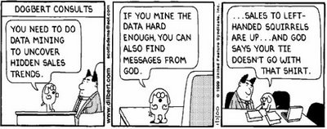
Data Mining
A risk with “Data mining” is that an analyst can “discover” patterns that are meaningless
Statisticians call it Bonferroni’s principle:
  Roughly, if you look in more places for interesting patterns than your amount of data will support, you are bound to find something

Slide 8
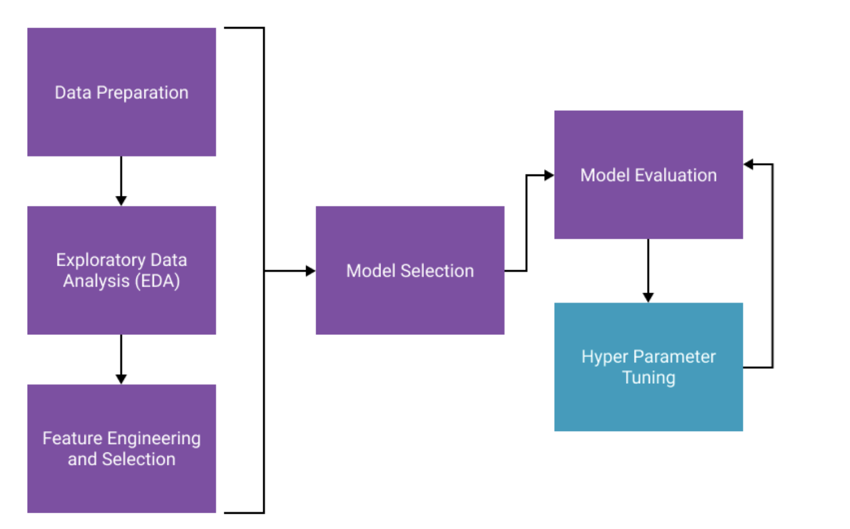
Data Mining

Slide 9
Data

Slide 10
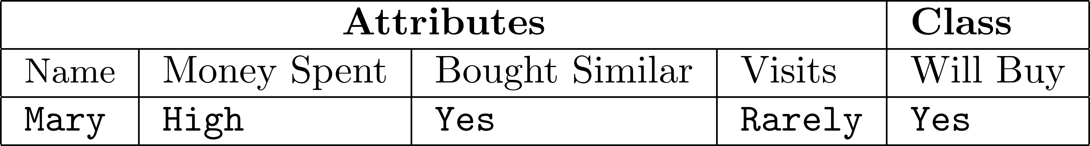
Data Instances
Data is in a tabular format (a set of instances)
Each instance is a collection of properties and features related to an object or person
  A patient’s medical record
  A user’s profile
  A gene’s information
Instances are also called points, data points, or observations
Feature Value
Class Attribute
Data Instance:
Features ( Attributes or measurements)
Class Label

Slide 11
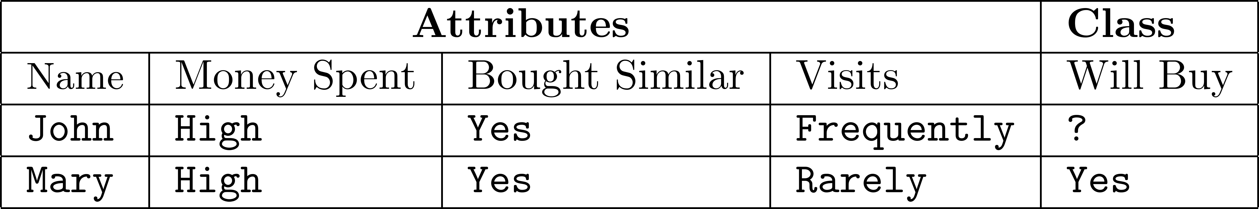
Data Instances
Predicting whether an individual who visits an online book seller is going to buy a specific book
Features can be
  Continuous: values are numeric values
    Money spent: $25
  Discrete: can take a number of values
    Money spent: {high, normal, low}
Unlabeled
Example
Labeled
Example

Slide 12
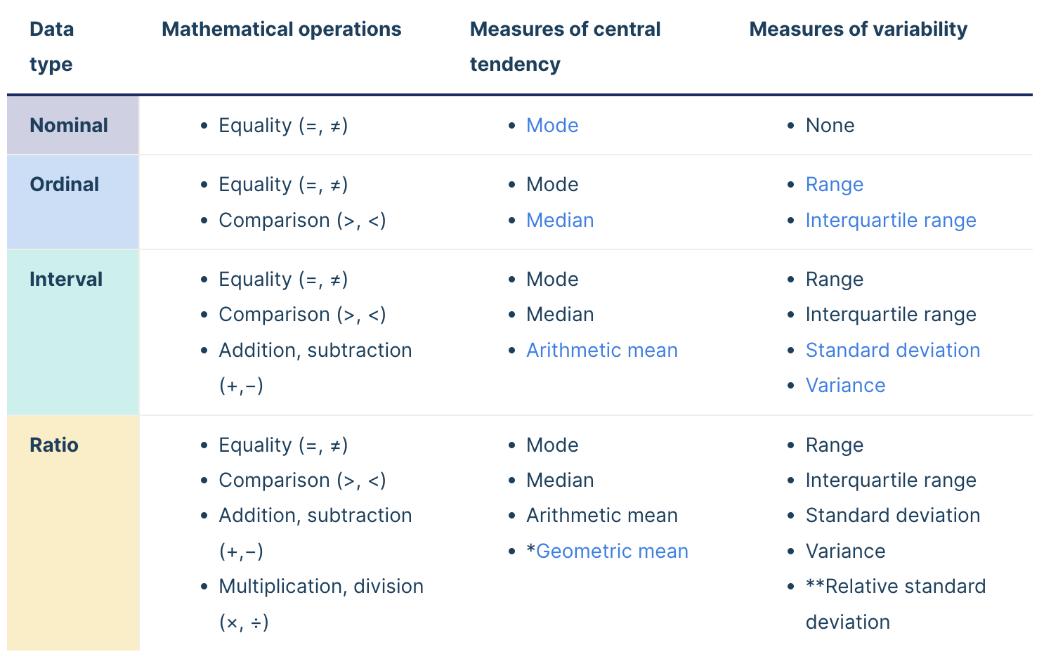
Data Types
Ordinal
discrete and ordered units
Categorical
Data
Types
Nominal
discrete units and no quantitative value
Interval
ordered units that have the same difference
Numerical
Ratio
same as interval but have absolute zero
Notes:
https://builtin.com/data-science/data-types-statistics
https://www.scribbr.com/statistics/levels-of-measurement/#:~:text=Nominal%3A%20the%20data%20can%20only%20be%20categorized.,and%20has%20a%20natural%20zero.
discrete data if the data can only take on certain values This type of data can’t be measured but it can be counted
Continuous data represents measurements and therefore their values can’t be counted but they can be measured.
With interval data, we can add and subtract, but we cannot multiply, divide or calculate ratios. Because there is no true zero, a lot of descriptive and inferential statistics can’t be applied.
But zero degrees is defined differently depending on the scale – it doesn’t mean an absolute absence of temperature.
Ratio values are also ordered units that have the same difference. Ratio values are the same as interval values, with the difference that they do have an absolute zero. Good examples are height, weight, length, etc.
A true zero means there is an absence of the variable of interest. In ratio scales, zero does mean an absolute lack of the variable.

Slide 13
Data Types - Text Representation
The most common way to represent documents is to transform them into vectors
  Process them with linear algebraic operations
This representation is called “Bag of Words”
  Vector Space Model
Weights for words can be assigned by TF-IDF
  Term Frequency and Inverse Document Frequency

Slide 14
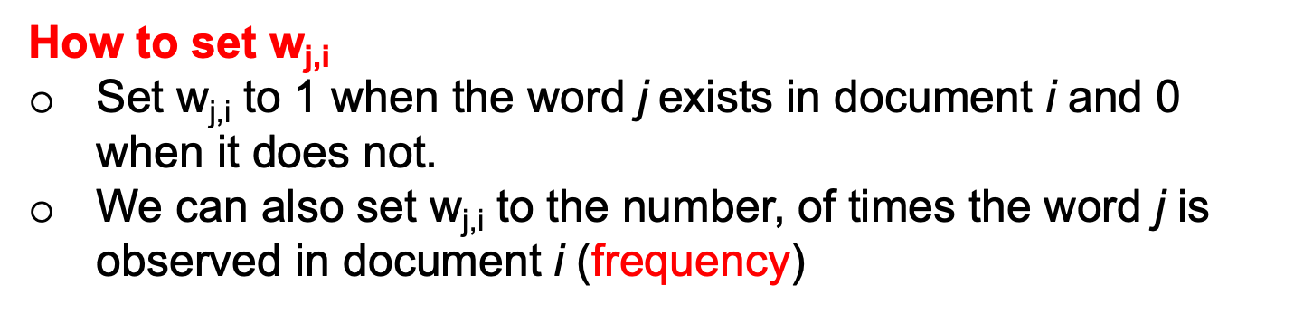

Data Types - Text Representation
Consider a set of documents $D$
Each document is a set of words
Goal: convert these documents to vectors
d_{i} : document i
w_{j,i} : the weight for word j in document i
How to set w_{j,i}
Set w_{j,i} to 1 when the word j exists in document i and 0 when it does not.
We can also set w_{j,i} to the number, of times the word j is observed in document i (frequency)

Slide 15
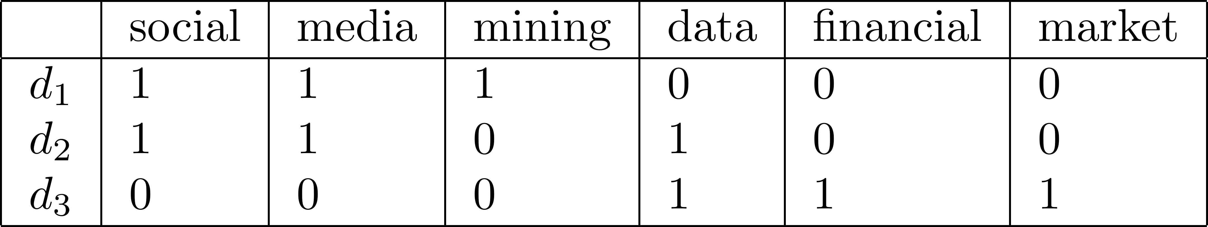
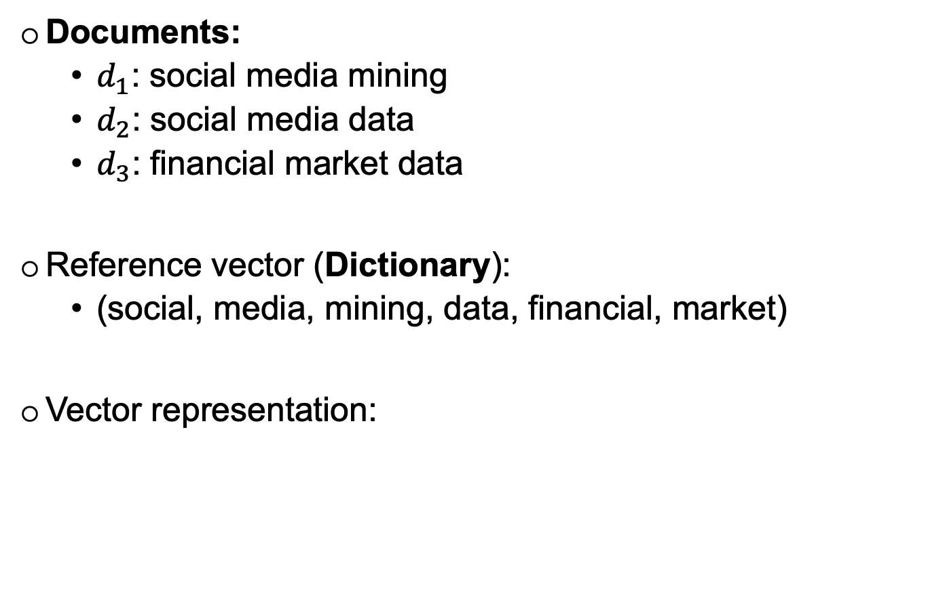
Data Types - Text Representation
Documents:
  $d_{1}$: social media mining
  $d_{2}$: social media data
  $d_{3}$: financial market data
Reference vector (Dictionary):
  (social, media, mining, data, financial, market)
Vector representation:

Slide 16
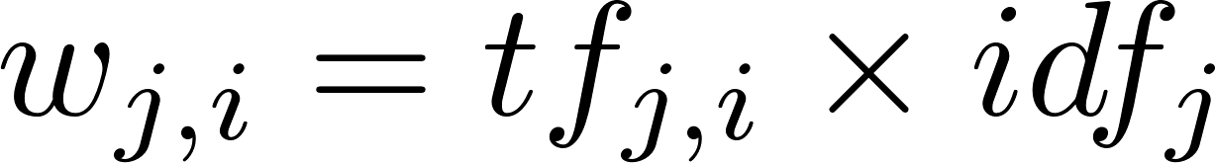
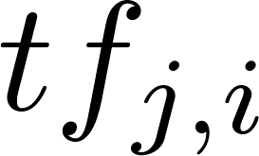
Data Types - Text Representation
TF-IDF (Term Frequency-Inverse Document Frequency)
TF-IDF of term (word) t, document d, and document corpus D (collection of documents) is calculated as follows:
is the frequency of word j in document i
The total number of documents in the corpus
The number of documents where the term j appears
Notes:
Corpus collection of documents

Slide 17
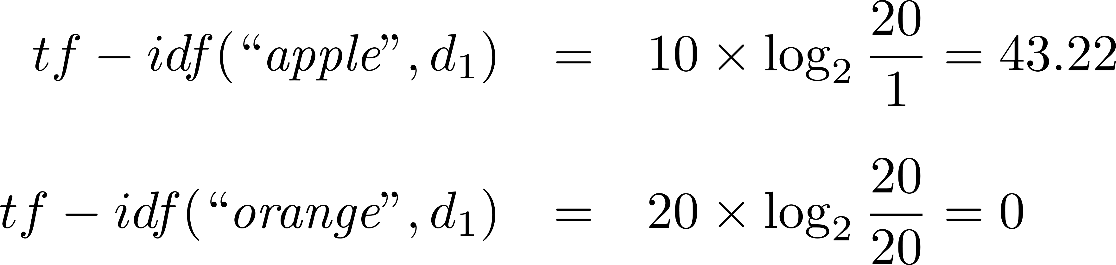
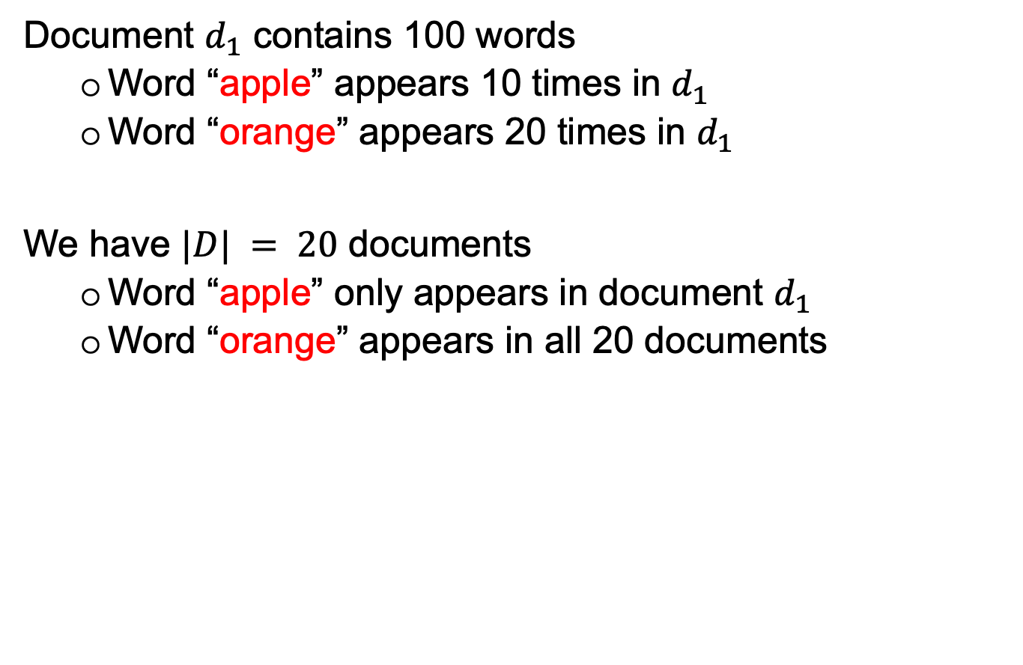
Data Types - Text Representation
Document $d_{1}$ contains 100 words
  Word “apple” appears 10 times in $d_{1}$
  Word “orange” appears 20 times in $d_{1}$
We have $|D| = 20$ documents
  Word “apple” only appears in document $d_{1}$
  Word “orange” appears in all 20 documents
Notes:
Corpus collection of documents

Slide 18
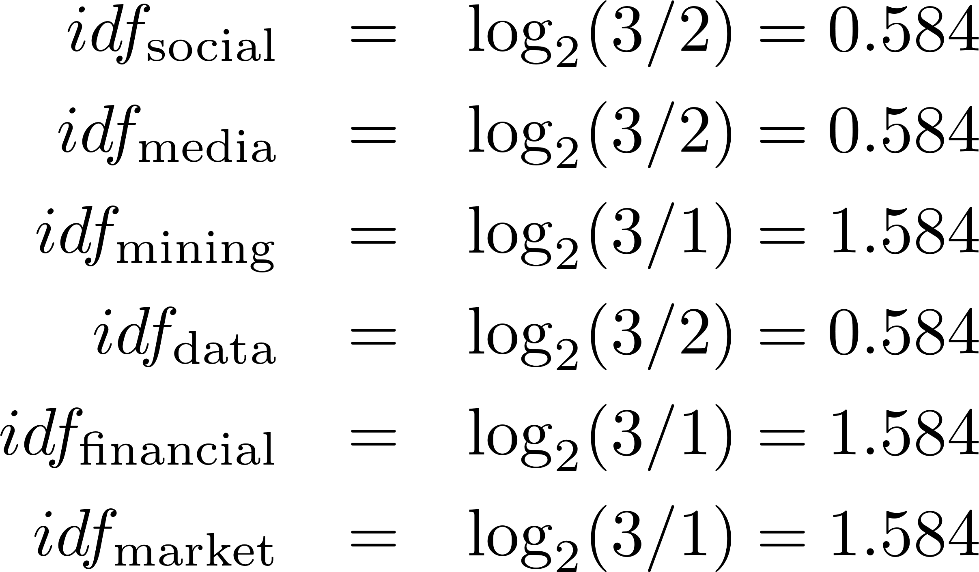
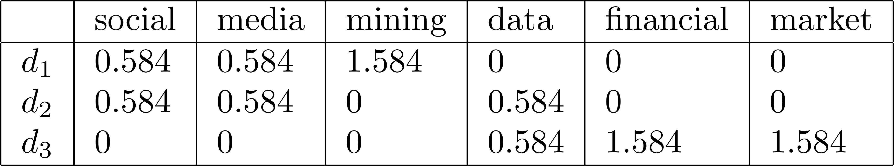
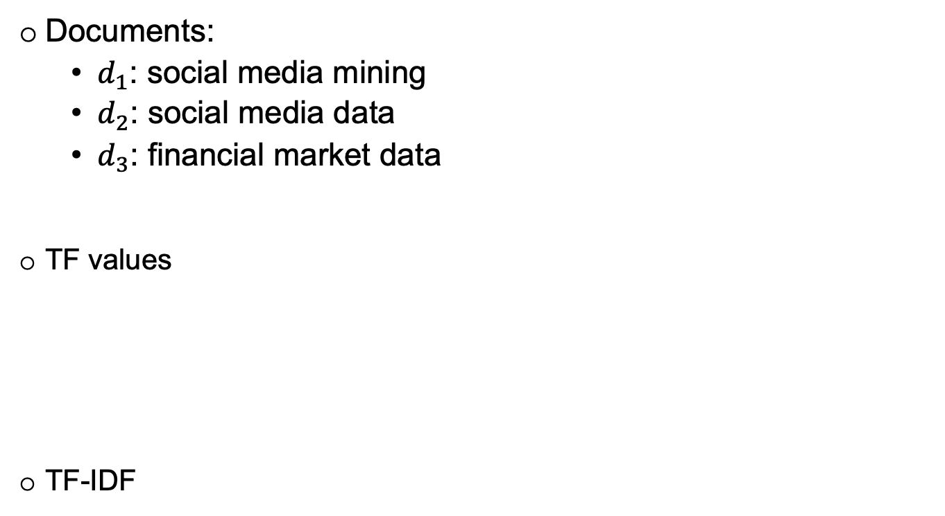
Data Types - Text Representation
Documents:
  $d_{1}$: social media mining
  $d_{2}$: social media data
  $d_{3}$: financial market data
TF values
TF-IDF
Notes:
Corpus collection of documents

Slide 19
Data Types - Text Representation
ALBERT
Amazon Comprehend
Aylien
BERT
DeBERTa
ELECTRA
GenSim
Google Cloud NLP API
GPT2
GPT3
IBM Watson
MonkeyLearn
NLTK
PaLM
RoBERTa
SpaCy
Stanford Core NLP
T5
TextBlob
XLNet
Notes:
Corpus collection of documents

Slide 20
Data Preprocessing - Data Quality
When making data ready for mining, data quality needs to be assured
Noise: Noise is the distortion of the data
  e.g., Salary=“-10”
Outliers: Outliers are data points that are considerably different from other data points in the dataset
  e.g., salary of CEO
Inconsistent: Contains discrepancies in codes or names
  e.g., Age=“42” Birthday=“03/07/1997”
  e.g., Was rating “1,2,3”, now rating “A, B, C”
Missing Values: Missing feature values in data instances
  e.g., occupation=“”
Duplicate data
Notes:
Corpus collection of documents

Slide 21
Data Preprocessing – Major Tasks
Data cleaning
  Fill in missing values, smooth noisy data, identify or remove outliers and noisy data, and resolve inconsistencies
Missing Data
  Remove instances that have missing values
  Estimate missing values, and
  Ignore missing values when running data mining algorithm
Data integration
  Integration of multiple databases, files or metadata
  Detect and resolve data value conflicts
Data reduction
  Obtains reduced representation in volume but produces the same or similar analytical results
Data discretization (for numerical data)
  Putting values into buckets so that there are a limited number of possible states
Notes:
putting values into buckets so that there are a limited number of possible states

Slide 22
Data Preprocessing – Feature Selection
Features | f1 | f2 | f3 | f4 | … | f_{n}
Instance₁ | 0.2 | 0.3 | 0.2 | 0.6 | … | 23
Instance₂ | 0.1 | 0.5 | 0.2 | 0.2 | … | 15
…
Instance_{n} | 0.2 | 0.4 | 0.3 | 0.4 | … | 13
Removing features with low variance
Recursive feature elimination
Sequential feature selection

Slide 23
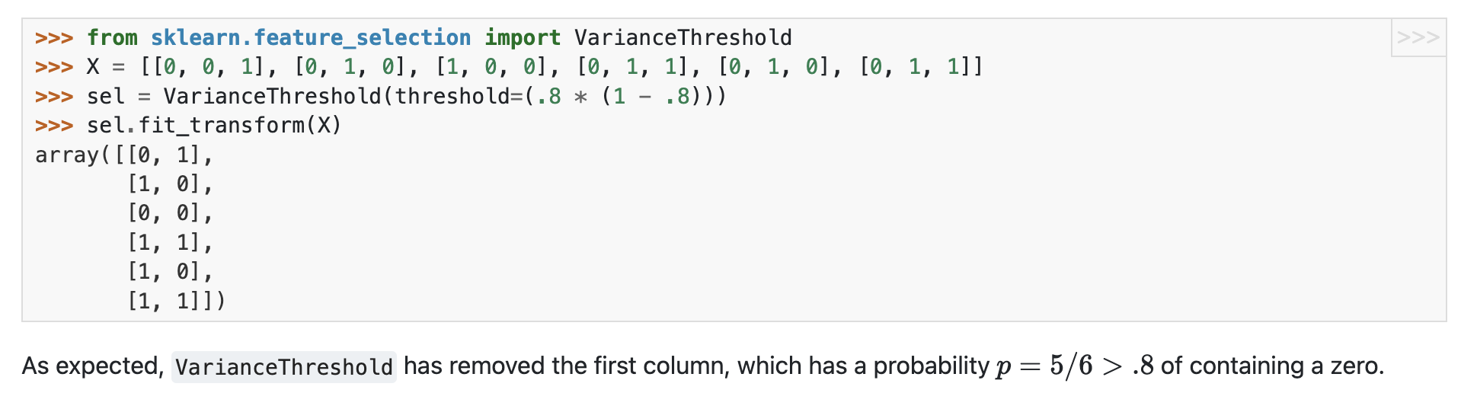
Data Preprocessing – Feature Selection
Removing features with low variance: features that have the same value in most of the samples

Slide 24
Data Preprocessing – Feature Selection
Recursive feature elimination (RFE)
Given an external estimator that assigns weights to features (e.g., tree classifier)
RFE selects features by recursively considering smaller and smaller sets of features
Estimator is trained on the initial set of features and the importance of each feature computed with estimator
The least important features are pruned from current set of features
Procedure is recursively repeated on the pruned set until the desired number of features obtained

Slide 25
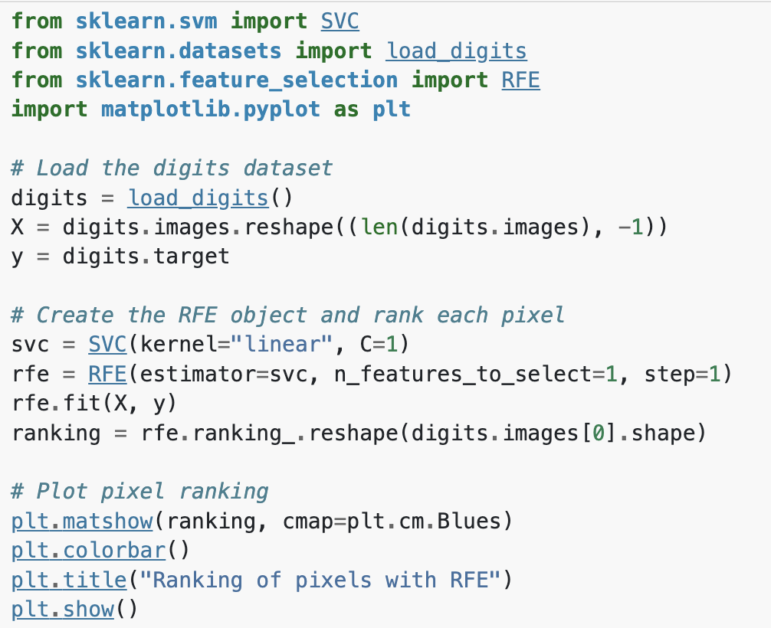
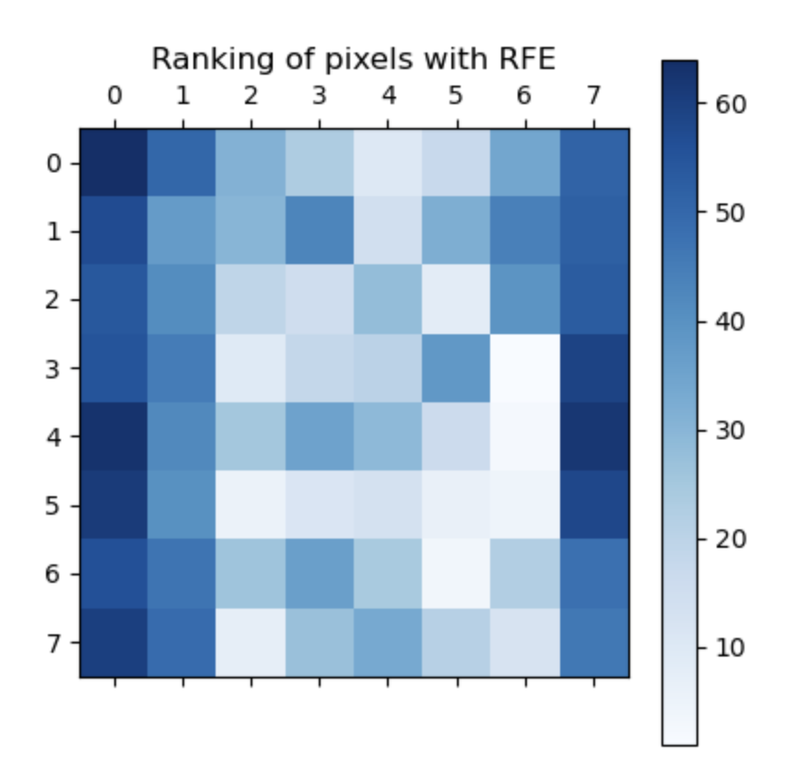
Data Preprocessing – Feature Selection
Recursive feature elimination (RFE)

Slide 26
Data Preprocessing – Feature Selection
Sequential Feature Selection (SFS)
Greedy procedure that iteratively finds the best new feature to add to the set of selected features
Given an external estimator (e.g., tree classifier)
Start with zero features and find the one feature that maximizes a cross-validated score when an estimator is trained on this single feature
Repeat the procedure by adding a new feature to the set of selected features until the desired number of features obtained

Slide 27
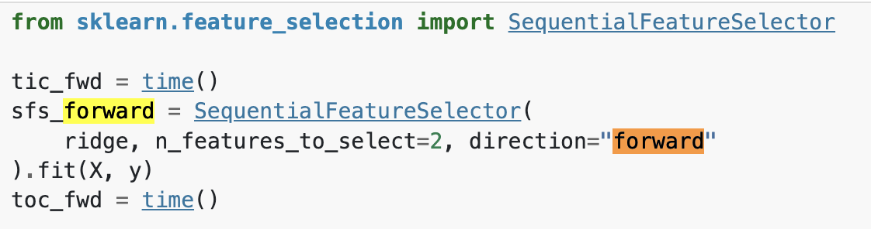
Data Preprocessing – Feature Selection
Sequential Feature Selection (SFS)

Slide 28

Data Preprocessing – Feature Selection
Univariate feature selection
Feature selection using SelectFromModel
https://scikit-learn.org/stable/modules/feature_selection.html

Slide 29
Algorithms

Slide 30
Algorithms
Supervised learning
  The data (observations, measurements, etc.) are labeled with pre-defined classes
  Classification, Regression
Unsupervised learning (clustering):
  Class labels of the data are unknown
  Clustering

Slide 31
Algorithms - Supervised learning
Classification
  Decision tree learning
  Naive Bayes Classifier
  𝑘-nearest neighbor classifier
Regression
  Linear Regression
  Logistic Regression
  Multiple Linear Regression

Slide 32
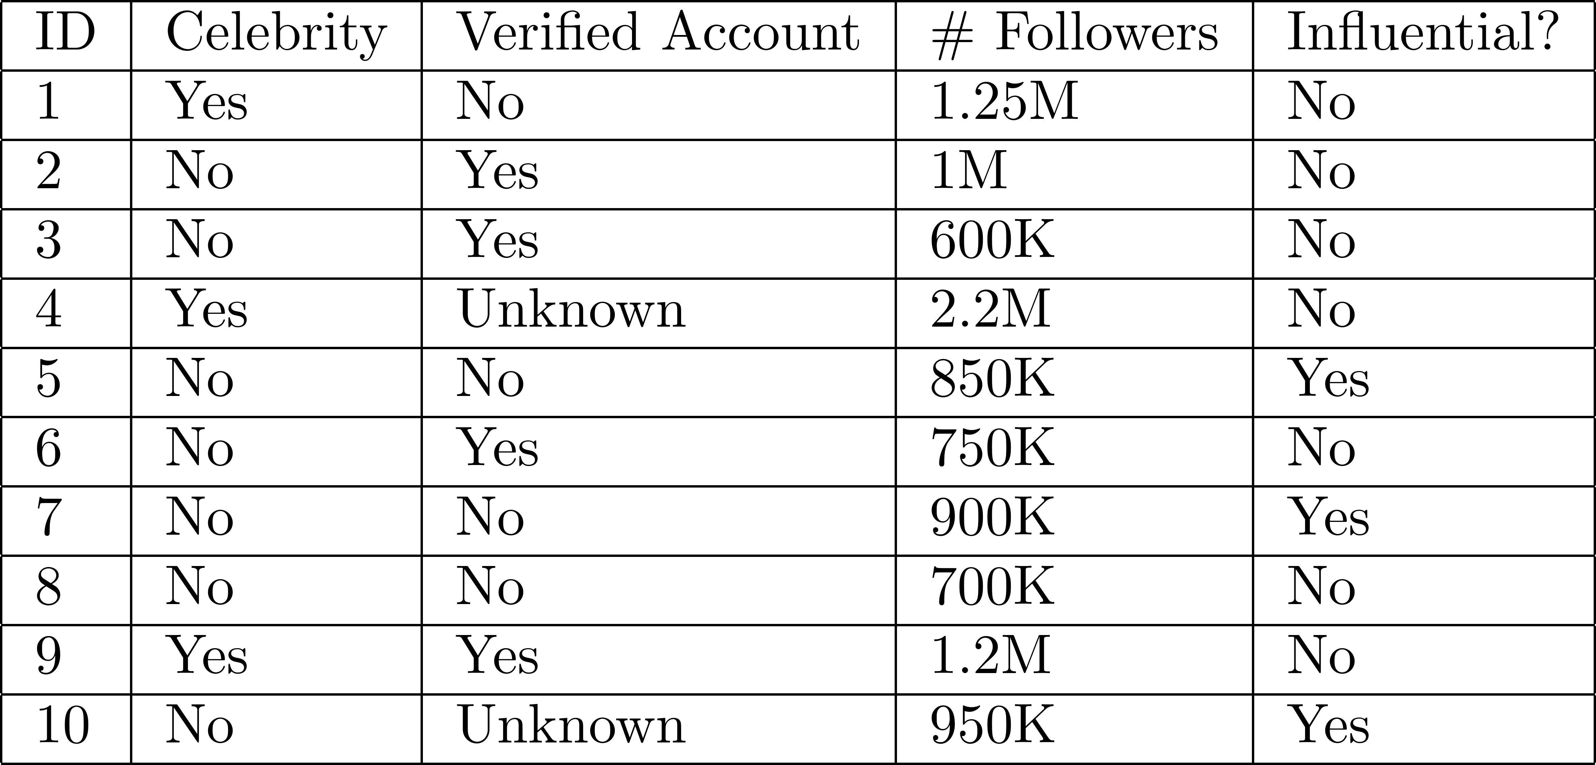
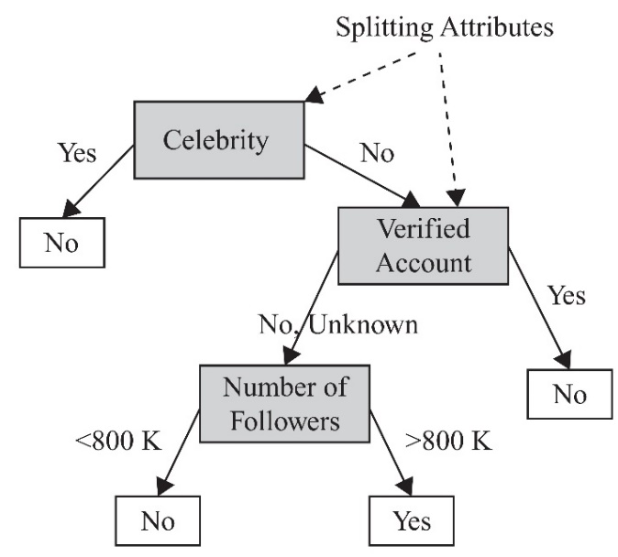
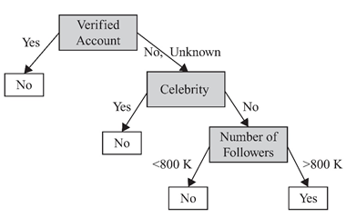
Algorithms - Decision Tree

Slide 33
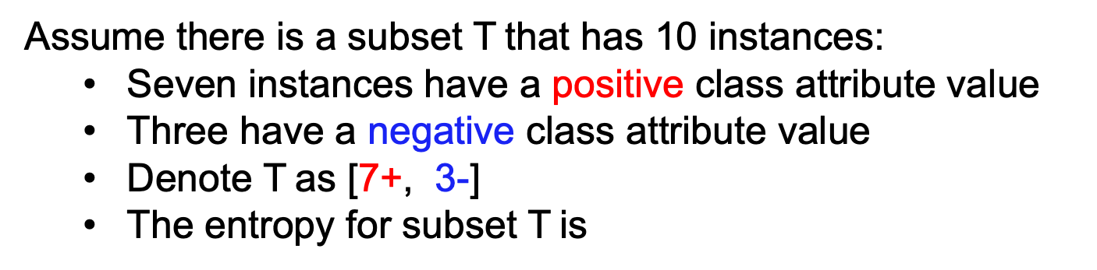
Algorithms - Decision Tree
Assume there is a subset T that has 10 instances:
  Seven instances have a positive class attribute value
  Three have a negative class attribute value
  Denote T as [7+, 3-]
  The entropy for subset T is
In a pure subset, all instances have the same class attribute value (entropy is 0)
If the subset contains an unequal number of positive and negative instances
  The entropy is between 0 and 1
Notes:
Sum(-p_i * logp_i)

Slide 34
Algorithms - Nearest Neighbor Classifier
K-NN nearest neighbor or K-NN
It uses the K nearest instances, called neighbors, to perform classification, and based on the majority of neighbors assigns the label
When K=1, the closest neighbor’s label is used as the predicted label for the instance being classified
To determine the neighbors of an instance, we need to measure its distance to all other instances based on some distance metric
  Often Euclidean distance is employed

Slide 35
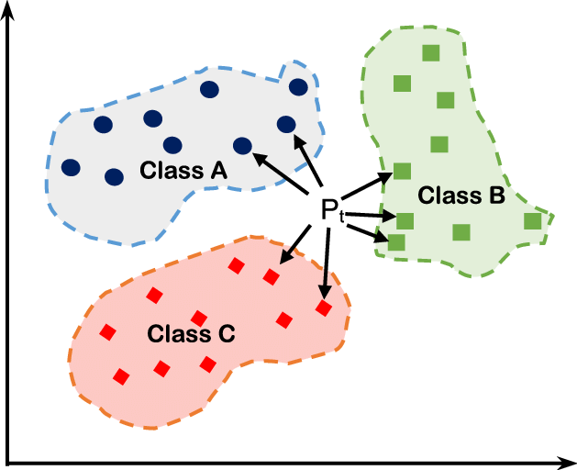
Algorithms - Nearest Neighbor Classifier

Slide 36
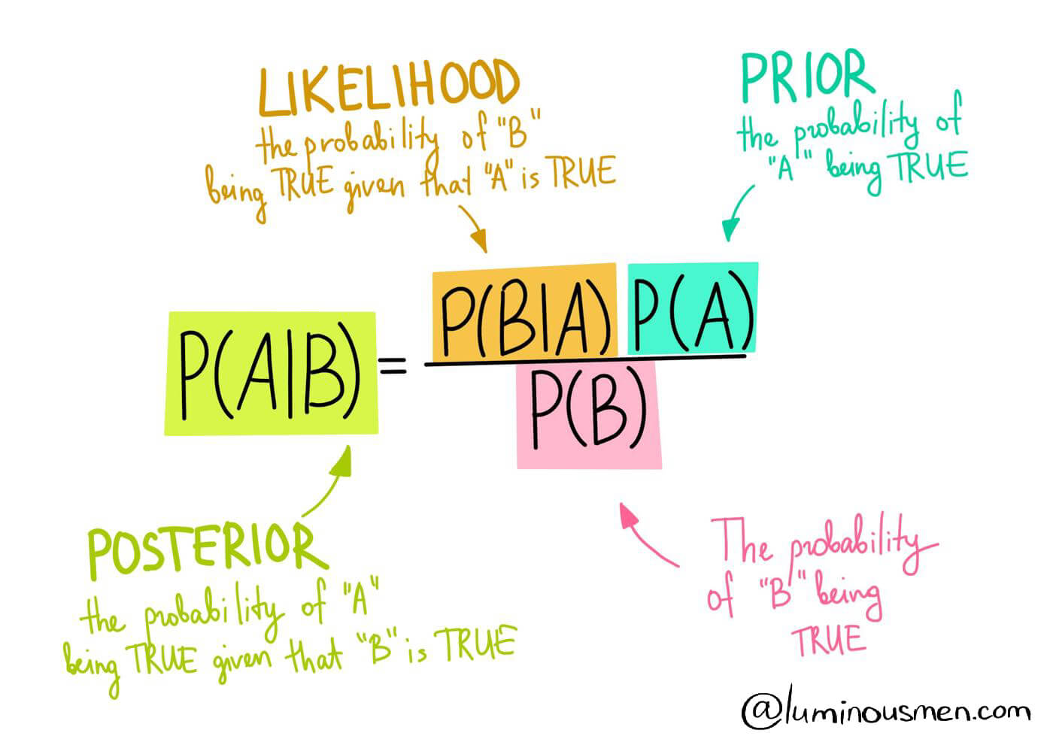
Algorithms - Naïve Bayes Learning
Probabilistic view

Slide 37
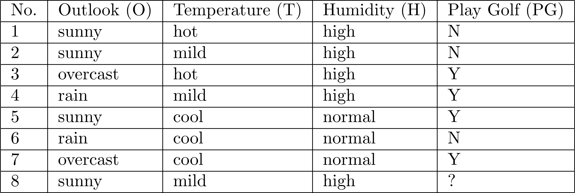
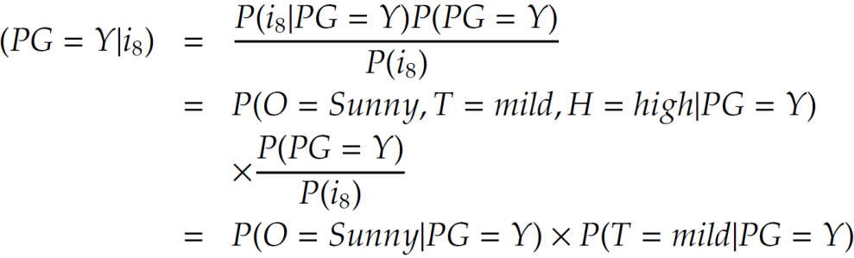
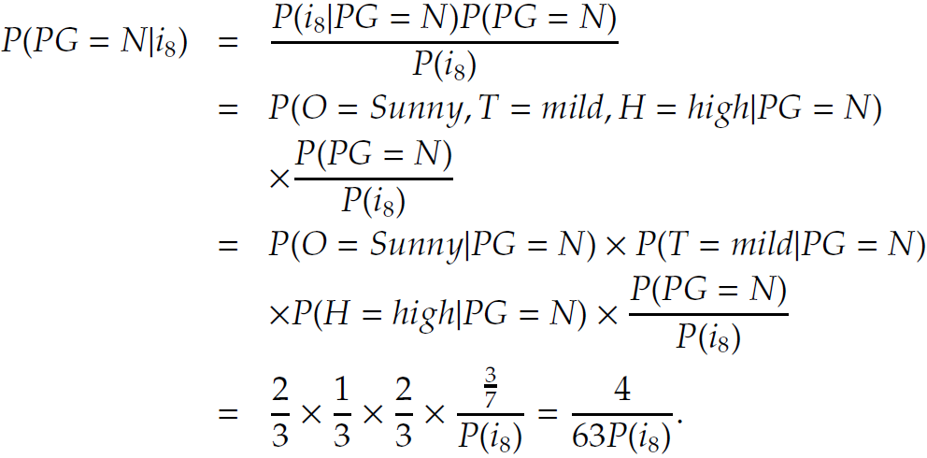
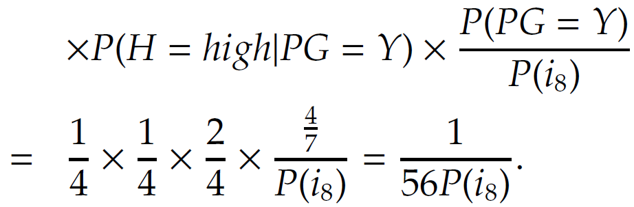
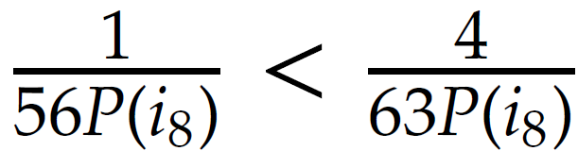

Algorithms - Naïve Bayes Learning

Slide 38
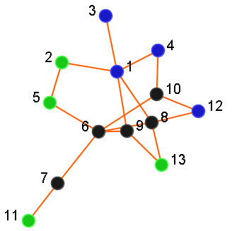
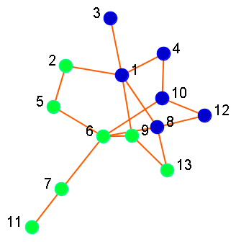
Algorithms – Weighted Vote Relational Neighbor
Given: A social network, and labels of some actors in the network
Output: Labels of remaining actors in the network
Predictions
6: Non-Smoking
7: Non-Smoking
8: Smoking
9: Non-Smoking
10: Smoking
: Smoking
: Non-Smoking
: ? Unknown

Slide 39
Algorithms - Supervised learning
Classification
  Decision tree learning
  Naive Bayes Classifier
  𝑘-nearest neighbor classifier
Regression
  Linear Regression
  Logistic Regression
  Multiple Linear Regression

Slide 40
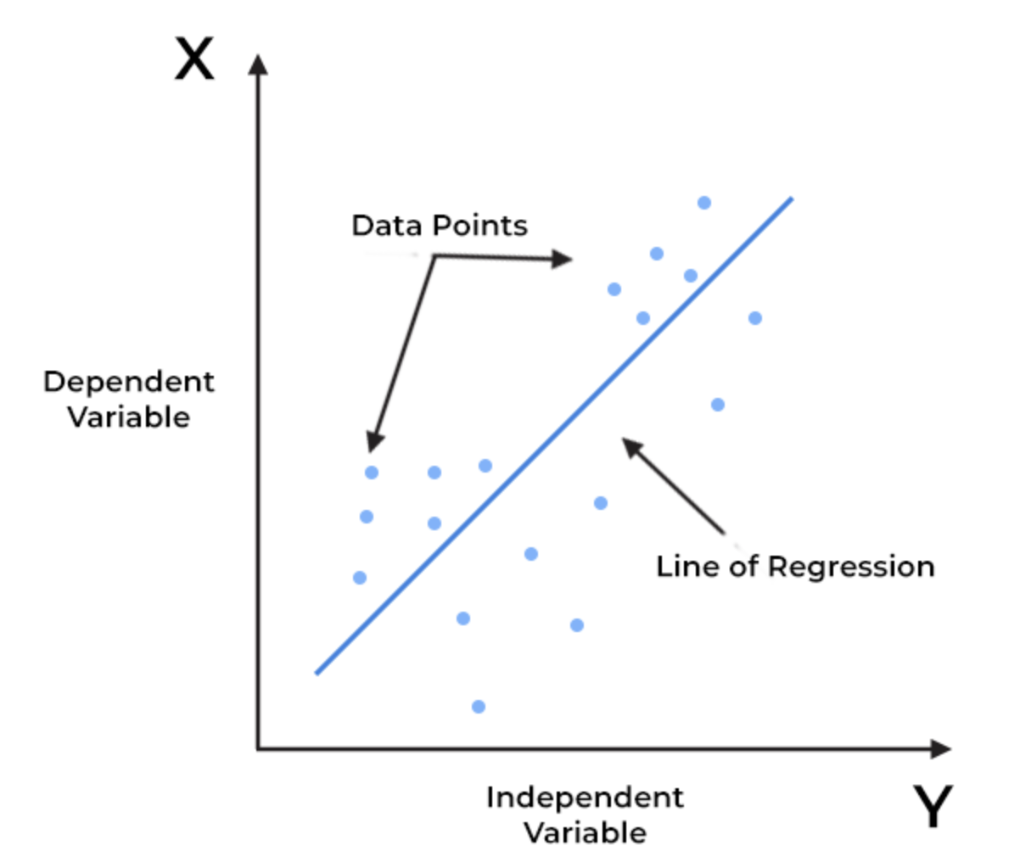
Algorithms - Regression
Linear regression provides a linear relationship between an independent variable and a dependent variable to predict the outcome of future events.
X-axis: Independent variable
Y-axis: Output/dependent variable
Line of regression: Best fit line for a model
Y
Goal of the linear regression algorithm is to find this best fit line
X

Slide 41
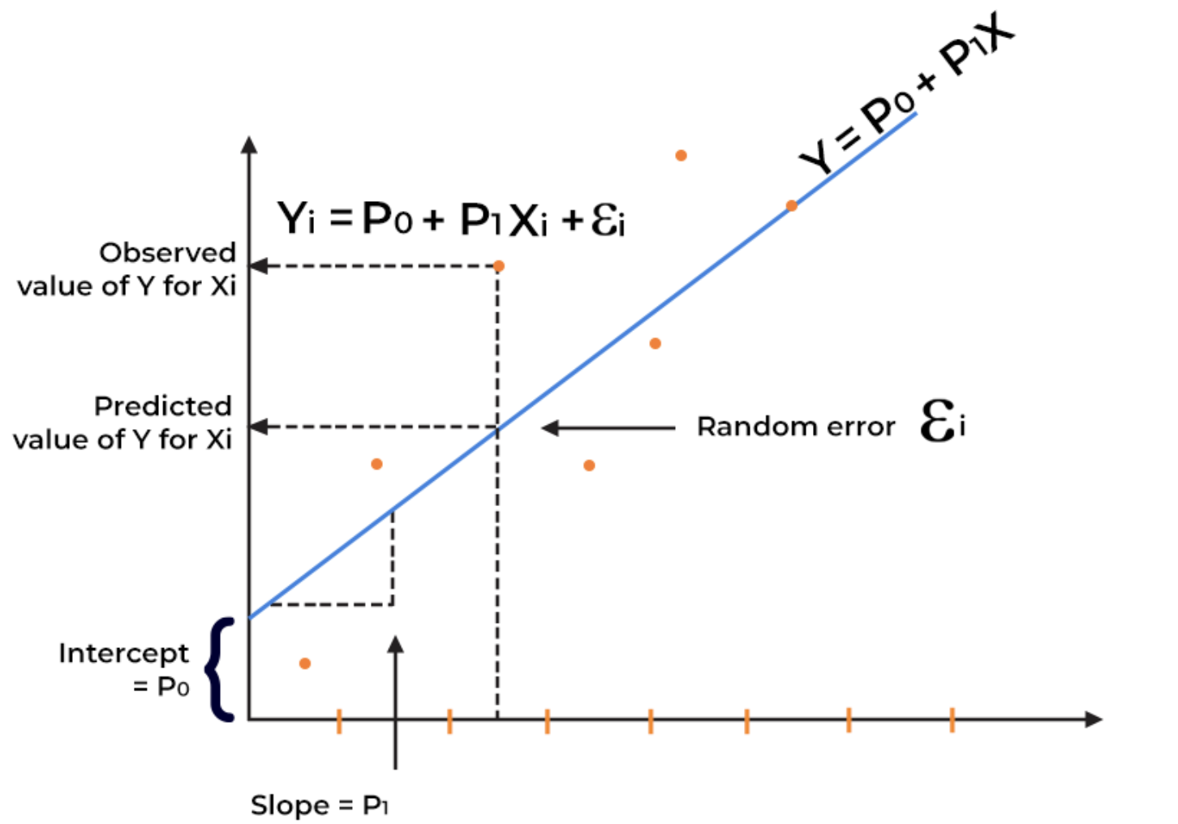
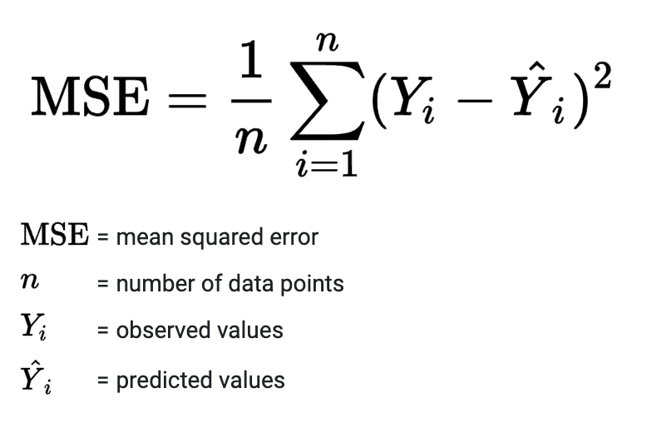
Algorithms - Regression
Key benefits: Easy implementation, Interpretability, Scalability
Mean squared error (MSE)

Slide 42
Unsupervised Learning

Slide 43
Algorithms - Unsupervised Learning
Clustering is a form of unsupervised learning
Clustering algorithms group together similar items
    The algorithm does not have examples showing how the samples should be grouped together (unlabeled data)
  K-means
  Hierarchical clustering
  DBSCAN
  Affinity Propagation
  Mean Shift
  Spectral clustering
  OPTICS
  BIRCH

Slide 44
Algorithms - Unsupervised Learning: K-means
1. Choose the initial centroids (initialization step)
a. Choose samples from the dataset as the centroids (simplest way)
2. Assign each sample to its nearest centroid
3. Create new centroids by taking mean value of all samples assigned to previous centroid
4. Repeat steps 2 and 3 until difference between old and new centroids is less than a threshold
a. In other words, repeat until the centroid do not move significantly

Slide 45
Algorithms - Unsupervised Learning: K-means

Slide 46
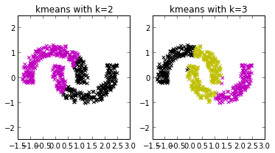
Algorithms - Unsupervised Learning: K-means
The k-means algorithm is not suitable non convex data points
The k-means algorithm is sensitive to initial seeds
Needs number of clusters (k)
+

Slide 47
Algorithms - Unsupervised Learning: HAC
Hierarchical Agglomerative Clustering (HAC)
Constructs a hierarchy of clusters based on some proximity metric
Bottom-up clustering algorithm
  Treats each point as a singleton cluster at the outset and then successively merges pairs of clusters until all clusters have been merged into a single cluster that contains all the points.

Slide 48
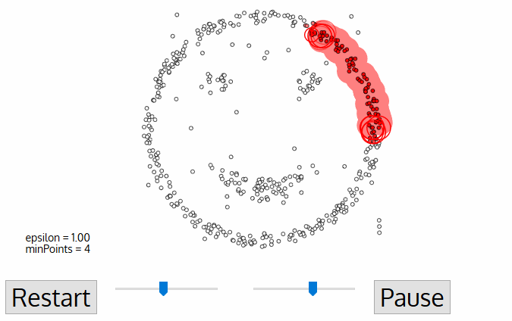
Algorithms - Unsupervised Learning: DBSCAN
DBSCAN (Density-Based Spatial Clustering of Applications with Noise)
The algorithm proceeds by arbitrarily picking up a point in the dataset (until all points have been visited).
If there are at least 'minPoint' points within a radius of 'ε' to the point then we consider all these points to be part of the same cluster.
The clusters are then expanded by recursively repeating the neighborhood calculation for each neighboring point
Parameters
minPts: The minimum number of points (a threshold) clustered together for a region to be considered dense
eps (ε): A distance measure that will be used to locate the points in the neighborhood

Slide 49
Tuning

Slide 50
Algorithms – Tuning the Models
Tuning the Models
Exhaustive Grid Search: tries all the possible parameter combinations
Randomized Parameter Optimization: randomly selects parameters
Searching for optimal parameters with successive halving: iterative selection process where all the parameter combinations are evaluated with a small amount of resources (subset of the data) at the first iteration. Only some of these candidates are selected for the next iteration, which will be allocated more resources.

Slide 51
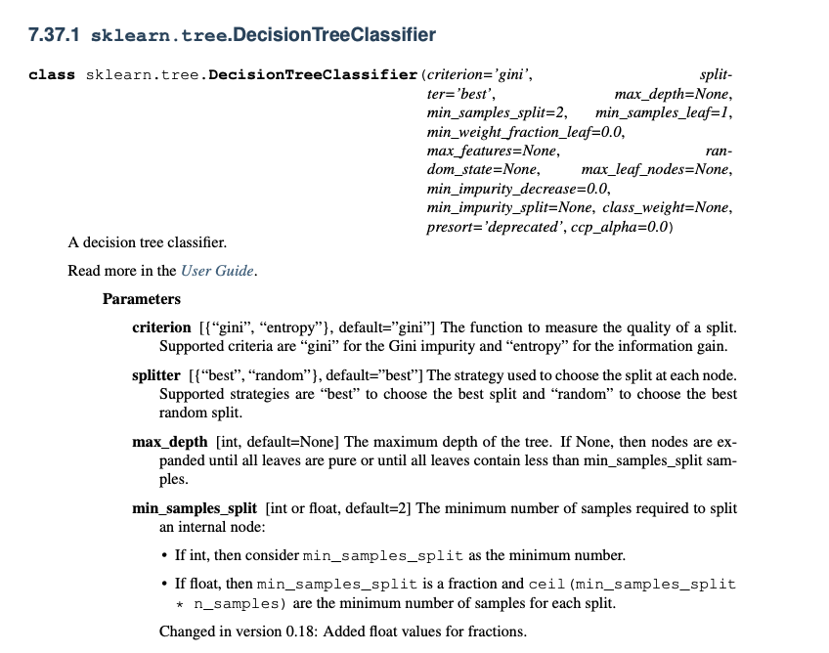
Algorithms – Tuning the Models

Slide 52
Evaluation

Slide 53
Evaluating Supervised Learning
Train Dataset: Used to fit the machine learning model.
Test Dataset: Used to evaluate the fit machine learning model
Validation: Used to evaluate hyperparameters when tuning the model
Common split percentages include:
  Train: 80%, Test: 20%
  Train: 67%, Test: 33%
  Train: 50%, Test: 50%
Stratified train-test split: when class is imbalanced to preserve the same proportions of examples in each class
  40 tigers, 60 lions
  Random sampling of 10% can be 2 tigers and 8 lions
  Stratified sampling of 10% is be 4 tigers and 6 lions

Slide 54
Evaluating Supervised Learning
K-fold cross validation
Shuffle the dataset randomly.
Split the dataset into k groups
For each unique group:
  Take the group as a hold out or test data set
  Take the remaining groups as a training data set
  Fit a model on the training set and evaluate it on the test set
  Retain the evaluation score and discard the model
Summarize the skill of the model using the sample of model evaluation scores
Data: 1, 2, 3, 4, 5, 6 fold-1: 1, 5 fold-2: 2, 4 fold-3: 3, 6
Model1: Trained on Fold1 + Fold2, Tested on Fold3
Model2: Trained on Fold2 + Fold3, Tested on Fold1
Model3: Trained on Fold1 + Fold3, Tested on Fold2

Slide 55
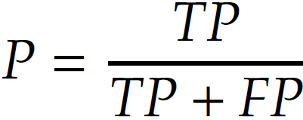
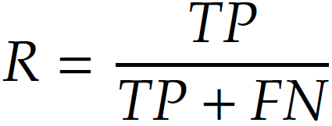
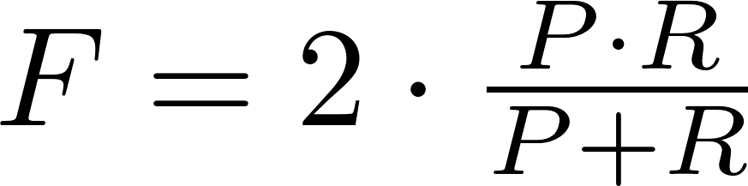
Evaluating Supervised Learning
True Positive (TP) :
  When similar members are assigned to the same group
  A correct decision.
True Negative (TN) :
  When dissimilar members are assigned to different group
  A correct decision
False Negative (FN) :
  When similar members are assigned to different group
  An incorrect decision
False Positive (FP) :
  When dissimilar members are assigned to the same group
  An incorrect decision

Slide 56
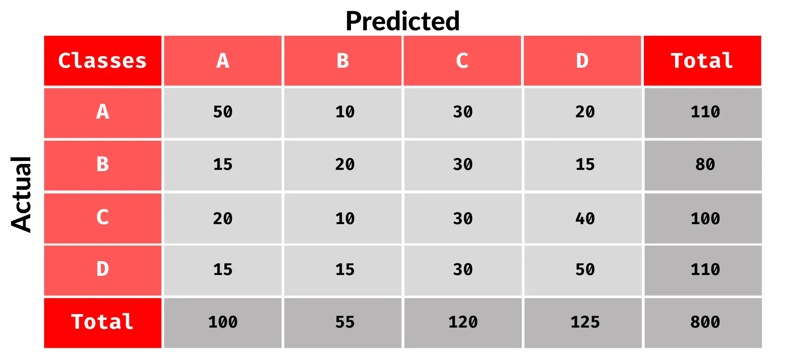
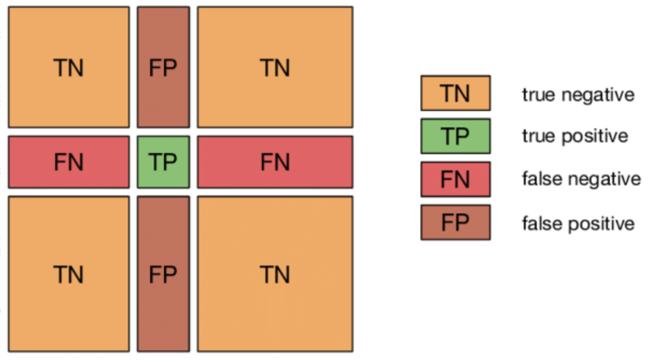
Evaluating Supervised Learning
Confusion Matrix

Slide 57
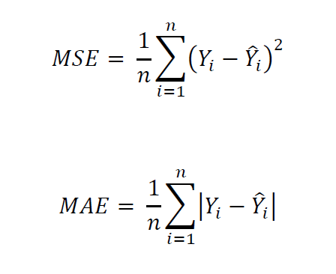
Evaluating Supervised Learning
Accuracy = (Number of Correct Predictions) / (Number of Total Predictions)
Specificity = TN / TN + FP
Mean Absolute Error (MAE): average of the difference between the Original Values and the Predicted Values.
Mean Squared Error (MSE)

Slide 58
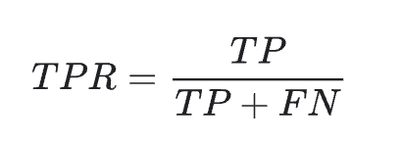
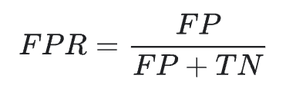
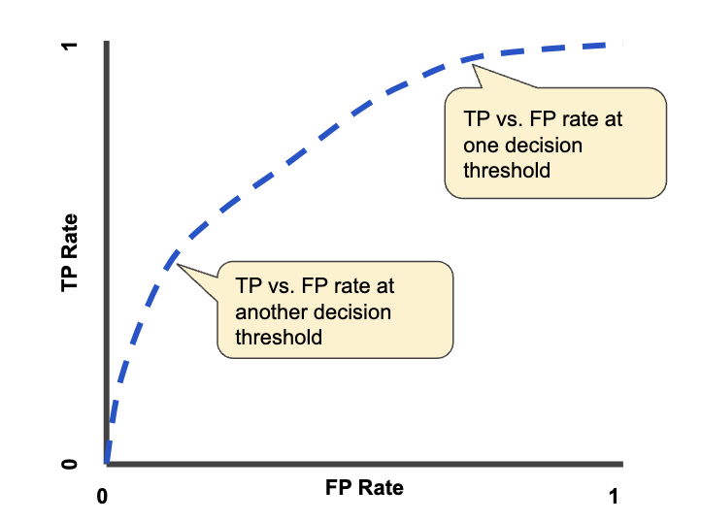
Evaluating Supervised Learning
ROC curve: An ROC curve plots TPR and FPR at different classification thresholds. Lowering the classification threshold classifies more items as positive, thus increasing both False Positives and True Positives.

Slide 59
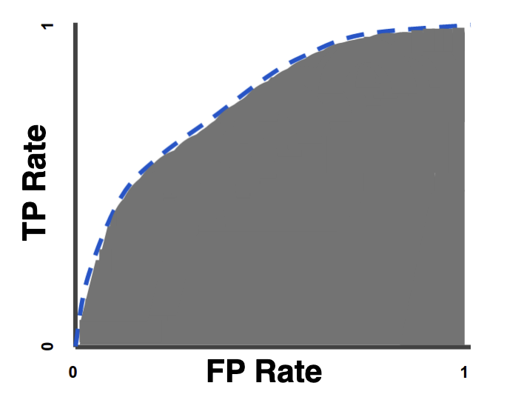
Evaluating Supervised Learning
AUC: stands for "Area under the ROC Curve." and measures the entire two-dimensional area underneath the entire ROC curve from (0,0) to (1,1)

Slide 60

Evaluating Unsupervised Learning
Cohesiveness
In statistics: having a small standard deviation, i.e., being close to the mean value
In clustering: being close to the centroid of the cluster

Slide 61

Evaluating Unsupervised Learning
Separateness
In statistics: separateness can be measured by standard deviation
  Standard deviation is maximized when instances are far from the mean
In clustering: cluster centroids being far from the mean of the entire dataset

Slide 62
Evaluating Unsupervised Learning
In a well-clustered dataset,
  the average distance between instances in the same cluster is small (cohesiveness) and
  the average distance between instances in different clusters is large (separateness).
Silhouette index
We are interested in clusters that are both cohesive and separate
It compares
  the average distance value between instances in the same cluster
  To
  the average distance value between instances in different clusters

Slide 63

Some Terminologies
Underfitting occurs when model is not able to obtain a sufficiently low error value on the training set
Overfitting occurs when the gap between the training error and the test error is too large

Slide 64

Some Terminologies
Bias: measures the expected deviation from the true value of the function or parameter
Variance: measure of the deviation from the expected estimator value

Slide 65
Graph mining

Slide 66
Graph Pattern Mining – Frequent Subgraphs
Frequent Subgraphs
Given a graph dataset D, find subgraph g such that
freq(g) >= threshold
Where freq(g) is the percentage of graphs in D that contain g.
Applications of graph pattern mining
  Mining biochemical structures
  What products were often purchased together?
  What are the subsequent purchases after buying a PC?
  Anomaly detection

Slide 67
Graph Pattern Mining – Frequent Subgraphs
GRAPH DATASET
(A)
(B)
(C)
FREQUENT PATTERNS
(1)
(2)

Slide 68




Graph Pattern Mining – Frequent Subgraphs
GRAPH DATASET
(A) caffeine
(B) diurobromine
(C) viagra
FREQUENT PATTERNS

Slide 69

Graph Pattern Mining – Frequent Subgraphs
Apriori Property
If a graph is frequent, all of its subgraphs are frequent.

Slide 70
Graph Pattern Mining – Frequent Subgraphs
Support: The number of graphs in the database that g is a subgraph

Slide 71
Graph Pattern Mining – Frequent Subgraphs
How to Mine Frequent Subgraph Pattern?
  Apriori-based approach
  Frequent pattern-growth approach

Slide 72
Graph Pattern Mining – Apriori Approach
Apriori Approach
AGM/AcGM: Inokuchi, et al. (PKDD’00) [1]
FSG: Kuramochi and Karypis (ICDM’01) [2]
PATH#: Vanetik and Gudes (ICDM’02, ICDM’04) [3,4]
FFSM: Huan, et al. (ICDM’03) and SPIN: Huan et al. (KDD’04) [5] [6]
FTOSM: Horvath et al. (KDD’06) [7]

Slide 73
Graph Pattern Mining – Apriori Approach
Apriori Algorithm (Agrawal & Srikant, 1994)
a - b
\/
c

Slide 74
Graph Pattern Mining – Apriori Approach

Slide 75
Graph Pattern Mining – Apriori Approach

Slide 76
Graph Pattern Mining – Apriori Approach

Slide 77
Graph Pattern Mining – Apriori Approach

Slide 78
Graph Pattern Mining – Apriori Approach

Slide 79
Graph Pattern Mining – Frequent pattern growth approach
Frequent pattern growth approach (FP-growth)
Use a compressed representation of the graph database using an FP-tree
MoFa: Borgelt and Berthold (ICDM’02) [8]
gSpan: Yan and Han (ICDM’02) [9]
Gaston: Nijssen and Kok (KDD’04) [10]

Slide 80
Graph Pattern Mining – Frequent pattern growth approach
itemsets | count
{B} | 7
{A} | 6
{C} | 6
{D} | 2
{E} | 2
TID | itemsets
T001 | B,A,E
T002 | B,D
T003 | B,C
T004 | B,A,D
T005 | A,C
T006 | B,C
T007 | A,C
T008 | B,A,C,E
T009 | B,A,C
F is infrequent
minSup=20%

Slide 81
Graph Pattern Mining – Frequent pattern growth approach
T001: B,A,E
T002: B,D
TID | itemsets
T001 | B,A,E
T002 | B,D
T003 | B,C
T004 | B,A,D
T005 | A,C
T006 | B,C
T007 | A,C
T008 | B,A,C,E
T009 | B,A,C
itemsets | count
{B} | 7
{A} | 6
{C} | 6
{D} | 2
{E} | 2
null
null
B:1
B:2
A:1
A:1
D:1
E:1
E:1
null
T004: B,A,D
T003: B,C
null
B:4
B:3
A:2
D:1
A:1
D:1
C:1
C:1
E:1
D:1
E:1

Slide 82
Graph Pattern Mining – Frequent pattern growth approach
T005: A,C
TID | itemsets
T001 | B,A,E
T002 | B,D
T003 | B,C
T004 | B,A,D
T005 | A,C
T006 | B,C
T007 | A,C
T008 | B,A,C,E
T009 | B,A,C
itemsets | count
{B} | 7
{A} | 6
{C} | 6
{D} | 2
{E} | 2
null
B:4
A:1
A:2
D:1
C:1
C:1
E:1
D:1
T007: A,C
null
T006: B,C
null
B:5
A:2
B:5
A:1
D:1
C:2
A:2
D:1
C:1
A:2
C:2
C:2
E:1
D:1
E:1
D:1

Slide 83
Graph Pattern Mining – Frequent pattern growth approach
T008: B,A,C,E
null
TID | itemsets
T001 | B,A,E
T002 | B,D
T003 | B,C
T004 | B,A,D
T005 | A,C
T006 | B,C
T007 | A,C
T008 | B,A,C,E
T009 | B,A,C
itemsets | count
{B} | 7
{A} | 6
{C} | 6
{D} | 2
{E} | 2
B:6
A:2
A:3
D:1
C:2
C:2
E:1
D:1
C:1
T009: B,A,C
E:1
null
B:7
A:2
A:4
D:1
C:2
C:2
E:1
D:1
C:2
E:1

Slide 84
Graph Pattern Mining – Frequent pattern growth approach
null
B:7
A:2
A2 A2 because they are on different sides of tree
A:4
D:1
C:2
C:2
E:1
D:1
C:2
E:1
Item | Conditional Pattern Base | Conditional FP-tree | Frequent Pattern
E | {{B, A: 1}, {B, A, C: 1}} | <B:2, A:2, C:1> | B,E : 2 | A,E : 2 | B,A,E : 2
D | {{B, A: 1}, {B: 1}} | <B:2, A:1> | B,D : 2
C | {{B, A: 2}, {B: 2}, {A: 2}} | <B:2, A:2, A:2> | B,C : 4 | A,C : 4 | B,A,C : 2
A | {{B: 4}, null} | <B:4> | B,A : 4
B | x | x | x

Slide 85
Graph Pattern Mining – Frequent pattern growth approach
Performance study shows
FP-growth is an order of magnitude faster than Apriori, and is also faster than tree-projection
Reasoning
No candidate generation, no candidate test
Use compact data structure
Eliminate repeated database scan
Basic operation is counting and FP-tree building

Slide 86

Graph Mining – Sequential Patterns Mining
Given a set of sequences, find the complete set of frequent subsequences

Slide 87
Graph Mining – Sequential Patterns Mining
Given a set of sequences, find the complete set of frequent subsequences
Motivation
Business
  Customer shopping patterns
  telephone calling patterns
  Stock market fluctuation
  Weblog click stream analysis
Medical Domains
  Symptoms of a diseases
  DNA sequence analysis

Slide 88

Graph Mining – Sequential Patterns Mining
Items: a set of literals {i₁,i₂,...,i_{m}}
Itemset (or event): a non-empty set of items.
Sequence: an ordered list of itemsets, denoted as <(abc)(aef)(b)>
A sequence <a₁...a_{n}> is a subsequence of sequence <b₁...b_{m}> if there exists integers i₁<...<i_{n} such that a₁∈b_{i1},..., a_{n} ∈ b_{in}
Support is the number of sequences that contain the pattern.
A sequential pattern is a sub-sequence appearing in more than minSup sequences

Slide 89
Graph Mining – Sequential Patterns Mining

Slide 90
Graph Mining – GSP Algorithm
Developed by Srikant and Agrawal in 1996
Multiple-pass over the database
Uses generate-and-test approach

Slide 91
Graph Mining – GSP Algorithm
Phase 1: makes the first pass over database
To yield all the 1-element frequent sequences.
Denoted L1.
Phase 2: the Kth pass:
starts with seed set found in the (k-1)th pass (L_{k-1}) to generate candidate sequences, which have one more item than a seed sequence; denoted C_{k}.
A new pass over D to find the support for these candidate sequences
Phase 3: Terminates when no more frequent sequences are found

Slide 92
Graph Mining – GSP Algorithm
Candidate Generation
Joining L_{k-1} with L_{k-1}: a sequence s₁ joins with s₂ if dropping the first item from s₁ and dropping the last item from s₂ makes the same sequence.
The added item becomes a separate event if it was a separate event in s₂, and part of the last event in s₁ otherwise.
When joining L₁ with L₁ we need to add both ways ((a) and (b) => (a)(b))

Slide 93
Graph Mining – GSP Algorithm

Slide 94
Graph Mining – GSP Algorithm
 | <a> | <b> | <c> | <d> | <e> | <f>
<a> | <aa> | <ab> | <ac> | <ad> | <ae> | <af>
<b> | <ba> | <bb> | <bc> | <bd> | <be> | <bf>
<c> | <ca> | <cb> | <cc> | <cd> | <ce> | <cf>
<d> | <da> | <db> | <dc> | <dd> | <de> | <df>
<e> | <ea> | <eb> | <ec> | <ed> | <ee> | <ef>
<f> | <fa> | <fb> | <fc> | <fd> | <fe> | <ff>
 | <a> | <b> | <c> | <d> | <e> | <f>
<a> |  | <(ab)> | <(ac)> | <(ad)> | <(ae)> | <(af)>
<b> |  |  | <(bc)> | <(bd)> | <(be)> | <(bf)>
<c> |  |  |  | <(cd)> | <(ce)> | <(cf)>
<d> |  |  |  |  | <(de)> | <(df)>
<e> |  |  |  |  |  | <(ef)>
<f>

Slide 95
Graph Mining – GSP Algorithm

Slide 96
Graph Mining – GSP Algorithm
GSP Drawbacks
A huge set of candidate sequences generated.
  Especially 2-item candidate sequence.
Multiple Scans of database needed.
  The length of each candidate grows by one at each database scan.
Inefficient for mining long sequential patterns.
  A long pattern grow up from short patterns.
  The number of short patterns is exponential to the length of mined patterns.

Slide 97
Graph Mining – SPADE Algorithm
SPADE (Sequential PAttern Discovery using Equivalent Class) developed by Zaki 2001 [11].
A sequence database is mapped to a large set of
  Item: <SID, EID>
Sequential pattern mining is performed by
  growing the subsequences (patterns) one item at a time by Apriori candidate generation

Slide 98
Graph Mining – SPADE Algorithm

Slide 99
Graph Mining – SPADE Algorithm

Slide 100
Graph Mining – PrefixSpan Algorithm
Step1: count the support of each item by scanning the database and eliminate infrequent items
(minsup=3)
Result:
<{a}> support: 3
<{b}> support: 4
<{c}> support: 4
<{d}> support: 1
S1 = | <{a,b}, {c}, {a}>
S2 = | <{a,b}, {b}, {c}>
S3 = | <{b}, {c}, {d}>
S4 = | <{b}, {a, b}, {c}>
Then extend each item recursively
Lets start with <{a}> (next slide)

Slide 101
Graph Mining – PrefixSpan Algorithm
Step2: Extend patterns with projection
(minsup=3)
Projection for <{a}>
S1 = | <{a,b}, {c}, {a}>
S2 = | <{a,b}, {b}, {c}>
S3 = | <{b}, {c}, {d}>
S4 = | <{b}, {a, b}, {c}>
S1 = | <{a,b}, {c}, {a}>
S2 = | <{a,b}, {b}, {c}>
S3 = | <{b}, {c}, {d}>
S4 = | <{b}, {a, b}, {c}>
Projection: Keep sequences containing <{a}> and for these sequences delete the first occurrence of <{a}> and everything that appears before

Slide 102
Graph Mining – PrefixSpan Algorithm
Step3: Count the support of each sequential pattern starting with <{a}>
(minsup=3)
Projection for <{a}>
S1 = | <{a,b}, {c}, {a}>
S2 = | <{a,b}, {b}, {c}>
S3 = | <{b}, {c}, {d}>
S4 = | <{b}, {a, b}, {c}>
S1 = | <{_ b}, {c}, {a}>
S2 = | <{_ b}, {b}, {c}>
S4 = | <{_ b}, {c}>
Result:
<{a}, {a}> support: 1
<{a}, {b}> support: 1
<{a}, {c}> support: 3
<{a,b}> support: 3

Slide 103
Graph Mining – PrefixSpan Algorithm
Step4: Keep extending
(minsup=3)
Projection <{a}> Projection <{a}, {c}>
S1 = | <{_ b}, {c}, {a}>
S2 = | <{_ b}, {b}, {c}>
S4 = | <{_ b}, {c}>
S1 = | <{_ b}, {c}, {a}>
S2 = | <{_ b}, {b}, {c}>
S4 = | <{_ b}, {c}>
Result:
<{a}, {c}, {a}> support: 1

Slide 104
Graph Mining – PrefixSpan Algorithm
Step4: Keep extending
(minsup=3)
Projection <{a}> Projection <{a, b}>
S1 = | <{_ b}, {c}, {a}>
S2 = | <{_ b}, {b}, {c}>
S4 = | <{_ b}, {c}>
S1 = | <{_ b}, {c}, {a}>
S2 = | <{_ b}, {b}, {c}>
S4 = | <{_ b}, {c}>
Result:
<{a, b}, {c}> support: 3
<{a, b}, {a}> support: 1
<{a, b}, {b}> support: 1

Slide 105
Graph Mining – PrefixSpan Algorithm
Step4: Keep extending
(minsup=3)
Projection <{a, b}> Projection <{a, b}, {c}>
S1 = | < {c}, {a}>
S2 = | < {b}, {c}>
S4 = | < {c}>
S1 = | <{a}>
Result:
<{a, b}, {c}, {a} > support: 1

Slide 106
Graph Mining – PrefixSpan Algorithm
For pattern starting with a we found <{a, b}, {c}>
We should repeat the process for b and c as in Step 1 we found
Result:
<{a}> support: 3
<{b}> support: 4
<{c}> support: 4
<{d}> support: 1
S1 = | <{a,b}, {c}, {a}>
S2 = | <{a,b}, {b}, {c}>
S3 = | <{b}, {c}, {d}>
S4 = | <{b}, {a, b}, {c}>

Slide 107
Graph Mining – PrefixSpan Algorithm
No candidate sequence needs to be generated
Projected databases keep shrinking
Major cost of PrefixSpan: constructing projected databases
Found to be more efficient than Spade
CAMLS (Constraint-based Apriori algorithm for Mining Long Sequences): by Gudes et. Al. [12]

Slide 108

Algorithms – Weighted Vote Relational Neighbor
18
22
21
?
Facebook friendship network, can you guess the age?
24
19

Slide 109




Algorithms – Weighted Vote Relational Neighbor
Given:
We need to compute these probabilities using some order until convergence [i.e., they don’t change]
What happens for different orders?

Slide 110

Algorithms – Weighted Vote Relational Neighbor

Slide 111
References
[1] A. Inokuchi, T. Washio, and H. Motoda. “An apriori-based algorithm for mining frequent substructures from graph data”, PKDD’00
[2] M. Kuramochi and G. Karypis. “Frequent subgraph discovery”, ICDM’01
[3] M. Kuramochi and G. Karypis, “GREW: A scalable frequent subgraph discovery algorithm”, ICDM’04
[4] N. Vanetik, E. Gudes, and S. E. Shimony. “Computing frequent graph patterns from semistructured data”, ICDM’02
[5] J. Huan, W. Wang, and J. Prins, and J. Yang, “SPIN: Mining maximal frequent subgraphs from graph databases”, KDD’04
[6] J. Huan, W. Wang, and J. Prins, “Efficient mining of frequent subgraph in the presence of isomorphism”, ICDM’03
[7] T. Horváth, J. Ramon, and S. Wrobel, “Frequent subgraph mining in outerplanar graphs,” KDD’06
[8] C. Borgelt and M. R. Berthold, “Mining molecular fragments: Finding relevant substructures of molecules”, ICDM’02
[9] X. Yan and J. Han, “gSpan: Graph-based substructure pattern mining”, ICDM’02
[10] S. Nijssen and J. Kok, “A quickstart in frequent structure mining can make a difference,” KDD'04
Notes:
https://www.youtube.com/watch?v=KoG5lEAJmgI

Slide 112
References
[11] Zaki, Mohammed J. "SPADE: An efficient algorithm for mining frequent sequences." Machine learning 42 (2001): 31-60.
[12] Gonen, Yaron, et al. "CAMLS: A Constraint-Based Apriori Algorithm for Mining Long Sequences." DASFAA (1). 2010.

